Slide 1
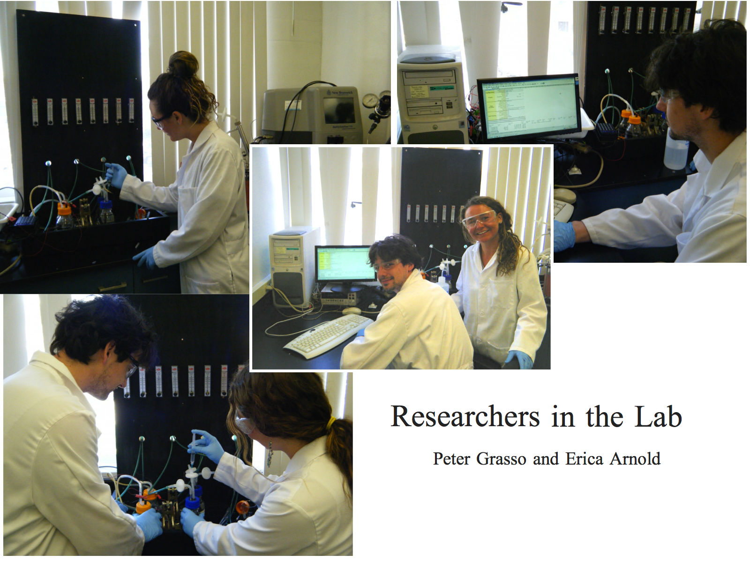
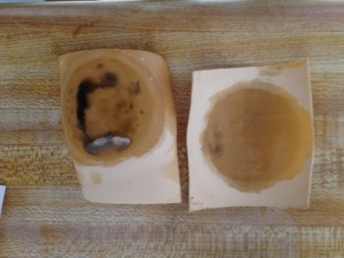
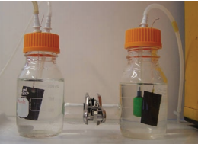
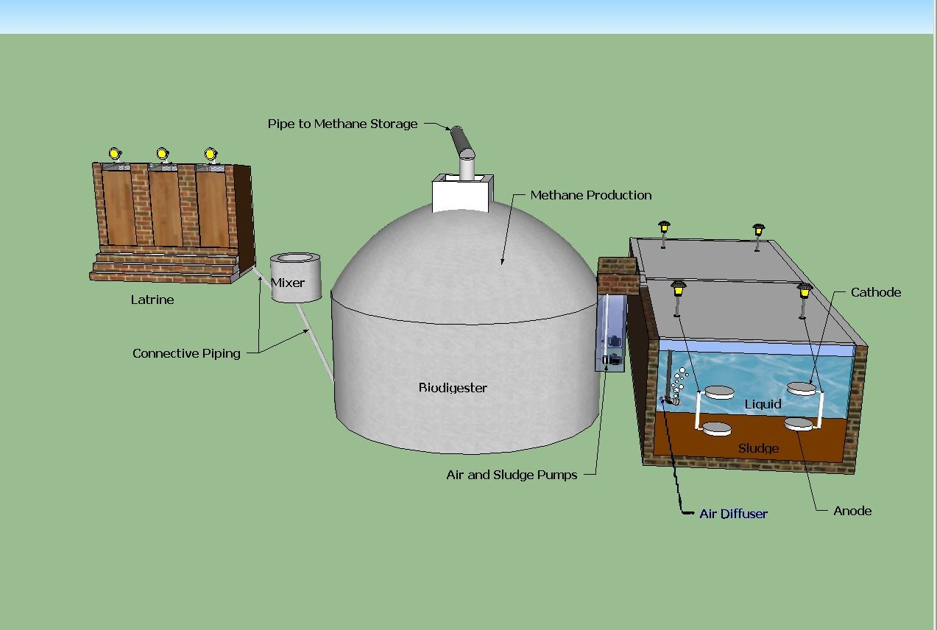


University of Southern California, Undergraduate Symposium for Scholarly and Creative Work, April 16, 2014
Sustainable Energy Recovery from Wastewater Treatment by Bioelectrochemical Fuel Cells
Undergraduate Research Students: Peter Grasso (Viterbi CEE), Erica Arnold (Viterbi AME)
Graduate Research Student: Woonhoe Kim
Faculty Advisor: Professor Massoud Pirbazari
Sonny Astani Department of Civil and Environmental Engineering
Introduction / Background
Wastewater Treatment is an energy intensive process
Increased population and energy demands leads to increased energy costs
Bioelectrochemical Fuel Cells (BEFCs) is a promising technology to achieve sustainable wastewater treatment
Energy generation by BEFCs can be implemented at different locations of an actual wastewater treatment plant to reduce net energy demand
Research Objective:
To compare the BEFC power output when inoculated with microorganism obtained from different locations in a wastewater treatment facility. As each reactor in the treatment facility contains a unique consortium of bacteria, our goal is to determine which reactor achieves the optimal power generation.
Discussion
Energy generation at the start of the aeration tank is greater than the energy generation at the ending
Anaerobic sludge produces consistent energy generation over an extended time period
BEFC technologies can be beneficial to both developing and developed nations
Research Results
Primary Clarifier
Aeration tank
Secondary clarifier
Summary
BEFC was successfully used to generate energy by different consortium of bacteria taken from different bioreactors in an actual wastewater treatment plant
Type of amended nutrients affected the performance of the BEFC process.
Energy production decreased significantly when membrane fouling occurred
Bioelectrochemcial Fuel Cell Technology
BEFCs exploit bacteria’s natural ability to catalyze the conversion of organic matter into energy
The superior performance of BEFCs is likely due to the coexistence of aerobic and anaerobic microorganisms
BEFCs have q low carbon footprint
BEFCs allow simultaneous pollutant removal and energy recovery
1
2
3
4
5
F: Facultative
An: Anaerobic
Ae: Aerobic
Sludge digester
Predominant Bacteria in Sample Locations
  Sample 1: Chemoorganotrophic heterotrophs (Ae)
  Sample 2: Chemoorganotrophic heterotrophs (F)
  Sample 3: Chemolithotrophic autotrophs (F)
  Sample 4: Chemoorganotrophic autotrophs + heterotrophs (F)
  Sample 5: Chemorganotrophic heterotrophs + autotrophs (F)
  Sample 6: Chemolithotrophic autotrophs (An)
6
1
2
4
3
Dual Chamber BEFC Unit
(Used in these Experiments)
Biofouling of the proton exchange membrane
Scanning Electron Micrograph of Proton Exchange Membrane
Scanning Electron Micrograph of
Anode Electrode
Bacteria serve as a biocatalyst, reducing organic carbon (wastewater) in the anode, and in the process generating carbon dioxide, electrons, and protons
Electrons are transported through an external electric circuit to the cathode where oxygen serves as a terminal electron acceptor
Proton exchange membrane (PEM) allows for the passage of protons across compartments
5
6
Future Research
Investigate the performance of the BEFC technology by using different types of electrodes and proton exchange membranes
Design and construct an upscaled BEFC unit for future experiments
Anode Reaction: C₂H₃O₂+2H₂O->2CO₂+8H⁺+8e⁻
Cathode Reaction:2O₂+9H⁺+8e⁻->4H₂O
Acknowledgements
We would like to express our appreciation to the USC Women in Science and Engineering for providing partial funding for this project.
Integrated Biodigester Latrine and BES system
(suggested for rural areas in Ghana, Africa)
Notes:
Scope of Project
Our research focuses on comparing the voltage output
of a BES when using a consortium of bacteria from
different parts of a waste treatment plant.
Samples taken from the primary clarifier (I), the front
of the aeration tank (II), back of the aeration tank (III),
secondary clarifier (IV), and sludge digester (V).
Each sample contained different amounts and types
of bacteria as each part plays a different role in
wastewater treatment.

