Slide 1




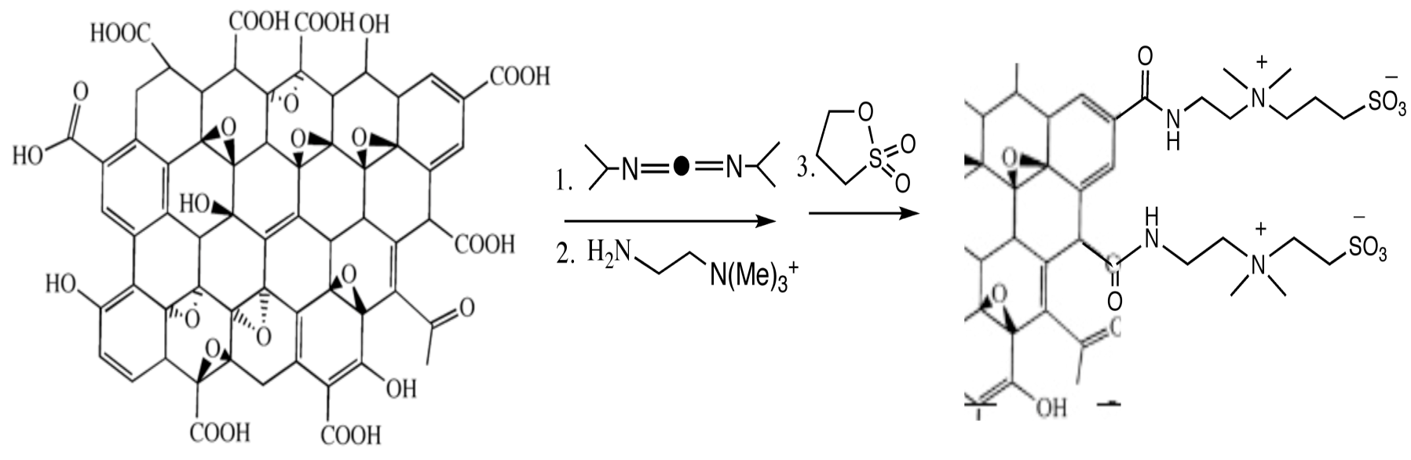
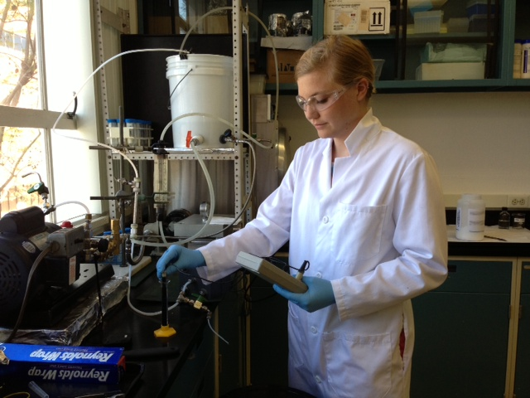
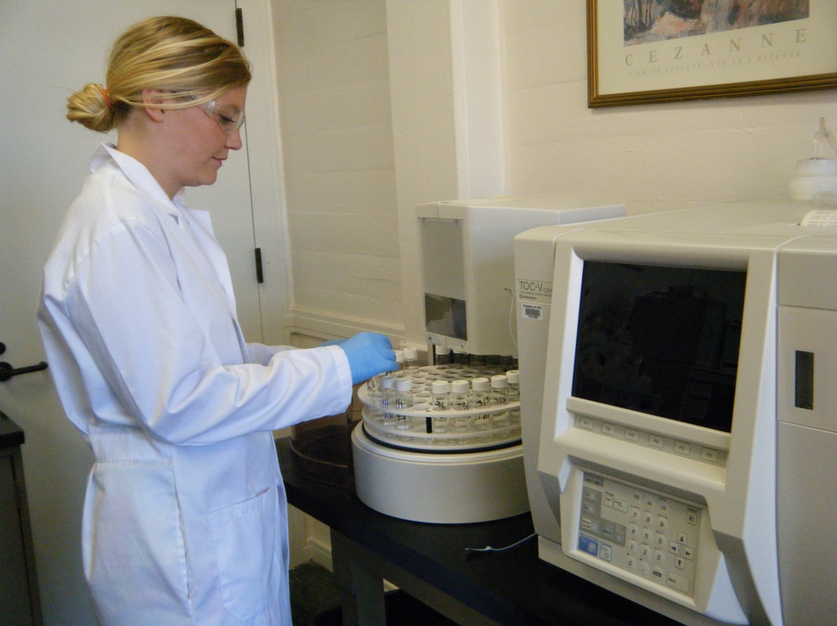
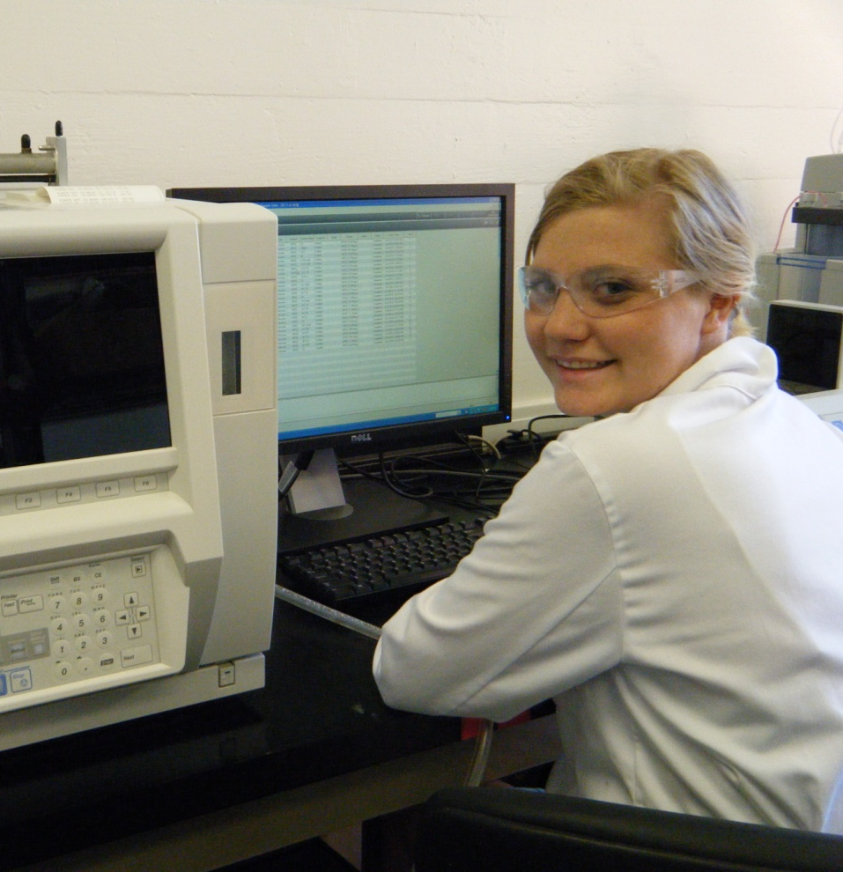
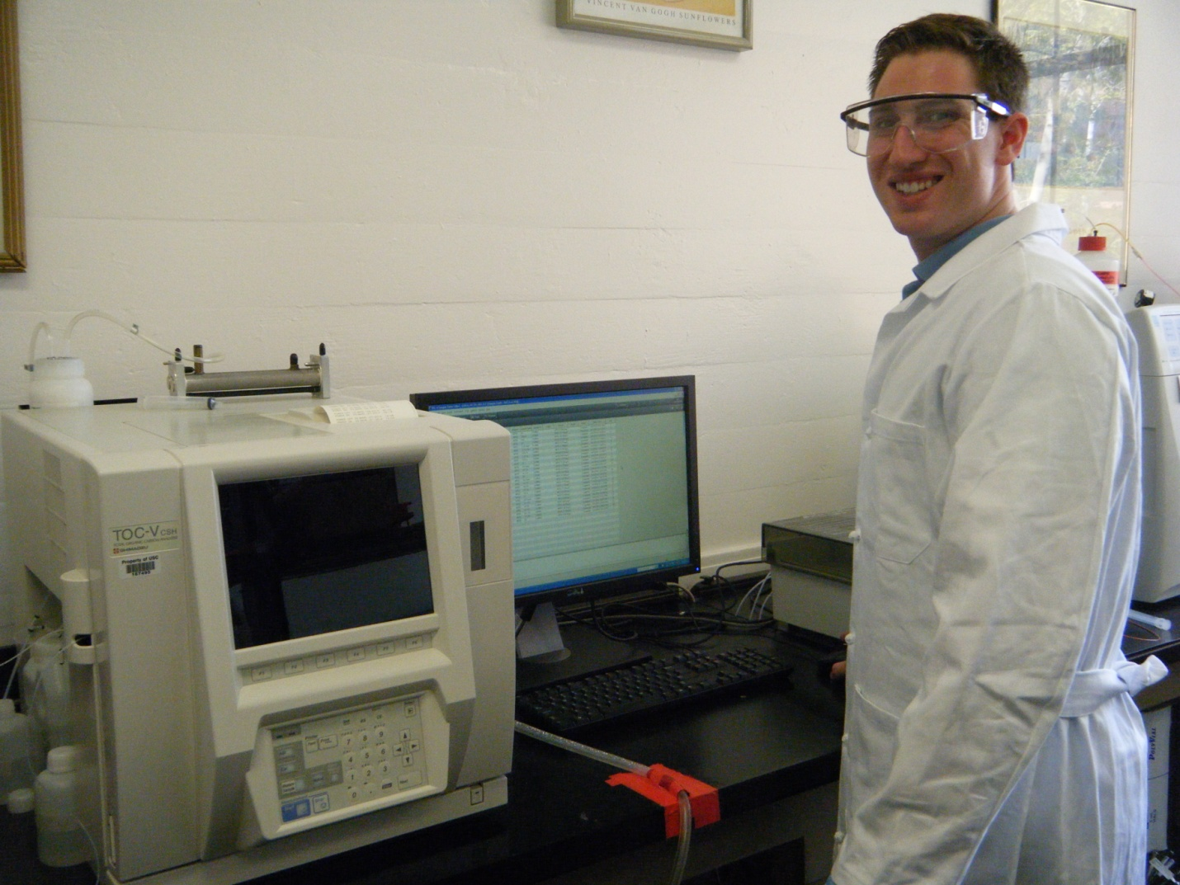
University of Southern California, Undergraduate Symposium for Scholarly and Creative Work, April 14 -16, 2014
Novel Membranes Using Polymeric and Nanomaterials for Water Reclamation Applications
Undergraduate Research Students: Kirsten Rice (Viterbi) and Anthony Ross (Dornsife)
Graduate Supervisors: Woohoe Kim (Viterbi), Merve Yurdacan (Dornsife)
Faculty Advisors: Professor Massoud (Mike) Pirbazari, Sonny Astani Department of Civil and Environmental Engineering
Professor Theo E. Hogen-Esch, Loker Hydrocarbon Research Institute
Introduction and Background
Improved membrane separations promise to yield substantial environmental and economic benefits that can enhance the global competitiveness of the United States by significantly reducing energy consumption, increasing industrial productivity, decreasing waste generation, and addressing water shortages.
Environmental applications of membrane processes include water purification, wastewater treatment, and water reclamation and reuse.
Membrane technologies face scientific and technological challenges: membrane fouling and permeate flux decline, poor rejection or selectivity, and large energy footprints.
The present research is directed at developing high-performance membranes for use in various applications including integrated membrane systems.
Summary and Discussion
The initial work involved the development of polymer synthesis protocols with appropriate reaction schemes, free-radical processes, syntheses conditions such as reaction times, curing procedures, and quantitatively controlled incorporation of graphene oxide (GO) into the polymers. Superior membranes were manufactured by adjusting these conditions.
The membranes were prepared by interfacial polymerization by sequential addition of MPD and TMC on a commercial polyether sulfone (PES) ultrafiltration membrane base with a nominal pore size of 0.08 micron and molecular weight cutoff off (MWCO) of 10,000 Daltons. This is one of the best commercially available ultrafiltration membranes for water reclamation and related applications.
The presence of GO in the polymer matrix improved not only the steady-state permeate flux (membranes #1 and #2) but also did not compromise with TOC rejection (slightly higher TOC rejection of 32.6% versus 30.9%).
Qualitatively similar results were observed when PAC was added to the feed to probe the role of GO, if any, regarding membrane fouling. Thus, the permeate fluxes and TOC rejections (after steady state was reached after 3 hours) were higher for membrane #2* as compared to #1* (presence of GO, see table).
The use of CSA and TEA during the polymerization (membrane #3) yielded a flux of 37 L/m²/h at 2 and 3 hours, but gave lower TOC rejection of 18.6%.
It is important to observe the GO content on aqueous transport and organic rejection to optimize membrane performance.
Polymer and Nano-Material Development Schemes
Scheme-2. Partially sulfonated polyamides for membrane applications
Scheme-1. Synthesis of Polyamide Copolymers for membrane fabrication
Rationale and Objectives
Among various technologies, integrated systems such as membrane bioreactor process (MBR) processes have shown excellent potential for water reclamation, water reuse, groundwater recharge, and similar applications.
Superior membranes with better aqueous transport and anti-fouling characteristics can make the technology more efficient and economical.
The present work focuses on a synthesis-guided strategy to develop a class of polymer composites through infusion of nano-objects such as graphene oxide (GO), and graphene derivatives, yielding superior permeate fluxes, fouling resistance and rejection properties, while retaining favorable mechanical characteristics.
A major goal of this work is production of low-energy and low-cost membrane technologies for water treatment and water reclamation to be used in developing countries.
Scheme-3. Chemical modification of graphene oxide for infusion into polymeric matrices
Experimental Methodologies and Analytical Techniques
Scheme-4. Synthesis of graphene oxide-modified polyamides
Polymer types based on
various formulation schemes
and annealing processes
Membrane optimization of material composition:
Mechanical integrity tests
Chemical tolerance tests
Membrane tests for permeate flux and rejection
Membrane cleaning tests for flux recovery
Membrane autopsy studies using spectroscopy, microscopy, and bio-molecular techniques
Membrane characterization tests
Atomic force microscopy (AFM)
Scanning electron microscopy (SEM)
Fourier transform infra-red (FTIR) spectroscopy
X-ray photoelectron spectroscopy (XPS)
Confocal laser scanning microscopy (CLSM)
Polymer membranes with
different types of
nanomaterials at various
concentrations
Future Work
The membrane filtration tests with membrane autopsy and surface characterization studies can be used for development of fouling resistant membranes.
The content of nano-materials like GO in the polymer (polyamide) matrices will be optimized to further drastically improve membrane performance.
One of the ultimate goals of developing the next generation nano-material and polymer composite membranes is to provide low-energy and low-cost membrane technologies for water treatment, water reclamation and similar applications in developing countries.
Future work
Development of hollow-fiber membranes for integrated membrane systems
Figure 2. Schematic of the plate-and-frame test cell for membrane filtration tests
Figure 1. Overall research plan for membrane performance optimization
Results
Researchers in the
Laboratory
91% recovery
82% recovery
Table 1. Comparison of performances of different membranes with reference to
permeate fluxes and TOC rejection
65% recovery
Figure 3. Permeate flux and TOC after membrane cleaning using deionized distilled (DI) water, surfactant Triton X-100 at 5 mg/L (surfactant A) , and dilute sodium hydroxide (1 mM); the cleaning run is for 1 hour.
Membrane | #1 | #2⁺ | #1* | #2* ⁺ | #3 ⁺⁺ | UF control
Time (h) | Permeate flux (L/m²/h)
0 | 265 | 275 | 200 | 210 | 137.5 | 100
0.5 | 150 | 140 | 125 | 155 | 125 | 70
1 | 50 | 50 | 75 | 90 | 69 | 40
2 | 18 | 40 | 45 | 65 | 37 | 40
3 | 10 | 40 | 45 | 65 | 37 | 30
TOC rejection ( %) | 30.9 | 32.6 | 44.4 | 55.9 | 18.6 | 3.6
DI water
Surfactant A
NaOH
The results show that Trition X-100 surfactant yielded a permeate flux recovery of 91%, much higher than the 82% flux recovery observed after caustic cleaning using sodium hydroxide. The use of DI water yielded a low flux recovery of 61%. The TOC after surfactant cleaning was as low as that observed after caustic cleaning. The higher rejection after cleaning reflects the favorable change in membrane surface properties to separate out more natural organic matter (as TOC).
⁺Membrane is infused with graphene oxide (GO)
*Powder activated carbon (PAC) was used in the feed at 40 mg/L
Acknowledgment
We would like to thank the Provost Undergraduate Research Associates Program at the University of Southern California for providing the majority of funding for this project.
Membranes designated as # 1 and # 2 were all synthesized by interfacial polymerization (for ~ 1 minute) using MPD and TMC, and cured at room temperature of 60ºC for 10 minutes, except for the presence of GO for membrane #2.
Membrane #3 was synthesized by a similar procedure using MPD and TMC followed by CSA and TEA.
Membranes # 1* and #2* were replicates of membranes #1 and #2, and were tested with 40 mg/L of powder activated carbon (PAC) added to the feed.
The purpose of these tests was to assess the performances of the membranes (#1 and #2) in the presence of powder activated carbon (PAC) regarding permeate flux and TOC rejection.
Notes:
Summary? Wastewater treatment, water reclamation and reuse, water treatment, water purification
Membrane fouling, permeate flux decline, poor rejection or selectivity, large energy footprint
Traditional polymeric membrane materials are hydrophobic and susceptible to fouling and low aqueous transport
The monomers used in the preparation of polyamide membrane were m-phenylene diamine (MPD) and 1,3,5-benzene tricarbonyl chloride or trimesoyl chloride (TMC). Another set of membranes were cast using these monomers MPD and TMC, but with the addition of camphor sulfonic acid (CSA) and triethanol amine (TEA) to make the material more solvophilic, and to observe their hydrophilicity, aqueous transport and rejection characteristics
The next item is to optimize the polyamide membranes using GO and other graphene derivatives at various proportions, as outlined in the overall research plan.
Acknowledgment
We would like to thank the Provost Undergraduate Research Associates Program at the University of Southern California for providing the majority of funding for this project.
They can significantly reduce energy costs that constitute a substantial fraction of total operation costs.
The research involves the incorporation of nanomaterials into aromatic polyamide through interfacial polymerization of m-phenylenediamine (MPD) and trimesoyl chloride (TMC).

