Slide 1
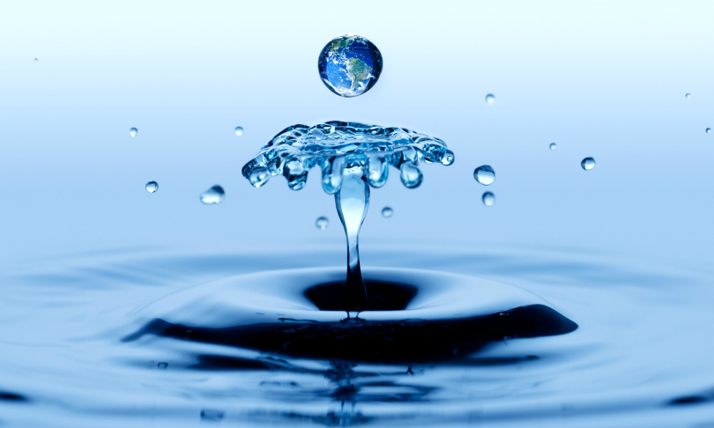
Water Sustainability in Commercial and Residential Buildings
Prepared by: Yusi Jin, Graduate Student
Supervising Professor : Dr. Massoud Pirbazari
Sonny Astani Department of Civil and Environmental Engineering
Viterbi School of Engineering
University of Southern California
December 2013

Slide 2
Scope of Presentation:
Water Sustainability
Rainwater Harvesting
Greywater Harvesting
Flush and Flow Fixtures in Commercial and Residential Buildings
Water Wise Landscaping in and around Buildings
Water Sustainability in LEED
The Trend and Development of Water Sustainability in Buildings

Slide 3
Water Sustainability
- Introduction
- What is Water Sustainability?
- Methods for Improving Water
- Sustainability in Buildings

Slide 4

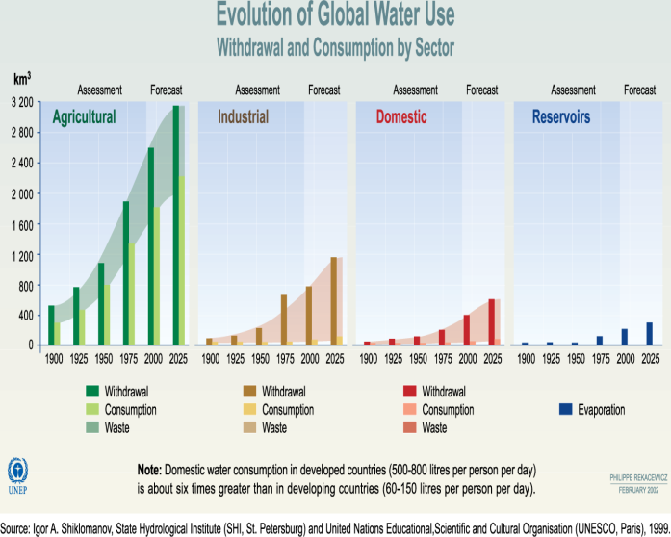
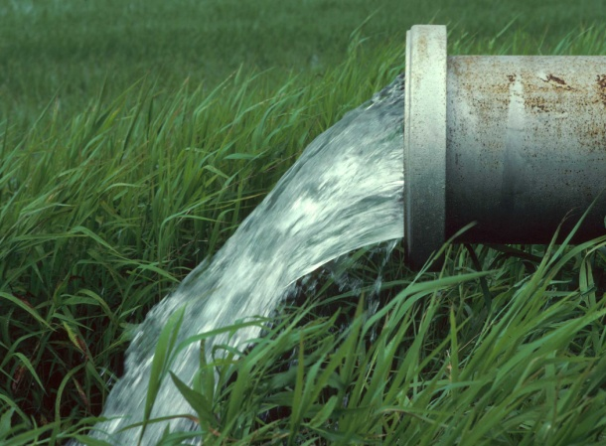
Introduction
With fast growing of society and economy, the conflict between growing water demand and limited water resources becomes more and more serious.¹
The sustainability of water resources, as well as energy, is one of the two factors challenging the world in 21st century. It will become a kind of precious strategic resources which plays an important role in international political and martial stages, like petroleum today.²

Slide 5
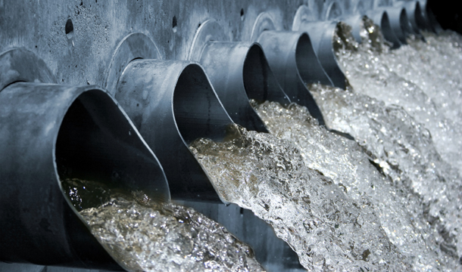
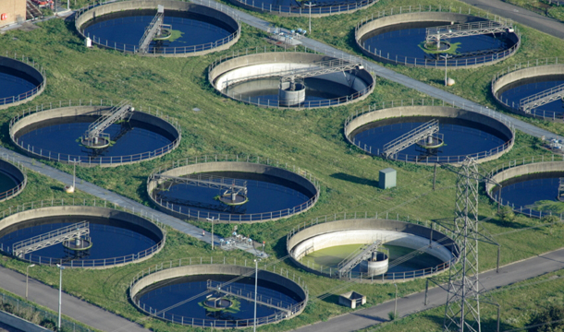
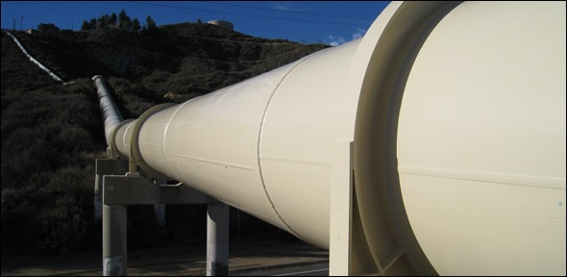
Introduction(continued)
It will be an enormous cost to manufacture enough clean water to support the urbanization.
Abundant chemical engineering products contribute complicated chemical compounds to water body, which tightly concerns human health. The significance of water quality in developed cities is even more important than water quantity to some extent.
Also, the increasing investment on water supply and drainage infrastructures is never a small number.
“Replacing old water and sewer pipes and upgrading aging treatment plants around the country could cost $1 Trillion over the next two decades” – Federal officials³

Slide 6
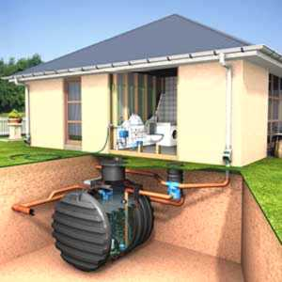
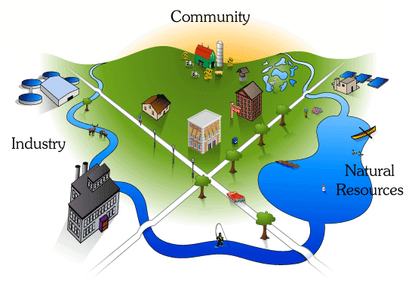
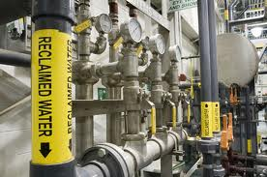
What is Water Sustainability?
Water sustainability is not a simple concept, generally, it focuses on four elements : integrating water quality and water quantity, water efficiency, green infrastructure and energy/water nexus.⁴
In buildings, water sustainability means utilizing limited water resources in a sustainable way to realize more functions and make it more efficient by recycling or harvesting.
Different from water conservation, water sustainability focus more on reducing water “waste” without sacrificing performance or customer satisfaction.
For improving water sustainability in buildings, some methods need to be taken as follows:

Slide 7
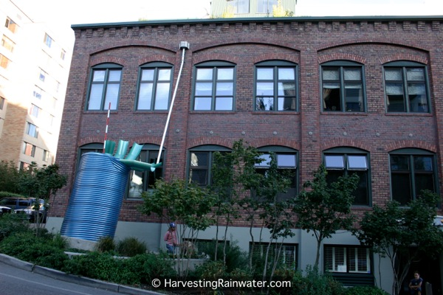
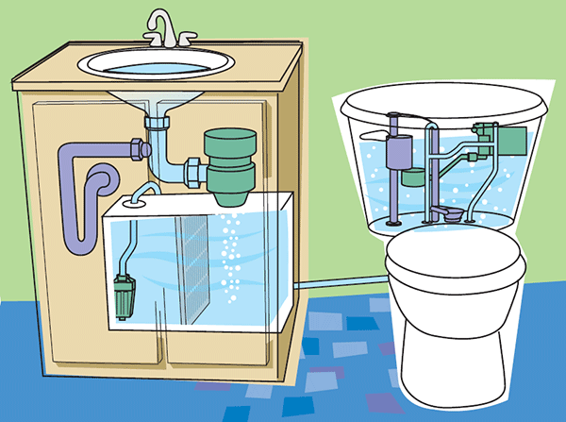
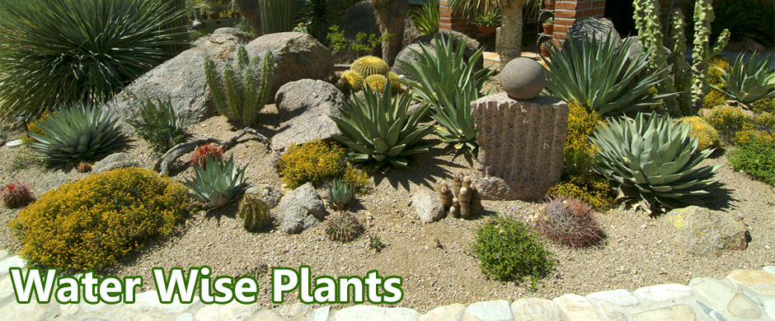
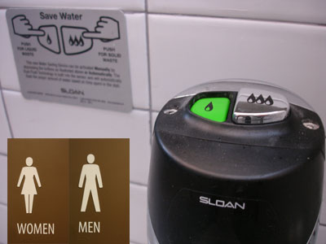
Methods for Improving Water Sustainability in Buildings
Rainwater harvesting
Greywater recycling
Water wise landscaping
Flush and flow fixtures

Slide 8
Rainwater Harvesting⁵
- Why Rainwater Harvesting?
- Potential Uses for Rainwater
Criteria for Selection of Rainwater
Harvesting Technologies
- Components of a Rainwater Harvesting System
- Effectiveness of Rainwater Harvesting
Technology
- Economic Efficiency of Rainwater Harvesting
- Disadvantages of Rainwater Harvesting System
- Case Study 1 and Case Study 2

Slide 9
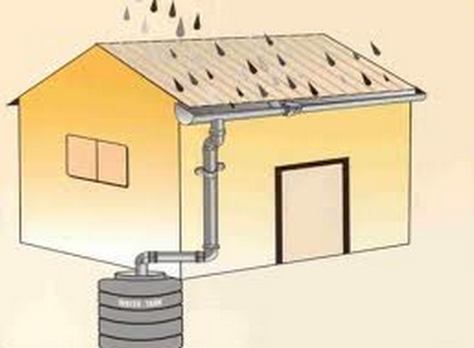
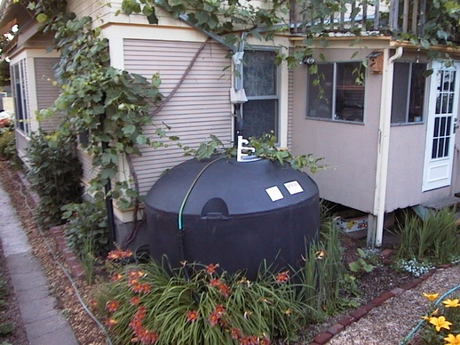
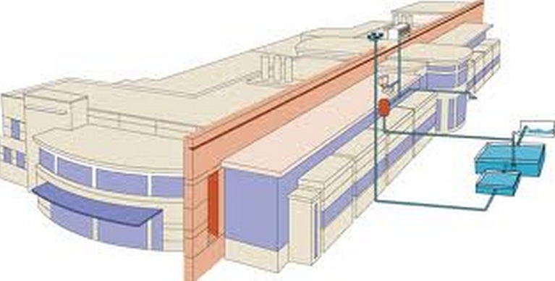
Why Rainwater Harvesting?
In many regions of the world, clean drinking water is not always available and this is only possible with tremendous investment costs and expenditure. Rainwater is a free source and relatively clean and with proper treatment it can be even used as a potable water source.⁶ Rainwater harvesting saves high-quality drinking water sources and relieves the pressure on sewers and the environment by mitigating floods, soil erosions and replenishing groundwater levels. In addition, rainwater harvesting reduces the potable water consumption and consequently, the volume of generated wastewater.

Slide 10
Potential Uses for Rainwater
Non-potable uses
Harvested rainwater is always for outdoor uses and toilet flushing which have lower requirements in water quality(shown in the next slide).
Potable uses
Harvested rainwater is also used in many parts of the world as a potable water source. With rainwater harvesting, the savings in potable water could amount up to 50% of the total household consumption (shown in the next slide).

Slide 11
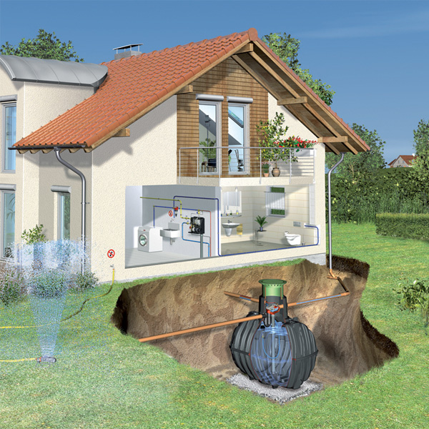
Potential Uses for Rainwater
Toilet Flushing
Garden Watering
Irrigation
Washing Hands
Cleaning and Laundry Washing

Slide 12
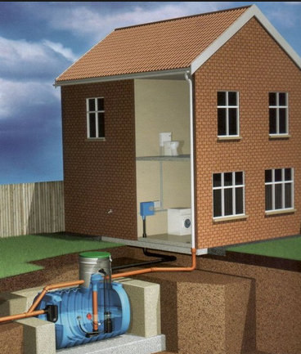
Criteria for Selection of Rainwater Harvesting Technologies⁷
• type and size of catchment area
• local rainfall data and weather patterns
• family size
• length of the drought period
• alternative water sources
• cost of the rainwater harvesting system
When rainwater harvesting is mainly considered for irrigation, several factors should be taken into consideration:
• rainfall amounts, intensities, and evapo-transpiration rates
• soil infiltration rate, water holding capacity, fertility and depth of soil
• crop characteristics such as water requirement and length of growing period

Slide 13
Components of a Rainwater Harvesting System⁸
A rainwater harvesting systems generally consist of the following:
(1) a collection (catchment) area
(2) a conveyance system consisting of pipes and gutters
(3) a storage facility
(4) a delivery system consisting of a tap or pump
(5) a disinfection system(optional)
Note: Although rainwater can be harvested from many surfaces, rooftop harvesting systems are most commonly used as the quality of harvested rainwater is usually clean with proper installation and maintenance.⁹ The effective roof area and the material used in constructing the roof largely influence the efficiency of collection and the water quality.

Slide 14
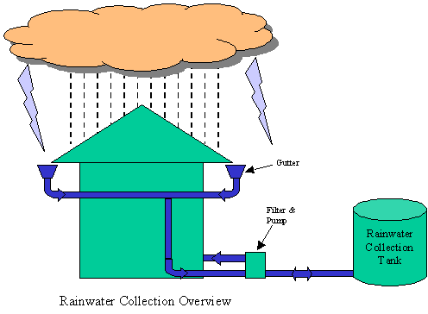
1: Collection or Catchment System
A collection or catchment system is generally a simple structure such as roofs and/or gutters that direct rainwater into the storage facility.
The amount and quality of rainwater collected from a catchment area depends upon the rain intensity, roof surface area, type of roofing material and the surrounding environment. Roofs should be constructed of chemically inert materials. Galvanised corrugated iron and thatched roofs made from palm leaves are also suitable. Generally, unpainted and uncoated surface areas are most suitable. If paint is used, it should be non-toxic (no lead-based paints).

Slide 15
2: Conveyance System
A conveyance system is required to transfer the rainwater from the roof catchment area to the storage system by connecting roof drains (drain pipes) and piping from the roof top to one or more downspouts that transport the rainwater through a filter system to the storage tanks. Before water is stored in a storage tank or cistern, and prior to use, it should be filtered to remove particles and debris. Low-maintenance filters with a good filter output and high water flow should be preferred. “First Flush”¹⁰ systems which filter out the first rain and diverts it away from the storage tank should be also installed. This will remove the contaminants in rainwater which are highest in the first rain shower.

Slide 16
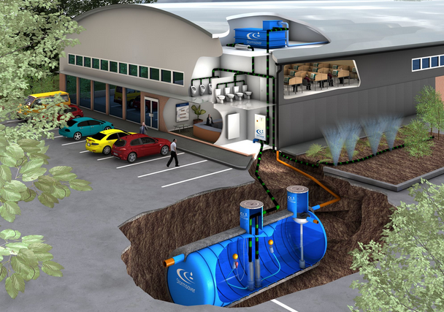
3: Storage Facility
Storage tanks or cisterns are used to store harvested rainwater for use when needed. Depending on the space available, these tanks can be constructed above grade, partly underground, or below grade. They may be constructed as part of the building, or may be built as a separate unit located some distance away from the building.

Slide 17
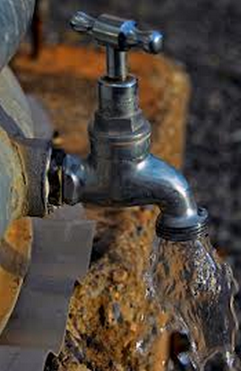
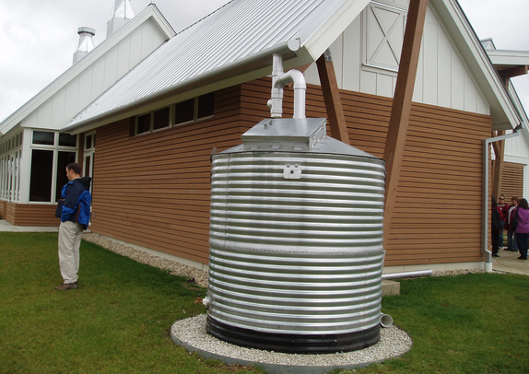
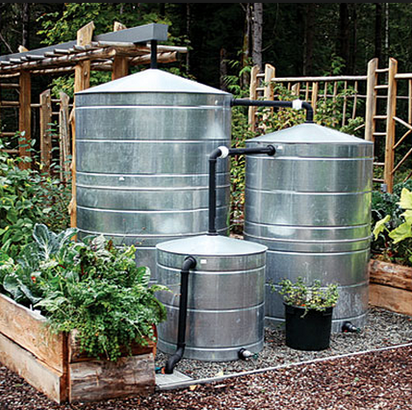
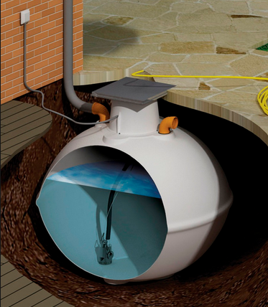
4: Delivery System
Delivery system ¹¹ delivers rainwater and it usually includes a small pump, a pressure tank and a tap, if delivery by means of simple gravity on site is not feasible.

Slide 18
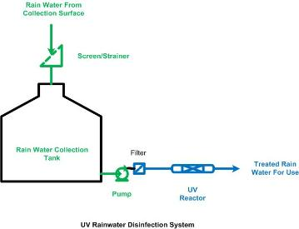
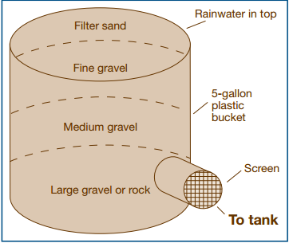
5: Disinfection System
The following are two typical disinfection systems.
1. The first system includes filtration and/or ozone or UV disinfection, if rainwater is to be used as a potable water source.
Filtration
UV
UV rainwater disinfection system¹²
Typical filter

Slide 19
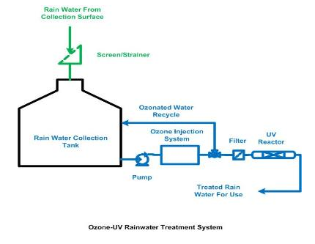
5: Disinfection System(continued)
Ozone
UV
2. The second system includes ozone and UV disinfection system. In this system ozone would treat the bulk of the water in the collection tank while UV can be used to further treat the water.
Ozone/UV rainwater disinfection system¹³

Slide 20
Effectiveness of Rainwater Harvesting Technology¹⁴
The feasibility of rainwater harvesting in a particular locality is highly dependent on the amount and intensity of rainfall.
The viability of rainwater harvesting systems is also a function of the quantity and quality of water available from other sources, household size, per capita water requirements and available budget.
An effective way of avoiding contamination is placing taps at about
10 cm above the base of the rainwater storage tanks.
Finally, effective water harvesting schemes require community participation which is enhanced by:
- sensitivity to people’s needs
- indigenous knowledge and local expertise
- full participation and consideration of gender issues, and
- taking consideration of prevailing farming systems as well as
national policies and community by-laws.
We need not only consider the reliability of the system ,but also the cost in installing and maintaining needs to be considered

Slide 21
Economic Efficiency of Rainwater Harvesting¹⁵
Valid data on the economic efficiency of rainwater harvesting systems is not possible. Depending on the regional conditions (water and wastewater prices, available subsidies), the amortization period may vary between 10 and 20 years. However, it should be taken into consideration that for the major investment (storage and pipe work) a period of use of several decades is expected.
The associated costs of a rainwater harvesting system are for installation, operation and maintenance. Of the costs for installation, the storage tank represents the largest investment which can vary between 30 and 45% of the total cost of the system depending on system size. A pump, a pressure controller and fittings in addition to plumber’s labor represent other major costs of the investment.

Slide 22
Economic Analysis of Rainwater Harvesting System for Dallas, Texas¹⁶
Based on whole-life cost analysis
5000 ft² roof collection area
1 inch storm event
3,200 gallon cistern
tank to fill with rainwater and be completely drawn down over 3,800 times ($2.50 / 1000gallon)
$31,000

Slide 23
Disadvantages of Rainwater Harvesting System¹⁷
1. High Initial investment Costs: The main cost of a rainwater collection system generally occurs during the initial construction phase and no benefit is derived until the system is completed.
2. Regular Maintenance: Regular maintenance, cleaning and repair will be required for the operation of a successful rainwater collection system.
3. Vulnerable Water Quality: The quality of rainwater can be affected by air pollution, insects, and dirt or organic matter. The type and kind of construction materials used can also adversely affect water quality.
4. Water Supply is Climate Dependent: Droughts or long periods of time with little or no rain can cause serious problems with the supply of water.
5. Storage Capacity Limits Supply: The supply of water from a rainwater collection system is not only limited by the amount of rainfall but also by the size of the collection area and the storage facilities.

Slide 24
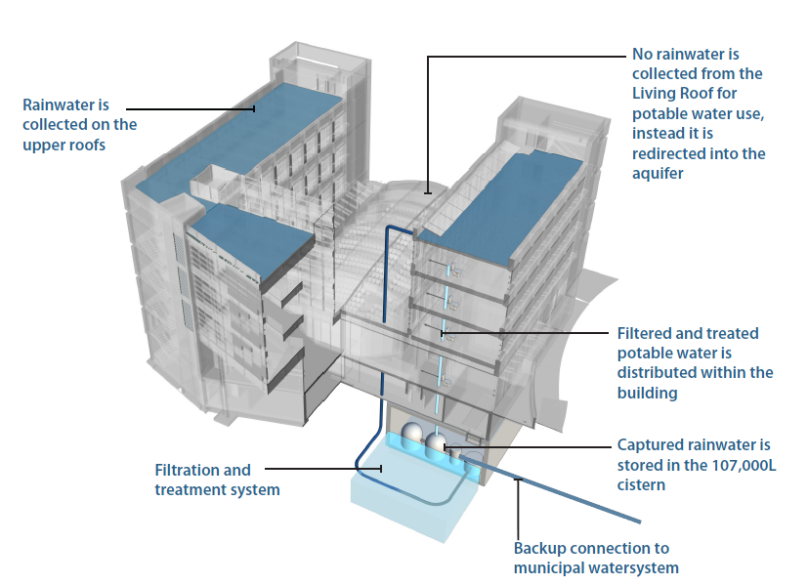
Case Study 1: UBC Point Grey Campus Rainwater Harvesting System Analysis
http://cirs.ubc.ca/building/building-manual/rainwater-system

Slide 25
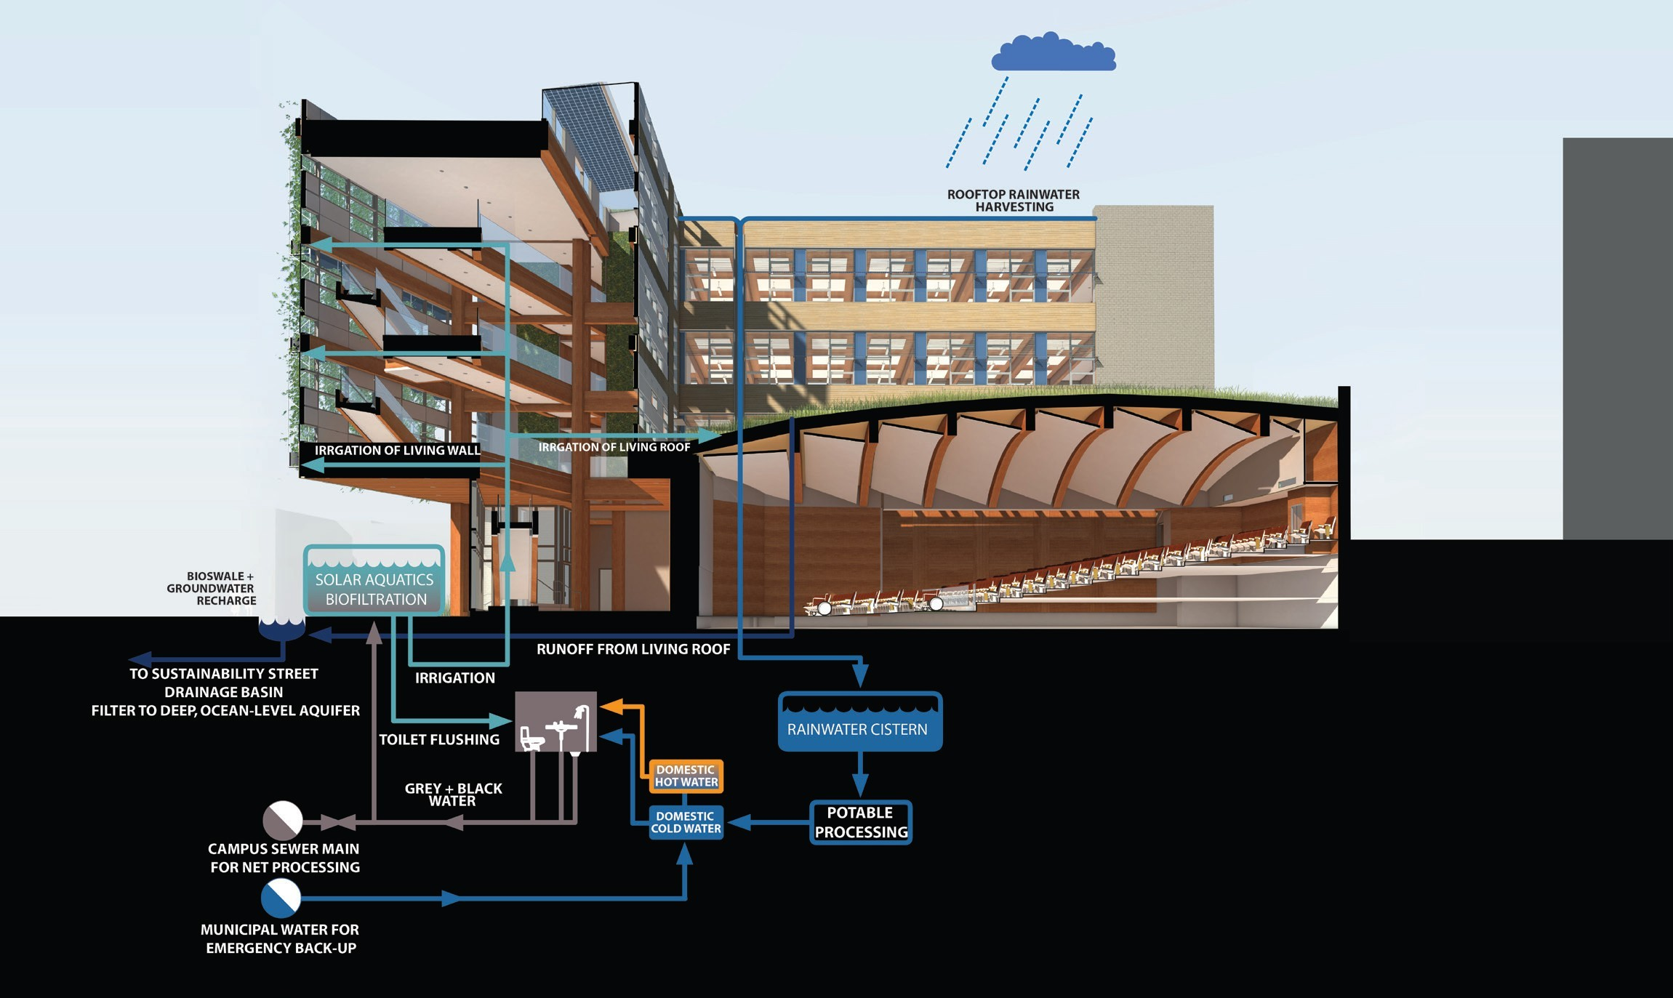
1.Catchment area
3.Storage Facility
2.conveyance system consisting of pipes and gutters
5.Water filtration and treatment system
4.Harvested water distribution
system

Slide 26
Different Steps of Rainwater Harvesting System
Step 1 – Collection: Rainwater is collected on the upper roof on the north and south wings of the building and channeled into the storage cistern underneath the building.
Step 2 - Storage : Depending on the potable water supply and demand, the rainwater is stored for up to three months (the cistern is 107,000 liters, sized to store a three-month demand). The longer storage time is possible due to the continual circulation of oxygen through the water, which reduces the growth of potential contaminant and the development of odour and discoloration.

Slide 27
Different Steps of Rainwater Harvesting System(Continued)
Step 3 – Filtration: From the cistern, the rainwater is filtered through a three step process. The first step is a slow sand filter to remove larger particles, next is a fine filter to remove smaller particles and parasites, and finally an activated carbon filter which removes metals and organic contaminants from atmospheric contaminants.
Step 4 – Disinfection: After filtration, the water is disinfected through a two-step process. First, the water is exposed to ultra-violet light to kill any remaining pathogens, and then a small amount of residual chlorine is added.

Slide 28
Different Steps of Rainwater Harvesting System(continued)
Step 5 - pH Adjustment: Rainwater in the lower mainland of British Columbia has a pH of about 4, which is below the regulated level for drinking water of between 6 and 9. Sodium bicarbonate is injected into the water to adjust the alkalinity and reach the required pH level.
Step 6 - Treated water tank: After the water has been treated, it is stored in two tank (for up to 12 hours, depending on demand) and delivered by pump through the building using a pressurized bladder system.

Slide 29
Benefits for Rainwater Harvesting System to UBC Campus
The use of the rainwater to potable water system at UBC benefitted the project in the following ways:
• Education
The rainwater system is designed to raise awareness of the relationship between water supply and consumption. Inhabitants know that the potable water supply is finite and they will adjust their consumption patterns.
• Reduced Potable Water Demand
The rainwater supply system reduces the demand for potable water from the regional water supply and the burden on municipal water infrastructure.
The use of a localized water harvesting and treatment system reduces the amount of energy required to move water from centralized water treatment plants.

Slide 30
Benefits for Rainwater Harvesting System to UBC Campus System(continued)
• Rainwater Management
The closed loop collection system eliminates run-off from the building, thus reducing the risk of flooding and erosion on campus. Rainwater that is not collected for potable use (run off from the living roof) is discharged into a natural water feature and eventually infiltrate into the aquifer.
• Infrastructure Synergies
The system provides an onsite water source for the enhanced fire suppression systems required by the building code. A cistern for the fire protection system would have to have been provided if the rainwater cistern had not been constructed.

Slide 31
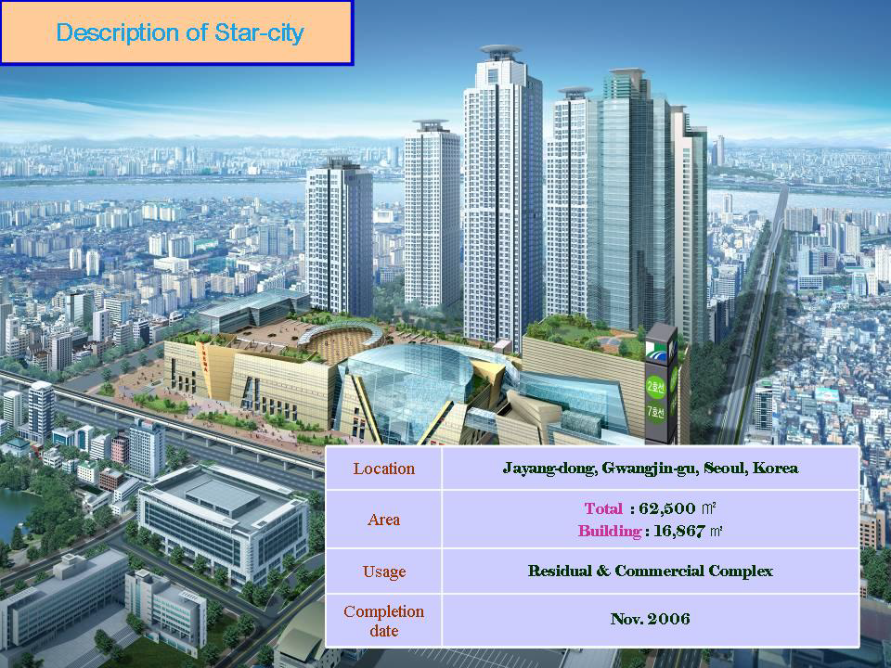
Case Study 2: Rainwater harvesting system in Seoul city commercial and residential buildings¹⁸

Slide 32
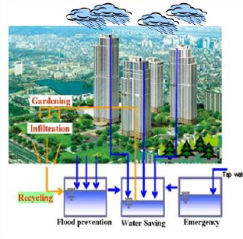
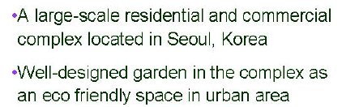
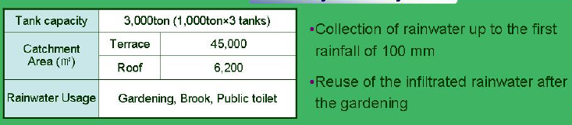
Seoul City Rainwater Harvesting System
Seoul City Complex
RWH System in Seoul
This system incorporates a few innovative design ideas to make the system more effective and efficient (see next slide).

Slide 33
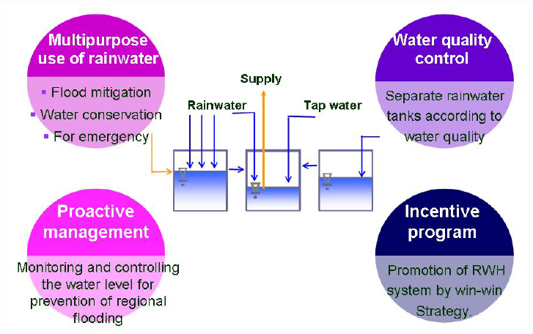
Innovative Application of
Seoul City Rainwater Harvesting System
Based on using these technologies, the rainwater harvesting system in Seoul City not only helps reduce water consumption, but also materialize potential future benefits.

Slide 34
Greywater Harvesting
- What is Greywater?
- Potential Uses for Recycled Greywater
Components of a Gerywater Recycling System
- Schematic of Greywater Recycling System
- Sequence of Greywater Recycling System
- Greywater Treatment System
- Biological Treatment System
- Benefits of Greywater Using Recycled Greywater
- Economic Benefits of Using Recycled Greywater
- Disadvantages on Using Recycled Greywater
- Case Study 1 and Case Study 2

Slide 35
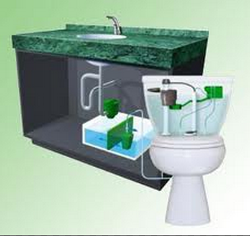
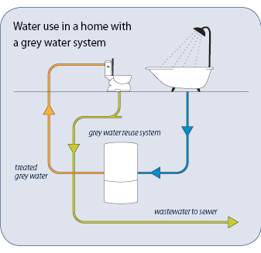
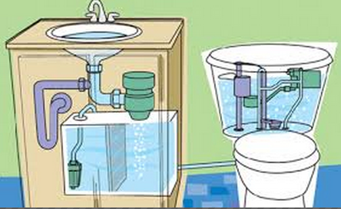
What is Greywater?
Greywater, is generally accepted as being wastewater generated from wash hand basins, showers and baths, which can be recycled on-site for uses such as WC flushing, landscape irrigation and constructed wetlands.¹⁹ Greywater often excludes discharge from laundry, dishwashers and kitchen sinks due to the high nutrient levels. It differs from the bathroom's discharge which is designated sewage or
blackwater to indicate it contains human waste.
Greywater gets its name from its cloudy appearance and from its status as being between fresh potable water (known as "white water") ²⁰ and sewage water.
http://www.waterforlife.nsw.gov.au/recycling/greywater

Slide 36
Potential Uses for Recycled Greywater²¹
The amount and quality of greywater will in part determine how it can be reused. Irrigation and toilet flushing are two common uses, but nearly any non-contact use is a possibility.
Irrigation : Greywater is suitable for irrigating lawns, trees, ornamentals, and food crops. Though irrigation methods in greenhouses may differ greatly from outdoor irrigation, several guidelines for use of greywater apply to both situations.
(See examples on the next two slide)
Toilet Flushing : Toilet flushing can use considerable amounts of greywater, as it normally accounts for up to 50% of indoor water use. Poor quality greywater is not a problem if it is used to flush toilets, because the water goes into the sewer or septic system where it would have gone had it not been reused.
(See examples on the next two slides )

Slide 37
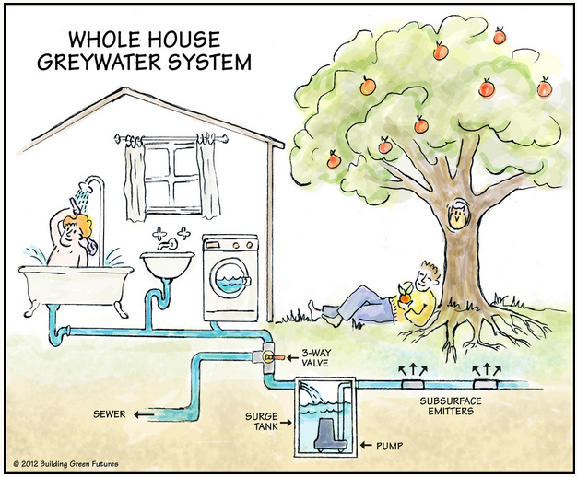
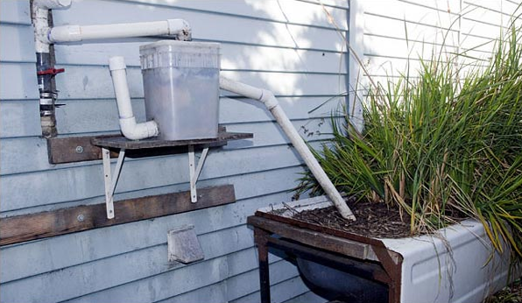
Recycled Greywater for Irrigation
Recycled greywater is mostly used for outdoor irrigation. The reason is that irrigation consumes large amount of water but has relatively lower requirements in water quality. Also, it costs little in constructing new pipes.

Slide 38
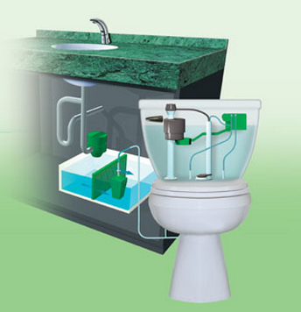
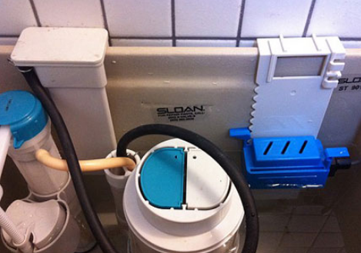
Recycled Greywater for Toilet Flushing
Potable water
Grey water
The figure on the right is an typical dual-flush toilet.²² .By pressing the blue button, greywater is used. By pressing the white button, potable water is selected to flush.

Slide 39
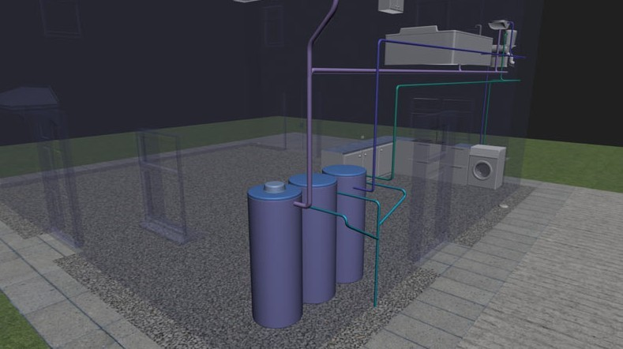
Components of a Gerywater Recycling System²³
Components :
Greywater Collection
Conveyance System
Treatment System
Storage Facilities
Using Recycled Greywater

Slide 40
At present, several water recycling systems exist which can be used to:
1. Recycle the water without purification
This is used in certain agricultural companies (e.g., tree
nurseries) and in dwellings where potable water is not
required (e.g., garden and land irrigation, toilet flushing, etc.).
2. Recycle the water after purification
Water purification/decontamination systems are used for
applications where potable water is required (e.g., drinking,
and/or other domestic tasks such as washing, showering,
etc.).

Slide 41
Sequence of Greywater Recycling System
Greywater collection: Greywater is collected from drains in bathtub, shower, washing machines, and wash sinks (household wastewater excluding toilet wastes).
2. Conveyance System: Greywater is conveyed to the treatment system which is always built on the basement floor of the buildings (See Schematic 1).

Slide 42
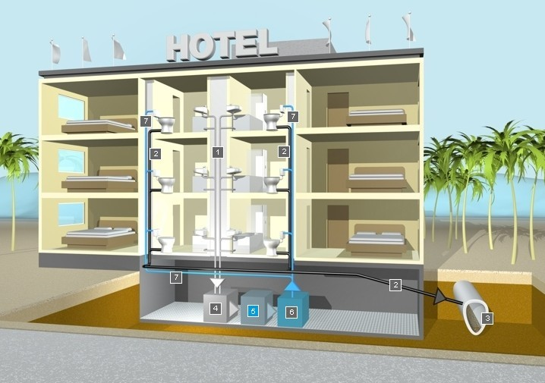
Schematic 1 : Greywater Recycling System
Conveyance system
Use recycled greywater as toilet flushing
Sewer pipes
Greywater collection
Grey water treatment process

Slide 43
Sequence of Greywater Recycling System(continued)
3. Greywater treatment system : Generally, the treatment system has three parts. They are separation system, wastewater treatment system and the disinfection system (See schematics 2 and 3).
(Note: the treatment system is discussed in the next few slides)
4. Storage facilities: If use recycled greywater without treatment, DO NOT store it in case of potential illness. If greywater is treated for potable use, it is able to be stored after the treatment process.
5. Using Recycled Greywater : The treated greywater can be sent to toilet or washing machines in the building for reuse. But it is never equivalent to potable water although it meets potable water quality sometimes

Slide 44
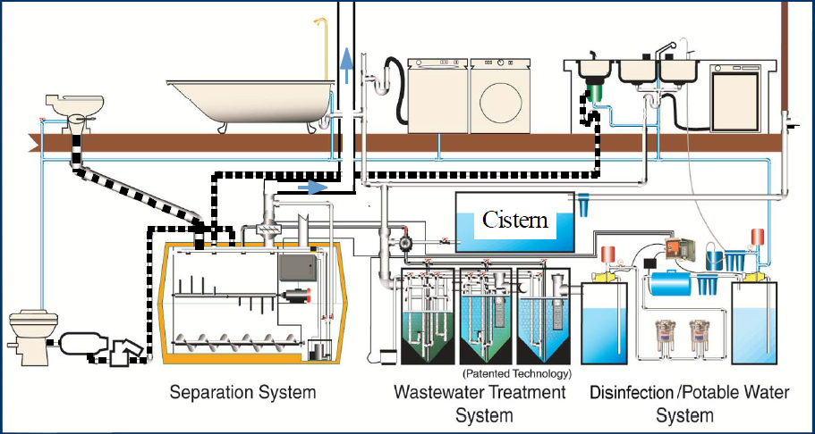
Schematic 2. Greywater Treatment System
Biological Treatment System
The treatment system consists of separation system, biological treatment system and the disinfection system. Among these three, biological treatment is used as the primary process to degradate organic compounds.

Slide 45
Greywater Treatment System(continued)
Separation System: It aims to separates the solids in greywater from the collection system. The separated solid waste will be sent to the sewer.
2. Biological Treatment System: In buildings, the biological treatment generally has three tanks named as BMRC (Bio-Matter Resequencing Converter) . The three tanks are surge tank, aeration tank and clarifying tank (See Schematic 3)²⁴.
Disinfection/Potable Water System: the disinfection system is designed to kill the microbes in water after biological treatment, widely used technologies are ozone or UV²⁵ .

Slide 46
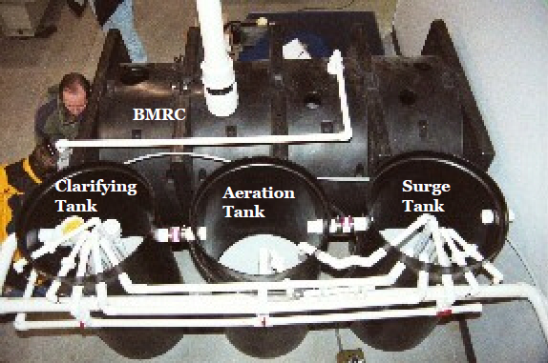
Schematic 3. Biological Treatment System
Bio-Matter Resequencing Converter
The biological treatment system is the major components of greywater system. It generally has three major parts: the surge tank , the aeration tank and the clarifying tank. Note: it is essential to conduct a cost analysis to determine If it is appropriate to use greywater system.

Slide 47
Benefits of Greywater Recycling
The potential ecological benefits of greywater recycling include
Lower fresh water extraction from rivers and aquifers
Less impact from septic tank and treatment plant infrastructure
Topsoil nutrification
Reduced energy use and chemical pollution from treatment
Groundwater recharge
Increased plant growth
Reclamation of nutrients
Greater quality of surface and ground water when preserved by the natural purification in the top layers of soil

Slide 48
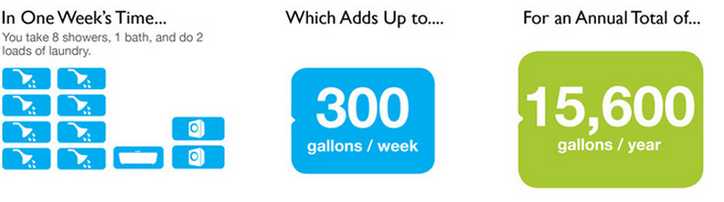
Economic Benefits of Using Recycled Greywater
Assuming one person takes shower eight times per week, takes bath once a week, and does two loads of laundry, if using treated greywater, he/she is able to save up to 300 gallons of potable water per week (15,600 gallons per year) . Based on the potable water price in Texas, $2.5 / 1000 gallons, one person is able to save 39 dollars and a family of four can save 156 dollars per year.

Slide 49
Disadvantages of Using Recycled Greywater²⁶
One of the greatest concerns with the reuse of greywater is the potential health problem due to incomplete treatment.
Another concern is that the reuse of greywater leads to the reduction of water in the sewer system where the waste cannot be completely removed and is fouling.
It is important to note that using greywater for near-potable use needs the approval of the Department of Health.

Slide 50
Cost Analysis of Greywater Recycling System for a Building in Dallas, Texas
The following table is calculated based on a building with 2370 people that consumes 783,904 gallons per day
Components | Cost
Piping | $1,101.60
Equalization Tank | $11,108.12
Living Machine | $650,000
Disinfection System | $244,000
Pumps | $965
Storage Tanks | $ 4,939.04
Additional Charges | $39,172.34
Total Construction Charges | $950,321.10
Activity | Cost
Labor Charges | $1,040
Power Consumption by Living Machines | $205
Power Consumption by pump to lift water to storage tank | $4038.94
Spare parts and Repairs | $5,222.98
Total O&M Charges | $10,506.92

Slide 51
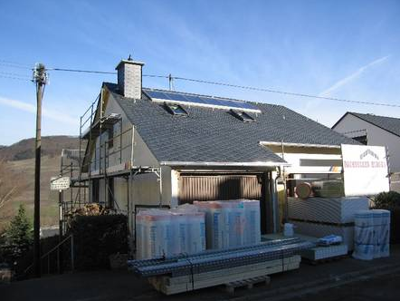
Case Study 1: Indoor Greywater Recycling in a Private Home in Montanusstrase, Germany²⁷
This is the latest installation of a greywater recycling system in a private home in Germany. The filtration system is designed to purify up to 1,000 liters per day although 300 - 500 l per day of recycled grey water is a more realistic requirement considering the is a 2- person dewelling unit.

Slide 52
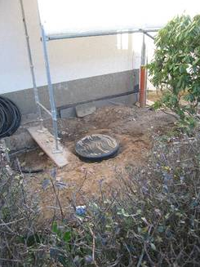
This house is being renovated including addtional insulation, a new solar thermal heating system and also resetting the piping structure. Instead of having one single piping for all water qualities, this house now separates black water (waste water from toilets) and grey water (all other waste waters).
An underground system has been installed in the garden of the house harvesting rain water from the roof.

Slide 53
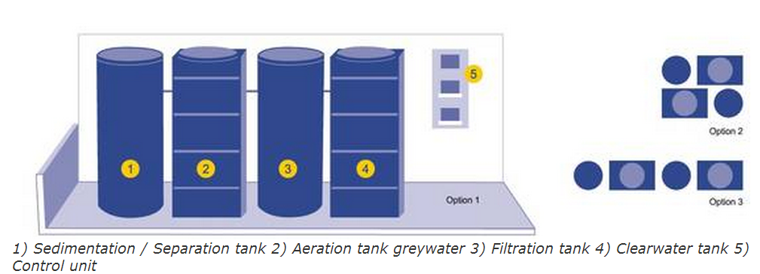
Components and Schematics of the Greywater Treatment System
Capacity
Total volume stage 1 = 500 L
Total volume stage 2 = 1,250 L
Total volume stage 3 = 500 L
Total volume stage 4 = 1,250 L
*Twin pump stations are recommended but not included in standard delivery.

Slide 54
Parameters for the Greywater Treatment System
Connections
Mains water supply (Optional)
Service water (Optional)
Input to unit DN 100
Overflow to sewage DN100
Working room needs to be air-ventilated, floor drain necessary
Control unit
Time intervals for aeration, filtration pre programmed (possible adjustment according to demand)
Main water supply
Solenoid valve DN 13 (optional)

Slide 55
Case Study 2: Greywater Recycling in Residential Buildings, China²⁸
The project locates at Che Gong Zhuang Road, Haidian District, which is near the 2008 Olympic Game Stadiums. The purpose of the project is to explore a new way of water conservation in communities to reduce the potable water demand and reduce the burden to city sewage system. Also , it is considered as a practice in realizing the “Green Olympic”.
Some basic information of the project is listed as follows:
- Supply for toilet flushing in a residential quarter consisting of
60 apartments; 86 boxes; 210 people
- Operating since June 2006
- Treats water from showers and basins

Slide 56
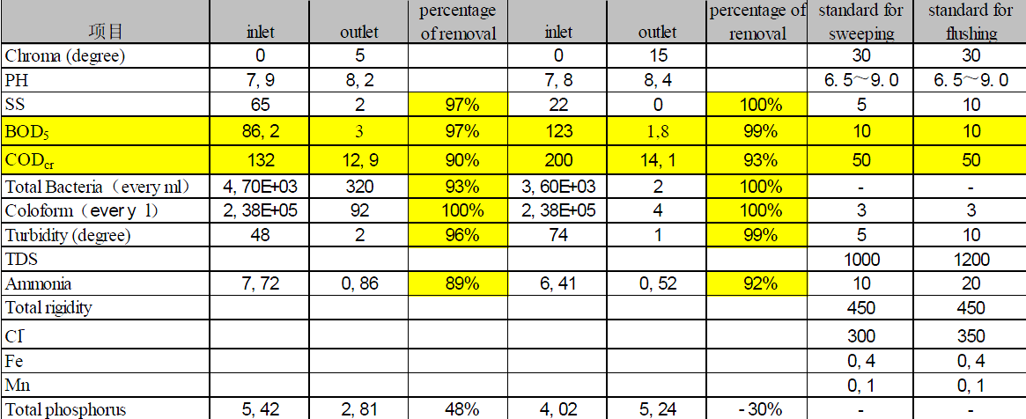
Technical data:
Membrane bioreactor:
Capacity: 10,000 L/day ; Volume of the clear water tank: 6,000 L;
Volume of the aerobic treatment 10,000 L
Greywater quality
Chemicals

Slide 57


Building information
Green building in between the housing complex contains all technical equipment. Local training and awareness
rising is part of the project.

Slide 58

In this project , the core part of greywater treatment is the MBR (membrane bio-reactor). The following is the schematic of the treatment system.
MBR Unit

Slide 59
Flush and Flow Fixtures in Commercial and Residential Buildings
- Introduction of Using Water Efficient
Flush and Flow Fixtures
Standard Water Use Baseline in Buildings
in United States
- High Water Efficiency Fixtures
- Dual Flush Toilets
- High Efficiency Toilets (HETs)
- Ultra Low Flow Pressure Assist Toilets
- Waterless Urinals
- Water Sense Labeled Products

Slide 60
Rationale for Using Water Efficient Flush and Flow Fixtures²⁹
Good sustainable designs need to be fulfilled by efficient facilities
The importance of using water efficient flush and flow fixtures to improve water sustainability primarily embodies the following four aspects:
1. Reducing the volume of water consumption in unit time
  or per flush without bringing down the performance
2. Improving the water efficiency
3. Reducing the waste of water caused by unnecessary leakage
4. Reducing water use helps reduce the energy consumption in water
supply and drainage
Note: To judge if a fixture is water efficient, we need to compare its water
consumption with the baseline which can be considered as the
standard value.²⁹

Slide 61


Standard Water Use Baseline in Buildings in United States
The baseline is to help compare the water efficiency after employing sustainable strategies, per USEPA (version 2002).³⁰

Slide 62
High Water Efficiency Fixtures
The following water fixtures should be considered:
Low Flow toilets (1.6 gpf is standard)
      Dual flush toilets – usually 1 gpf and 1.6 gpf
      High efficiency toilets (HETs) – usually 1.28 gpf
      Ultra low flow pressure assist toilets – usually 1 gpf
Waterless urinals (1.0 gpf is standard)
Low flow urinals - 0.1 to 0.5 gpf
Low Flow Showerheads – usually 1.5-2.0 gpf (2.5 is standard)
Low Flow faucet aerators and non aerating, flow restricting devices (where aerators are not permitted by code)
Several examples of high efficiency fixtures are depicted in the following slides.

Slide 63



Dual Flush Toilets
Full
Half
The main feature of the toilet is that it has two buttons for releasing water. It outputs water in both 0.8-gallon (3 liter) and 1.6-gallon (6 liter) capacities. The smaller lever is designed for liquid waste, and the larger is designed for solid waste. It also uses a larger 4-inch (10 cm) trapway in the bowl, allowing for water to come out faster and clear the bowl efficiently.

Slide 64


High Efficiency Toilets (HETs)
Double Cyclone features:
• Hole-free rim design means less
trapped dirt and bacteria (less
cleaning).
• The dual-nozzle water propulsion
system allows more water to be
directed to the siphon.
HETs use a redesigned bowl that only requires 1.28 gpf for any flush. There are only a few brands of HETs now available, but more are expected
In the near future.

Slide 65


Ultra Low Flow Pressure Assist Toilets
As the higher-pressure water enters the tank, a rubber diaphragm is pressurized and shrinks accordingly. During flushing, the compressed air inside the diaphragm pushes the water into the bowl at a flow rate which is significantly higher than a tank style gravity-flow toilet. This system requires less water than a gravity-flow toilet- or alternatively can be more effective for a similar amount of water.
• Disadvantage: noisy

Slide 66


Waterless Urinals
When the porcelain of conventional urinals is replaced by a water resistant surface that does not retain urine molecules, the need for water is eliminated. A trap at the base of the urinal holds a liquid that is lighter than urine, so when urine enters, it always falls to the bottom and exits the system. The traps need to be replaced at specific
time/use intervals, though these vary by product.
Most of the high water efficiency fixtures used today is labeled as Water Sense products.

Slide 67

“WaterSense” Labeled Products
WaterSense is a U.S. Environmental Protection Agency (EPA) program designed to encourage water efficiency in the United States through the use of a special label on consumer products. It was launched in June 2006.
Products that seek the WaterSense label must:
  Achieve national water savings
  Provide measurable results
  Perform as well as or better than similar products in the
  same category
  Be water-efficient, using at least 20 percent less water than
  EPA‘s fixture-specific water use baseline.
http://www.epa.gov/WaterSense/about_us/watersense_label.html

Slide 68
Water Wise Landscaping in and Around Buildings³¹
- What is Water Wise Landscaping?
- Water Wise Landscaping Designing Strategies
How Much Water Could be Saved from
Water Wise Landscaping?
“Landscaping in Urban Areas”
Benefits from Roof Garden
- Sustainable Water Management Plan for
Roof Gardens
- Nutrient Cycling of Roof Garden

Slide 69

What is Water Wise Landscaping?
Water-Wise landscaping, also known as “Xeriscape,” is quality landscaping that conserves water and protects the environment. Using seven common-sense principles, you can create a lush, beautiful landscape that saves time, money and energy and prevents water pollution and water waste. Water-Wise landscaping consists of the following seven principles.

Slide 70
Water Wise Landscaping Designing Strategies
Use less-than-thirsty plants in your garden. Keep turf grass (the thirstiest plant of all!) to a minimum. Look for plants that are well-suited to regional and local conditions.
Group plants thoughtfully. When selecting trees, shrubs, ground covers, perennials and annuals for your garden, look for those that naturally grow together and use about the same amount of water.
Use water wisely. Water plants only when needed, not by the clock or calendar. Water at night, when evaporation is much lower and air is calmer. Avoid runoff and overspray.

Slide 71
Water Wise Landscaping Designing Strategies(continued)
Improve your soil. Routinely cultivate your soil, incorporating organic matter such as compost. Doing so improves the soil’s ability to resist evaporation and retain moisture. Aerate heavy or compacted soil around trees.
Use mulch. A two- to four-inch layer of mulch also evens out temperature extremes, keep soil cool on hot days and warm on cool days.
Plant trees. Trees help lower air and soil temperatures, reducing plant and soil moisture loss.
Group container plants. Arrange containers so they shade one another. During droughts or periods of drying winds, place them in the deepest shade they can tolerate.

Slide 72
How Much Water Could be Saved from Water Wise Landscaping?
Assuming a traditional garden in California with lawn needs to be watered three times per week by sprinkler for one hour, the flow rate is 360 gallons/ hour.
Water demand = 360 ×1×3 = 1080 gal/week
Using drip irrigation will increase efficiency by 50%
Using xeriscape will reduce 50% the watering frequency
Water demand using water wise landscaping =
1080 ×0.5/ （1+50%）=360 gal/ week
You save 720 gal /week ! It is equal to 450 toilet flush!
If you use rainwater harvesting or greywater recycling to compensate for the 360 gallons water needed, you can have a garden with “zero water demand”.

Slide 73

“Landscaping in Urban Areas”
A roof garden ³²is any garden on the roof of a building. In urban area, there is not much land for landscaping, roof gardens can be considered as potential landscaping in cities.

Slide 74
Benefits from Roof Garden
Sustainability: an important component of urban sustainability
Decorative Benefit: the rooftop garden creates a beautiful scenery in the crowded city
Temperature Control: A research shows that the air temperature around a roof garden is 4 – 5⁰ C cooler in hot summer.
http://en.wikipedia.org/wiki/Roof_garden

Slide 75
Benefits from Roof Garden(continued)
Energy Saving: Roof Gardens help effectively cool the building and help the cost of maintaining air conditioning system.
Entertainment: Roof Garden is a good place to relax in city and it may also provide food and other agricultural product.
Hydrological Benefit: It reduces the run-off from the roof top and thus help avoid flood in city
http://en.wikipedia.org/wiki/Roof_garden

Slide 76

Sustainable Water Management Plan for Roof Gardens
Using rainwater to irrigate the roof garden by applying the rainwater harvesting technologies.
Using recycled grey water to irrigate the roof garden (plants for food not included)

Slide 77
Nutrient Cycling of Roof Garden
Apart from using recycled water, organic waste including fallen leaves and sewage can be used in roof garden.
The idea is based on the most basic cycle of gardening: using wastes (organic waste and sewage), appropriately broken down, usually in some specialized container, on the soil, and harvesting food which, when processed, generates biodegradable waste, and when eaten, generates sewage. In most of the world, this kind of very tight closed loop gardening is used, despite certain health risk.

Slide 78
Water Sustainability in LEED³³
- LEED
The purpose of considering WE in LEED
Water Efficiency Pre-requisite
- Water Efficiency Credits

Slide 79
LEED
LEED means Leadership in Energy & Environmental Design. It is a rating system of green building by determining if it is sustainable in Site Selection(SS), Water Efficiency (WE), Energy and Atmosphere (EA), Materials and Resources (MR) and Indoor Environmental Quality(IEQ)
WE encourages the use of strategies and technologies that reduce the amount of potable water consumed in buildings.

Slide 80
The purpose of considering WE in LEED
Monitoring water consumption performance
Reducing indoor potable water consumption
Reducing water consumption to save energy and improve environmental well-being
Practicing water –efficient landscaping
To reach these goals, LEED sets one prerequisite and four credits to evaluate the water efficiency performance, which are listed as follows.

Slide 81
Water Efficiency Pre-requisite
Requirement: Use 20% less water than the water use baseline for building, excluding irrigation
Strategies and Implementation:
Consider rainwater harvesting
Consider grey water recycling
Use non-water toilets and urinals
Use flow restrictors and reduced urinals
Use automatic sensors
Use WaterSense labled products

Slide 82
Water Efficiency Credits
Credit 1 : Water efficient landscaping
Requirement: Reduce 50% potable water for irrigation (2 pts)
or no potable water use (4 pts)
Strategies and Implementation:
- Reduction may be attributed to any of the following:
- Plant species, density, microclimate factor
- Irrigation efficiency
- Use captured rainwater
- Use recycled wastewater
- Use of public non-potable water

Slide 83
Water Efficiency Credits
Credit 2 : Innovative wastewater technologies
Requirement:
Option 1- Reduce potable water use for sewage conveyance by
50% through use of water conserving fixtures or non-
potable water
Option 2- Treat 50% of wastewater on-site to tertiary standards.
Treated water must be infiltrated or used on-site.
Strategies and Implementation:
1. Water conserving flush fixtures
2. Use of non-potable water
-Collected rainwater
-Recycled grey water
-Water treated or conveyed by public agency

Slide 84
Water Efficiency Credits
Credit 3 : Water use reduction
Requirement: Employ strategies that in aggregate use less water than the water use baseline calculated for the building (not including irrigation). The minimum water savings percentage for each point threshold is as follows:
- 30% reduction = 2 points
- 35% reduction = 3 points
- 40% reduction = 4 points
Strategies and Implementation:
  - Installing flow restrictors
  - Automatic faucet sensors
  - Low consumption flush fixtures
  - Non-water fixtures
  - Collecting rainwater

Slide 85
Water Efficiency Credits
Credit 4 : Process water reduction
Requirement: To receive this credit, buildings must have the following:
1. No refrigeration equipment using once through cooling potable water
2. No garbage disposals
3. At least 4 process items where water use is at or
below the levels shown in the following table (table needs to be inserted for specific purpose). Inclusion of any equipment not listed must be supported by documentation showing 20% reduction from benchmark or industry standard

Slide 86

Case Study: USC Engemann Health Center
USC Engemann Health Center was put into use in March 2013.
As a LEED Silver certified building, its design has satisfied two credits in water efficiency.
It reduced 50% potable water
consumption for irrigation.
The whole building use 40%
less potable water than baseline.

Slide 87

USC Health Center Score Card
From the score card, we can see the Health Center received 2 points in water efficient landscaping and 4 points in water use reduction. They can be attributed to methods taken. One is the rainwater harvesting system and the other is installing the water saving flush fixtures.

Slide 88




Collector
Conduct
Rainwater
Harvesting
System at Health Center
Less thirsty plants
Irrigations

Slide 89
The trend and development of water sustainability in buildings

Slide 90

City of the future?!
No one knows what tomorrow brings, but it can be predicted that water sustainability in buildings will be given serious consideration and more and more sustainable buildings will appear in global cities.

Slide 91
Reference
[1] Fang, C.-l., Bao, C., & Huang, J.-c. (2007). Management Implications to Water Resources Constraint Force on Socio-economic System in Rapid Urbanization: A Case Study of the Hexi Corridor, NW China. Water Resources Management, 21(9), 1613-1633.
[2] Adham, S., & Minier-Matar, J. (2009). Water sustainability and the petroleum industry. Paper presented at the International Petroleum Technology Conference 2009, IPTC 2009, December 7, 2009 - December 9, 2009, Doha, Qatar.
[3] Trussell, R. R., & Hand, D. W. (2012). MWH's Water Treatment Principles and Design (3rd Edition). Hoboken, NJ, USA: Wiley.
[4] Kansal, M. L., & Gaur, A. (2011). Expert system based water sustainability index. Paper presented at the World Environmental and Water Resources Congress 2011: Bearing Knowledge for Sustainability, May 22, 2011 - May 26, 2011, Palm Springs, CA, United states.
[5] Koenig, K. (2003). Rainwater harvesting: Public need or private pleasure Water 21(FEB.), 56-58.
[6] Foraste, J. A., & Hirschman, D. (2010). A methodology for using rainwater harvesting as a stormwater management BMP. Paper presented at the 2010 International Low Impact Development Conference - Redefining Water in the City, April 11, 2010 - April 14, 2010, San Francisco, CA, United states.
[7] Angrill, S., Farreny, R., Gasol, C. M., Gabarrell, X., Vinolas, B., Josa, A., et al. (2012). Environmental analysis of rainwater harvesting infrastructures in diffuse and compact urban models of Mediterranean climate. International Journal of Life Cycle Assessment, 17(1), 25-42.
[8] Fewkes, A. (2012). A review of rainwater harvesting in the UK. Structural Survey, 30(2), 174-194.

Slide 92
Reference
[9] Sachdeva, S. N., & Sharma, U. (2008). Potential of road rainwater harvesting in urban areas. Paper presented at the Advanced Topics on Water Resources, Hydraulics and Hydrology. 3rd IASME/ WSEAS International Conference on Water Resources, Hydraulics &amp; Hydrology (WHH'08), 23-25 Feb. 2008, Stevens Point, WI, USA.
[10] Lee, J. Y., Kim, H. J., & Han, M. Y. (2011). Quality assessment of rooftop runoff and harvested rainwater from a building catchment. Water Science and Technology, 63(11), 2725-2731.
[11] Kandiah, V. K., & Zechman, E. M. (2012). Agent-based modeling for simulating the decentralization of urban water infrastructure systems. Paper presented at the World Environmental and Water Resources Congress 2012: Crossing Boundaries, 20-24 May 2012, Reston, VA, USA.
[12] Singh, H. P., Sharma, M. R., Hassan, Q., & Ahsan, N. (2010). Potential of rainwater harvesting in Himachal Pradesh. Nature Environment and Pollution Technology, 9(4), 837-842.
[13] Nzewi, E. U., Sarikonda, S., & Lee, E. J. (2010). Analysis and treatment of harvested rainwater. Paper presented at the World Environmental and Water Resources Congress 2010: Challenges of Change, May 16, 2010 - May 20, 2010, Providence, RI, United states.
[14] Grandet, C., Binning, P. J., Mikkelsen, P. S., & Blanchet, F. (2010). Effects of rainwater harvesting on centralized urban water supply systems. Water Science and Technology: Water Supply, 10(4), 570-576.
[15] Farreny, R., Gabarrell, X., & Rieradevall, J. (2011). Cost-efficiency of rainwater harvesting strategies in dense Mediterranean neighbourhoods. Resources, Conservation and Recycling, 55(7), 686-694.

Slide 93
Reference
[16] Jaber, F. H., & Mohan, S. (2011). Design, construction and evaluation of five LID practices in North Central Texas. Paper presented at the American Society of Agricultural and Biological Engineers Annual International Meeting 2011, August 7, 2011 - August 10, 2011, Louisville, KY, United states.
[17] Li, X., Gou, M., Cheng, M., & Wang, Y. (2010). Maize crop-water model under condition of supplemental irrigation with harvested rainwater. Nongye Gongcheng Xuebao/Transactions of the Chinese Society of Agricultural Engineering, 26(8), 80-84.
[18] Jungsoo, M., Reeho, K., & Mooyoung, H. (2012). The effects of catchment materials and treatment train on rainwater quality in a rainwater harvesting system. Materials Science Forum, 724, 451-454.
[19] Pinto, U., Maheshwari, B. L., & Grewal, H. S. (2010). Effects of greywater irrigation on plant growth, water use and soil properties. Resources, Conservation and Recycling, 54(7), 429-435.
[20] Ghisi, E., & Mengotti de Oliveira, S. (2007). Potential for potable water savings by combining the use of rainwater and greywater in houses in southern Brazil. Building and Environment, 42(4), 1731-1742.
[21] Jamrah, A., Al-Futaisi, A., Prathapar, S., & Harrasi, A. A. (2008). Evaluating greywater reuse potential for sustainable water resources management in Oman. Environmental Monitoring and Assessment, 137(1-3), 315-327.
[22] Ilemobade, A. A., Olanrewaju, O. O., & Griffioen, M. L. (2013). Greywater reuse for toilet flushing at a university academic and residential building. Water SA, 39(3), 351-360.

Slide 94
Reference
[23] Baker, K. H., Harrow, D. I., & Ritchey, B. A. (2010). Tricosan in greywater: Implications for reuse. Paper presented at the 2010 International Low Impact Development Conference - Redefining Water in the City, April 11, 2010 - April 14, 2010, San Francisco, CA, United states.
[24] Hernandez Leal, L., Zeeman, G., Temmink, H., & Buisman, C. (2007). Characterisation and biological treatment of greywater. Paper presented at the Advanced Sanitation, 12 Caxton Street, London, SW1H 0QS, United Kingdom.
[25] Gilboa, Y., & Friedler, E. (2008). UV disinfection of RBC-treated light greywater effluent: Kinetics, survival and regrowth of selected microorganisms. Water Research, 42(4-5), 1043-1050.
[26] Gual, M., Moia, A., & March, J. G. (2008). Monitoring of an indoor pilot plant for osmosis rejection and greywater reuse to flush toilets in a hotel. Desalination, 219(1-3), 81-88.
[27] Nolde, E. (2005). Greywater recycling systems in Germany - Results, experiences and guidelines. Water Science and Technology, 51(10), 203-210.
[28] Siyu, Z., Xin, D., Jining, C., & Pan, L. (2013). Planning an urban wastewater system with centralised greywater reuse: a case in Beijing. Civil Engineering and Environmental Systems, 30(1), 40-55.
[29] De Oliveira, L. H., & Moura, T. A. M. (2004). Performance evaluation of water saver fixtures in buildings Avaliacao de desempenho de componentes economizadores de agua em edificios. Ciencia y Engenharia/ Science and Engineering Journal, 13(1), 13-18.

Slide 95
Reference
[30] Maddaus, W. O., Parker, D. S., & Hunt, A. J. (2003). Reducing water demand and wastewater flow. Journal / American Water Works Association, 75(7), 330-347.
[31] Pauker, R. (1997). Water-wise landscaping. International Water and Irrigation, 17(1).
[32] Wang, X. (2012). A study on the impact of soil thickness and matrix matching of roof garden on plant growth. Paper presented at the 2012 World Automation Congress, WAC 2012, June 24, 2012 - June 28, 2012, Puerto Vallarta, Mexico.
[33] Hutson, A. C., & Ickert, R. A. (2012). Sustainability in water supply. Paper presented at the World Environmental and Water Resources Congress 2012: Crossing Boundaries, 20-24 May 2012, Reston, VA, USA.

