Slide 1
Existing and proposed desalination plants in Southern California
(Work in Progress)
Prepared by : Lidong Cai, Graduate Student
Supervising Faculty: Professor Massoud Pirbazari
Sonny Astani Department of Civil and Environmental Engineering
Viterbi School of Engineering
University of Southern California
May 2014

Slide 2
Table of Content
1. Seawater desalination
1.1. Introduction
1.2. Typical desalination process
1.3. Benefits of desalination
2. Carlsbad desalination plant
2.1. Introduction
2.2. Cost and water rate
2.3. Intake and discharge
2.4. Mutual benefits
2.5. Desalination pilot study
3. Santa Barbara desalination plant
3.1. History and development
3.2. Cost and water rate
3.3. Intake and discharge
3.4. Reactivation protocal

Slide 3
4. Huntington beach desalination plant
4.1. Introduction
4.2. Cost and water rate
4.3. Intake and discharge
4.4. Intake study investigations
5. Camp Pendleton desalination plant
5.1. Introduction
5.2. Intake study investigations
5.3. Plant flow diagram
6. West Basin desalination plant
6.1. Pilot study
6.2. Demonstration study
6.3. Intake technology
6.4. Plant flow diagram
6.5. Site selection
6.6 Power supply options

Slide 4
7. Desalination based on renewable energy
7.1 Solar thermal desalination
7.2 Photovoltaic desalination
7.3 Wind power desalination
7.4 Geothermal Desalination
8. Discussion
9. Reference
Note: Please contact Lidong Cai at <lidongca@usc.edu> if you have any suggestions or comments.

Slide 5

Seawater Desalination
Obtaining reliable fresh water supplies
from challenging water sources

Slide 6




Fresh Water Needs
Economic expansion
Agriculture and food
Public health
Quality of life
Notes:
Scarcity of fresh water has serious implications.
It can slow or stop economic expansion, reduce agricultural output, hamper food independence, and degrade public health and quality of life.

Slide 7

Why Desalination?
75% of the Earth’s surface is covered by water, 97.5% of that water is oceans
80 countries are suffering from water scarcity
1.5 billion people lack ready access to drinking water
Notes:
Link takes you to a Water Desalination Module created by the General Electric Company
See: http://www.gewater.com/images/multimedia/desal/index_flash.html

Slide 8
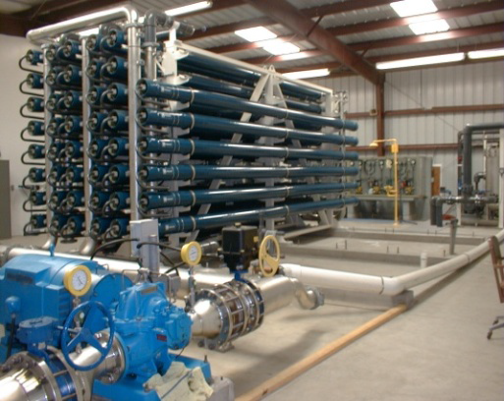
Seawater Desalination
Definition: The processes of removing salt, other minerals and impurities from seawater.
Mission: Create a safe and reliable water supply that is local and not dependent on varying weather conditions or water rights.

Slide 9
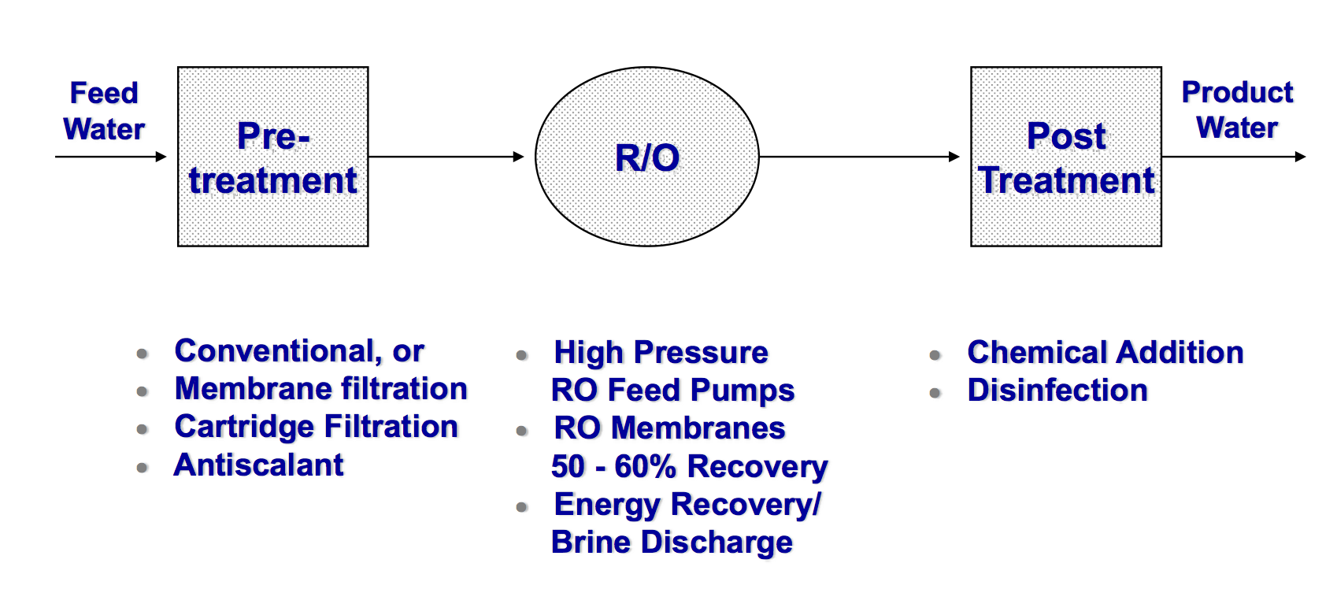
Typical Desalination Process

Slide 10
Introduction to Reverse Osmosis
“ Reverse osmosis(RO) is the process of forcing a solvent from a region of high solute concentration through a semipermeable membrane to a region of low solute concentration by applying a pressure in excess of the osmotic pressure”

Slide 11
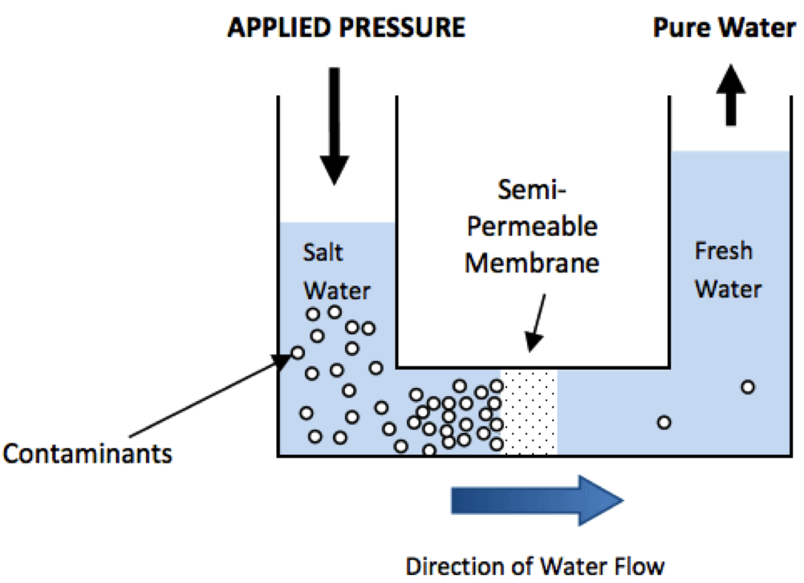
Reverse Osmosis Schematic
Reference source: 1

Slide 12
Benefits of Desalination
Part of the Diversification Strategy
New drought-proof / emergency local water supply
Will be cost-competitive with other new water supplies
Reduces reliance on increasingly constrained imported water supplies

Slide 13
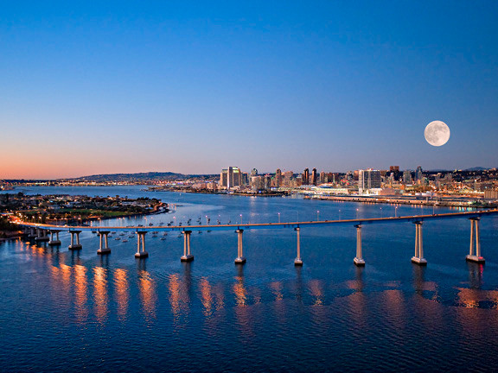
Carlsbad Desalination Plant
Provide San Diego County with a locally-
controlled, drought-proof supply of
high-quality water

Slide 14
Introduction
Carlsbad desalination plant:
The plant is now under construction (to be completed in 2016) in Carlsbad, California (adjacent to the Encina Power Station). It will produce 50 million gallons of water per day and will provide 7% of the potable water needs for the San Diego region.

Slide 15
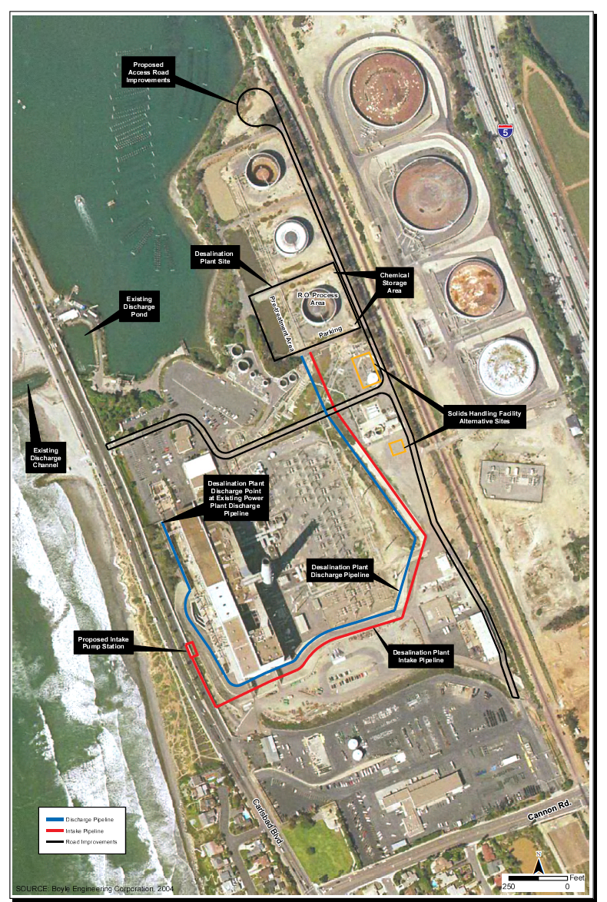
Landscape of Carlsbad Desalination Plant
Reference source: 2

Slide 16
Cost and Water Rate
This project will have a capital cost at $700 million, and the operation cost will be $50 million per year.
Additionally, the water produced will be sold at a price of $2,014-2,257 per acre foot. While the price of water getting from the Metropolitan Water District of Southern California is about $1,000 per acre-foot.

Slide 17
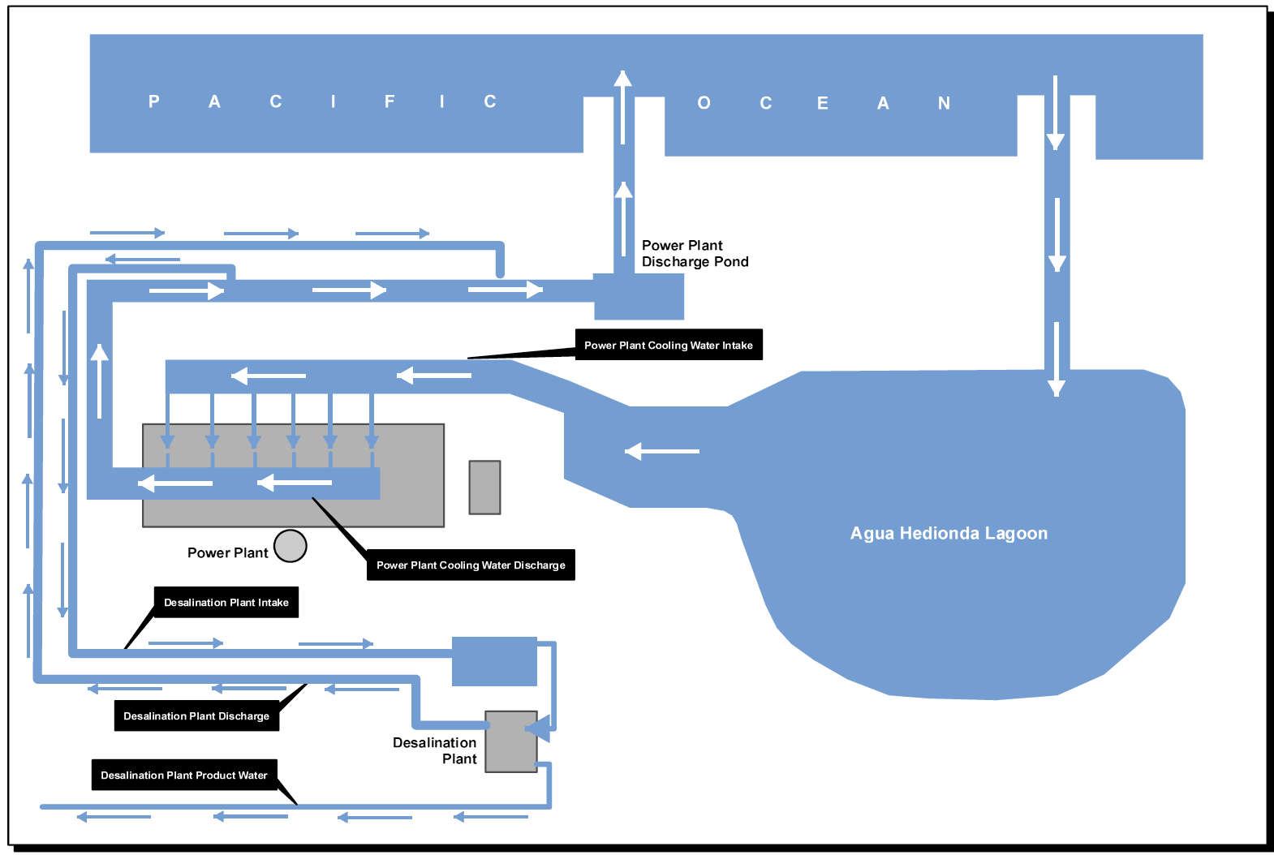
Intake and Discharge Schematic
Reference source: 2

Slide 18
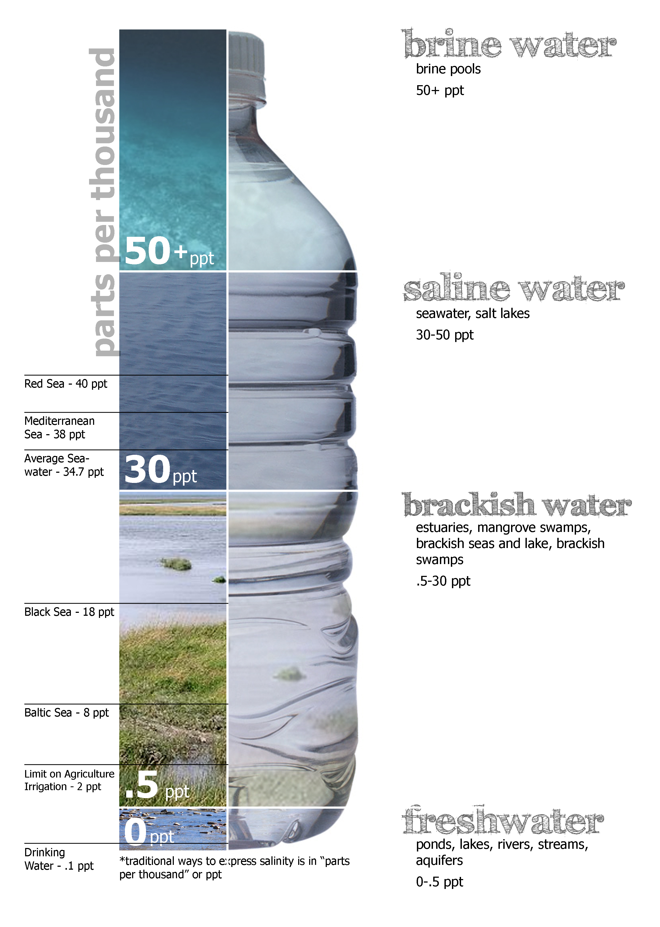
Salinity Consideration
100 MGD cooling water with the salinity of 33.5 ‰ (parts per thousand) is treated, producing 50 MGD clean water and 50 MGD concentrated water(67 ‰), which are returned to power plant discharge to mix with 500 MGD cooling water. The blend discharge has salinity of 36.2‰.
Reference source: 3

Slide 19
Mutual Benefits with Power Plant
Use of existing intake and outfall structures
Electricity supply from power plant
Reduced energy associated with treating water at elevated temperatures
Note: Power plant effluent is already filtered by 2 inch bar
screens and 3/8- inch fine self-cleaning traveling screens.

Slide 20
Desalination Pilot Study
A pilot study has been conducted to compare the performance of sand filter pretreatment, MF membrane pretreatment, UF membrane pretreatment, and the performance of the RO when operating on filtrate from the above pretreatment systems.
Next, different pretreatment will be illustrated.

Slide 21
Sand Filtration
Composition:
The granular-media pretreatment system includes two continuous backwash upflow filters in series. The first filter has a coarse (0.9 mm) sand media bed which is 2.03 m (80 inch) deep. The second filter contains finer (0.5mm) sand media and its media depth is 1.02 m (40 inches).

Slide 22
Removal mechanism on sand filtration:
As seawater passes through the sand filter media, the sand granules travel from the bottom of the filter to the top and back to the bottom in a continuous motion. Seawater solids trapped by the sand media travel downwards with the sand particles to the bottom of the filter.

Slide 23
Backwash of sand filtration:
Removed solids are lifted upwards to the sand washer located on the top of the filter via an air lift, and are removed from the filter cell as a waste filter backwash (reject).

Slide 24
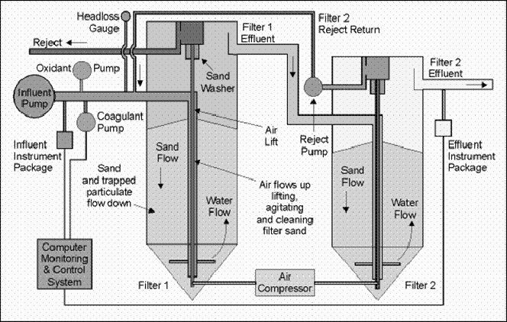
Sand Filtration Schematic
Reference source: 4

Slide 25
2. Microfiltration
Composition:
The MF consists of a test vessel which contains two completely submerged membrane modules with 12 membrane fiber bundles per module. The fibers are made of polypropylene and have outside diameter of 0.31 mm and wall thickness of 0.035 mm. The fiber pore size is less than
0.2 µm and fiber porosity is 45 percent.

Slide 26
Removal mechanism of microfiltration:
The MF system feed seawater is prescreened by a self-cleaning disk filter with a nominal screening size of 100 μm. The permeate side of the modules is connected to the suction of a centrifugal pump, which moves the seawater across the MF membranes in direct-flow (with bleed) operation.

Slide 27
Backwash of microfiltration:
The MF filtration process sequence consists of 15-minute filtration cycle followed by 15-second backwash cycle. The membrane surface is kept clean by air scouring. During the backwash cycles membrane filtration effluent is forced in a reverse direction.

Slide 28
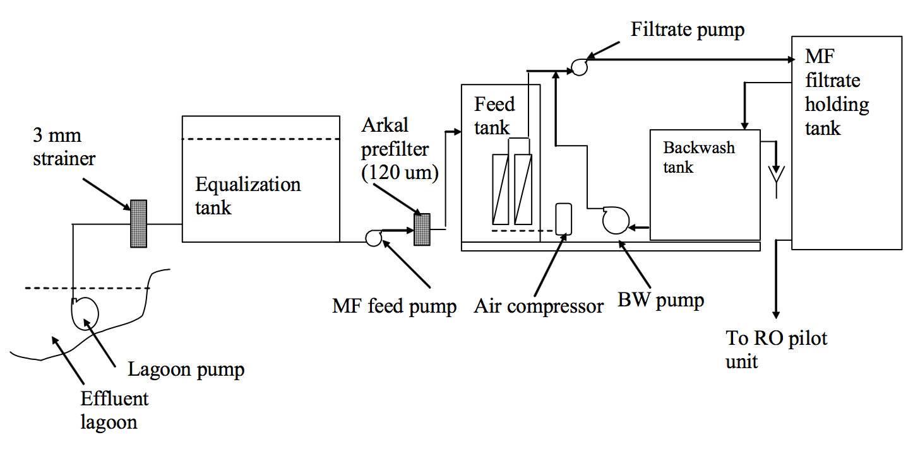
Microfiltration Schematic
Reference source: 4

Slide 29
3. Ultrafiltration
Composition:
The UF is a low energy immersed membrane process that consists of outside-in, hollow-fiber modules immersed directly in the feed-water. The pilot system uses six modules, each module is comprised of 40,000 individual fibers with a nominal pore size of 0.02 μm.

Slide 30
Removal mechanism of ultrafiltration:
The same prescreening filters successfully used on the MF filtration unit were used before the UF filtration unit. Then water passes through UF membrane under pressure, causes pollutants to be retained .

Slide 31
Backwash of ultrafiltration:
The filtration process consists of a 40-minute filtration cycle followed by a backwash cycle. The backwash cycle is made up of a number of different sequences. The backwash cycle starts by aerating the membranes for 15-seconds followed by a 30-second reversal of flow where a portion of the permeate is sent back through the fibers to the membrane process tank.

Slide 32
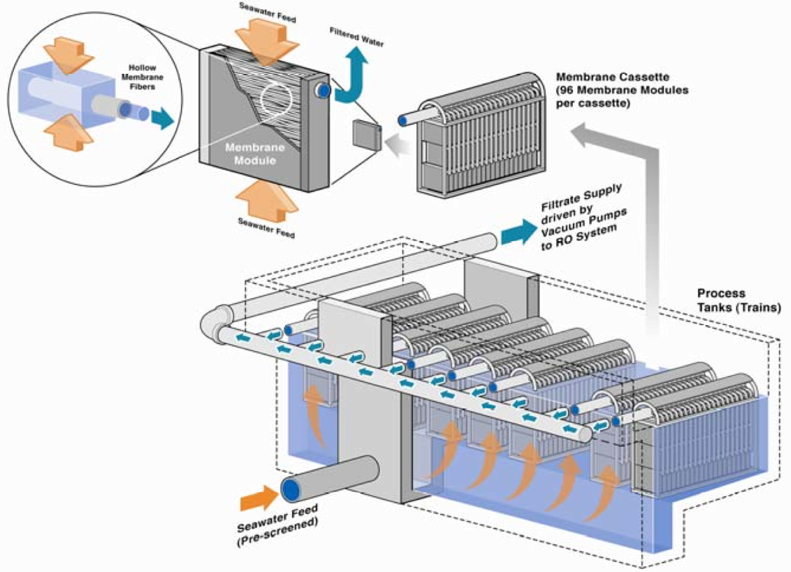
Ultrafiltration Schematic
Reference source: 4

Slide 33
4. Disinfection
The water discharged from the RO system will be disinfected using chloramination.
Chloramination process in essence forms chloramines in water, controlling the population of microorganisms.
The water at the delivery level will have a chloramine residual concentration in the range of 2mg/l to 2.5mg/l.

Slide 34
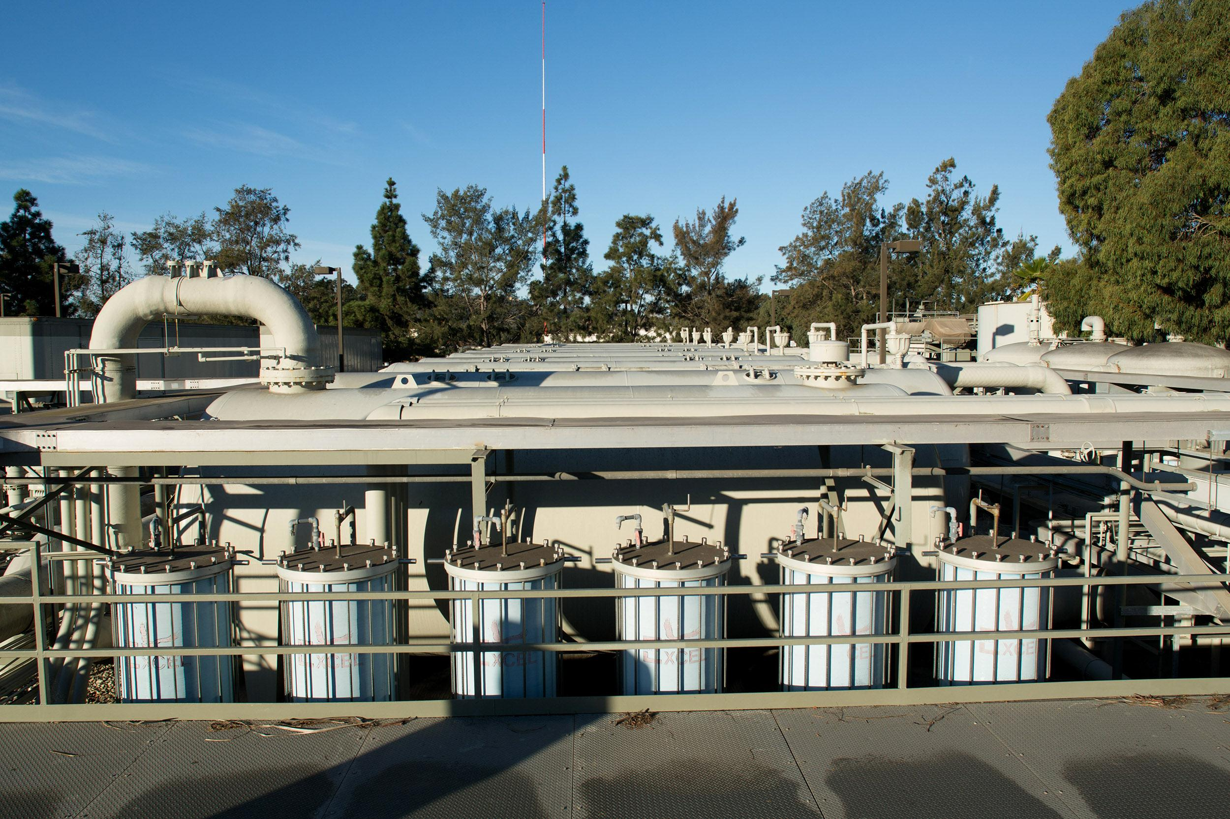
Santa Barbara Desalination Plant
An emergency water supply in response to
the severe drought from 1986 to 1991.
Reference source: 5

Slide 35
Santa Barbara Desalination Plant
History & Development:
• In the face of water supply crisis in late 1980’s, the plant was constructed as emergency supply with a capacity of 7,500 acre feet per year (maximum 10,000 AFY), and was operated between March and June of 1992.

Slide 36
•Due to abundant rainfall in the 1991-1992 winter and subsequent winters, the plant was placed into a standby mode.
•On May 6, 2014, City Council authorized execution of a “ preliminary design contract” for reactivating the desalination facility.

Slide 37
Desalination Plant Overall Cost
Preliminary design and reactivation:
The plant is now under preliminary design for reactivation, preliminary design and permitting will cost $1,863,053, while reactivation will cost $28.75 million.
Capital and operation:
The original capital cost is $34 million, with operation cost of $5 million per year.

Slide 38
Water Rate
The water Rate will be $1500 per acre foot, while water from Lake Cachuma or Gibraltar Reservoir only costs $100 (around $350-450 after treatment)per acre foot.

Slide 39
Plant Water Intake and Discharge
Water is pumped in from an intake station three-quarters of a mile offshore and then filtered at the plant.
Solid waste is trucked away, wastewater is dumped out with the discharge from the
El Estero wastewater treatment plant, and drinking water goes into the city’s reservoirs.

Slide 40
Reactivation Protocal
Replace all the old RO membrane
Test all the existing systems and facilities
Upgrade outdated equipment

Slide 41
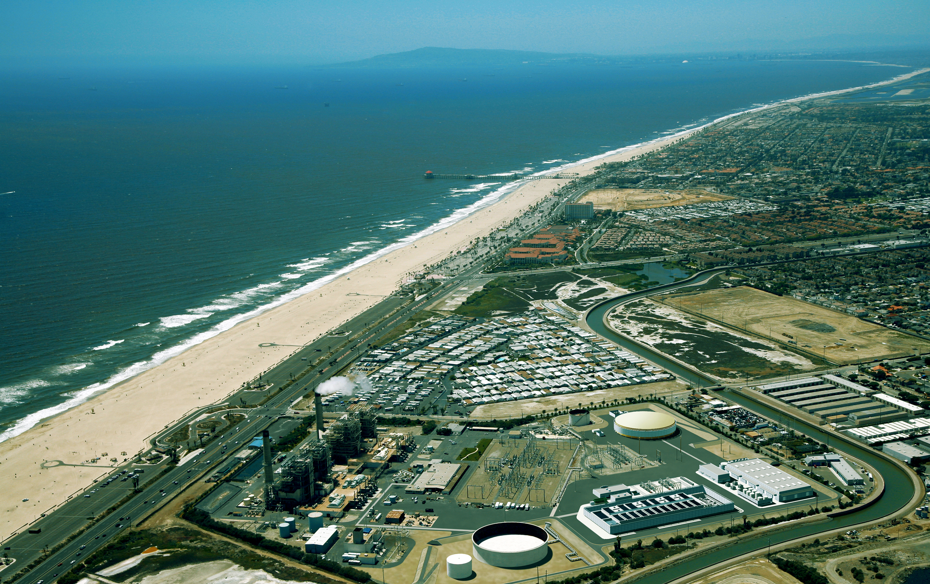
Huntington Beach Desalination Plant
Serves as an alternative water source and relieves
the burden of the current sources of
water supply for orange county
Reference source: 6

Slide 42
Introduction
Huntington beach desalination plant:
The plant is a 50-million gallon per day facility currently in late-stage development. It will be located adjacent to the AES (Applied Energy Services) Huntington Beach Power Station and is scheduled to be operational by 2018.

Slide 43
Plant Cost and Water Rate
Cost: $888 million(capital), $46.7 million/per (operation)
Water Rate: $1,850 ($1,600 if subsidy is received), while the cost of MWD Treated full service water is $970/acre-foot.
Next slide will show water rates for different water supplies

Slide 44
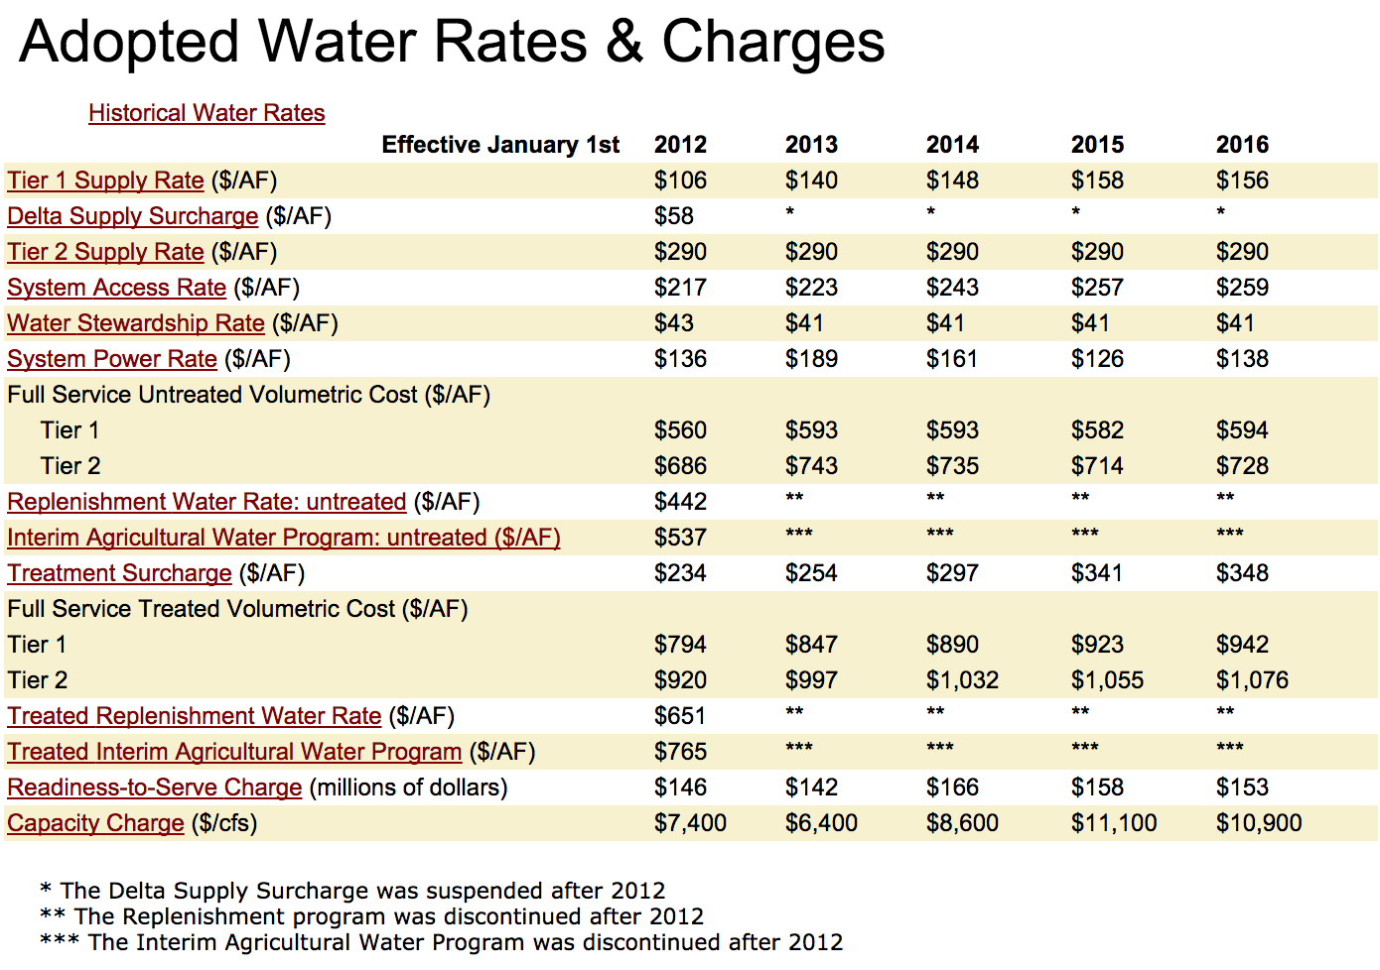

Slide 45
Water Rates Comparison
MWD has indicated their rates can be expected to increase 3 to 6% annually.
The figure on next slide provides three future estimates for the cost of imported MWD water, 3%, 4.5% and 6% annual increases. Additionally the cost of the ocean desalination water is assumed to increase at 2.5% annually.

Slide 46
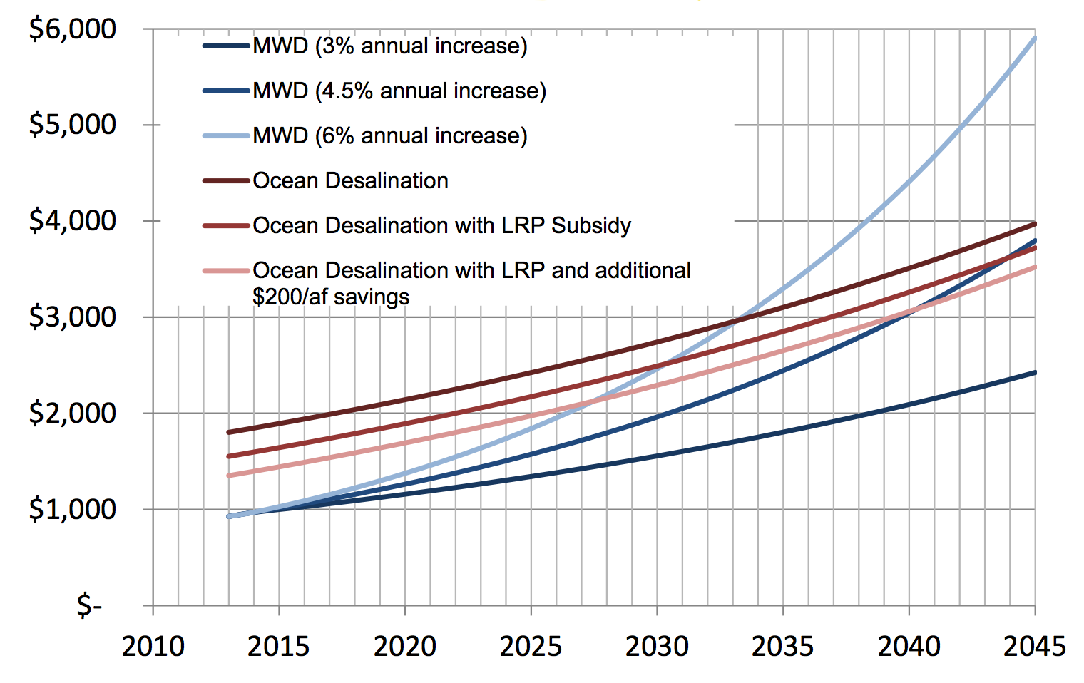
Water Rates Comparison
Reference source: 7

Slide 47
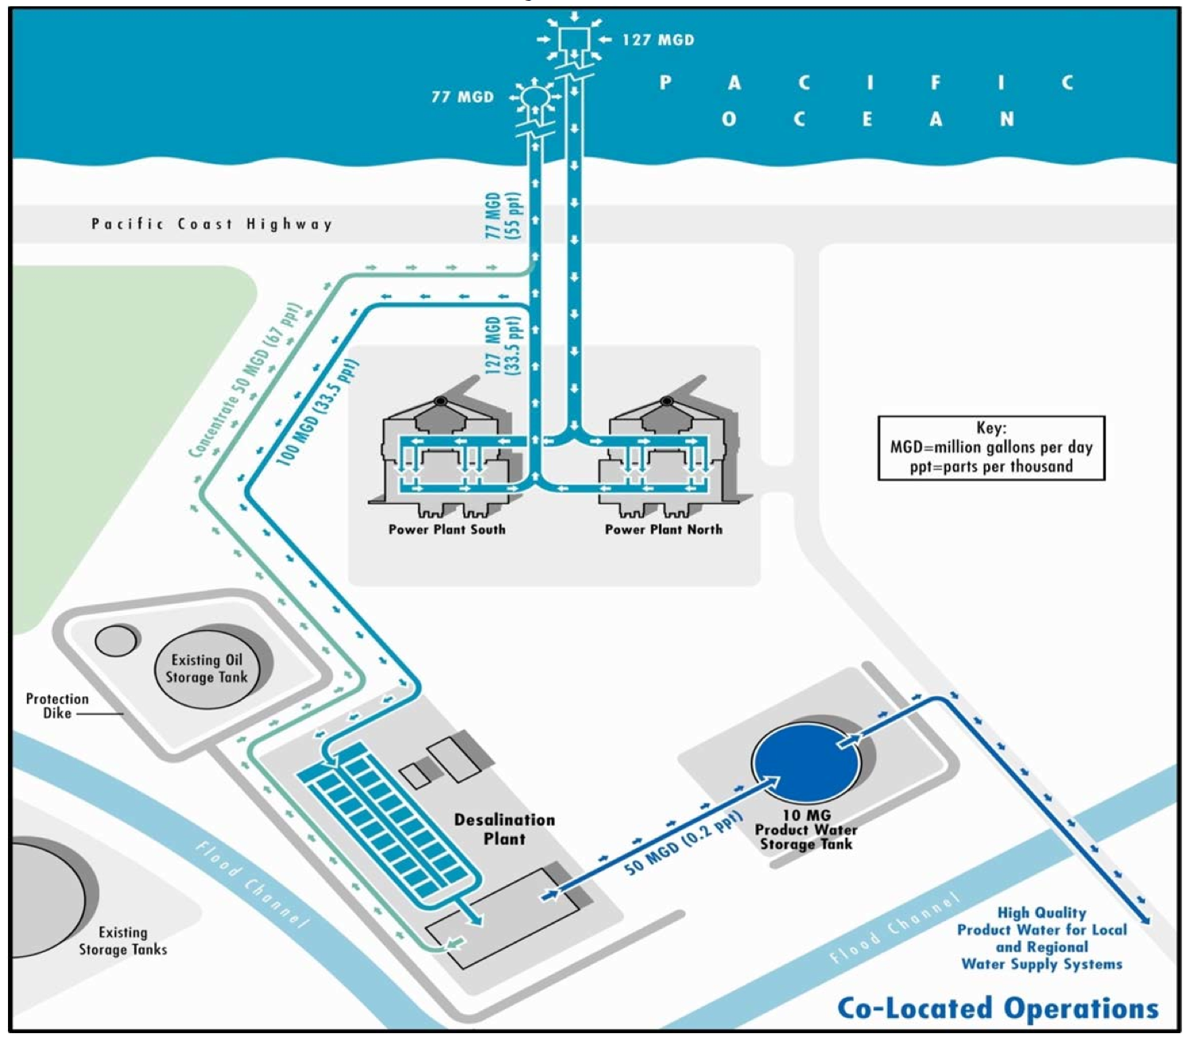
Intake and Discharge Schematic
Reference source: 8

Slide 48
Intake Study Investigations
A panel of experts selected by the California Coastal Commission and plant builder Poseidon Water concluded that two types of systems — seabed and beach intakes — are possible to build at the proposed site.

Slide 49
Seabed infiltration galleries — a method in which intake pipes to collect seawater are placed under the ocean floor — can withstand natural events such as earthquakes and can be built off Huntington's shore
Beach galleries — are similar but are constructed closer to shore.

Slide 50
3. Vertical wells — which take in water directly underneath the well station. That method was found to be infeasible because it could draw water from the Orange County groundwater basin.
4. Slant wells — were deemed infeasible because they too could draw large amounts of water from the groundwater basin and it is unknown how reliable they are in the long run.

Slide 51
5. Radial collectors — which consist of a vertical, water-tight chamber with horizontal intakes protruding from it, were found infeasible because there are limits on how long the intakes can be, and the terrain is inappropriate for the system, according to the report.

Slide 52
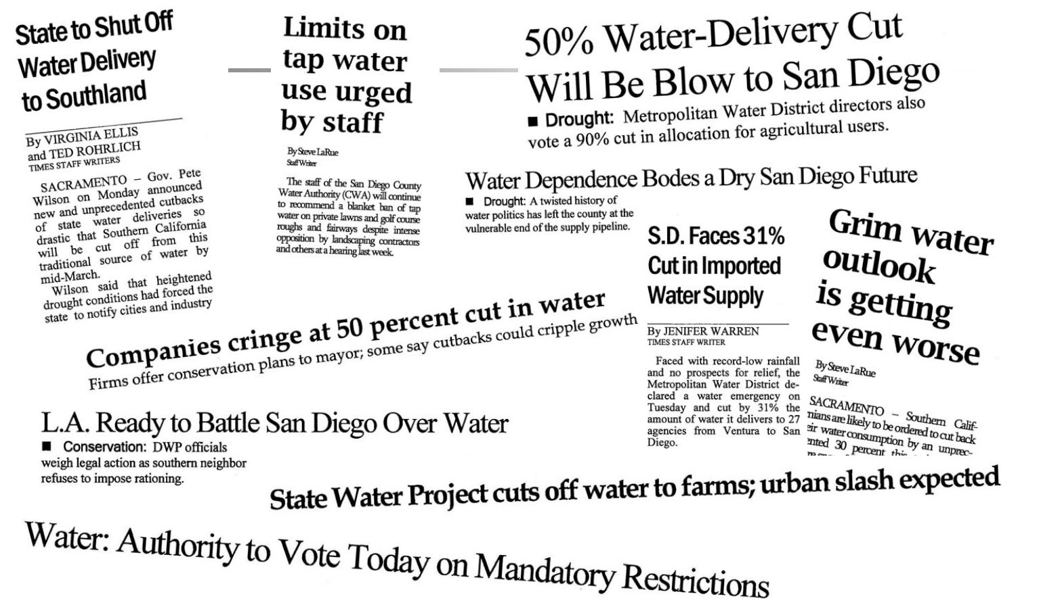
Camp Pendleton Desalination Plant
Reference source: 9

Slide 53
Introduction
Camp Pendleton Desalination Plant:
The project is currently in the planning phase. Early feasibility studies suggest potential capacity 100-150 million gallons per day. Construction cost is estimated to be 2.32 to 2.90 billion with conveyance costs of 350-360 million and annual operation and maintenance costs of 174-200 million.

Slide 54
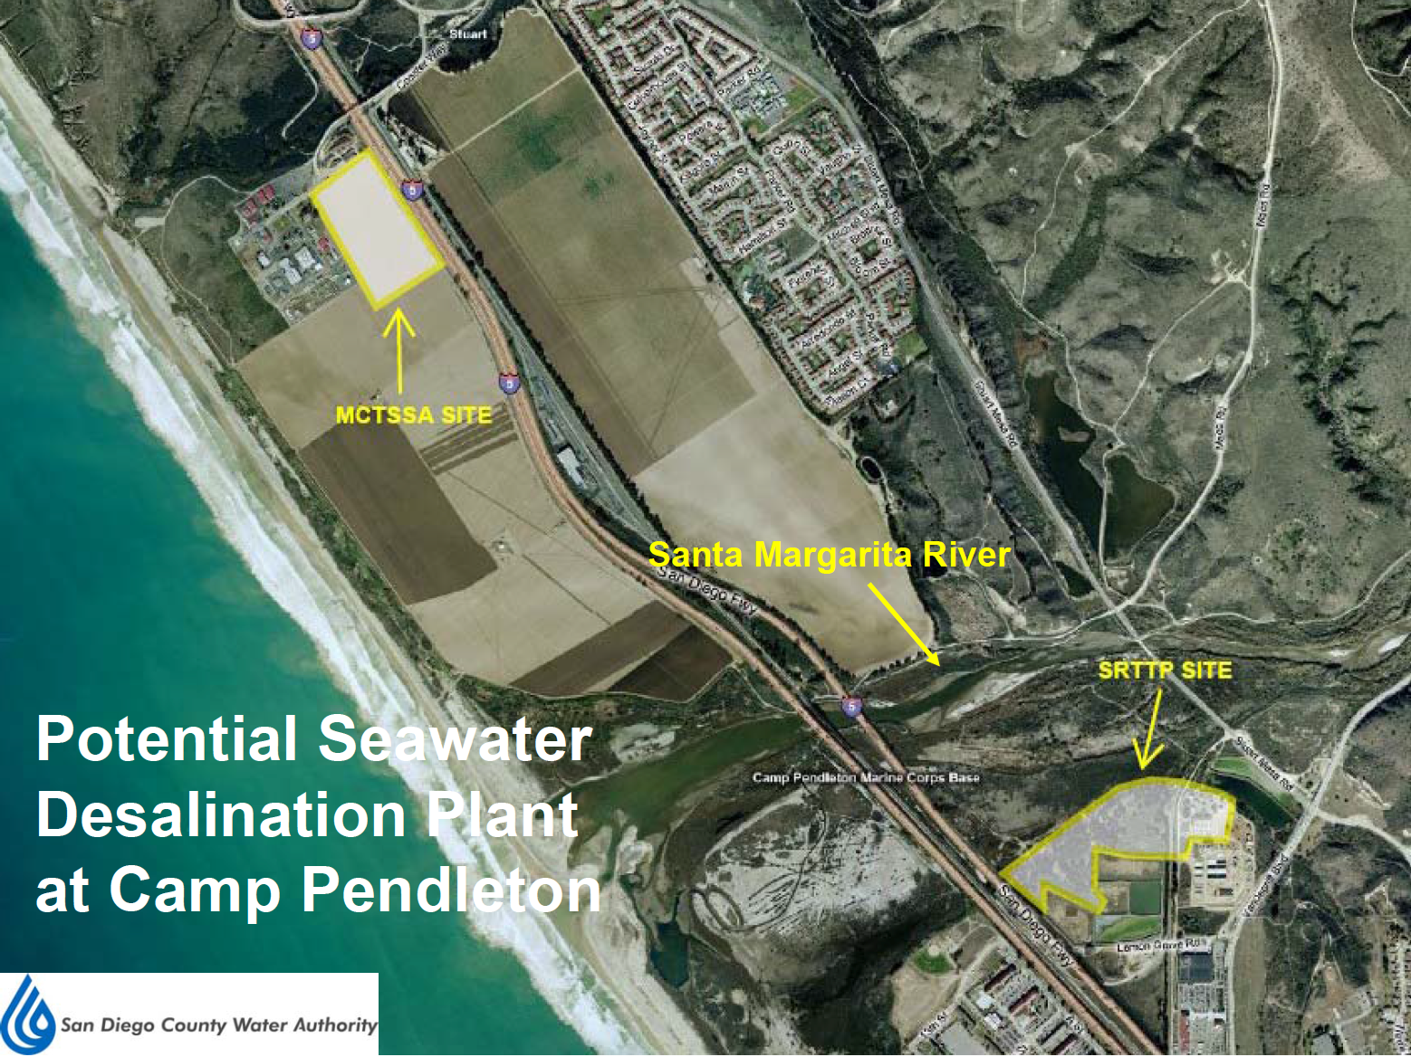
Reference source: 10

Slide 55
Why Choose Camp Pendleton?
Location: North County location ideal for efficient integration of new treated supply into the Water Authority system
Plant Site: Unique attributes of Camp Pendleton coastline provide an opportunity to develop a regional desalination facility

Slide 56
Intake Study Investigations
Screened Open-Ocean Intake: An offshore screened open-ocean intake using cylindrical wedge-wire mesh screens suspended in the water column.
Seabed Infiltration Gallery (SIG): An offshore shallow pipe gallery installed under the seabed using sand as a filter.

Slide 57
Deep Infiltration Gallery (DIG): A gallery of deep offshore collector wells drilled to the underground tunnel below the seabed; and
Beach (Slant) Wells drilled from onshore.

Slide 58
Intake and Outfall Pipelines
A pipe-in-pipe (dual-use) tunnel would serve both offshore intake and concentrate conveyance. It is comprised of a 16-feet diameter outer pipe with an approximate 8-foot diameter interior pipe.

Slide 59
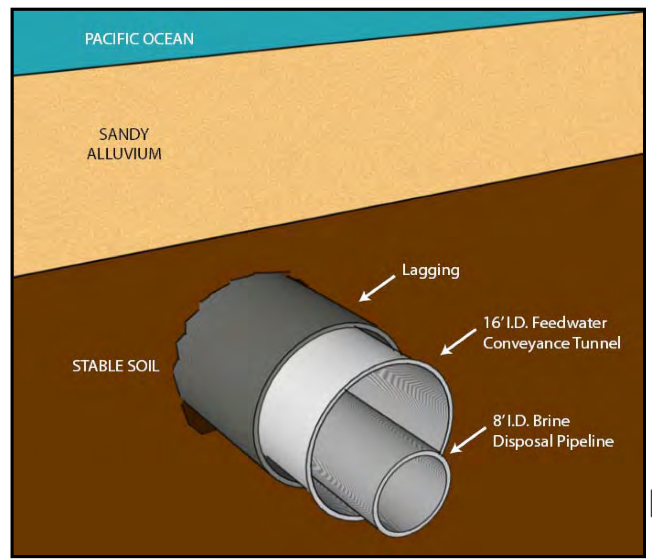
Feed water would be conveyed within the annular space of the tunnel.
Concentrate would be conveyed in the pressurized interior pipeline.
Reference source: 11

Slide 60
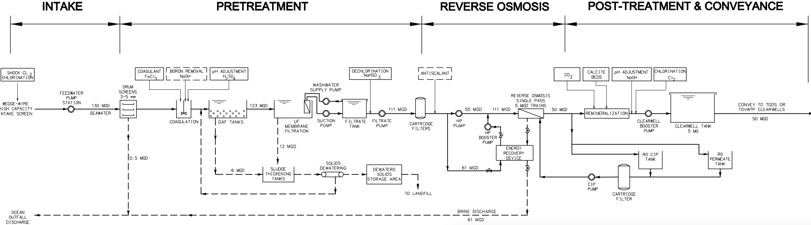
Plant Flow Diagram
Reference source: 12

Slide 61
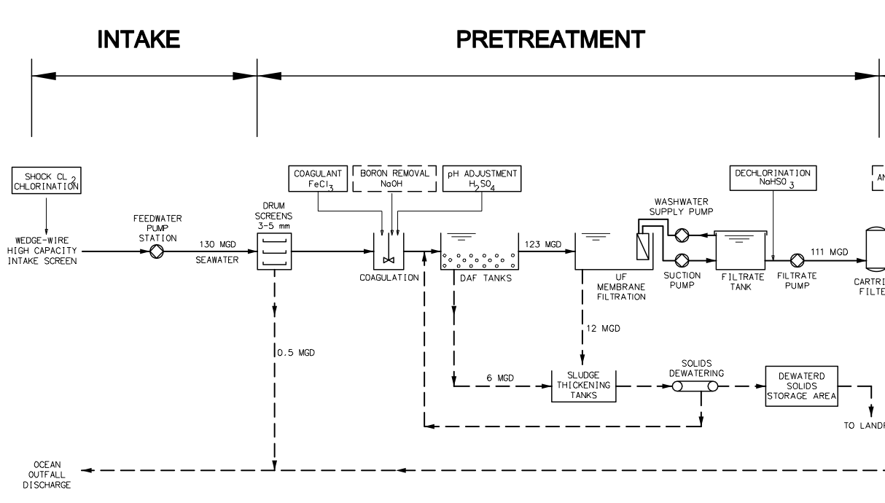
Intake and Pretreatment

Slide 62
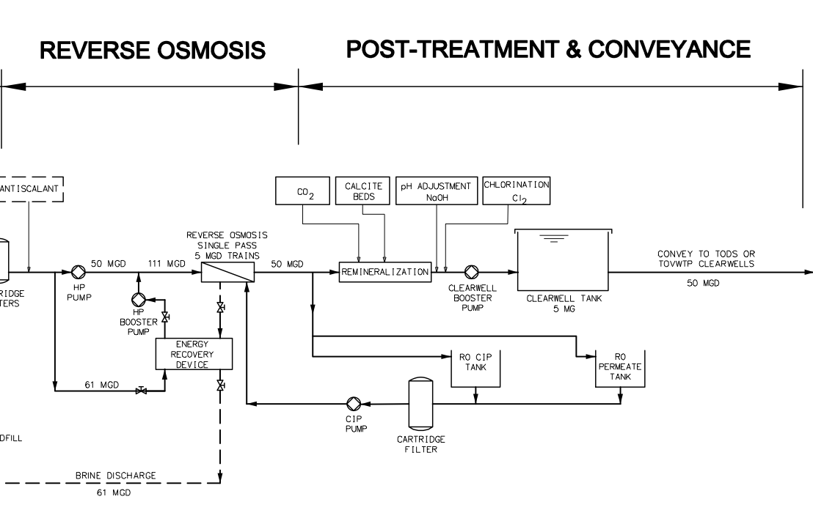
RO and Post Treatment

Slide 63
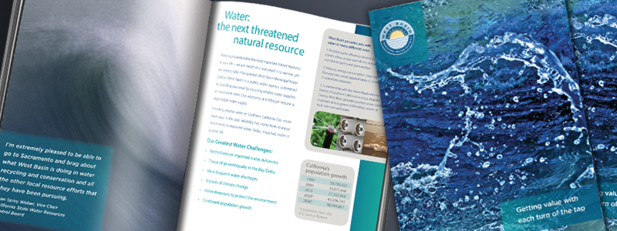
West Basin Desalination Plant
To reduce West Basin’s dependency
on imported water

Slide 64
Study on Desalination
West Basin has been testing the feasibility of ocean-water desalination since 2002.
The study was conducted at a pilot facility in
El Segundo.
Now operating a Demonstration Facility at the SEA Lab in Redondo Beach.

Slide 65
Desalination Pilot Study
It is an early step in the evaluation process that utilizes small- scale equipment to test for basic water quality and operating parameters as cost-efficiently as possible.
The Pilot Project includes micro-filtration and reverse osmosis components, and processes approximately 40 gallons per minute of ocean water.

Slide 66
Approximately 500 analytical tests are performed monthly. Data collected at the Pilot Project is being used in the development of the Demonstration Facility.

Slide 67
Desalination Demonstration Study
The Demonstration Facility will lay the foundation for West Basin's ultimate goal of supplementing the water-reliability portfolio with a full- scale desalination.
The objective is to conduct research to develop data for permitting, design, construction, and operation of West Basin's proposed full-scale desalination facility.

Slide 68
The plan is to utilize limited quantities of full-scale equipment to refine operating parameters and perform additional water quality testing.
The evaluation will involve environmentally-protective source intake methodologies and assessment of energy efficiency.

Slide 69
Intake technology
The system is comprised of:
8-inch pipe installed inside the existing concrete pipe.
Pipeline extends from a wet well to approximately 1,600 feet offshore.
A passive wedge wire screen at the seaward end of intake pipeline designed to minimize impingement and entrainment.

Slide 70
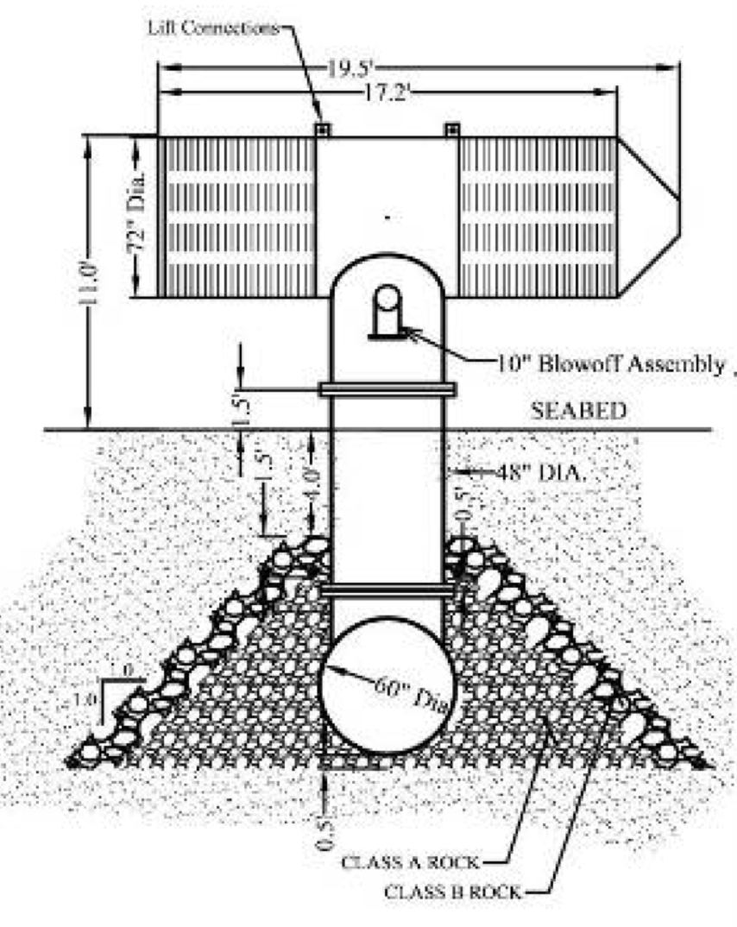
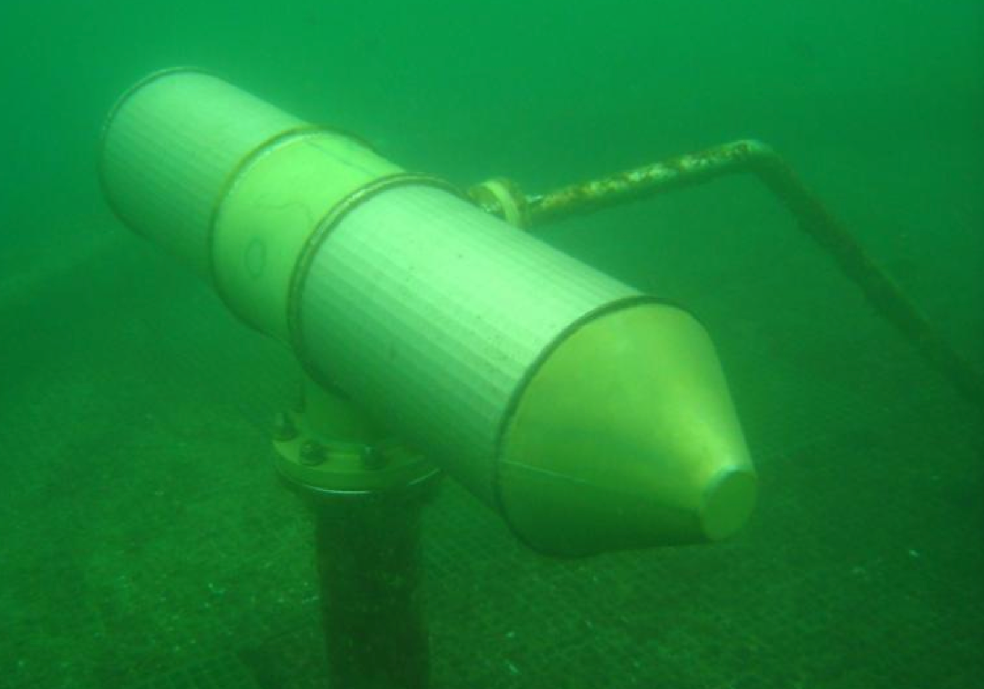
Wedge Wire Screen Schematic
Reference source: 13

Slide 71
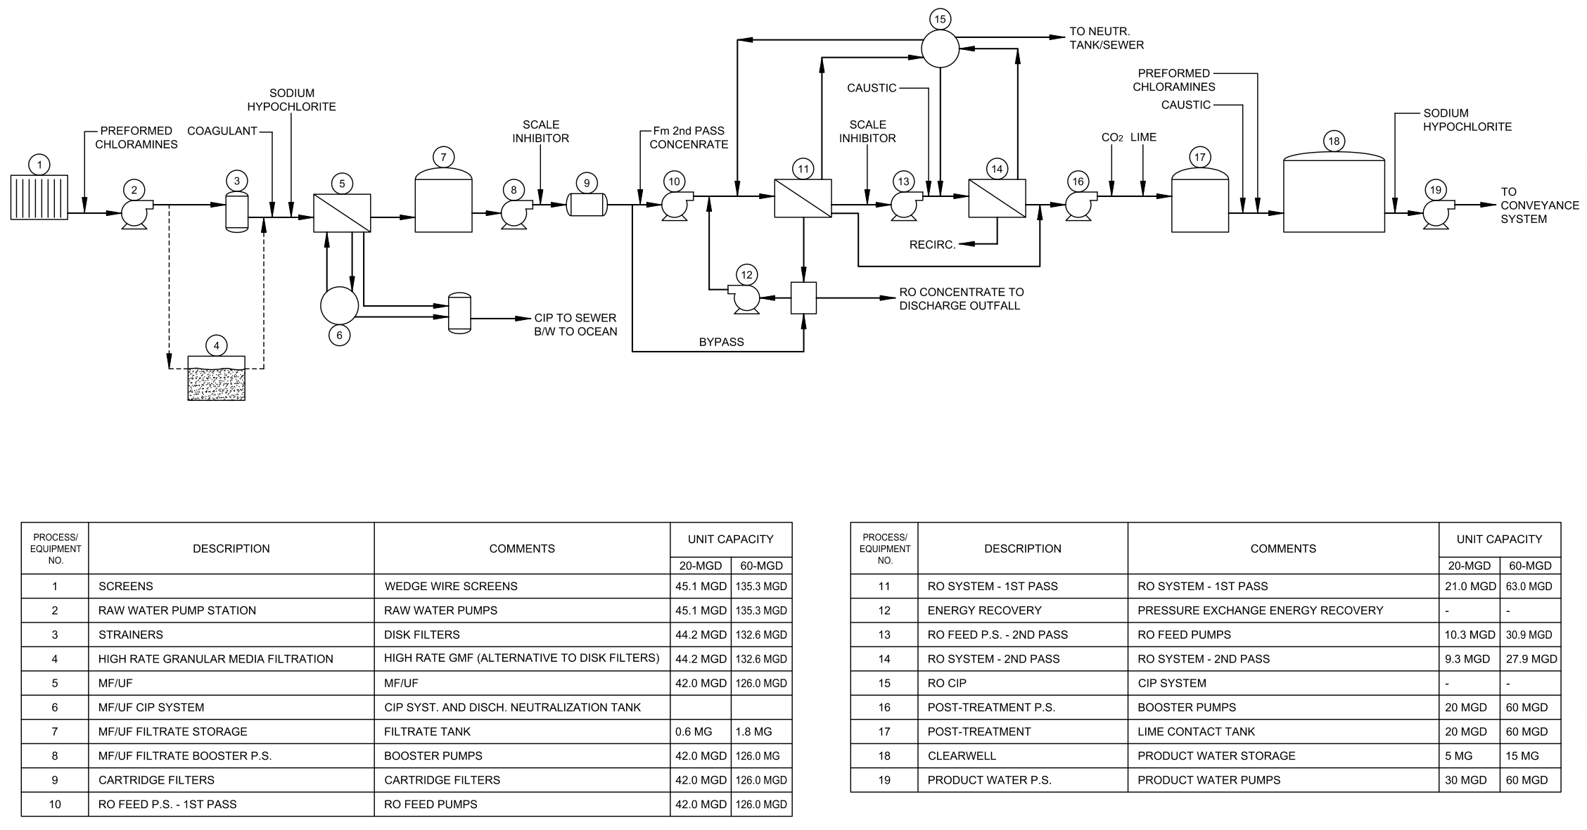
Plant Flow Diagram
Reference source: 13

Slide 72
Site Selection
Two candidate desalination plant sites (Segundo and Redondo Beach) were assessed and ranked using a standardized approach that considered several key performance factors:
(1) Technical Performance
(2) Economic Performance
(3) Environmental Performance
(4) Social Performance

Slide 73
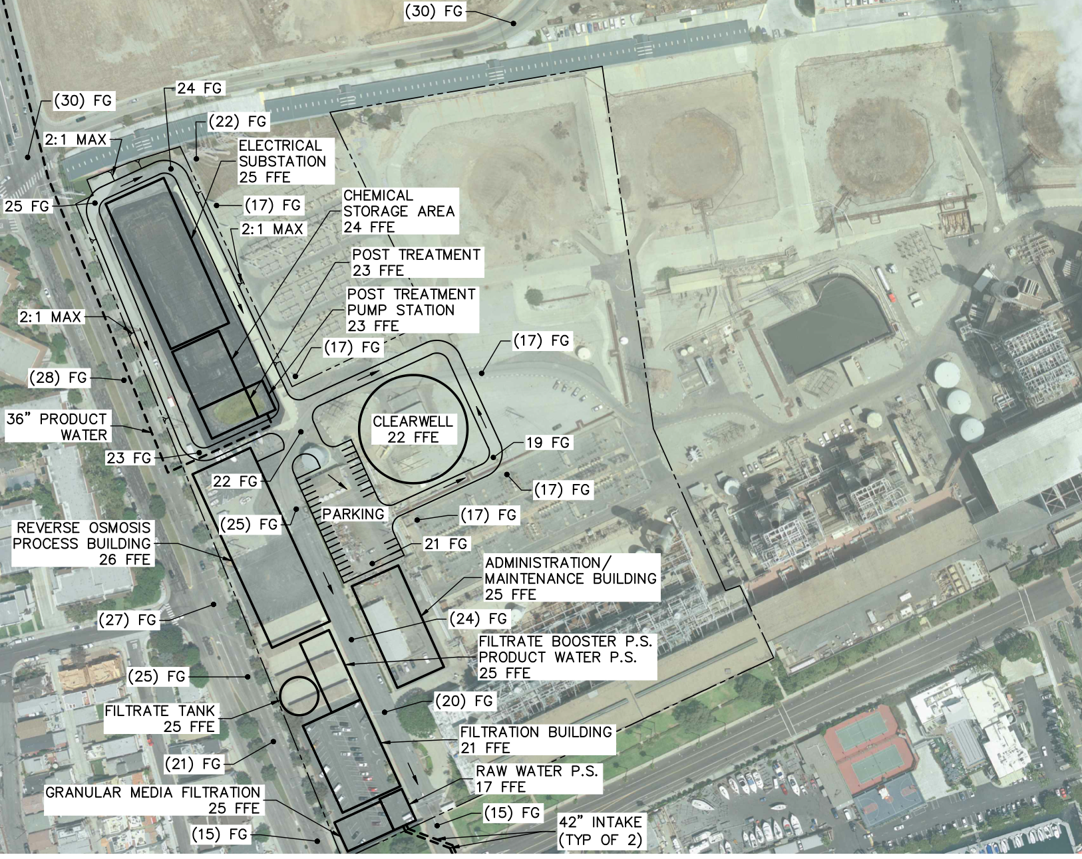
Preliminary Site Layout-Redondo
Reference source: 13

Slide 74
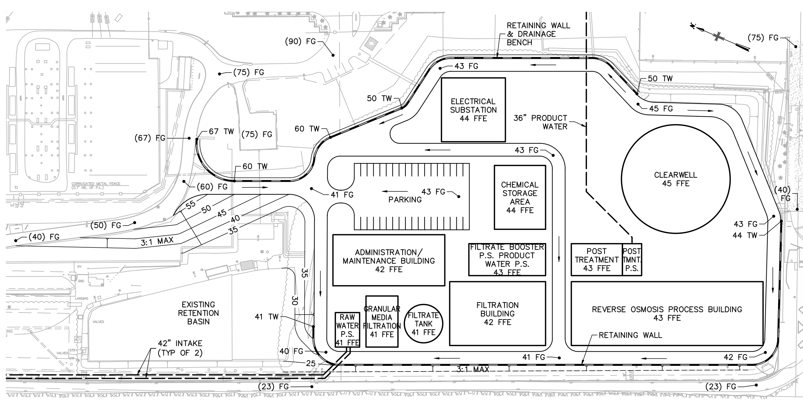
Preliminary Site Layout-Segundo
Reference source 13

Slide 75
Power Supply Options
Various power supply options were evaluated from both a legal and technical perspective.
(1) On-site power generation with conventional means
(2) On-site power generation by renewable resources
(3) Power supply directly purchased from SCE

Slide 76
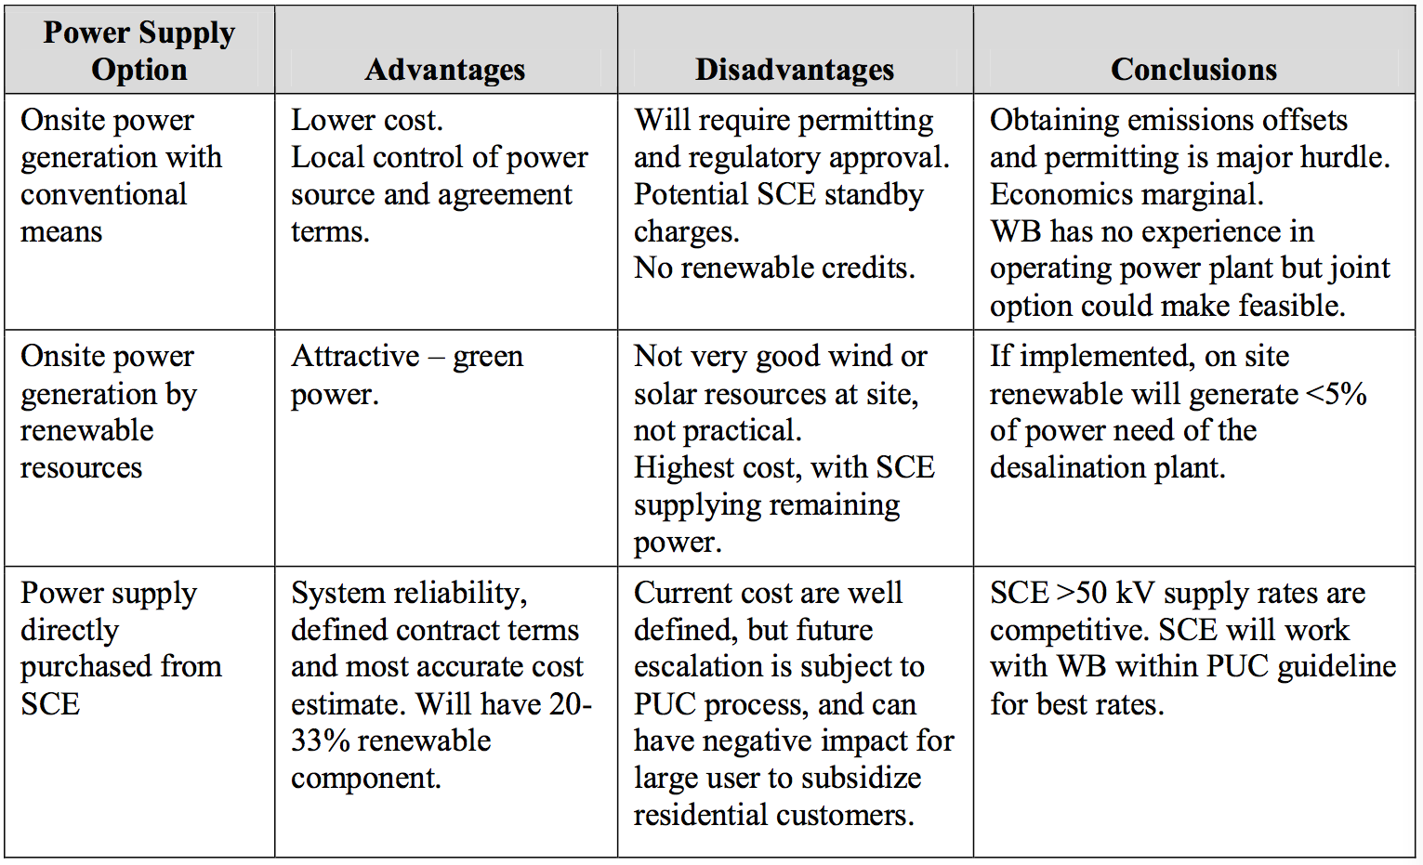
Power Supply Options Comparison

Slide 77
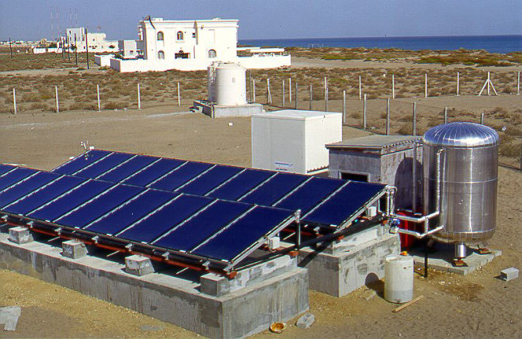
Desalination based on Renewable Energy
To provide a sustainable way to produce fresh water
by using renewable energy sources
Reference source: 14

Slide 78
Solar Thermal Desalination
• Solar thermal desalination is the desalination process via multi stage flash and multi effect distillation using solar heat as the energy input.
• These plants collect solar radiation and provide high-temperature heat for electricity generation. They can be associated with either membrane desalination units or thermal desalination units.

Slide 79
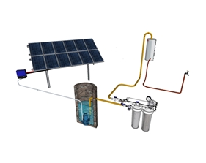
Photovoltaic Desalination
Photovoltaic technology can be connected directly to reverse osmosis or electrodialysis desalination processes.This technology produces electricity as the input energy.
• Saudi Arabia’s Research Agency, King Abdulaziz City for Science and Technology, built the world’s largest solar-powered (photovoltaic) desalination plant in the city of Al-Khafji. Completed in the end of 2012, the plant has been operating well, produce 30,000 cubic meters of desalinated water per day to meet the needs of 100,000 people.
Reference source: 15

Slide 80
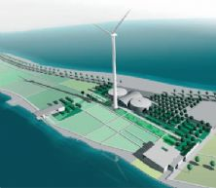
Wind Power Desalination
Using electrical and mechanical power generated by a wind turbine to power desalination plants, notably reverse osmosis and vapor compression distillation processes.
• The Kwinana Desalination
plant, is the first wind power
desalination plant in Australia
and covers several acres in an
industrial park near the suburb
of Kwinana. No information was
found regarding the plant working
Efficiency.
Reference source: 16

Slide 81
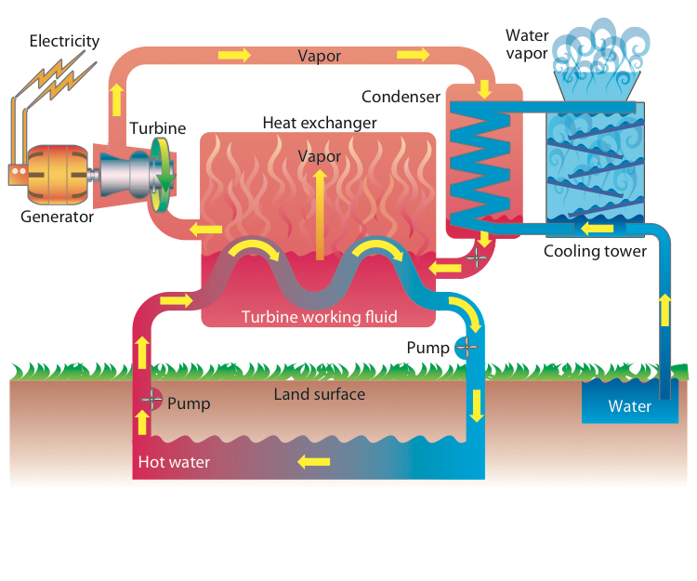
Geothermal Desalination
As geothermal energy can produce electricity and heat, it can be integrated with both thermal and membrane desalination technologies.
• A project on Milos Island, Greece, has proposed a geothermal desalination system to produce 1,920 m³/d of water. This can benefit the local community by producing desalinated water at a very low cost. However, the exploitation of geothermal energy very much depends on the specific local conditions.
Reference source: 17

Slide 82
Discussion
Desalination based on the use of renewable energy sources can provide a sustainable way to produce fresh water with low energy cost. It is expected to become economically attractive as the costs of renewable technologies continue to decline and the prices of fossil fuels continue to increase.

Slide 83
Furthermore, energy supplies in traditional desalination processes are usually from burning of fossil fuels, which release large amount of carbon dioxide, causing global warming. In this context, application of renewable energy will help reduce the use of fossil fuels and significantly lower carbon dioxide emission.

Slide 84
Reference
1. http://puretecwater.com/what-is-reverse-osmosis.html
2. http://www.nytimes.com/2013/03/01/business/energy-environment/a-costly-california-desalination-plant-bets-on-future-affordability.html?pagewanted=all&_r=0
3. http://carlsbaddesal.com/eir
4. http://en.wikipedia.org/wiki/Salinity
5. http://www.nbcnews.com/storyline/california-drought/parched-california-pours-mega-millions-desalination-tech-n28066
6. http://poseidonwater.com/our_projects/all_projects/huntington_beach_project
7. http://www.ocwd.com/Portals/0/ProgramsProjects/Explore%20Desal/PoseidonResourcesHuntingtonBeachOceanDesalinationProjectInformationAndUpdate.pdf
8. http://www.watereuse.org/files/s/Cesar_Lopez_1.pdf
9. http://www.sdcwa.org/sites/default/files/files/water-management/desal/ExecSummary_desal-study_Dec09.pdf
10. http://www.westbasin.org/files/final-desal-master-plan/executive-summary.pdf

Slide 85
11. http://www.westbasin.org/files/desal-reports-and-research/west-basin-ie-report-final-081314-.pdf
12. Al-Karaghouli, A.A. et al., 2011, Renewable Energy Opportunities in Wa- ter Desalination, Desalination, Trends and Technologies, Michael Schorr (Ed.), ISBN: 978-953-307-311-8, InTech.
13. Al-Karaghouli, A.A. et al., 2009, Solar and wind for water desalination in the Arab regions, Renewable and Sustainable Energy Reviews 13 (2009) 2397–2407.
14. http://poseidonwater.com/
15. http://www.westbasin.org/water-reliability-2020/ocean-water-desalination/overview
16. http://www.westbasin.org/water-reliability-2020/ocean-water-desalination/west-basins-approach
17. http://www.westbasin.org/water-reliability-2020/ocean-water-desalination/reports-research
18. http://www.westbasin.org/water-reliability-2020/ocean-water-desalination/demonstration-facility
19. http://www.santabarbaraca.gov/gov/depts/pw/resources/system/sources/desalination.asp
20. http://www.carlsbadca.gov/

Slide 86
21. http://carlsbaddesal.com/
22. http://carlsbaddesal.com/project-overview
23. http://carlsbaddesal.com/construction-updates
24. http://carlsbaddesal.com/public-outreach
25. http://poseidonwater.com/our_projects/all_projects/huntington_beach_project
26.http://wle.cgiar.org/blogs/2013/05/23/desalination-using-renewable-energy-is-it-the-answer-to-water-scarcity/
27. http://www.worldfutureenergysummit.com/Portal/exhibitors/products/as-technology-srl/pv-desalination-solutions.aspx
28.https://www.google.com/search?q=Geothermal+Desalination&oq=Geothermal+Desalination&aqs=chrome.69i57j0l5.413j0j1&sourceid=chrome&es_sm=91&ie=UTF-8

