Slide 1
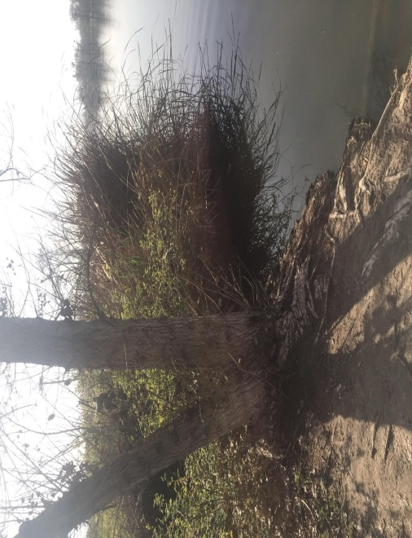
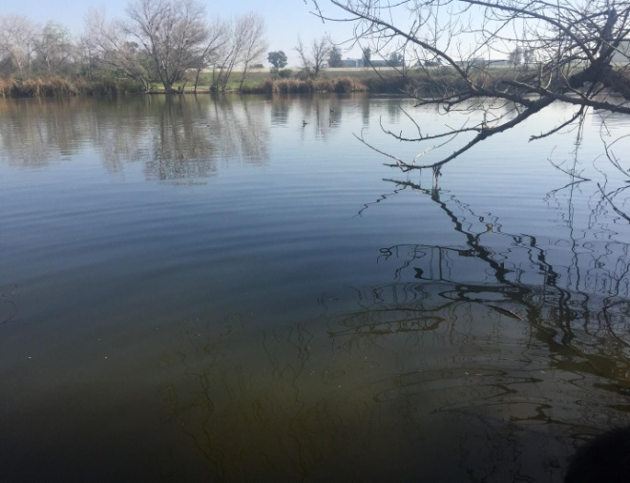
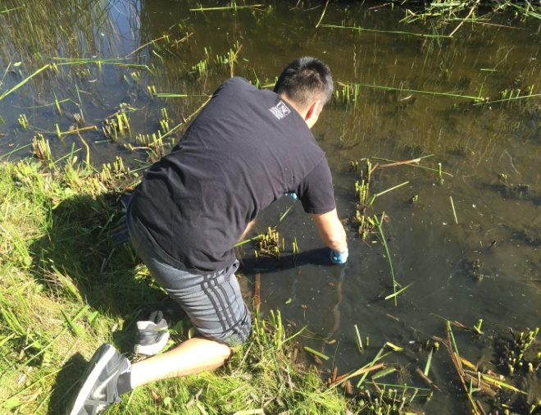
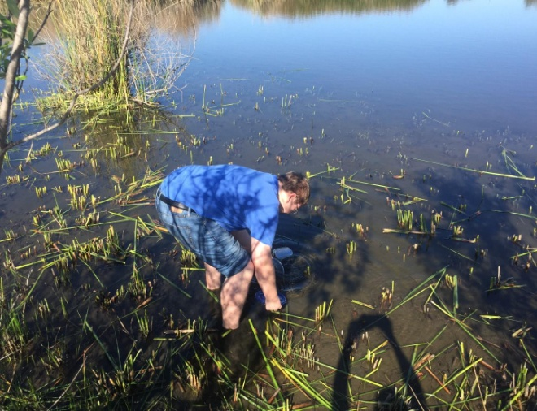
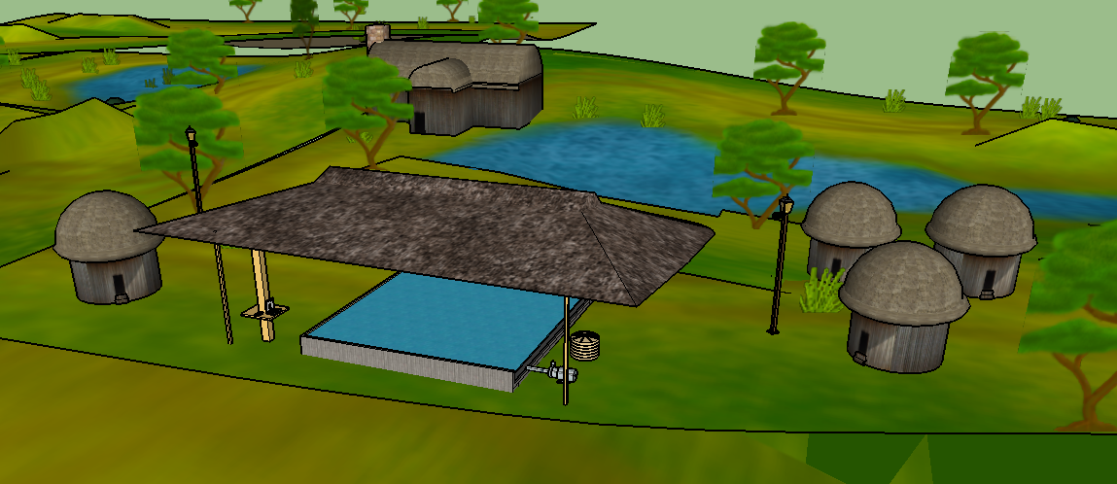
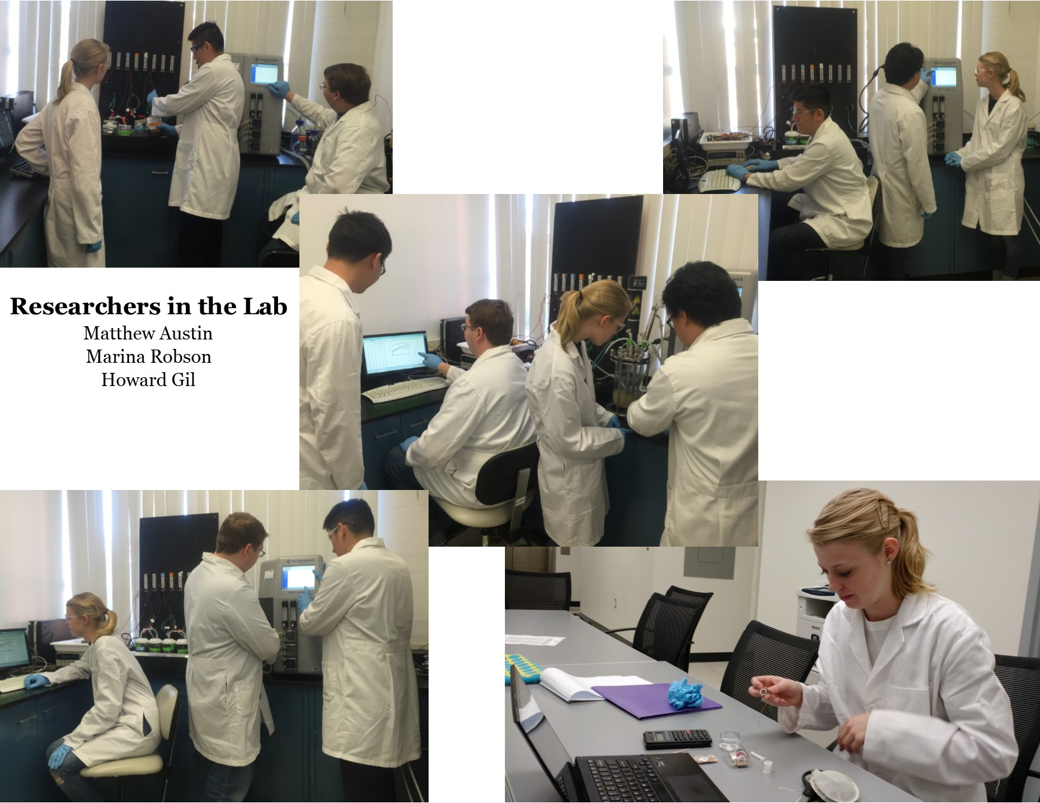
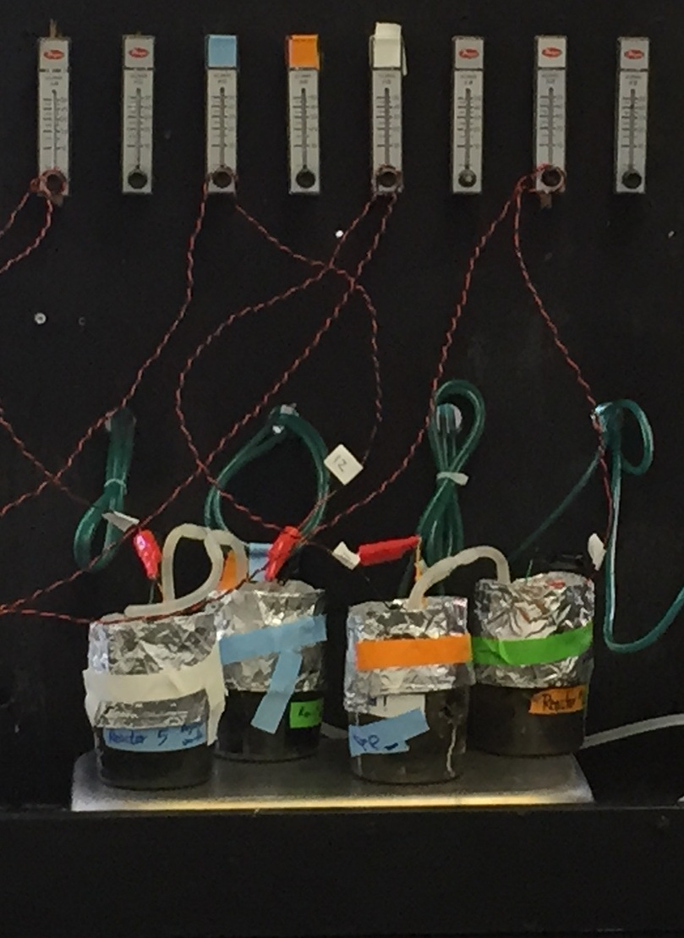
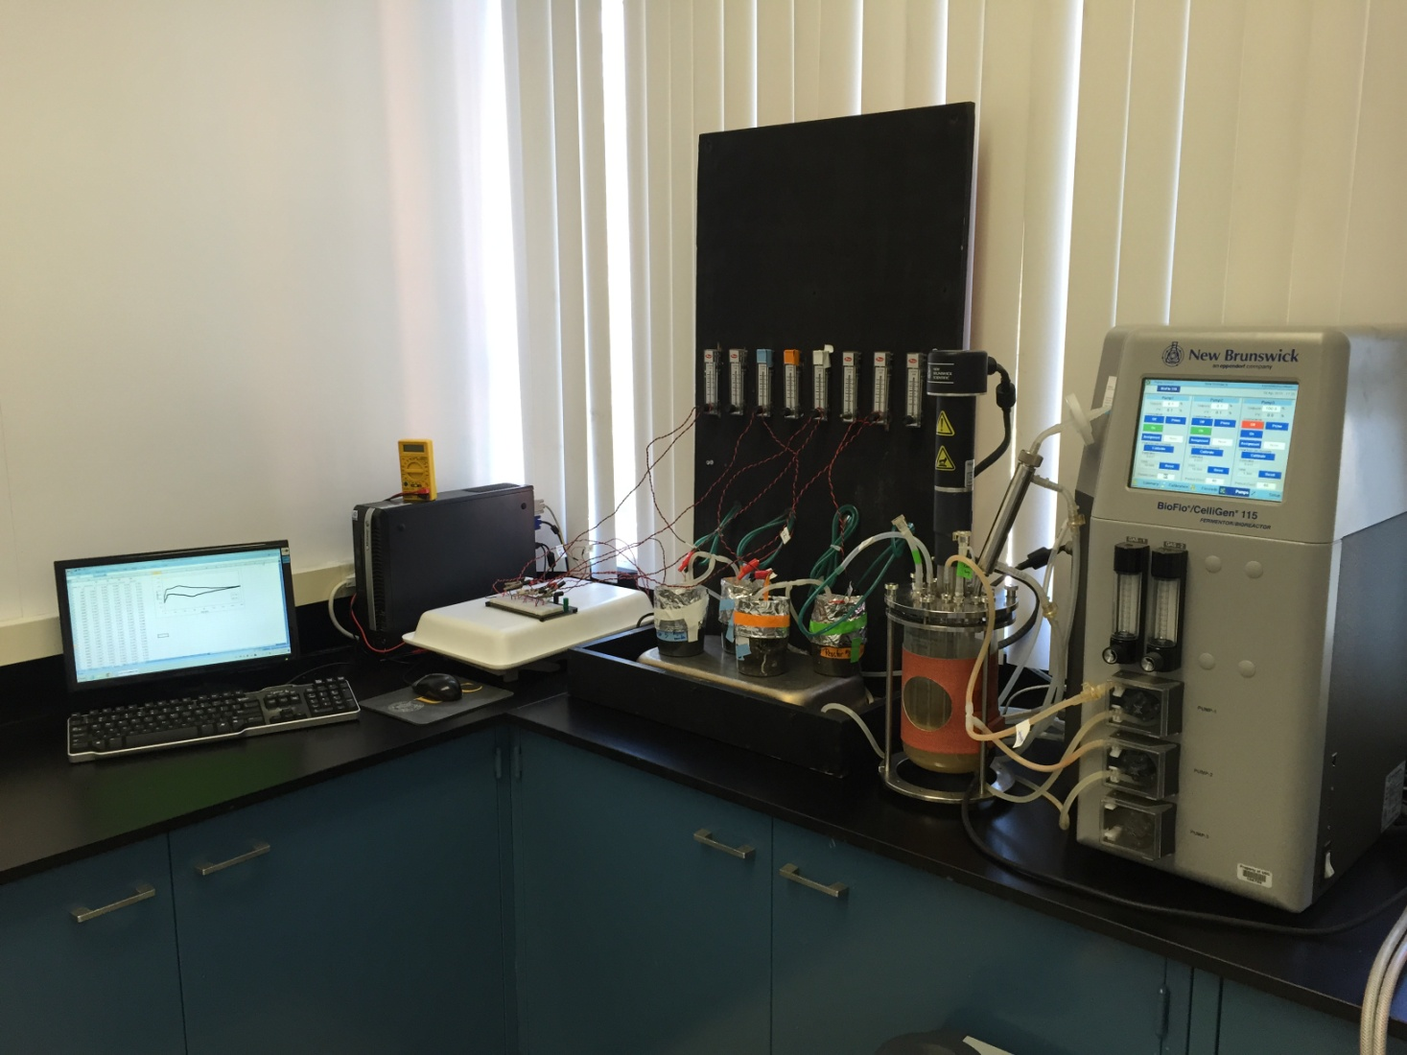
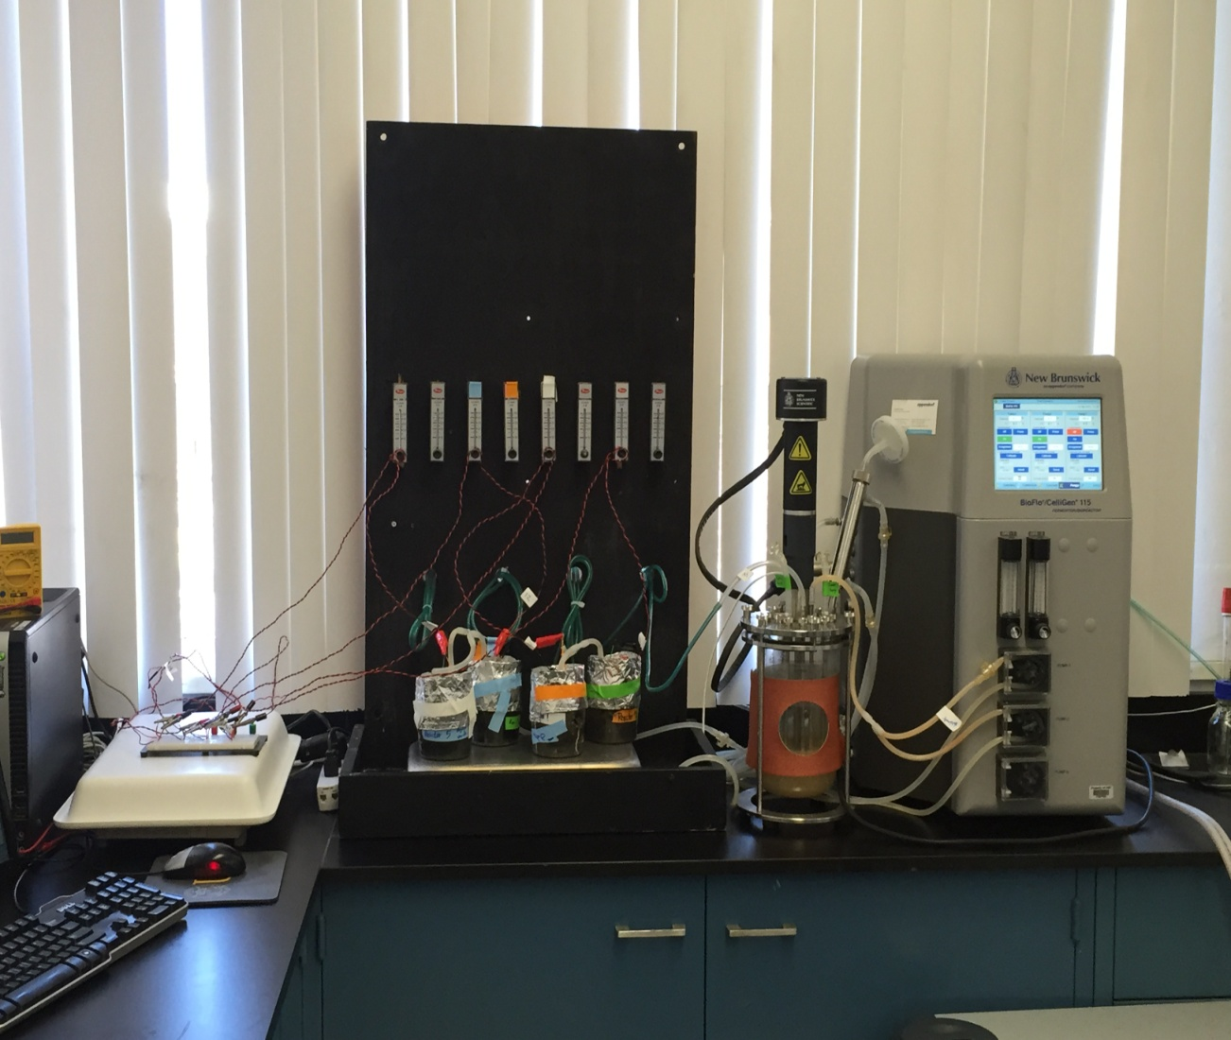
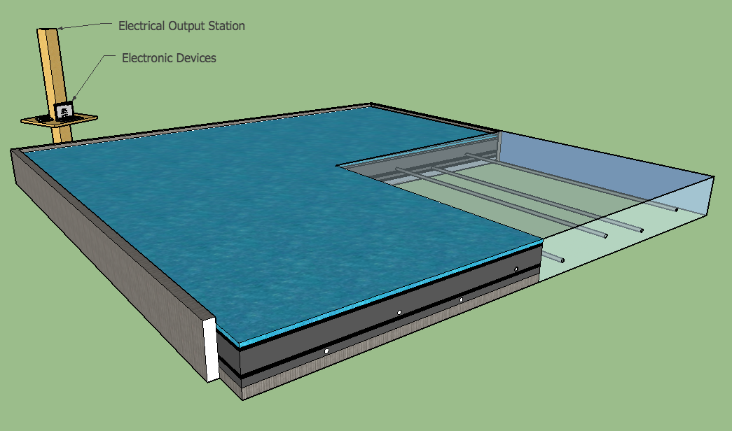


University of Southern California, Undergraduate Symposium for Scholarly and Creative Work, April 15, 2015
Sustainable Power Generation Using Integrated “Wetland Sediment” and “Microbial Fuel Bioreactor” Technology
Undergraduate Research Students: Marina Robson (Viterbi CEE), Howard Gil (Viterbi CEE), and Matthew Austin (Viterbi CHE)
Supervising Research Student: Woonhoe Kim, Ph.D. Candidate
Graduate Research Student: Xinyuan Zheng
Faculty Advisor: Professor Massoud Pirbazari
Sonny Astani Department of Civil and Environmental Engineering
Viterbi School of Engineering
Introduction/Background
Many people in developing nations do not have access
to electricity.
As interest in transitioning from fossil fuels to renewable energy grows, many of the current renewable energy options yield pollution by-products or are very expensive to install and maintain, making them undesirable for
implementation in developing countries.
The wetland sediment fuel bioreactor is a “low-cost and low-maintenance” system that can be deployed in any area where wetland sediments are available, such as the
Democratic Republic of Congo.
Discussion
The type of microbial inocula was found to have strong
influence on the power generation.
Activated carbon addition to anode electrode
significantly increased the power output.
It was found that the continuous addition of electron source and nutrients could produce steady power
generation.
It was observed that all four sediments contain
indigenous electrogenic bacteria.
Pump
Nitrogen gas purging
Results
Air
Nutrient solution
Sediment type and characteristics
Water
O₂
H₂O
System controller &
data collector
Sediment | Wetland Location | Color | Smell | pH | Nitrogen | Phosphorous | Potassium
No. 1 | Sepulveda Basin Wildlife Refuge, Haskell Creek, Location 1 | Light grey | Earthy/ neutral | 7.0 - 7.5 | Depleted | Surplus | Sufficient
No. 2 | Sepulveda Basin Wildlife Refuge, Haskell Creek, Location 2 | Light grey | Earthy/ neutral | 7.0 - 7.5 | Depleted | Deficient | Sufficient
No. 3 | Ballona Wetlands Marsh, Location 1 | Dark grey/ Brownish | Strongly sulfurous/ stinky | 7.2 | Depleted | Deficient | Surplus
No. 4 | Ballona Wetlands Marsh, Location 2 | Dark grey/ Brownish | Faintly sulfurous/ stinky | 7.6 | Depleted | Surplus | Surplus
Sediment
Cathode
Electronic device
charger
H⁺
e⁻
Digital multimeter
(Voltage monitor)
Nutrients
_{(C, N, P, Fe, etc.)}
CO₂
LED
light bulb
H⁺
e⁻
Bacteria
Breadboard
Future Work
Design and construction of laboratory-scale wetland sediment microbial fuel bioreactor (WS-MFB) systems (30 cm x 30 cm) inoculated with appropriate bacterial
species
Optimize the WS-MFB system for maximum power generation by employing suitable electrode materials
and appropriate supply of nutrients
Upscale and design of a large WS-MFB (20 m x 20 m) to be installed in “Tumba-Ngiri Maindombe” wetland (the largest wetland of international importance), located in Democratic Republic of Congo, Africa, to generate sustainable power for variety of applications, including space lighting as well as charging battery units in cell phones and laptop computers. To accomplish this goal,
we need to pursue the following:
i) identify and collaborate with NGOs that would be interested in sponsoring the implementation of WS-
MFB in developing nations
ii) encourage the participation of local people from
villages (school children, young adults, etc.)
iii) employ local people for maintenance and upkeep of
the system
Organic carbon
from sediment
Anode
e⁻
Research Objectives
To assess the potential of wetland sediment microbial fuel bioreactor (WS-MFB) as a source of sustainable energy production, especially in areas where power is not
readily available
To study the factors governing the system power output
To encourage wetland preservation and sustainability
Schematic diagram of
wetland sediment microbial fuel bioreactor (WS-MFB) system
Sediment #1
Sediment #2
Description of Wetland Sediment Microbial Fuel Bioreactor System
The WS-MFB is essentially an electrochemical cell that generates electrical current across the sediment-water interface. The voltage is determined by difference in redox potential between two electrodes. Anode is placed in anoxic environment and cathode in oxic environment. Power generation depends on the availability of nutrients within the anodic media. The electrons released at the anode travel along a conducting wire to the cathode, creating a voltage through the system that can be harnessed to power a wide range of devices.
Comparison of power generation between:
  Anode electrode with E.coli
  Anode electrode without E.coli
Comparison of power generation between:
  Addition of activated carbon to anode electrode
  No addition
Sediment #3
Sediment #4
Comparison of power generation between:
  Graphite anode electrode
  Activated carbon electrode
Comparison of power generation between two inocula:
  Anode electrode with Geobacter
  Anode electrode with Shewanella
Researchers in the Lab
Marina Robson
Howard Gil
Matthew Austin
Experimental Setup
Legend
Water layer
Cathode electrode
Sediment layer
Anode electrode
Nutrient delivery pipes
A
Acknowledgement
We would like to extend our appreciation to Professor Kenneth Nealson for providing different microbial species for this project. We would also like to thank Dr. Varadarajan Ravindran for his assistance in this research study. We would like to acknowledge the USC WiSE program for awarding Marina Robson with the WiSE Fellowship for
Undergraduate Research.
E
Wetland Sediment Microbial Fuel Bioreactor “WS-MFB” System considered for implemetation in “Tumba-Ngiri Maindombe” Wetland in the Democratic Republic of Congo
C
D
B

