Slide 1
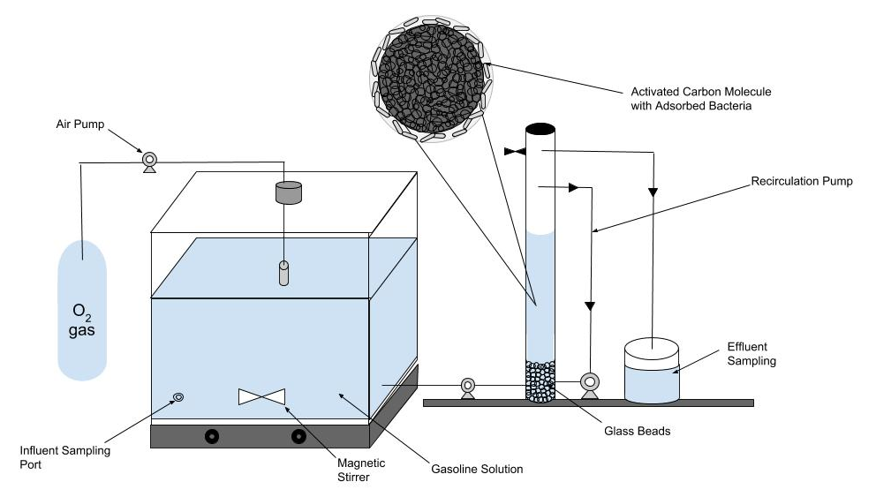
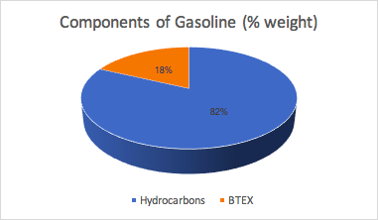
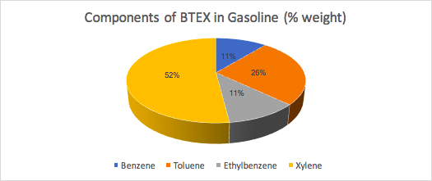
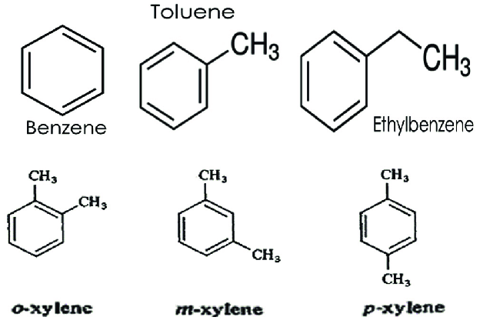
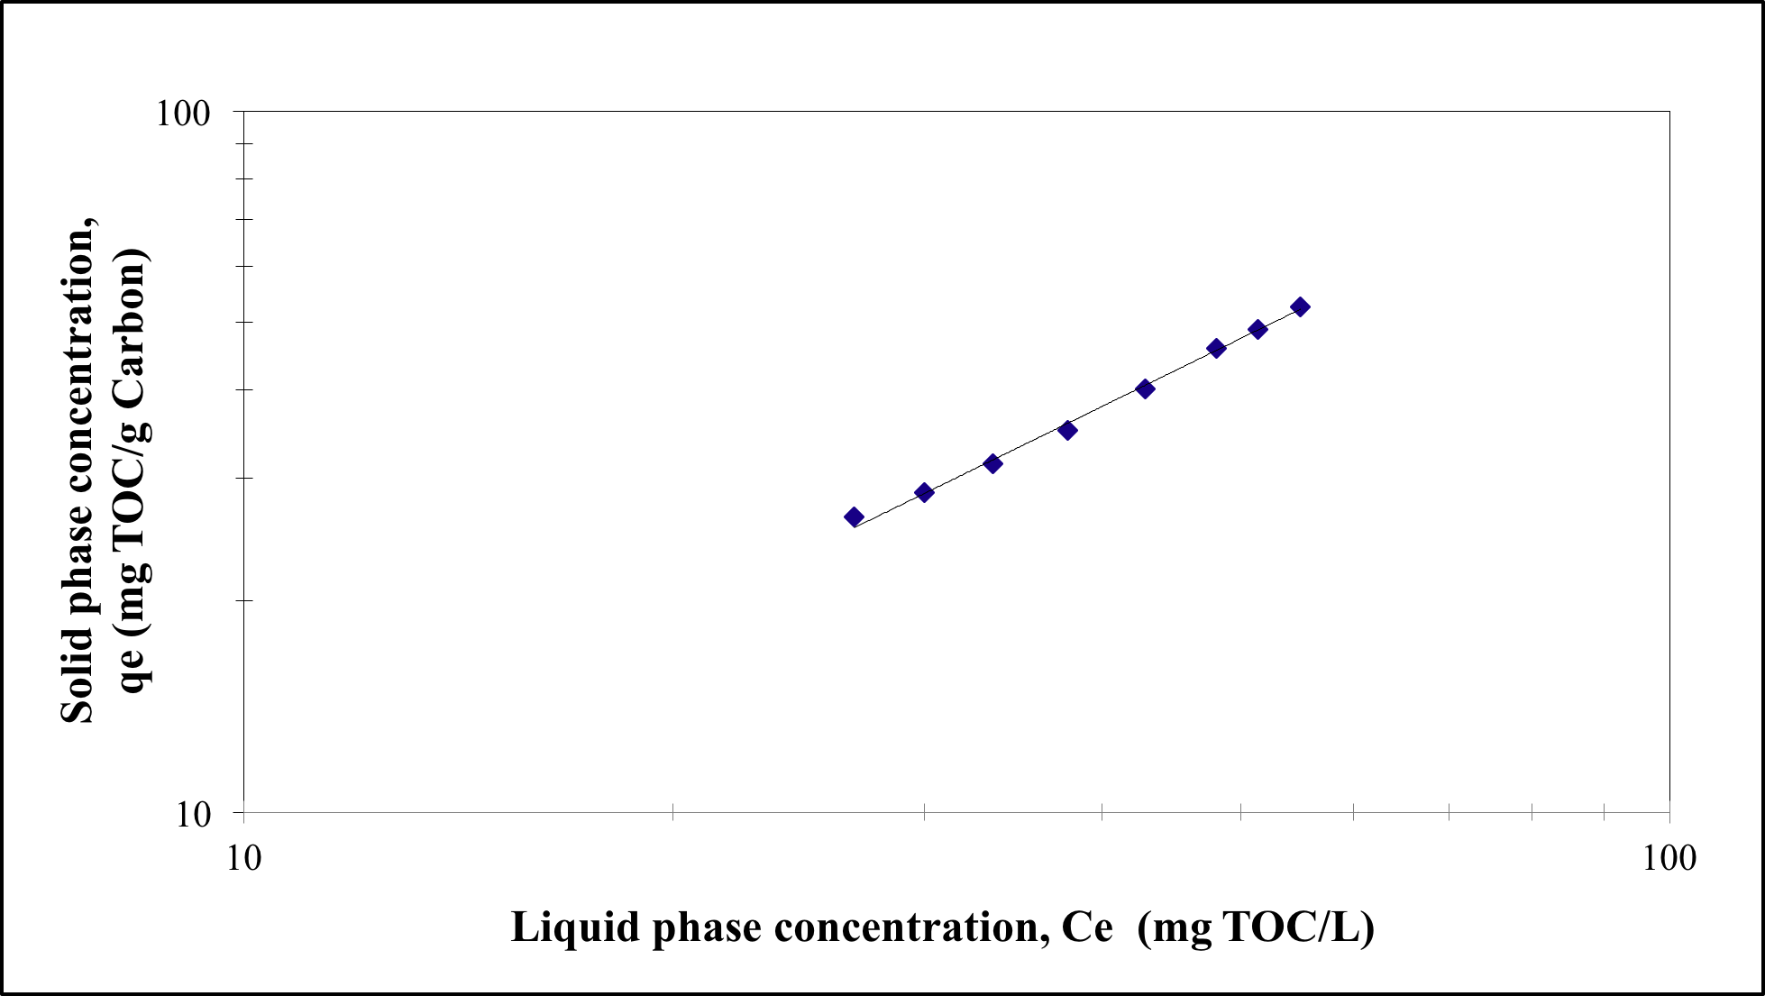
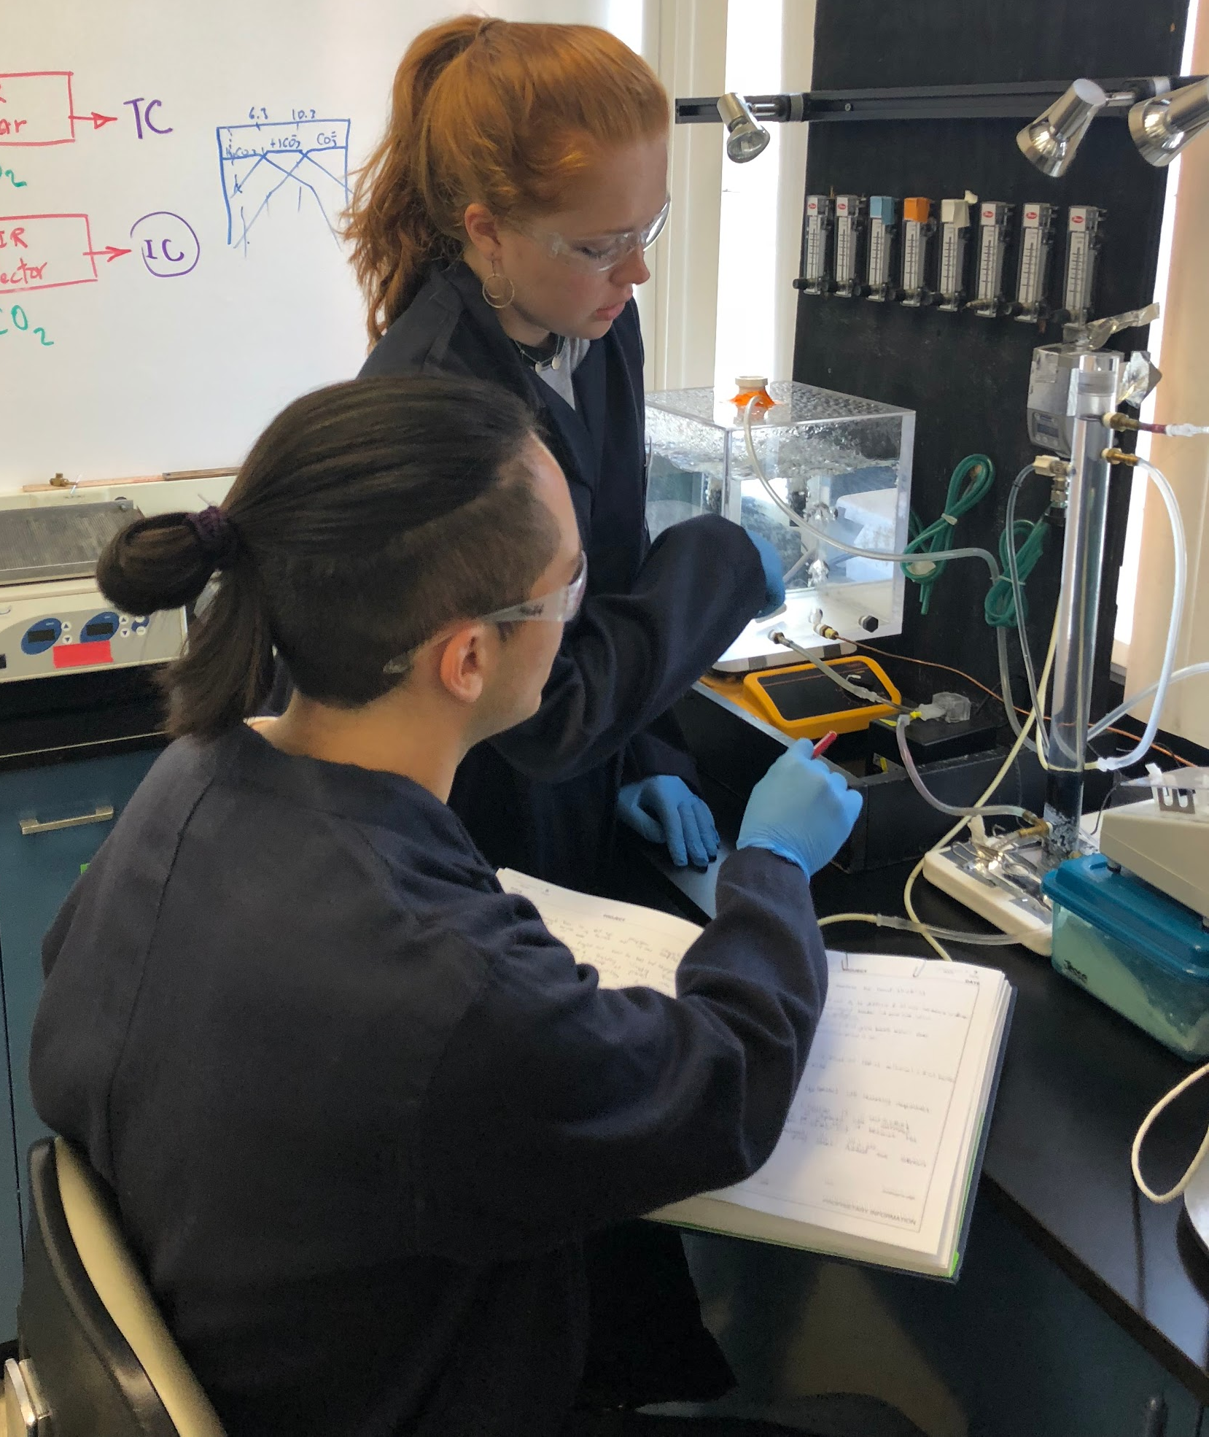
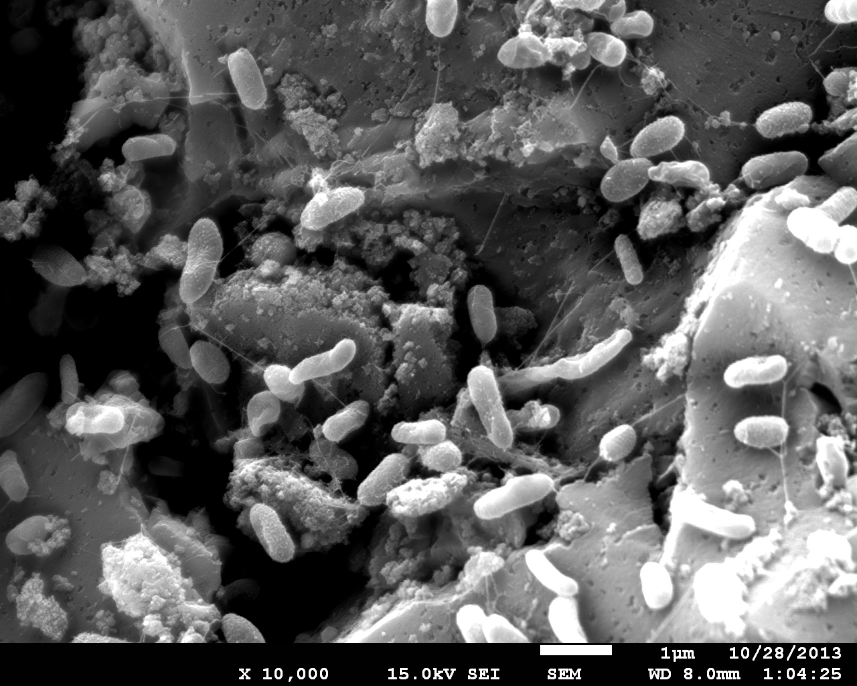
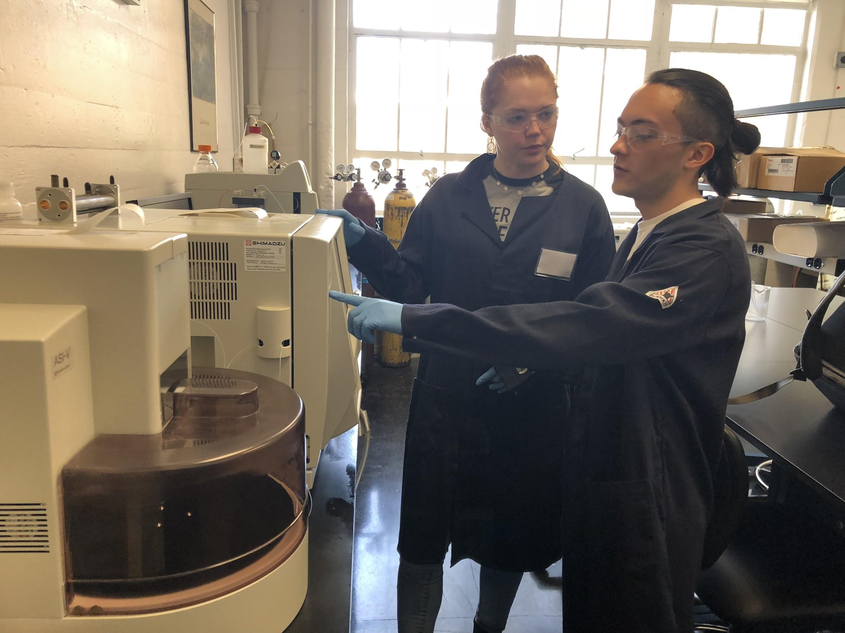
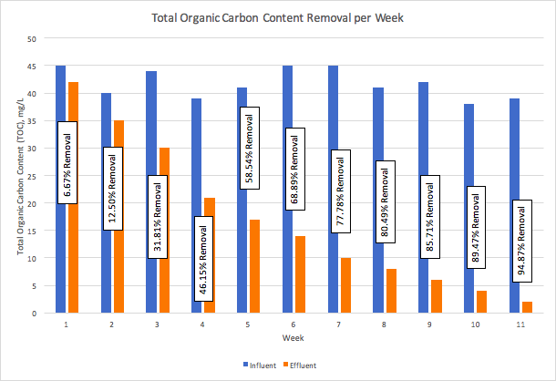
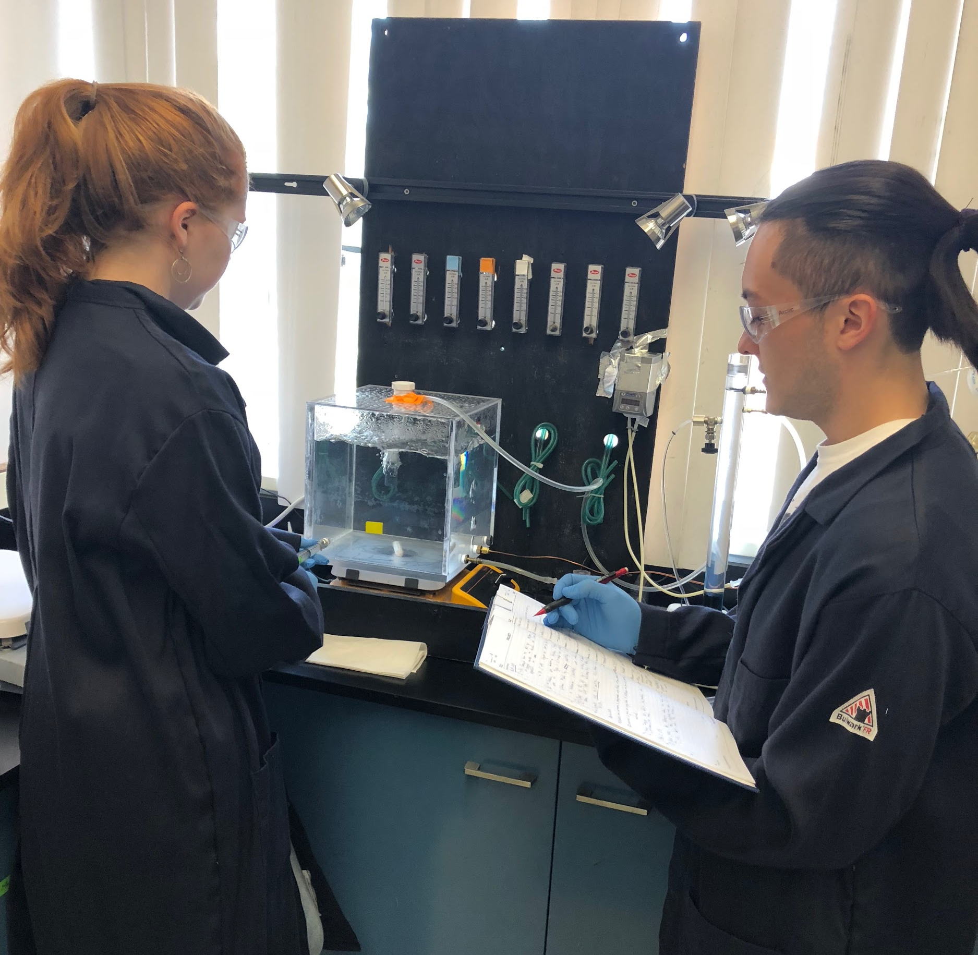
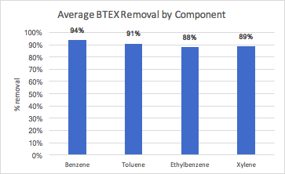
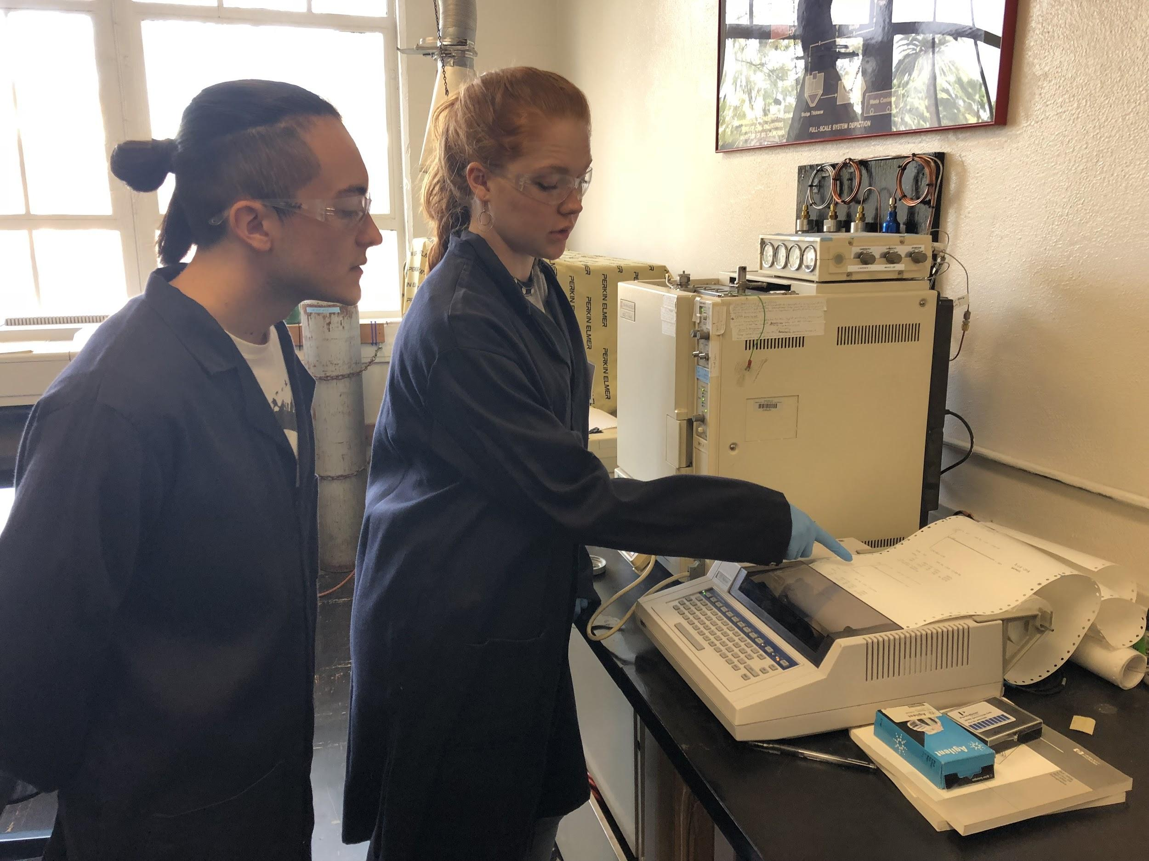
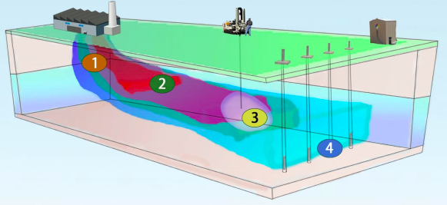
University of Southern California, Undergraduate Symposium for Scholarly and Creative Work, April 11, 2018
Evaluating the Performance of Bio-adsorber Technology in the Removal of Gasoline and its Toxic and Carcinogenic Components from Groundwater
Category: Physical Sciences and Engineering
Undergraduate Research Students: Juan Rincon (ISE) and Juliana Tichota (ChE)
Research Objectives
Faculty Advisor: Professor Massoud Pirbazari (CEE)
Viterbi School of Engineering, University of Southern California
Results and Discussion
This research aimed to determine the viability and efficiency of fluidized-bed bioadsorber reactor in removing toxic and carcinogenic compounds from water. The proposed method, bioactive carbon filtration (BCF), was used to successfully treat groundwater containing gasoline and its harmful BTEX components.
Effective removal of gasoline hydrocarbons including the BTEX components was demonstrated to be the result of adsorption and microbial degradation.
The system requires less frequent carbon regeneration due to microbial degradation.
The FBAR recirculation pattern holds the bacterial enzymes in the system for a far longer period and this results in more effective degradation.
The technology is significantly less expensive than other alternatives.
Experimental Methods
Microorganisms’ activity is generally enhanced at surfaces where nutrients concentrate. The holding of adsorbed substrate(s) and organisms on close proximity on a surface may provide sufficient time to allow microbial acclimation and induction of enzymes necessary to metabolize otherwise “resistant” compounds. Bacteria attach to solid surfaces through biosynthesis and secretion of polymeric adhesives that provide for firm and irreversible attachment. The microbial inoculum for these experiments was obtained from an activated sludge process of a wastewater treatment plant The bacteria were acclimated to the gasoline components for nearly six weeks.
Gasoline as a Contaminant
391.73 million gallons of gasoline are consumed daily in the United States
Gasoline is a fuel made up of multiple hydrocarbons and four main aromatic component toxins: benzene, toluene, ethylbenzene, and 3 isomers of xylene (BTEX).
BTEX makes up an average of 18% of gasoline by weight, 32.7% by mole
Fluidized Bio-adsorber with Recycle (FBAR)
Future Work
A bench-scale FBAR was employed in these experiments. The column (2.5 cm ID and 30 cm height) was constructed of plexiglass. Bacteria were obtained from an activated sludge treatment plant and acclimated to gasoline solution for several weeks. The GAC particles were subsequently coated with the acclimated bacteria and placed in the adsorber column. As can be observed in Figure 3, the efficiency of the FBAR system in removing gasoline components is quite satisfactory (> 94%). Similarly, as depicted in Figure 4, the FBAR system was found to remove substantial amounts of BTEX toxins: benzene (94%), toluene (91%), ethylbenzene (88%), and xylene (89%).
Conduct FBAR column experiments using different gasoline solution concentrations and different flow rates
Conduct chemostat studies to determine the biological parameters
Test and evaluate the capability of FBAR predicitice design model for performance evaluation
BTEX: Risks and Effects
Acknowledgements
BTEX: Benzene, Toluene, Ethylbenzene, and 3 isomers of xylene.
Benzene is the only known carcinogen of the 4 components. Toluene exposure causes long term liver, kidney, immune system, and brain damage.
BTEXs are polar alkylbenzenes and are therefore very soluble in water
The US EPA maximum contaminant level (MCL) for benzene in drinking water is 5 𝜇g/L. US Public Health Services recommend <2 mg/L toluene in drinking water.
Common causes of BTEX groundwater and soil contamination include gasoline, diesel fuel, heating/lubricating oil spills or leaks from any kind of industrial tank
BTEX can enter the body through:
Consumption of contaminated water
Bathing in contaminated water
Inhalation of contaminated water vapors
Consumption of crops contaminated by contaminated water
Figure 1. Schematic of the Bioactive Carbon filtration (BCF) method used in this study
Results
Funding for this project was mainly provided by the Provost Undergraduate Research Associates Program, University of Southern California. Also, this project was partly supported by Viterbi Merit Research Scholar Program. We would like to extend our appreciation to Dr. Varadarajan (Raj) Ravindran for his valuable suggestions.
Absorption Isotherm Experiments: Activated carbon adsorption capacity was determined by conducting completely mixed batch (CMB) reactor studies. The Freundlich Model (q_{e} = K_{f} C_{e}^{n}) described the adsorption data successfully (Figure 2).
Scanning Electron Microscopy: Scanning electron microscopy (SEM) was used to observe the biofilm morphology and extent of bacteria coverage on activated carbon particles. Random carbon particles were taken from the adsorber column and prepared for SEM observation. Figure 4 shows a typical biofilm growth on activated carbon particle.
Ground Water
Figure 2: Experimental data and Freundlich adsorption model for gasoline chemical components
Though nearly half the US population relies on groundwater for domestic use, few sources are clean enough for direct potable use.
Primary “risky” contaminants: organic/inorganic chemicals, toxic metals, radionuclides
Ground water quality are impacted in 4 general ways: natural processes, agricultural or urban runoff, waste disposal processes, and spills or leaks.
Figure 4: Scanning Electron Micrograph of biological growth on activated carbon particle
Contamination and Pump-and Treat Processes Diagram
Figure 3. Comparison of Total Organic Carbon Content Levels Before and After Filtration through the BCF System Over 11 Weeks
Figure 5. Removal of Individual BTEX Component Levels by the BCF System After 11 Weeks

