Slide 1
Stormwater BMPs for Industries
“A Holistic Approach to LA River Revitalization Program”
ENE510 - Water Quality Management and Practice
Students: Wanxin Cai, Pooja Sinha, Luyue Zhang, Atosa Vahdati,
Honghong Li, Wenyu Li, Yudu Guo, Qiao Zhou, Xiaoshuang Zheng,and Xueyao Zhang
Supervisor: Professor Massoud (Mike) Pirbazari
August 2019

Slide 2
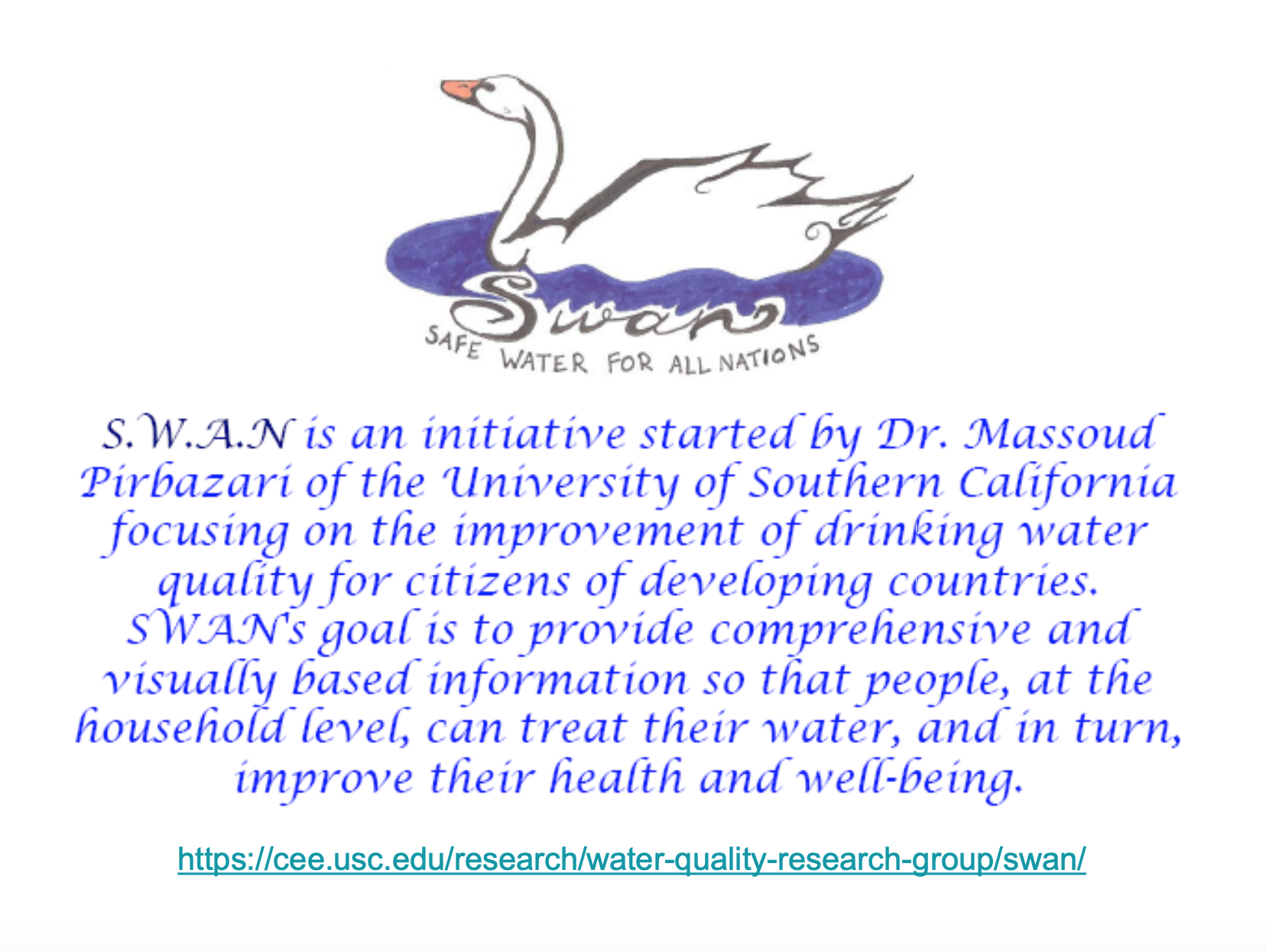
https://cee.usc.edu/research/water-quality-research-group/swan/

Slide 3
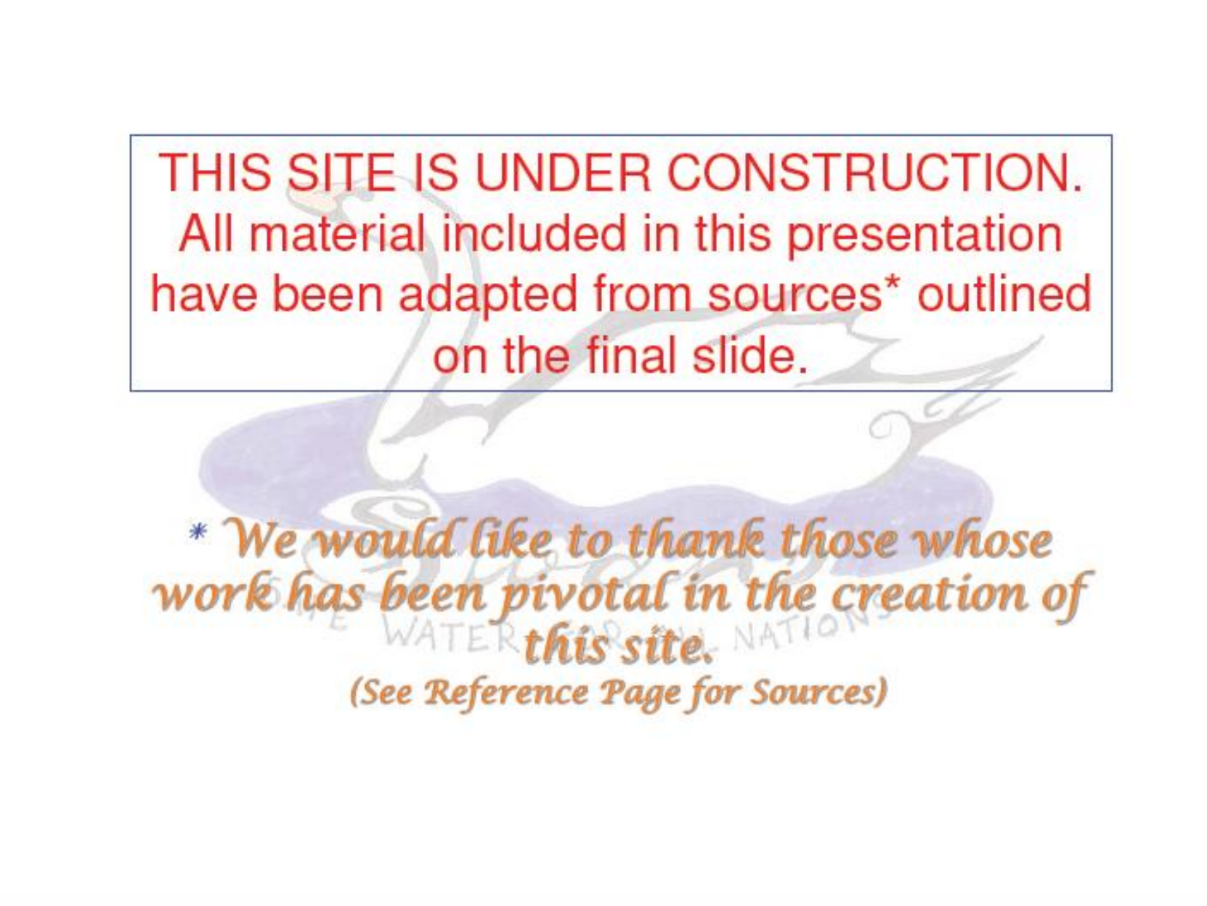

Slide 4
To the Visitors:
Your comments and suggestions are appreciated. Please direct your thoughts to Wanxin Cai at wxcai@alumni.usc.edu.
Thank you.

Slide 5
Overview
Many industrial sites are exposed to rain and snow conditions. In particular, stormwater discharge, if not managed properly, can cause a variety of unwanted challenges for industrial sectors ranging from construction to manufacturing process to oil and gas to agriculture.
The industrial contaminants in stormwater discharges are largely dependent on:
The sector of industrial activity and type of activities occurring at the facility
Site-specific factors, such as topography, site outline, and soil
Contaminant type, based on the specific materials handled
Loading/unloading operations, outdoor storage, waste practice, and outside process activities
Illicit connection and non-stormwater discharges

Slide 6
Overview (cont’d)
According to EPA, “the best way to prevent stormwater pollution from industrial sites is to minimize the use of materials and products in industrial activities that contaminate water and to minimize opportunities for stormwater to come into contact with industrial activities and polluting materials”.

Slide 7
Table of Contents
    1. Background: LA River Revitalization
      Impact to LA River
      Relation to LA River Revitalization
    2. Stormwater BMPs
    3. Examples of Different Industries
    Summary and Discussion
    Future Work
    References

Slide 8
Part 1
Background: LA River Revitalization

Slide 9
Impact to LA River
Stormwater runoff includes all flows discharged into stormwater conveyance systems and receiving waters and includes both dry weather non-stormwater sources and wet weather stormwater runoff.
With the increasing urbanization of Los Angeles, the water quality in LA River has declined significantly. It is mostly due to untreated stormwater runoff from 2200 storm drain outlets. Storm drains carry runoff from streets, urban centers, industrial sites, and open spaces into streams, creeks, and rivers.
Industrial operations are major contributors of stormwater contamination in LA River. They are known to be sources of heavy metals, oily wastes, and a host of other contaminants. For example, manufacturing, shipping, storage operations, and other industrial activities that are exposed to stormwater can be sources of pollutants in stormwater.

Slide 10
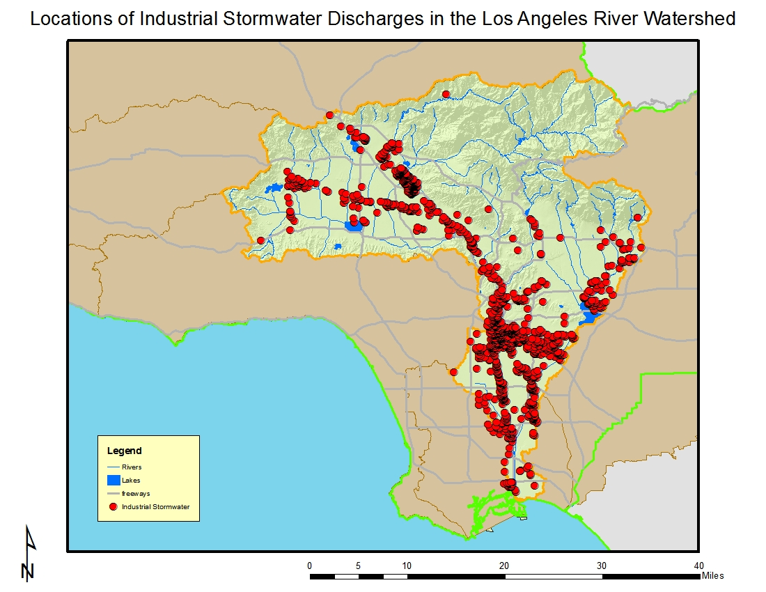
Impact to LA River (cont’d)
Of the 1,319 dischargers enrolled under the general industrial storm water permit in the LA River Watershed, the largest numbers occur in the cities of Los Angeles (many within the community of Sun Valley), Vernon, South Gate, Long Beach, Compton, and Commerce.
Wholesale trade-durable goods, fabricated metal products, trucking & warehousing, and chemicals & allied products are a large component of these businesses based on their Standard Industrial Classification (SIC) codes.
This watershed has about twice the number of industrial stormwater dischargers as does the San Gabriel River Watershed and the most in the region. The locations of facilities with discharges covered by the general industrial stormwater permit are shown in the figure.
Locations of industrial stormwater discharges in the Los Angeles River Watershed
https://www.waterboards.ca.gov/rwqcb4/water_issues/programs/regional_program/Water_Quality_and_Watersheds/los_angeles_river_watershed/la_summary.shtml

Slide 11
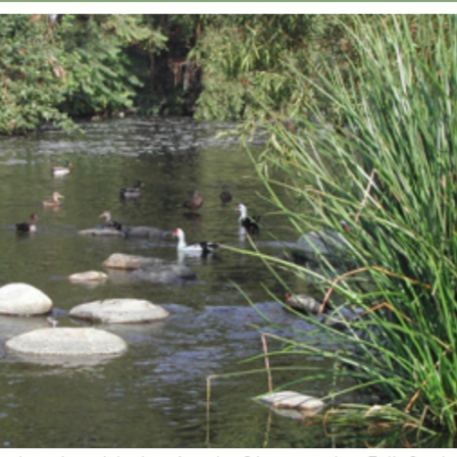
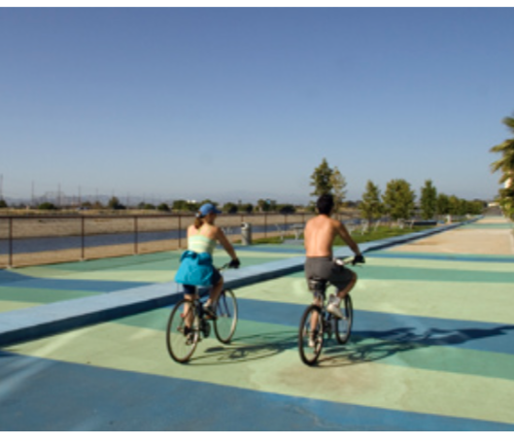
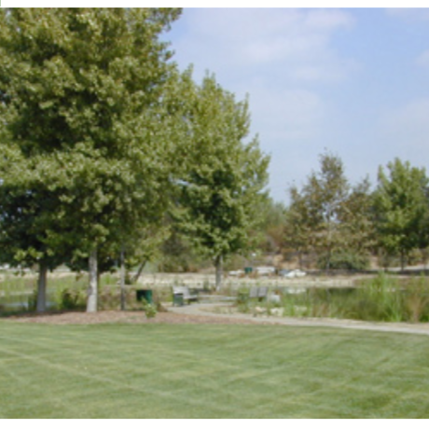
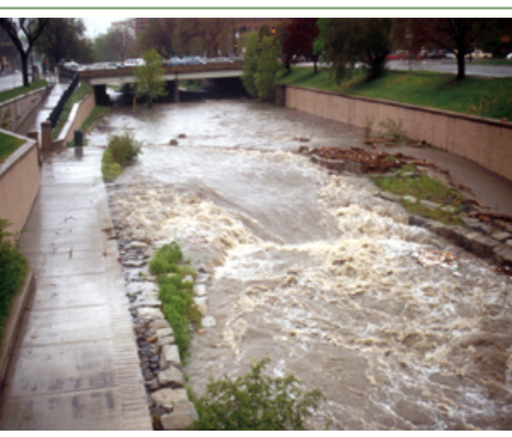
Relation to LA River Revitalization
Four goals of LA River Revitalization
Enhance Flood Storage
Enhance Water Quality
Enable Safe Public Access
Restore a Functional Riparian Ecosystem

Slide 12
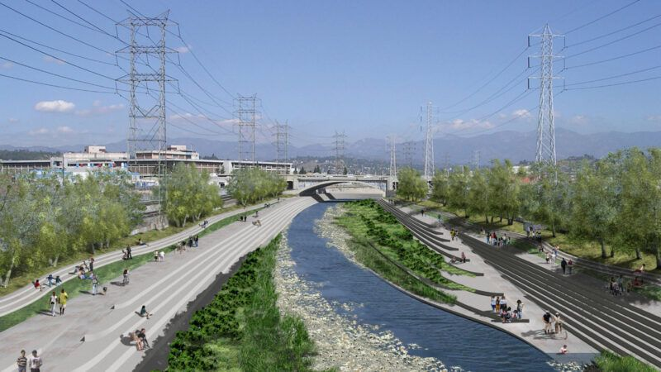
Relation to LA River Revitalization (cont’d)
Different plants can have very different stormwater quantities, flow patterns, and potential pollutants. Even different facilities of the same general industry may need different approaches to prevent stormwater pollution due to the different sizes or distances to LA River. Thus, it is essential to identify appropriate industrial stormwater Best Management Practices (BMPs) for these facilities to protect LA River water quality.
Stormwater BMPs provide economical and environmental-friendly incentives for achieving LA River revitalization.
https://www.ioes.ucla.edu/project/how-competing-los-angeles-river-revitalization-plans-will-affect-surrounding-communities/

Slide 13
Table of Contents
    Background: LA River Revitalization
    Stormwater BMPs
      Common pollutants of concern in industrial stormwater
      California regulatory requirements
      Non-structural BMPs
      Advanced BMPs and structural control
    Examples of Different Industries
    Summary and Discussion
    Future Work
    References

Slide 14
Part 2
Stormwater BMPs

Slide 15
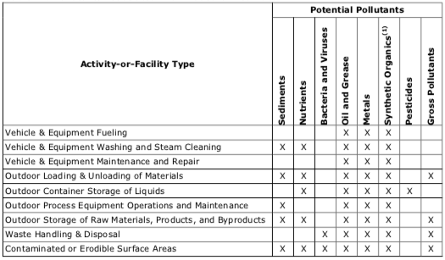

California regulatory requirements
Common pollutants of concern in industrial stormwater
Potential pollutants associated with common industrial activities
Most common pollutants in industrial stormwater:
Total Suspended Solids (TSS)
Biological Oxygen Demand (BOD)
Chemical Oxygen Demand (COD)
Nutrients
Metals
Petroleum-derived hydrocarbons
Chlorides/salt
Temperature
Turbidity
pH
Source: Stormwater Best Management Practice Handbook: Industrial and Commercial, California Stormwater Quality Association (CASQA), September 2014

Slide 16
California regulatory requirements
General Permit for Storm Water Discharges Associated with Industrial Activities
In California, owners or operators of specific industrial facilities are required to obtain NPDES permit coverage by submitting Permit Registration Documents (PRDs) to be covered under the State Water Resources Control Board (SWRCB) Order No. 2014-0057-DWQ, National Pollutant Discharge Elimination System General Permit No. CAS000001, General Permit for Storm Water Discharges Associated with Industrial Activities (General Permit - SWRCB, 2014).
The following parts of federal regulations contain Effluent Limitation Guidelines(ELGs) approved by USEPA for specific categories of industrial storm water discharges:
Cement Manufacturing
Fertilizer Manufacturing
Petroleum Refining
Phosphate Manufacturing
Steam Electric Power Generating
Wetting of Logs at Wet Deck Storage Areas
Coal Mining
Mineral Mining and Processing
Ore Mining and Dressing
Paving and Roofing Materials (tars and asphalt)
Landfills
Airport Deicing

Slide 17
California regulatory requirements
General Permit for Storm Water Discharges Associated with Industrial Activities (cont’d)
Facilities covered by National Pollutant Discharge Elimination System (NPDES) General Permit Storm Water Discharges Associated With Industrial Activities (General Permit) are required to prepare a Stormwater Pollution Prevention Plan (SWPPP). These include:
Facilities Subject to Storm Water Effluent Limitations Guidelines, New Source Performance Standards (NSPS), or Toxic Pollutant Effluent Standards Found in 40 Code of Federal Regulations, Chapter I, Subchapter N(Subchapter N)
Manufacturing Facilities
Oil and Gas/Mining Facilities
Hazardous Waste Treatment, Storage, or Disposal Facilities
Landfills, Land Application Sites, and Open Dumps
Recycling Facilities
Steam Electric Power Generating Facilities
Transportation Facilities
Sewage or Wastewater Treatment Works

Slide 18
California regulatory requirements
General Permit for Storm Water Discharges Associated with Industrial Activities (cont’d)
The General Permit requires the dischargers to comply with the following:
Eliminate unauthorized non-stormwater discharges.
Develop and implement a facility specific stormwater pollution prevention plan (SWPPP), including a Monitoring Implementation Plan (MIP).
Implement minimum BMPs and advanced BMPs, if needed, and evaluate effectiveness (to the extent feasible).
Conduct monitoring, including visual observations and analytical monitoring of stormwater.
Compare analytical monitoring results to numeric action levels (NALs).
Perform Exceedance Response Actions (ERAs) when NALs are exceeded.
Certify and submit all compliance documents in the Storm Water Multi Application Reporting and Tracking System (SMARTS).

Slide 19
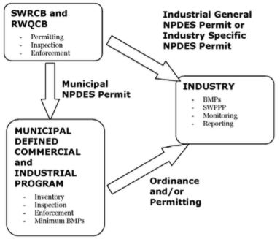
California regulatory requirements
General Permit for Storm Water Discharges Associated with Industrial Activities (cont’d)
The owners and operators of industrial and commercial facilities must understand the relationship between the agencies, their jurisdictions, and the requirements of each, as shown in the figure below.
Source: Stormwater Best Management Practice Handbook: Industrial and Commercial, California Stormwater Quality Association (CASQA), September 2014

Slide 20
California regulatory requirements
Stormwater Pollution Prevention Plan (SWPPP)
Dischargers are required to prepare a SWPPP which includes:
Facility name and contact information
Site map
List of industrial materials
Description of potential pollution sources
Assessment of potential pollutant sources
Identified stormwater BMPs
Annual evaluation
Date that SWPPP was initially prepared and the date of each SWPPP amendment, if applicable

Slide 21
Stormwater BMPs
Stormwater BMPs are measures to prevent or mitigate stormwater pollution, commonly categorized whether they are non-structural or structural. The General Permit categorizes BMPs as either minimum BMPs or advanced BMPs, which will be discussed in the following slides.
Structural BMPs: Design-based facilities that prevent the pollutants from reaching stormwater and treat or remove pollutants in stormwater.
Non-Structural BMPs: Generally consist of processes, prohibitions, procedures, schedule of activities, etc., that prevent pollutants associated with industrial activities from entering stormwater. They are generally economical and use low technology.
Minimum BMPs: All General Industrial Permit holders are required to conduct minimum BMPs.
Advanced BMPs: Will be required if a site has pollutant exceedances and cannot meet the discharge requirements. Selected according to activities and pollutants.
Note: Most minimum BMPs are non-structural, while some are structural.

Slide 22
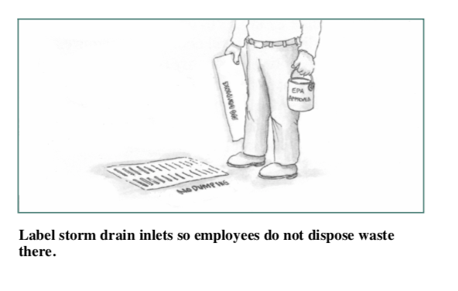
Minimum BMPs
The following minimum BMPs are required by the General Permit and should be tailored to certain industrial activities or facilities.
Good housekeeping:
  Observe and maintain industrial activity outdoor areas
  Minimize or prevent material tracking
  Minimize dust generated
  Cleanup areas affected by rinse and wash water
  Cover stored industrial materials that can be readily mobilized by contact with stormwater
  Contain stored non-solid industrial materials or wastes
  Prevent disposal of rinse/wash waters
  Minimize flows of offsite stormwater and NSWDs into material handling areas
Source: Best Management Practices For Industrial Storm Water Pollution Control, Sacramento Stormwater Management Program

Slide 23
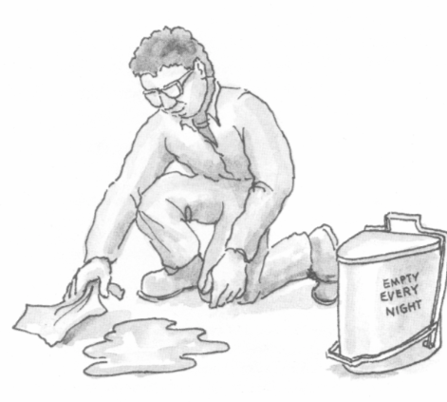
Minimum BMPs (cont’d)
Preventative maintenance:
  Identify equipment and systems that may leak
  Observe the equipment and systems to detect leaks
  Establish procedures for equipment operation, maintenance, and repair
Spill and leak prevention and response
  Establish procedures and/or controls to minimize spills and leaks
  Develop and implement spill and leak response procedures to prevent industrial materials from being discharge
  Clean up spills and leaks promptly
  Identify and describe needed spill and leak response equipment
Source: Best Management Practices For Industrial Storm Water Pollution Control, Sacramento Stormwater Management Program

Slide 24
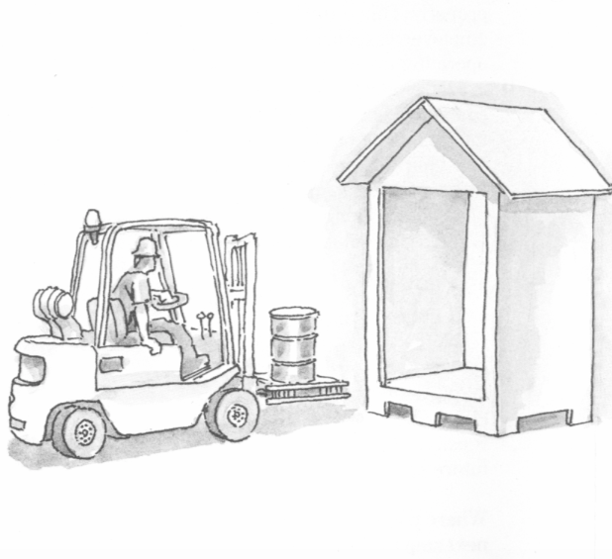
Minimum BMPs (cont’d)
Material handling and waste management:
  Minimize handling of industrial materials or wastes that can be readily mobilized by contact with stormwater
  Contain non-solid industrial materials or wastes that can be transported or dispersed by the wind or contact with stormwater
  Cover industrial waste disposal and industrial material storage containers
  Divert run-on and stormwater away from stockpiled materials
  Clean spills that occur during handling
  Observe and clean outdoor material/waste handling equipment or containers
Source: Best Management Practices For Industrial Storm Water Pollution Control, Sacramento Stormwater Management Program

Slide 25
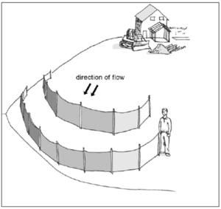
Minimum BMPs (cont’d)
Erosion and sediment controls:
  Implement effective wind erosion controls
  Provide effective stabilization for inactive areas, finished slopes, and other areas prior to a forecasted storm event
  Maintain effective perimeter controls and stabilize site entrances
  Divert runoff and stormwater generated from within the facility away from erodible materials
  Properly design sediment basins
Employee training program
  Train stormwater team members
  Prepare or acquire training manuals
  Identify which personnel need to be trained
  Maintain training documentation
https://stormwater.pca.state.mn.us/index.php/Sediment_control_practices_-_Perimeter_controls_for_disturbed_areas

Slide 26
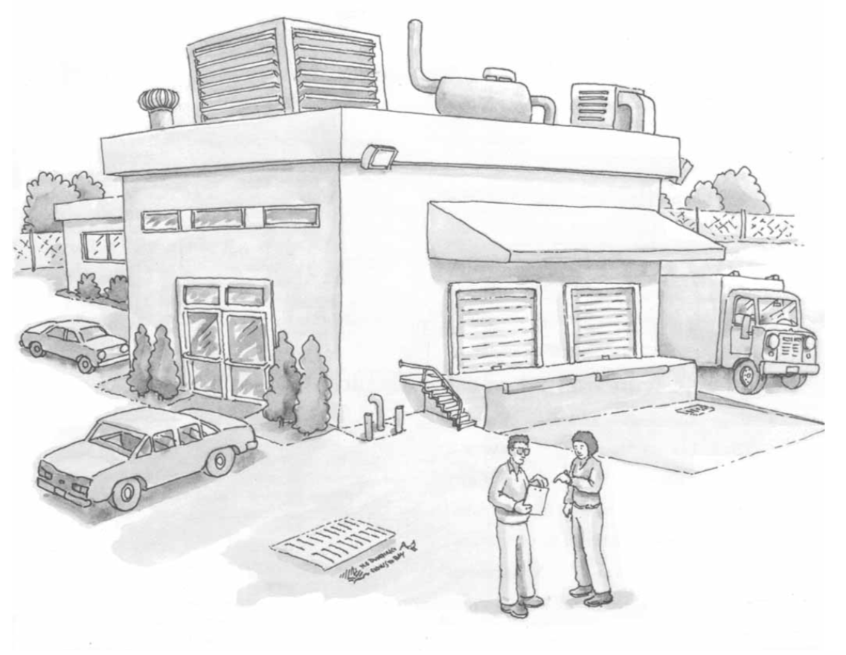
Minimum BMPs (cont’d)
Quality assurance record keeping:
  Develop and implement management procedures to ensure implementation of plans
  Develop a method of tracking and recording program implementation
  Maintain implementation records (i.e., BMP deployment records, employee training logs, spill occurrence and clean-up records)
Source: Best Management Practices For Industrial Storm Water Pollution Control, Sacramento Stormwater Management Program

Slide 27
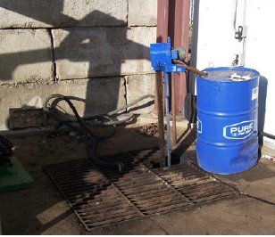
Advanced BMPs and structural control
1. Coolant/Oil recovery
Activities: metal removal discharges metal fines in the form of swarf, grindings, chips etc.
Typical problems: the coolants, metal fines, and tramp oil leak out of the outside container or are spilled in the process of loading onto a transport vehicle.
Typical pollutants: heavy metals (chromium, copper, manganese, lead, zinc), bacteria, fungi, chemicals in the coolant (corrosion inhibitors, emulsifiers, biocides), tramp oil, and decreased pH
BMP:
Locate scrap bin on a concrete pad that drains into a containment sump
Source: Industrial Stormwater Best Management Practices Manual, by Dennis Jurries and Krista Ratliff, February 2013

Slide 28
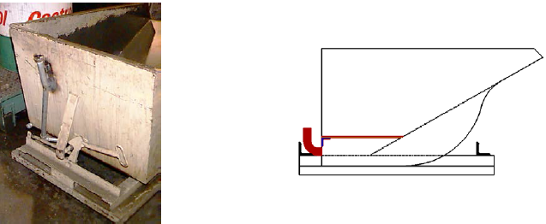
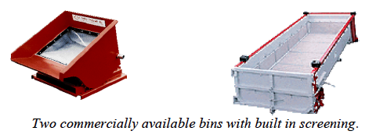
Advanced BMPs and structural control
1. Coolant/oil recovery (cont’d)
b. Modify the scrap hopper for coolant/oil separation from the swarf while the coolant/oil is warm and less viscous
c. Use bins with built-in filtering screen to separate the scrap from the liquid chamber
Source: Industrial Stormwater Best Management Practices Manual, by Dennis Jurries and Krista Ratliff, February 2013

Slide 29
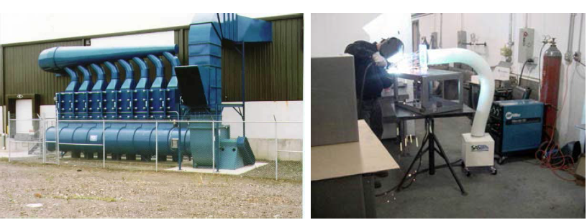
Advanced BMPs and structural control
2. Weld fume control
Activities: metal cutting with gas burners, and welding metal with stick, wire or gas welders
Typical problem: fume exhausted outside comes in contact with rain and pollutes stormwater
Typical pollutants: oily air emissions, metal particles, gaseous metal, and vaporized flux
BMP: centralized cartridge filtration systems (figure on the left) and portable High-Efficiency Particulate Air (HEPA) filtration systems (figure on the right) are a couple of control methods in use today which phases out electrostatic precipitator systems. Air extraction units with mist or charcoal filters can also be used.
Source: Industrial Stormwater Best Management Practices Manual, by Dennis Jurries and Krista Ratliff, February 2013

Slide 30
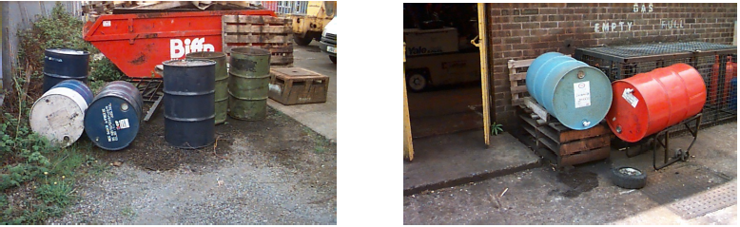
Advanced BMPs and structural control
3. Drum and container containment
Activities: oil and other fluid dispensing and outside storage
Typical Problems: uncontained, expansions and contractions causes damage to container generating leaks. Dispensing oil, antifreeze, and other hazardous liquids may result in spills and leaks around the dispensing area. The leaked liquid can contact with stormwater or seep into soil and groundwater.
Typical Pollutants: oil, hydraulic fluid, antifreeze, paint, solvent, cleaners, petroleum hydrocarbons, toluene, ethylene glycol, etc.
Source: Industrial Stormwater Best Management Practices Manual, by Dennis Jurries and Krista Ratliff, February 2013

Slide 31
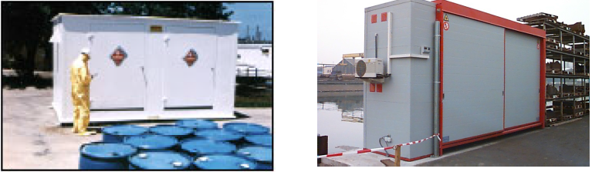
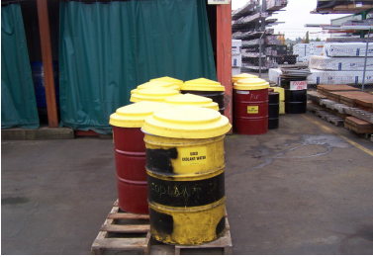
Advanced BMPs and structural control
3. Drum and container containment (cont’d)
BMPs:
Potable metal storage building with built-in containment
Use cone shaped drum covers to keep water off the top of the drums
Source: Industrial Stormwater Best Management Practices Manual, by Dennis Jurries and Krista Ratliff, February 2013

Slide 32
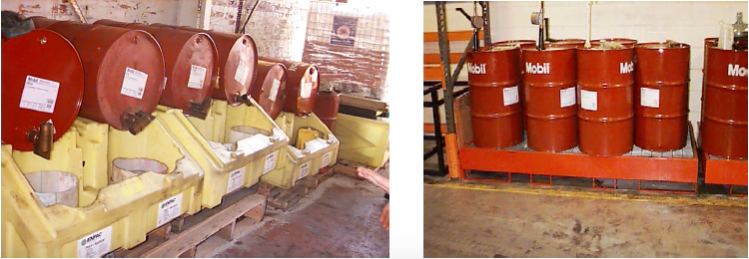
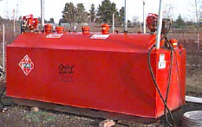
Advanced BMPs and structural control
3. Drum and container containment (cont’d)
c. Use containment palettes made by plastic or steel
d. Use double-walled storage tanks
Source: Industrial Stormwater Best Management Practices Manual, by Dennis Jurries and Krista Ratliff, February 2013

Slide 33
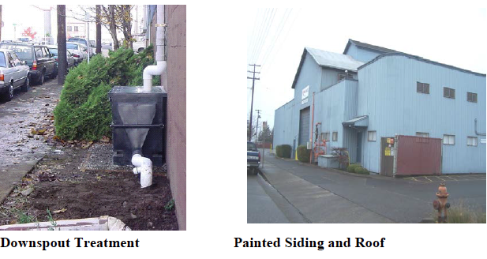
Advanced BMPs and structural control
4. Metal roof and siding coating treatment
Typical problems: runoff from building with corrugated galvanized sheet metal roofs, siding, gutter, and downspout
Typical pollutants: zinc and iron
BMPs:
Avoid using galvanized sheeting
Clean and paint the exposed galvanized sheet
Contain and collect any liquids used in cleaning for proper disposal
Conduct regular inspections and maintenance
Collect and treat roof runoff
Source: Industrial Stormwater Best Management Practices Manual, by Dennis Jurries and Krista Ratliff, February 2013

Slide 34
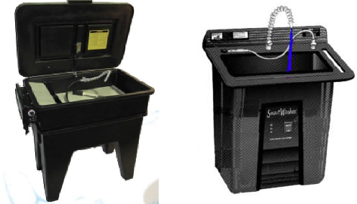
Advanced BMPs and structural control
5. Biological based parts cleaner
Activities: cleaning parts and equipment with petroleum based cleaners
Typical problem: increase the risk of spilling and leakage getting spent cleaner into stormwater
Typical pollutant: petroleum hydrocarbons
BMPs:
Large Parts and frames cleaned in shot blast machine
Smaller parts should be cleaned in water based solution solution (caustic or other) or biological solution. The sludge from these washers are not hazardous.
Biological Parts Washer
Source: Industrial Stormwater Best Management Practices Manual, by Dennis Jurries and Krista Ratliff, February 2013

Slide 35
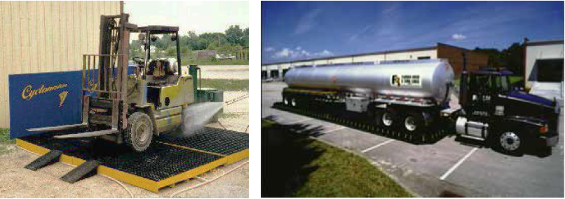
Advanced BMPs and structural control
6. Vehicle, pavement and building washing
Activities: pressure washing or steam cleaning of equipment, outdoor surfaces and/or vehicles
Typical problems: when equipment, pavement, vehicles, or buildings are washed outside, contaminants in the wash-water and the overspray mix with the stormwater runoff.
Typical pollutants: degreasers, organics, heavy metals, oil and grease, and pollutants from soaps
Source: Industrial Stormwater Best Management Practices Manual, by Dennis Jurries and Krista Ratliff, February 2013

Slide 36
Advanced BMPs and structural control
6. Vehicle, pavement and building washing (cont’d)
BMPs:
Locate washing area on a well constructed, impervious surfaces with drains to other stormwater BMPs or storage tank.
Discharge the stormwater to a properly sized grassy swale or constructed wetland.
Discharge the washwater and stormwater to a collection sump for later disposal.
Discharge the stormwater through an oil/water separator.
Provide a package recirculation/treatment system for washing.
Contract with a mobile washer to wash the vehicles and ensure that they capture and remove the liquid and solids and properly dispose of them.
Perform the washing activities offsite at a commercial vehicle wash facility.

Slide 37
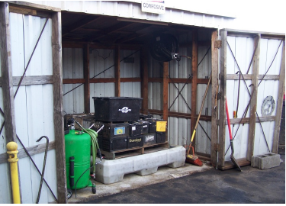
Advanced BMPs and structural control
7. Battery storage
Activities: the outdoor storage of batteries and the long time storage of vehicles or battery-powered equipment outside
Typical problems: lead sulfate usually present in batteries can contaminate stormwater and soil.
Typical pollutants: soluble metals such as lead, nickel, or cadmium, sulfuric acid
BMPs:
Batteries should be stored in contained area.
Use containment pallet to prevent any acid spillage and put it inside to keep stormwater away from contacting it.
Source: Industrial Stormwater Best Management Practices Manual, by Dennis Jurries and Krista Ratliff, February 2013

Slide 38
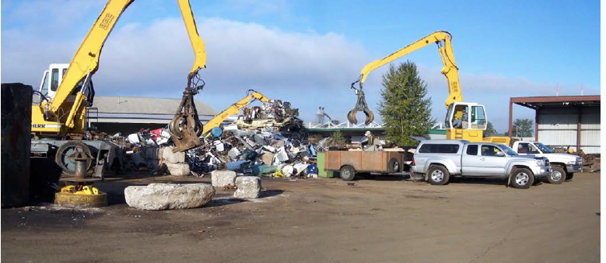
Advanced BMPs and structural control
8. Wrecked vehicle storage and scrap metal recycling
Activities: wrecked or damaged vehicle storage or scrap metal recycling
Typical problems: fluids may leak due to the damage incurred and/or the damage may expose oily components of the vehicle. This can pollute stormwater, soil, and groundwater.
Typical pollutants: antifreeze (ethylene glycol), gasoline, oil, grease, brake fluid, diesel
Source: Industrial Stormwater Best Management Practices Manual, by Dennis Jurries and Krista Ratliff, February 2013

Slide 39
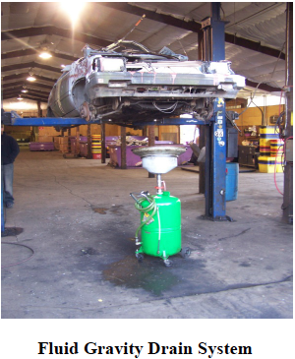
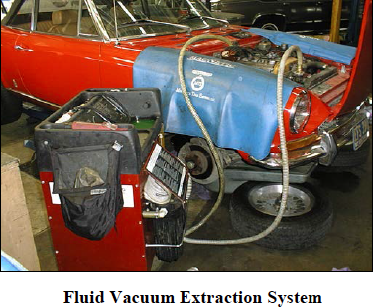
Advanced BMPs and structural control
8. Wrecked vehicle storage and scrap metal recycling (cont’d)
BMPs:
Ensure that all fluids are completely drained from the wrecked vehicles.
Provide impervious surface containments, drainage should pass through oil/water separators before being discharged.
Provide a roof to prevent stormwater contact with wrecked vehicles if possible.
Source: Industrial Stormwater Best Management Practices Manual, by Dennis Jurries and Krista Ratliff, February 2013

Slide 40
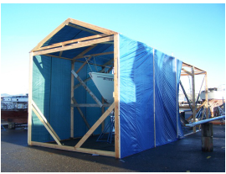
Advanced BMPs and structural control
9. Paint stripping
Activities: stripping coatings from metal and wood surfaces outdoors
Typical problems: stripping of wood and metal parts usually uses hazardous chemicals. High pressure water blasting produces increased runoff. Sand blasting creates lots of solids to dispose.
Typical pollutants: hazardous stripping chemicals, lead from old lead based paints, zinc chromate
BMP:
Use dry ice or baking soda abrasion type removal of old surface coatings
Use a removable ground cover before blasting to ease the cleaning efforts
Consider temporary or portable structure to contain and isolate the work and debris
Source: Industrial Stormwater Best Management Practices Manual, by Dennis Jurries and Krista Ratliff, February 2013

Slide 41
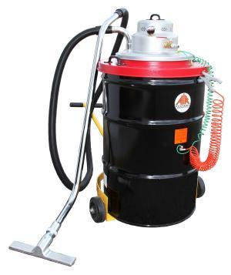
Advanced BMPs and structural control
10. Brake Shoe Replacement
Activities: vehicle repair/brake shoe replacement
Typical problems: dust in the brake shoe/wheel housing is typically disturbed and can be released to outdoors when brake shoes are replaced.
Typical pollutants: asbestos, copper, total suspended solids
BMPs:
Use the Low Pressure/Wet Cleaning Method for dust removal
  Low Pressure/Wet Cleaning Method: This specially designed low-pressure spray equipment wets down the brake assembly and catches the runoff in a special basin to prevent airborne brake dust from spreading in the work area.
Use HEPA Vacuum System Method that can retain the micron sized particles
  HEPA Vacuum System Method: This type of enclosure and vacuum system has a special box with clear plastic walls or windows, which fits tightly around a brake or clutch assembly to prevent asbestos exposure.
HEPA Vacuum System
https://instrumentnation.com/air-systems-av-55-electric-55-gallon-drum-lid-hepa-vacuum-system/

Slide 42
Advanced BMPs and structural control
11. Ozone generators for cooling towers
Activities: the use of cooling towers with the associated water treatment chemicals and blowdown discharges.
Typical problems: chemicals such as biocides, algaecides, and corrosion inhibitors are added to cooling towers to prevent biological growth and to reduce scaling and corrosion. Periodically cooling tower water must be blown down in order to remove sediment and particulate buildup in the cooling tower sump. This water can contain elevated levels of copper, zinc, and chemicals with high BOD₅ and COD.
Typical pollutants: biocides, algaecides, fungicides, BOD, COD, suspended solids, metals (zinc and copper).
BMP: use ozone or UV light instead of chemicals to control biological growth and scaling. It is to be noted that a properly operated and controlled ozone treatment system will not allow microorganisms that secrete the glue-like substance to survive. Ozone will dissipate quickly and not be found in the blow down water. This reduces the overall chemical load found in the discharged water, making it easier to comply with regulations.

Slide 43
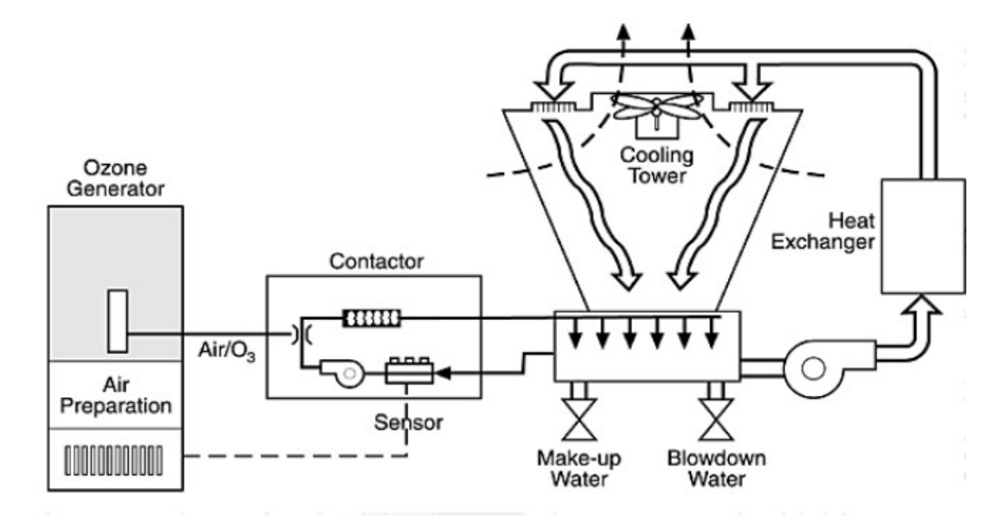
Advanced BMPs and structural control
11. Ozone generators for cooling towers (cont’d)
Advantages
Safe and easy in use
Very effective in removing biofilms
Low maintenance costs
Ozone is produced on site and requires no additional disinfectants
Use ozone can reduce the need for blow down
Most cooling tower ozone treatment systems include an air dryer, air compressor, water and oil coalescing filters, particle filter, ozone injectors, an ozone generator, and a monitoring/control system.
Ambient air is compressed, dried, and then ionized in the generator to produce ozone. Ozone is typically applied to cooling water through a side stream of the circulating tower water as is illustrated in the figure.
Process for ozone treatment of cooling tower water
https://www.spartanwatertreatment.com/articles/Ozone-Treatment-for-Cooling-Towers-Federal-Technology-Alert.pdf

Slide 44
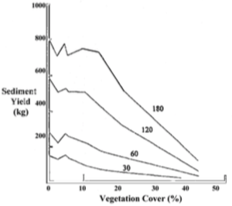
Advanced BMPs and structural control
12. Grassy Filter Strip and Planter
Install a grassy filter strip and ensure that the storm water passes through the strip in sheet flow. Vegetated filter strips are best used on sites with sheet runoff.
Target Pollutants: sediment (TSS), PAH, metals, BOD, phosphorus, and oil & grease
Best for smaller drainage basins with sheet flows
Cannot be used to convey large storms or concentrated flow discharge
Properly sized and maintained vegetated filter strips can have a removal efficiency of up to 80 percent for suspended solids
The graph on the right depicts the different simulated rainfall events of a specific intensity for durations from 30 to 180 minutes. (The slope of the vegetation cover is 10%)
Source: Industrial Stormwater Best Management Practices Manual, Oregon Department of Environmental Quality, February 2013

Slide 45
Advanced BMPs and structural control
13. Constructed wetland
Constructed wetland uses natural processes involving wetland vegetation uptake, microbiological degradation, retention and settling.
Target pollutants: sediment (TSS), PAH, metals, BOD, phosphorus, and oil & grease
Advantages
Disadvantages
Removes stormwater pollutants
Reduces peak flow
Provides wildlife habitat
Retains stormwater
Landscaping purpose
Must have a continuous base flow to maintain aquatic plants
Plants cannot endure drought or be submerged for a long time.
Cannot be placed on steep, unstable slopes
Public safety concerns
May have mosquito and vector breeding issues

Slide 46
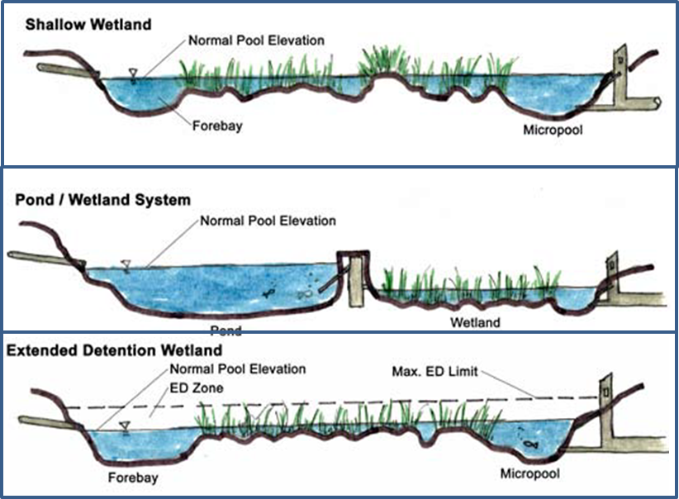
Advanced BMPs and structural control
13. Constructed wetland (cont’d)
There are five basic types of constructed wetland: shallow marsh, basin/wetland (formerly pond/wetland), extended detention (ED) wetland, pocket wetland, and gravel wetland.
https://stormwater.pca.state.mn.us/index.php/Types_of_stormwater_wetlands

Slide 47
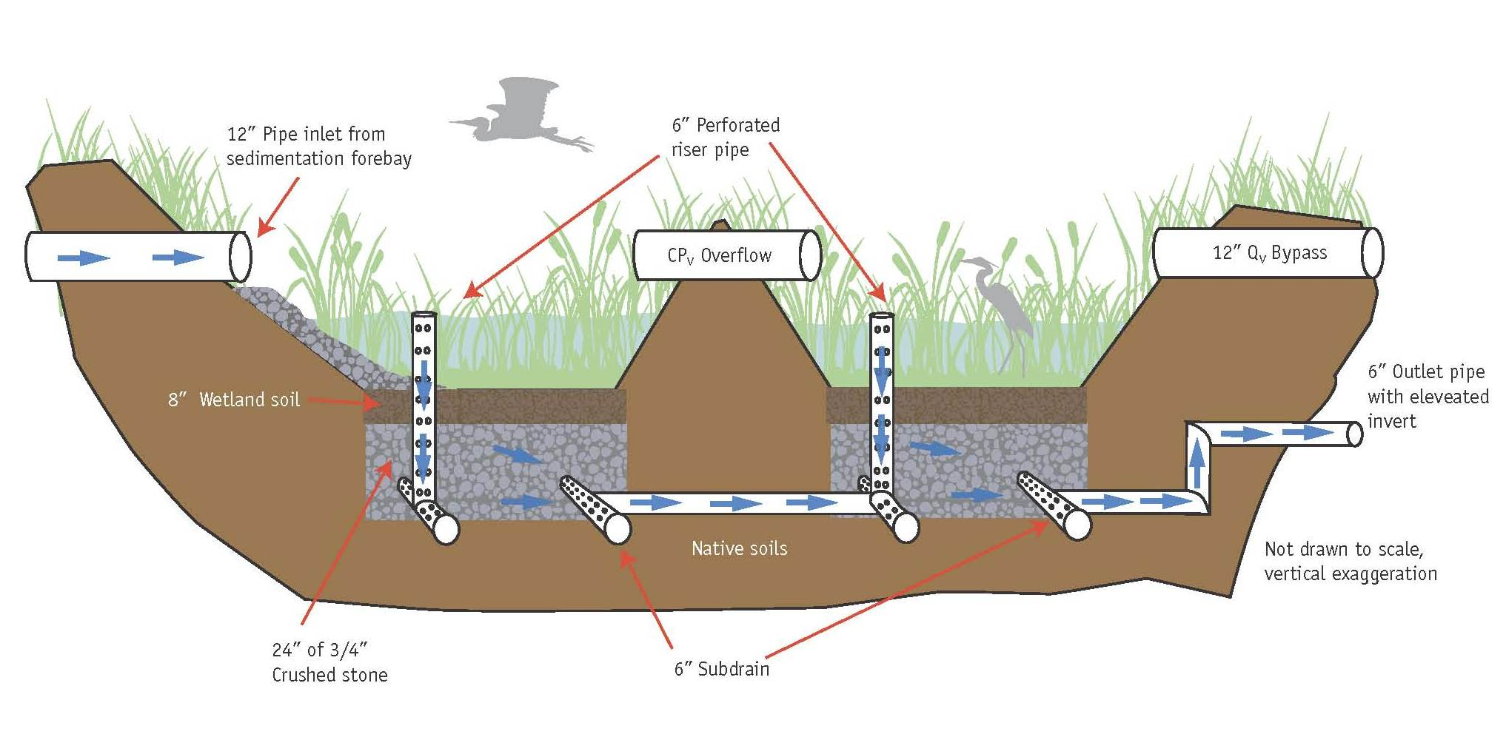
Advanced BMPs and structural control
13. Constructed wetland (cont’d)
Concept schematic for subsurface gravel wetland
https://stormwater.wef.org/2012/07/subsurface-gravel-wetlands-for-stormwater-management/

Slide 48
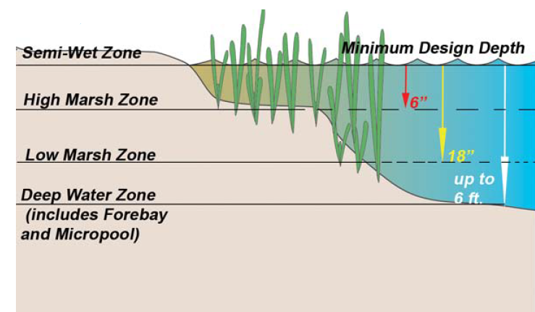
Advanced BMPs and structural control
13. Constructed wetland (cont’d)
Contaminant | Remove efficiency*
Heavy metals | 40 - 80%
Total Phosphorus | 40 - 80%
Total Nitrogen | 40 - 60%
Soluble reactive phosphorus | 75%
Nitrate | 65%
Total copper, lead, and zinc | 80 - 95%
TSS | 70%
Different zones for constructed wetland
http://prj.geosyntec.com/npsmanual/constructedstormwaterwetlands.aspx
* Higher efficiencies are associated with use of O/G trap, larger pond/marsh area and volume.
Source: Industrial Stormwater Best Management Practices Manual, by Dennis Jurries and Krista Ratliff, February 2013

Slide 49
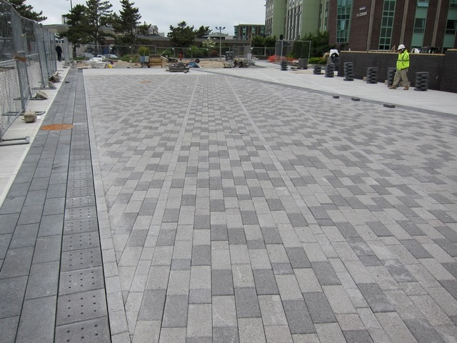
Advanced BMPs and structural control
14. Pervious pavement
Pervious pavement is a specially designed system that allows water to infiltrate through pavement and prevent it from becoming runoff. Used in uncontaminated areas where chemical or fine particle spill not likely occur.
Target pollutants: sediment (TSS), PAH, metals, BOD, phosphorus, and oil & grease
Small amounts of petroleum contamination will be treated in the shallow soils or fillings beneath the porous material.
The porous pavement can drain larger pavement area if it is designed and installed properly.
Pervious pavement reduces stormwater runoff volume and peak flows.
https://www.1800sweeper.com/sweeping-services/permeable-pavement-cleaning

Slide 50
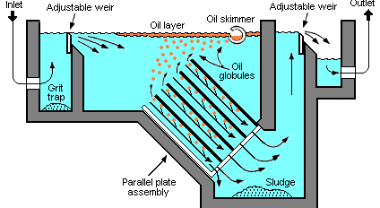
Advanced BMPs and structural control
15. Oil/water (W/O) separators
There are two common types of oil/water separator: API (American Petroleum Institute) W/O separator and coalescing plate separator (CPS).
Activities: any site that has steel, equipment or vehicles stored outside and has a potential for oily or sediment-laden stormwater discharges.
Target pollutants: oil & grease and suspended solids
API oil/water separators are typically large-capacity, underground cement vaults designed with baffles to trap sediments and retain floating oils.
https://en.wikipedia.org/wiki/API_oil%E2%80%93water_separator

Slide 51
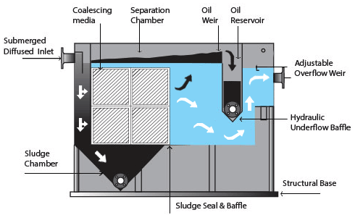
Advanced BMPs and structural control
15. Oil/water (W/O) separators (cont’d)
Limitations of O/W separators
It cannot handle concentrated amounts of oily products and sediment in stormwater.
Antifreeze, degreasers, and detergents will break up oil into small droplets so it will allow the oil to pass through the separator.
It is not designed to treat heavy metal-bearing wastewater.
Coalescing plate separator (CPS) has a smaller capacity and employs a series of oil-attracting plates.
Coalescing plate separator (CPS)
http://www.elliswastewater.com/products/oil-water-separator/

Slide 52
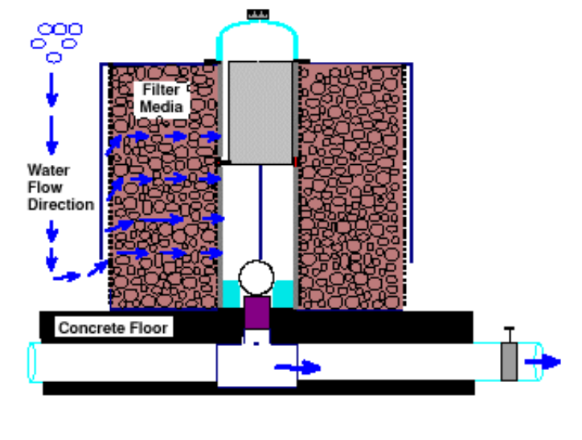
Advanced BMPs and structural control
16. Cartridge Filtration
Activity: operations with exposed copper and/or galvanized piping, galvanized siding and/or roofing materials, cathodic protection coatings of copper, or other exposed copper, brass, and/or zinc coated materials that are exposed to stormwater may have significant levels of these metals present in stormwater discharge. Operations involving heavy vehicle traffic may also have metals in their stormwater discharge such as copper from brake shoes and clutches or zinc from tire wear.
Target Pollutants: copper, zinc, PAH, total suspended solids
Vault type filter
Source: Industrial Stormwater Best Management Practices Manual, Oregon Department of Environmental Quality, February 2013

Slide 53
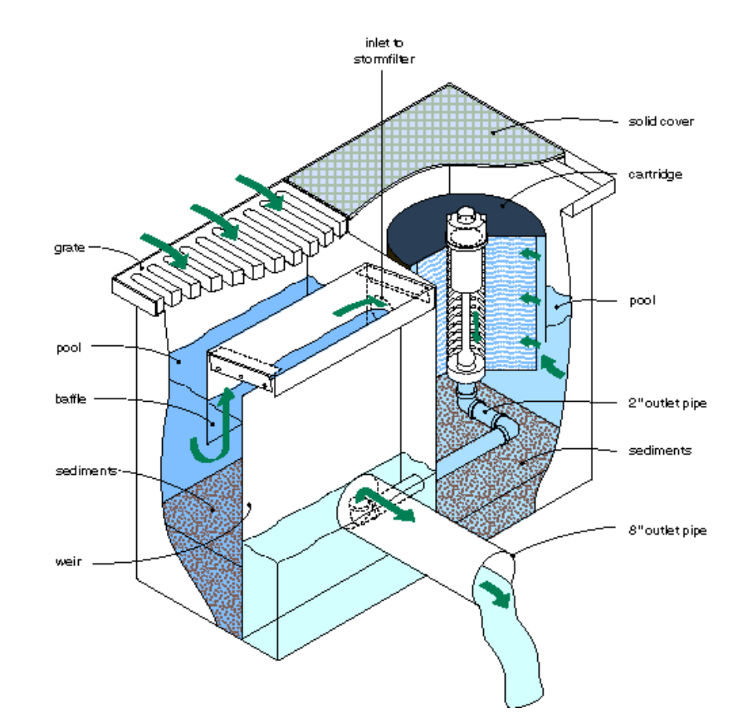
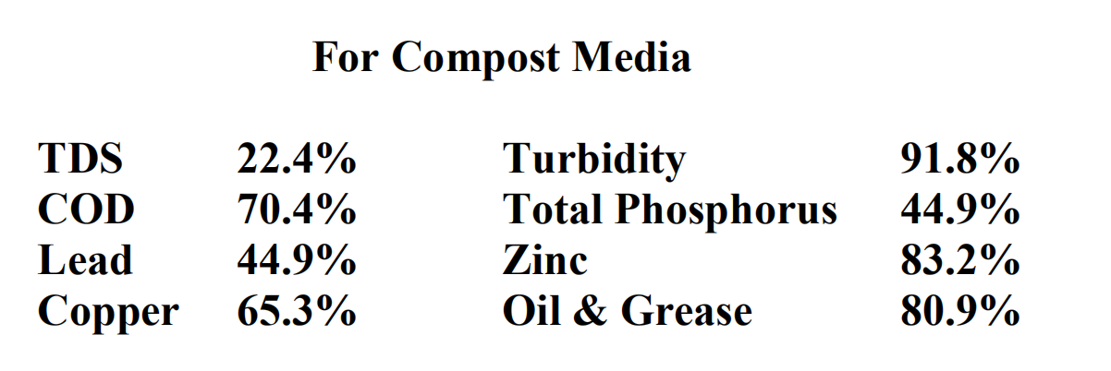
Advanced BMPs and structural control
17. Cartridge Filtration (cont’d)
The installation of properly sized compost filtration units can remove significant amounts of both chemical and particulate forms of heavy metals like copper and zinc and reduce TSS levels in the storm water discharge. Colloidal particulate levels from clay soils should also be reduced effectively.
Removal efficiency
Catch basin type filter
Heavy Metals: 65 to 95%
Oil & Grease: up to 85% for a properly designed and sized system
Source: Industrial Stormwater Best Management Practices Manual, Oregon Department of Environmental Quality, February 2013

Slide 54
Advanced BMPs and structural control
18. Rain garden
A rain garden is a vegetated shallow depression that is designed to receive, retain, and infiltrate stormwater runoff from downspouts, piped inlets, or sheet flow from adjoining paved areas.
It can be applied in areas that are known as hot-spots (gas stations, transfer sites, and transportation depots). But impervious liner between in-situ soils and the planting soil medium is needed to reduce or eliminate the possibility of groundwater contamination
Target pollutants: sediment (TSS), metals, BOD, nutrients, and bacteria
Provides a level of treatment strictly through filtration processes that occur when the runoff moves through the soil material to the underdrain discharge point
Reduces stormwater runoff
Eliminates pollutant discharge
http://www.jkdirtworks.com/html/rain_gardens.html
Notes:
Rain garden is one of the most common stormwater BMPs.
It can reduce runoff, recharge groundwater, eliminate pollutant, provide habitat for wildlife, however, it requires maintenance, should be constructed on relatively flat site, and may result in vector breeding.
This is the general removal efficiency of common contaminants for all kinds of rain garden. Some removal efficiency vary in a big range, cuz it depends largely on media in the structure.

Slide 55
Table of Contents
    Background: LA River Revitalization
    Stormwater BMPs
    Examples of Different Industries
      Scrap metal recycling
      Metal fabrication/finishing industry
      Food industry
      Petroleum industry
    Summary and Discussion
    Future Work
    References

Slide 56
Part 3
Examples of Different Industries

Slide 57
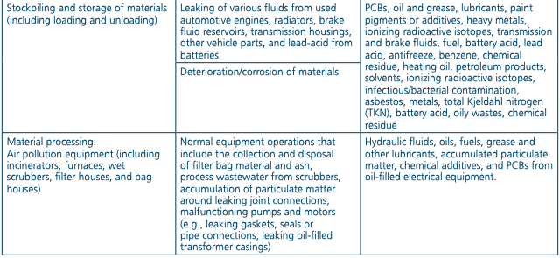
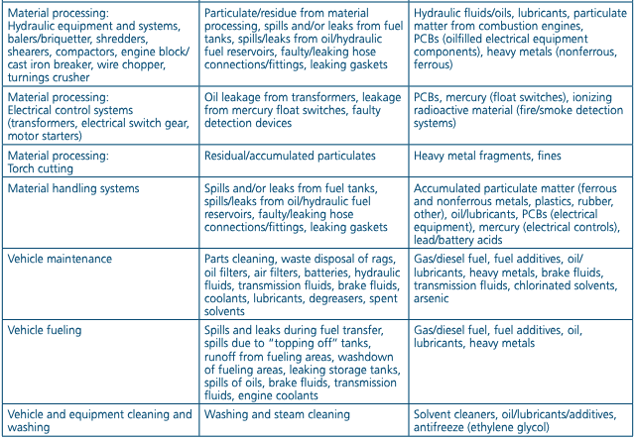
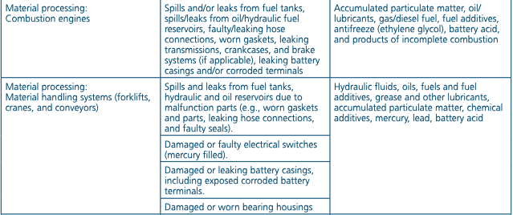
I. Scrap metal recycling
Each scrap recycling facility is unique in regards to sources, type, and volume of contaminated stormwater discharges. As a result, there is variation in pollutants for which BMPs may be necessary to address. The table below indicates the common pollutants and its source associated with activities.
Source: Industrial Stormwater Fact Sheet Series, U.S. EPA Office of Water, Dec 2006

Slide 58
I. Scrap metal recycling (cont’d)
A combination of appropriate BMPs will yield the most effective stormwater management for minimizing the offsite discharge of pollutants via stormwater runoff.
The effective BMPs include:
Regular cleanup, collection and containment of debris in storage areas
Housekeeping practices
Spill control
Employee training
Oil/water separators
Wet ponds
Proprietary filter devices
Other BMPs based on activities
Example
Treat stormwater from 40 acre recycling yard in Schnitzer Steel, Portland, OR.
Pollutants: aluminum, cadmium, chromium, copper, iron, lead, nickel, zinc and total suspended solids (TSS)
A multi-stage 600gpm WaveIonics treatment system (see next slide) consisting of electrocoagulation, clarification, filtration and carbon polishing are used to treat stormwater.

Slide 59
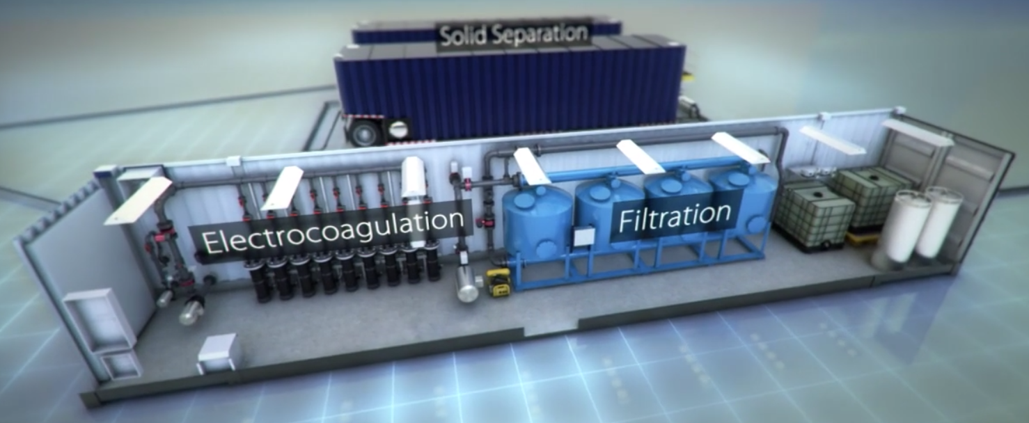
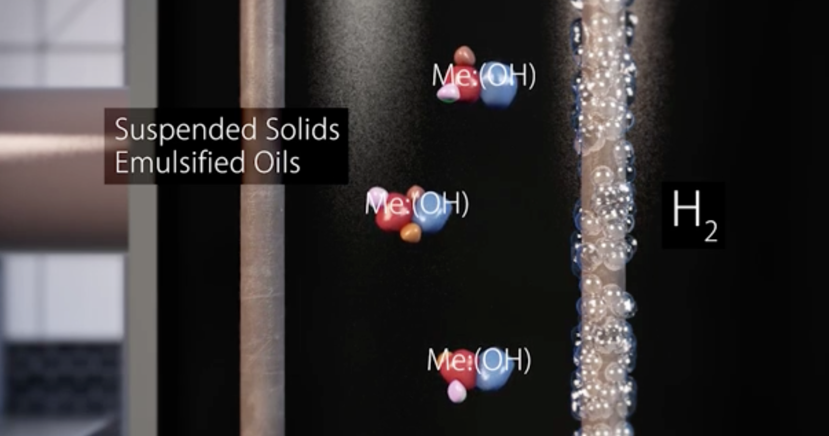
I. Scrap metal recycling (cont’d)
WaveIonics technology
Uses electrocoagulation enhanced filtration technology
Removes total suspended solids, heavy metals, emulsified oil, bacteria, sulfides, oil & grease, silica, phosphorus, BOD, COD, PCB, PAHs.
Suitable for applications such as oil & gas produced water, mine process water, industrial storm and wastewater, and construction stormwater
Modifications can be applied to the process based on effluent objectives
http://www.watertectonics.com/technology/waveionics/
http://www.watertectonics.com/technology/waveionics/
Video demonstration: http://www.watertectonics.com/technology/waveionics/

Slide 60
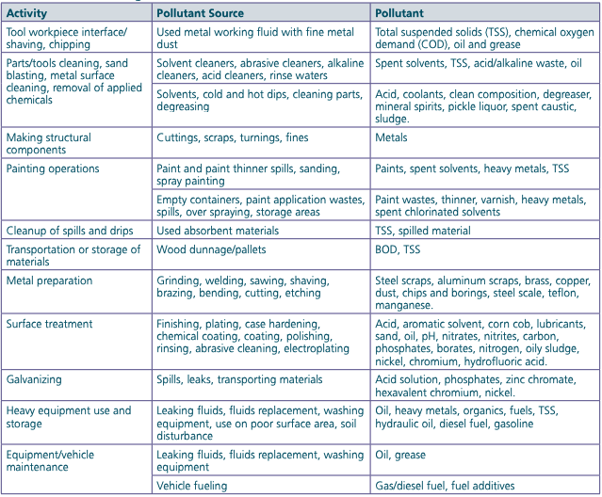

II. Metal fabrication/finishing industry
Pollutants conveyed in stormwater discharges from facilities involved with metal fabrication/finishing will vary. The activities, pollutant sources, and pollutants detailed in the following table are commonly found at metal fabricating/finishing facilities.
Source: Industrial Stormwater Fact Sheet Series, U.S. EPA Office of Water, Dec 2006

Slide 61
II. Metal fabrication/finishing industry (cont’d)
A variety of BMP options may be applicable to eliminate or minimize the presence of pollutants in stormwater discharges from metal fabrication/finishing facilities. Since most of the operations occur indoors, minimizing exposure of pollutants to stormwater runoff is very important. The effective BMPs include:
Regular cleanup, collection and containment of debris in storage areas
Housekeeping practices
Spill control
Employee training
Use of covers, indoor storage, and indoor operations
Grass swales
Sedimentation ponds
Other suitable BMPs according to activities

Slide 62
II. Metal fabrication/finishing industry (cont’d)
Silver Bullet — A technology for metal fabrication/finishing facilities
https://brashind.com/
The Sivler Bullet is an automatic stormwater treatment system. It can treat stormwater at the rate of up to 200 gallon per minute with high removal efficiency.
Target pollutants:
Metals (Aluminum, Copper, Iron, Lead, Magnesium, Zinc)
Oil & grease
Total suspended solid
COD
BOD
Enterococcus
Fecal Coliform
Other applicable industries:
Scrap metal recyclers
Municipal waste collection facilities
Secondary metal refiners
Manufacturing facilities
Sand blasting companies
Plating and galvanizing facilities
Municipal waste sorting facilities
Truck maintenance facilities

Slide 63


II. Metal fabrication/finishing industry (cont’d)
Silver Bullet treatment process
Stormwater is pretreated to remove large particles and pollutants
Followed by flocculation to form large particles, then settled out by gravity settling
https://brashind.com/
Remaining suspended particles (100 micron to 5 micron) are removed by filter
Dissolved pollutants are removed by an ion bed
Disinfected by UV radiation
https://brashind.com/

Slide 64


III. Food industry
The food industries have requirements for sanitary conditions, so that raw materials through final product be protected from stormwater.
Therefore, the contamination of stormwater from these activities are primarily from the loading and unloading of products and raw materials; spillage and leaks from tanks and containers stored outdoors; waste management practices; pest control; and improper connections to the storm sewer.
The activities, pollutant sources, and pollutants detailed in table are commonly found at food products facilities.
Source: Industrial Stormwater Fact Sheet Series, U.S. EPA Office of Water, Dec 2006

Slide 65



III. Food industry(cont’d)
Non-structural BMPs
Dispose of grease and oil safely
Clean spills
Maintain garbage dumpsters
https://www.countyofnapa.org/DocumentCenter/View/2904/BMPs-for-Food-Service-Facilities---Brochure-PDF
Maintain, pump, and use grease traps and interceptors to prevent overflows. Keep grease bins covered and contained. Recycle grease and oil. Reduce the amount of grease washed down the drain by scraping off trays, grills, and pans into a grease can. Do not pour grease and oil into sinks, floor drains, parking lots or streets.
Keep garbage dumpster lids closed to keep rain and rodents out. Keep litter from accumulating around docks by providing trash receptacles and encouraging employees to use them. Never dispose of liquids in the dumpster. Inspect for leaks on a regular basis and have bins replaced when necessary.
For small spills or drips, put absorbent material like kitty litter on the spill to contain it. Sweep up the used absorbent, place in a secure bag, and deposit in a secure trash bin.

Slide 66

III. Food industry (cont’d)
Example: Double Scoop ice cream company
Effective BMPs
Minimum BMPs (discussed in Part 2)
Oil/water separator
Rain garden
Vegetated Swales
Cartridge filtration
Permeable pavement
Constructed wetland
Other suitable BMPs according to activities
Parking
Pavement
Storage Building
Milk Storage Tanks
Double Scoop ice cream company
Pre-BMP site map
Source: Stormwater Management for Industrial Activities, U.S. EPA Office of Water, Dec 2006

Slide 67
III. Food industry (cont’d)
Example: Double Scoop ice cream company
Parking
Pavement
Permeable pavement
vegetated swale
Infiltrate stormwater into ground
Detain stormwater runoff and remove pollutants
Storage Building
Green roof
Cisterns
Detain roof stormwater runoff
Milk Storage Tanks
Collect excess roof stormwater runoff
Double Scoop ice cream company
Pre-BMP site map
Rain Gardens
Tree well
Detain stormwater runoff and remove pollutants
Detain stormwater runoff and remove pollutants
Source: Stormwater Management for Industrial Activities, U.S. EPA Office of Water, Dec 2006

Slide 68
IV. Petroleum industry
Pollutants in stormwater runoff from facilities involved with the exploration and production techniques will vary depending on the type and characteristics of formations, pollutants present, and waste management controls.
Major pollutants in petroleum industry
Effective BMPs
Total suspended solids (TSS)
Total dissolved solids(TDS)
Oil and grease
Chemical oxygen demand (COD)
Chlorides
Barium
Naphthalene
Benzene
Lead
Arsenic
Fluoride
Petroleum-derived hydrocarbons
Minimum BMPs (discussed in Part 2)
Drum & container containment
Tank containment
Biological based parts cleaners
Oil/water separator
Other suitable BMPs according to activities

Slide 69

IV. Petroleum industry (cont’d)
Oil/Water Separators
Drum & Container Containment
Remove oil and sediment
Prevent damages and leakages
Tank Containment
Prevent damages and leakages
Biological Based Parts Cleaners
Constructed Wetlands
Detain stormwater and remove pollutants
Remove petroleum hydrocarbons
https://www.schneider-electric.com/en/work/solutions/for-business/oil-and-gas/

Slide 70
Table of Contents
    Background: LA River Revitalization
    Stormwater BMPs
    Examples of Different Industries
    Summary and Discussion
    Future Work
    References

Slide 71
Part 4
Summary and Discussion

Slide 72
Summary and Discussion
Relation to LA River revitalization:
Stormwater BMPs provide economical and environmental-friendly incentives for achieving LA River revitalization, protecting LA River from being polluted by industrial stormwater discharges.
Regulations to protect LA River:
Owners or operators of specific industrial facilities are required to obtain General Permit and prepare Stormwater Pollution Prevention Plan to protect beneficial uses of water resources.
Stormwater BMPs for industries:
Minimum BMPs should be implemented by all General Industrial Permit holders.
Advanced BMPs can be chosen and tailored based on industrial activities to ensure the compliance with regulations.
The following industries are presented as examples:
Scrap metal recycling
Metal fabrication/finishing industry
Food industry
Petroleum industry

Slide 73
Summary and Discussion (cont’d)
With the increasing urbanization of Los Angeles, the water quality in LA River has declined significantly. Stormwater BMPs will play a more and more important role in achieving LA River Revitalization.
The stormwater BMPs discussed in this study should be identified and tailored according to the industry type, facility sizes, industry activities, and other factors.
Some industrial activities can be applied to a variety of other industrial facilities, and the selected BMPs can be tailored to the specific industrial activity or operation.
It would be more effective to implement a combination of different BMPs to address stormwater runoff at the facility.

Slide 74
Table of Contents
    Background: LA River Revitalization
    Stormwater BMPs
    Examples of Different Industries
    Summary and Discussion
    Future Work
    References

Slide 75
Part 5
Future Work

Slide 76
Future Work
(This section is in progress)
The use of BMPs in several European countries is currently being reconsidered to address efficiency, practicality, and cost-effectiveness. Other countries such as China are also adopting new programs and technologies to better manage and treat stormwater.
This section briefly discusses stormwater case studies in several countries.

Slide 77

  Case study I:
  Coal-powered electricity generating facilities in China
Pollutants may be present in stormwater as a result of outdoor activities such as: material handling and transport operations, waste disposal, and deposition of airborne particulate matter.
The primary and largest potential source is ash refuse piles. Pollutants such as vanadium, sodium, sulfur, and nickel are all common elements found in oil ash. Silica, alumina, ferric oxide, calcium oxide, magnesium oxide, and sodium and potassium oxides are all common.
The activities, pollutant sources, and type of pollutants detailed in the following table are commonly found at steam electric generating facilities, including coal handling areas.
Source: Industrial Stormwater Fact Sheet Series, U.S. EPA Office of Water, Dec 2006

Slide 78
  Case study I:
  Coal-powered electricity generating facilities in China (cont’d)
Example: Stormwater management in coal handling area, China
Treatment steps:
Collect stormwater
Intercept and temporarily store trash
Discharge early-period stormwater due to its heavy load pollutants
Filtration
Temporarily store stormwater
Coagulation, clarification, deep filtration, and disinfection
Reuse for recreation, toilet flushing, and landscape irrigation

Slide 79





  Case study I:
  Coal-powered electricity generating facilities in China (cont’d)
Example: Stormwater management in coal handling area, China
Recreation
Reuse
Toilet flushing
Stormwater collection
Storage tank
Pretreatment
Integrated treatment device
Screen
Filtration
Pump
Landscape irrigation
https://www.hlhbzj.com/id557787.html

Slide 80
Table of Contents
    Background: LA River Revitalization
    Stormwater BMPs
    Examples of Different Industries
    Summary and Discussion
    Future Work
    References

Slide 81
Part 6
References

Slide 82
References
  Stormwater Best Management Practice Handbook: Industrial and Commercial, California Stormwater Quality Association (CASQA), September 2014.
  Best Management Practices For Industrial Storm Water Pollution Control, Sacramento Stormwater Management Program, June 1992.
  Industrial Stormwater Best Management Practices Manual, by Dennis Jurries and Krista Ratliff, February 2013.
  https://www.waterboards.ca.gov/rwqcb4/water_issues/programs/regional_program/Water_Quality_and_Watersheds/los_angeles_river_watershed/la_summary.shtml
  https://www.ioes.ucla.edu/project/how-competing-los-angeles-river-revitalization-plans-will-affect-surrounding-communities/
  https://instrumentnation.com/air-systems-av-55-electric-55-gallon-drum-lid-hepa-vacuum-system/
  https://www.spartanwatertreatment.com/articles/Ozone-Treatment-for-Cooling-Towers-Federal-Technology-Alert.pdf
  https://stormwater.pca.state.mn.us/index.php/Types_of_stormwater_wetlands
  https://stormwater.wef.org/2012/07/subsurface-gravel-wetlands-for-stormwater-management/
  http://prj.geosyntec.com/npsmanual/constructedstormwaterwetlands.aspx

Slide 83
References
  https://www.1800sweeper.com/sweeping-services/permeable-pavement-cleaning
  https://en.wikipedia.org/wiki/API_oil%E2%80%93water_separator
  http://www.elliswastewater.com/products/oil-water-separator/
  http://www.jkdirtworks.com/html/rain_gardens.html
  Industrial Stormwater Fact Sheet Series, U.S. EPA Office of Water, Dec 2006
  http://www.watertectonics.com/technology/waveionics/
  https://brashind.com/
  https://www.countyofnapa.org/DocumentCenter/View/2904/BMPs-for-Food-Service-Facilities---Brochure-PDF
  Stormwater Management for Industrial Activities, Section I, U.S. EPA Office of Water, Dec 2006.
  Stormwater Management for Industrial Activities, Section N, U.S. EPA Office of Water, Dec 2006.
  Stormwater Management for Industrial Activities, Section O, U.S. EPA Office of Water, Dec 2006.
  Stormwater Management for Industrial Activities, Section U, U.S. EPA Office of Water, Dec 2006.

Slide 84
References
  Stormwater Management for Industrial Activities, Section AA, U.S. EPA Office of Water, Dec 2006.
  https://www.schneider-electric.com/en/work/solutions/for-business/oil-and-gas/
  https://www.hlhbzj.com/id557787.html
  Los Angeles River Revitalization Master Plan, City of Los Angeles Department of public Works Bureau of Engineering, April 2007.
  Green Infrastructure for Los Angeles: Addressing Urban Runoff and Water Supply Through Low Impact Development, City of Los Angeles, April 17, 2009.
  Water Quality Compliance Master Plan for Urban Runoff: Clean Stormwater/Urban Runoff Master Plan, Watershed Protection Division Bureau of Sanitation Department of Public Works, City of Los Angeles, May 2009.
  https://www.epa.gov/npdes/stormwater-discharges-industrial-activities
  https://www.waterboards.ca.gov/water_issues/programs/stormwater/docs/industrial/2014indgenpermit/atta.pdf
  State Water Resources Control Board (SWRCB) Order No. 2014-0057-DWQ, National Pollutant Discharge Elimination System General Permit No. CAS000001, General Permit for Storm Water Discharges Associated with Industrial Activities.

Slide 85
References
  Industrial Stormwater Best management practices Guidebook, Minnesota pollution control agency, Version 1.1, April 2015.
  Stormwater Best Management Practice Handbook: New Development and Redevelopement, California Stormwater Quality Association (CASQA), January 2003.
  https://www.waterboards.ca.gov/water_issues/programs/stormwater/igp_20140057dwq.shtml
  https://www.waterboards.ca.gov/rwqcb4/water_issues/programs/stormwater/municipal/watershed_management/los_angeles/upper_reach2/15-01-27LARUR2WMARevWMP.pdf
  https://escholarship.org/content/qt42m433ps/qt42m433ps.pdf
  https://www.waterboards.ca.gov/rwqcb2/water_issues/programs/stormwater/muni/nrdc/16%20bmp_refguide%5B1%5D.pdf
  http://www.waterresources.saccounty.net/stormwater/documents/industrial-BMP-manual.pdf
  http://sccd.org/wp-content/uploads/2015/07/Infiltration-Trenches.pdf
  https://www.epa.gov/sites/production/files/2015-11/documents/swppp_guide_industrial_2015.pdf
  https://www.epa.gov/sites/production/files/2015-07/documents/tmdl-sw_permits11172008.pdf
  https://www.waterboards.ca.gov/rwqcb4/water_issues/programs/regional_program/Water_Quality_and_Watersheds/los_angeles_river_watershed/la_summary.shtml

Slide 86
References
  https://www.waterboards.ca.gov/water_issues/programs/stormwater/igp_20140057dwq.shtml
  https://www.pca.state.mn.us/sites/default/files/wq-strm3-26.pdf
  https://www.epa.gov/sites/production/files/2015-10/documents/sector_f_primarymetals.pdf
  https://stormwaterx.com/stormwaterx_products/aquip/
  https://www.deq.state.or.us/wq/wqpermit/docs/indbmp021413.pdf

