Slide 1
Stormwater BMPs for
Construction Site and Parking Lot
“A Holistic Approach to LA River Revitalization Program”
ENE510 - Water Quality Management and Practice
Students: Wanxin Cai, Hisham Maddah, Wenxin Deng,
Atosa Vahdati, Jacqueline Wu,and Mohammed AlMugahwi
Supervisor: Professor Massoud (Mike) Pirbazari
July 2019

Slide 2

https://cee.usc.edu/research/water-quality-research-group/swan/

Slide 3
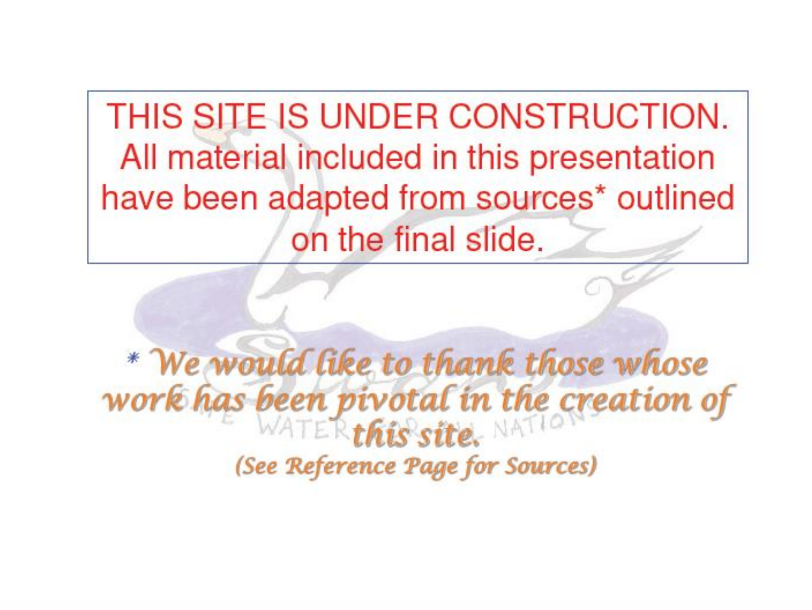

Slide 4
To the Visitors,
Your comments and suggestions are appreciated. Please direct your thoughts to Wanxin Cai at wxcai@alumni.usc.edu.
Thank you.

Slide 5
Table of Contents
    1. Background: LA River Revitalization
      Impact to LA River
      Relation to LA River Revitalization
    2. Stormwater BMPs for Construction Site
    3. Stormwater BMPs for Parking Lot
    Summary and Discussion
    References

Slide 6
Part 1
Background: LA River Revitalization

Slide 7
Impact to LA River
With the increasing urbanization of Los Angeles, the water quality in LA River has declined significantly. It is mostly resulted from untreated stormwater runoff entered the LA River.
Water pollution from point sources including commercial, industrial, and municipal facilities are controlled by Clean Water Act and National Pollution Discharge Elimination Systems permit (NPDES). While nonpoint source pollution is difficult to control. Stormwater runoff can come in contact with natural and manmade pollutants and transport the pollution into the water systems. A wide range of pollutants including sediments, oil, grease, toxic chemicals, heavy metals, and bacteria can find their way into LA River.
As the stormwater runoff flows, it collects and transports pollutants. Disturbances of the soil from construction site can cause erosion and wash sediment into storm systems and receiving waters. Leaking or spilt petroleum, pesticides, cleaning solvents, heavy metals, paint, or preserved wood, and other toxic chemicals in construction site, as well as oil and grease from parking lot can contaminate stormwater and be transported downstream into LA River.

Slide 8
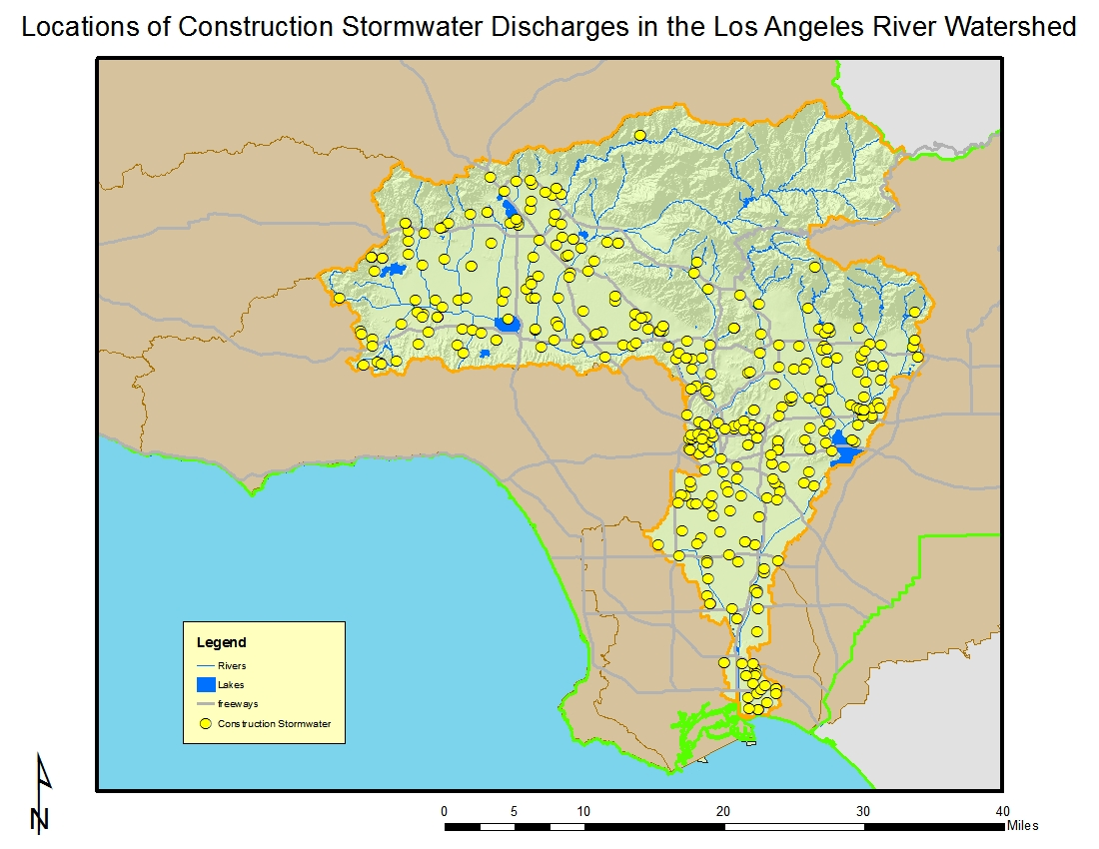
Impact to LA River (cont’d)
There are a total of 378 construction sites enrolled under the general construction storm water permit in this watershed, the most in the Region but half of the number of sites enrolled in 2007.
The larger sites are in the upper watershed (which includes the San Fernando Valley) and the construction in this watershed is fairly evenly divided between commercial and residential.
About one-third of the sites are five acres or larger in size with the largest sites being up to 700 acres.
Locations of construction stormwater discharges in the Los Angeles River Watershed
https://www.waterboards.ca.gov/rwqcb4/water_issues/programs/regional_program/Water_Quality_and_Watersheds/los_angeles_river_watershed/la_summary.shtml

Slide 9
Relation to LA River Revitalization
The 303(d) list (in next page) implicates pH, ammonia, a number of metals, coliform, trash, scum, algae, oil, chlorpyrifos as well as other pesticides, and volatile organics.
The City of Los Angeles, US Army Corps of Engineers and multiple partners developed a Los Angeles River Revitalization Master Plan. Improving water quality of LA River is a major priority of this Plan.
The pollution source control in construction areas and parking lot plays an important role in protecting LA River. Construction sites have to follow the guidelines, and obtain the necessary permits to minimize the release of the pollutants due to construction activities. Requiring Stormwater Permit, compliance with Total Maximum Daily Load (TMDL) Requirements, installation and monitoring of the Best Management Plans (BMPs), design and implementation of the Stormwater Pollution Prevention Plan (SWPPP) are among the controls that checks the construction sites to protect LA River from being polluted by stormwater runoff.

Slide 10
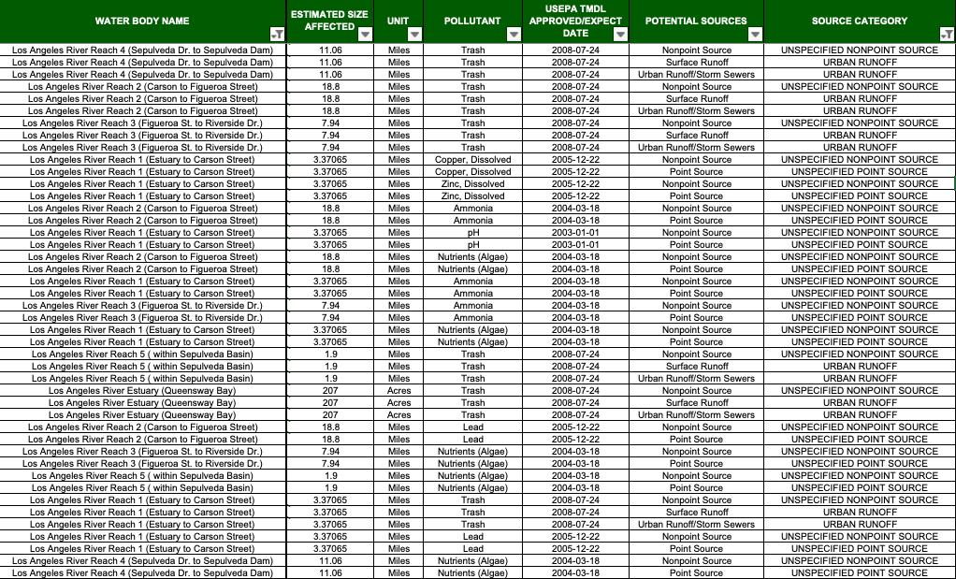
Relation to LA River Revitalization (cont’d)
LA River impaired water body – 303(d) list
Source: CAEPA
Notes:
List all the table or just nonpoint source and urban runoff
TMDL Numeric target/ TMDL Allocation

Slide 11
Table of Contents
    Background: LA River Revitalization
    Stormwater BMPs for Construction Site
      Introduction
      Pollutants of concern in construction site
      California regulatory program
      Stormwater Pollution Prevention Plan (SWPPP)
      Erosion and sediment control BMPs
      Non-structural BMPs
      Treatment technologies
      Case studies
    Stormwater BMPs For Parking Lot
    Summary and Discussion
    References

Slide 12
Part 2
Stormwater BMPs for
Construction Site

Slide 13

Introduction
  Construction activities can be a significant source of stormwater contamination to LA River.
  Sediment and other pollutants (paint, concrete, etc.) can be washed or tracked offsite, eventually entering the storm drain system.
  Suitable stormwater BMPs can effectively prevent stormwater pollutants from being discharged to LA River.
http://southvault.com/2018/10/08/top-10-construction-site-security-tips-for-contractors/

Slide 14
Pollutants of concern in construction site
Common pollutants in stormwater runoff
Pollutant | Sources | Impact
Nutrients (N & P) | Fertilizers, sediment, other chemicals | Prompts algae growth and deoxygenation
Pathogens | Human wastes | Diseases and infections
Metals | Treated wood, paint | Toxic to aquatic organisms
Pesticides | Herbicides, insecticides through erosion of soil | Kill aquatic organisms and vegetation, and contaminate drinking water
Oil, grease, and fuels | Leaks, spills, and dumping of fuel and petroleum products | Toxic and might be carcinogenic
Solid Waste | Mulch, wood material, paper waste, litter by workers | Clog waterways, floating pollution and aesthetic impacts

Slide 15
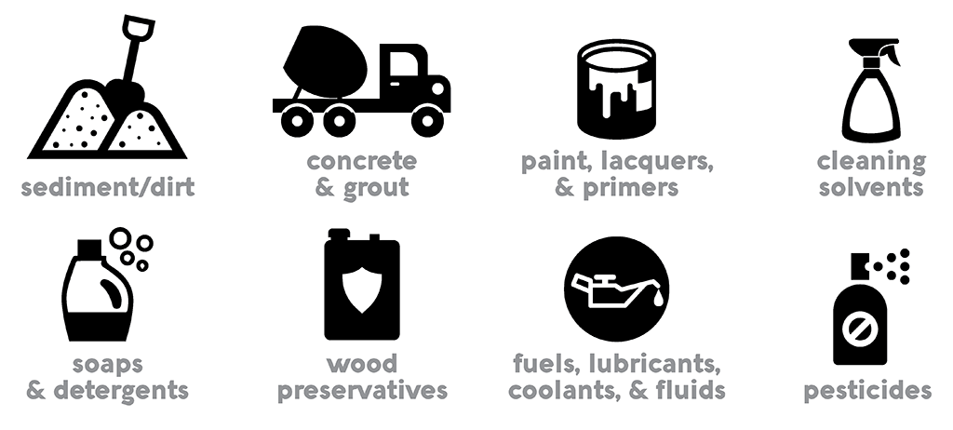
Pollutants of concern in construction site
Pollutants associated with construction activities
https://h2oc.org/resources/pollution-prevention-for-construction-sites/
Excessive erosion and sedimentation are the most visible water quality impacts due to construction activities.
Other less visible pollutants are metals, nutrients, soil additives, pesticides, construction chemicals, and other construction waste.
The magnitude of stormwater impacts depends on construction activities, climatic conditions, and site conditions.

Slide 16
Pollutants of concern in construction site
Pollutants associated with construction activities (cont’d)
Area of consideration | Sediment | Nutrient | Heavy metals | pH | Pesticide& herbicide | Oil & grease | Bacteria &viruses | Trash& solid | Other toxic chemicals
Clearing, grading, excavating, and unstabilized areas
Paving operations
Concrete washout and waste
Structure construction /painting/cleaning
Demolition & debris disposal
Dewatering operation
Drilling and blasting operations
Material delivery and storage
Material use
Solid waste
Hazardous waste
Contaminated spills
Sanitary/septic waste
Vehicle/equipment fueling and maintenance
Vehicle/equipment use and storage
Landscape operations

Slide 17
California regulatory program
State NPDES stormwater permitting program
The NPDES stormwater permitting program is administered by the State Water Resources Control Board (SWRCB) through its nine Regional Water Quality Control Boards (RWQCBs).
Construction General Permit: it can be applied to most construction activities in the state.
Construction Individual Permit: it generally be limited to very large construction projects that discharge to critical receiving waters.
Construction General Permit
In California, owners of construction projects may obtain NPDES permit coverage by filing a Notice of Intent (NOI) to be covered under the State Water Resources Control Board (SWRCB) Order No. 2009-0009-DWQ, National Pollutant Discharge Elimination System (NPDES) General Permit No. CAS000002, Waste Discharge Requirements (WDRs) for Discharges of Stormwater Runoff Associated with Construction Activity (General Permit) and subsequent adopted modifications.

Slide 18
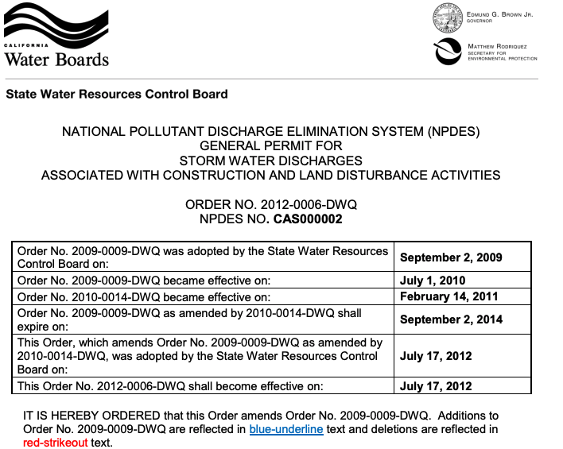
California regulatory program
General Permit
Adopted Order 2009-0009-DWQ (As amended by 2010-0014-DWQ and 2012-0006-DWQ)

Slide 19
California regulatory program
General Permit (cont’d)
Effluent Standards
Narrative Effluent Limitations
Storm water discharges and authorized non-storm water discharges regulated by this General Permit shall not contain a hazardous substance equal to or in excess of reportable quantities established in 40 C.F.R. §§ 117.3 and 302.4, unless a separate NPDES Permit has been issued to regulate those discharges.
Dischargers shall minimize or prevent pollutants in storm water discharges and authorized non-storm water discharges through the use of controls, structures, and management practices that achieve BAT for toxic and non-conventional pollutants and BCT for conventional pollutants.
Source: Adopted Order 2009-0009-DWQ (As amended by 2010-0014-DWQ and 2012-0006-DWQ)

Slide 20
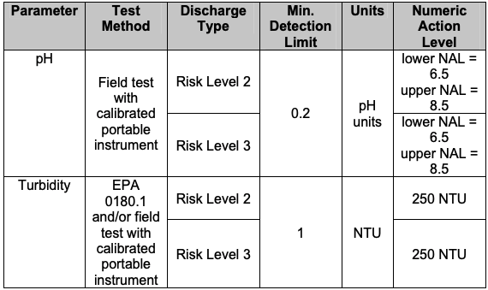
California regulatory program
General Permit (cont’d)
Effluent Standards
Numeric Action Levels, test methods, detection limits, and reporting units
Storm event average NAL
Storm event average daily NAL
Source: Adopted Order 2009-0009-DWQ (As amended by 2010-0014-DWQ and 2012-0006-DWQ)

Slide 21
California regulatory program
General Permit (cont’d)
Receiving Water Limitation
The stormwater discharges and authorized non-storm water discharges will not adversely affect human health or the environment.
The stormwater discharges and authorized non-storm water discharges will not contain pollutants in quantities that threaten to cause pollution or a public nuisance.
The stormwater discharges and authorized non-storm water discharges will not contain pollutants that cause an exceedance of any applicable water quality objectives or water quality standards contained in a Statewide Water Quality Control Plan, the California Toxics Rule, the National Toxics Rule, or the applicable Regional Water Board’s Water Quality Control Plan(Basin Plan).
Dischargers located within the watershed of a CWA § 303(d) impaired water body, for which a TMDL has been approved by the U.S. EPA, shall comply with the approved TMDL if it identifies “construction activity” or land disturbance as a source of the pollution.
Source: Adopted Order 2009-0009-DWQ (As amended by 2010-0014-DWQ and 2012-0006-DWQ)

Slide 22
California regulatory program
Primary objectives of the General Permit
Reduce erosion.
Minimize or eliminate sediment in stormwater discharge.
Prevent materials used at a construction site from contacting stormwater.
Implement a sampling and analysis program if stormwater is exposed to construction materials.
Eliminate unauthorized non-stormwater discharges from the construction sites.
Implement appropriate measures to reduce potential impacts on waterways both during and after construction of projects.
Establish maintenance commitments on post-construction pollution control measures.
Comply with Construction General Permit
Submit a Notice of Intent (NOI) and pay fees prior to the beginning of construction.
Prepare the SWPPP before construction begins.
Keep the SWPPP on the site; implement it during construction and revise it as needed to reflect all phases of construction.
Submit Notice of Termination (NOT) when construction is complet.

Slide 23
Stormwater Pollution Prevention Plan (SWPPP)
Construction sites that result in soil disturbance of one acre or greater will require the preparation and implementation of a SWPPP meeting the requirements of the General Permit. The SWPPP must be prepared prior to any activity with the potential to cause water pollution. Implementation of the SWPPP begins when construction begins.
The SWPPP includes:
The project location, site features, and materials/activities that may result in the off-site discharge of pollutants during construction
Controls to be implemented during construction - BMPs selected to control erosion, the discharge of sediment, and other pollutant sources
An inspection and maintenance program for BMPs
A sampling and analysis plan for sediment discharges to impaired water bodies as well as a plan to sample for non-visible pollutants
Post construction controls – BMPs to prevent or control pollutants in runoff after construction is complete, including long-term maintenance

Slide 24
Stormwater Pollution Prevention Plan (SWPPP) Assess construction site and planned activities
Contractor activities
Information about contractor activities is required for the selection of proper BMPs:
  Equipment storage, cleaning and maintenance areas and activities
  Points of ingress and egress to the construction site
  Material loading, unloading, and storage practices and areas, including construction materials, building materials and waste materials
  Materials, equipment, or vehicles that may come in contact with stormwater
Disturbed areas and erosion potential
The physical condition of the site and adjacent areas should be reviewed.
Site characteristics including drainage patterns, soils, vegetation, surface water bodies, and steep or unstable slopes should be noted.
A hydrology report, soils report, and a grading/drainage plan should be prepared.
The SWPPP must be amended to address conditions as activities change at the site.
Disturbed areas and erosion potential
  Existing site characteristics, and areas of historic contamination (natural and/or industrial or agricultural) should also be recorded on the project layout.

Slide 25
Stormwater Pollution Prevention Plan (SWPPP) Identify and select BMPs
Define BMPs objectives
Selection of BMPs is based on the pollution risks associated with the construction activity. The pollution prevention objectives of BMPs are defined based on a review of information gathered during the assessment of the site and planned activities. The BMP objectives for construction projects are as follows:
  Control of erosion, and discharge of sediment:
  - Minimize disturbed areas
  - Stabilize disturbed areas
  - Protect slope and channels
  - Control site perimeter
  - Retain sediment
  Control of erosion, and discharge of sediment:
  - Practice good housekeeping
  - Contain materials and waste

Slide 26
Stormwater Pollution Prevention Plan (SWPPP) Identify and select BMPs (cont’d)
Identify BMPs catogories
After the BMP objectives are defined, identify the most suitable BMP to meet the objective. The BMP categories include:
  Erosion control (EC)
  Sediment control (SE)
  Wind erosion control (WE)
  Tracking control (TR)
  Non-stormwater management(NS)
  Waste mangement and materials pollution control (WM)
Select BMPs
  BMPs for erosion and sediment control are selected to meet the BMP objectives based on specific site conditions, construction activities, and cost.
  Various BMPs may be needed at different times during construction since activities are constantly changing site conditions.

Slide 27
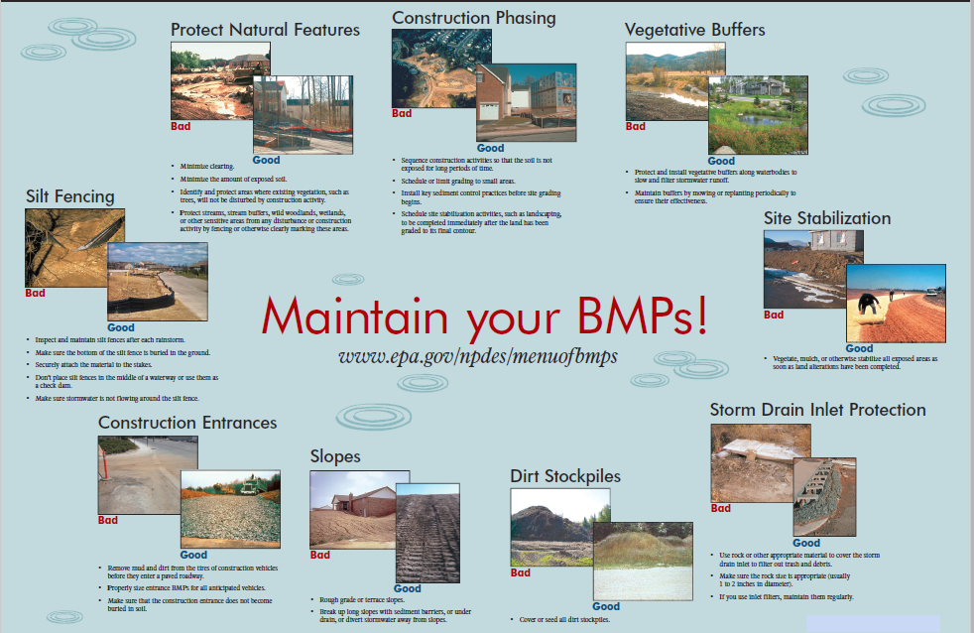
Stormwater Pollution Prevention Plan (SWPPP)
BMPs maintenance

Slide 28
Stormwater BMPs
Stormwater BMPs are control measures taken to mitigate changes to both quantity and quality of urban runoff caused through changes to land use.
Structural BMPs are engineering design based facilities that help to prevent pollutants in stormwater runoff and impact our local waterways. Structural BMPs require regular inspection and maintenance to ensure that they are operating effectively.
Non-structural BMPs focus on preserving open space, protecting natural systems, and incorporating existing landscape. Some focus on minimizing disturbed areas, and reducing the impervious areas by education, employee training and site management.
Stormwater BMPs in construction site:
Excessive erosion and sedimentation are the most visible water quality impacts due to construction activities. Other impacts are associated with discharge of pollutants such as metals, nutrients,, pesticides, construction chemicals, and other construction waste. Therefore, the types stormwater BMPs in construction site include erosion and sediment control BMPs, tracking control BMPs, material management BMPs, and site management BMPs.

Slide 29
Erosion and sediment control BMPs
Erosion Control BMPs
Scheduling
Existing vegetation preservation
Soil preparation and roughening
Hydroseeding
Hydraulic mulch
Straw mulch
Wood mulching
Soil binder
Geotextiles and mats
Earth dikes and drainage swales
Slope drain
Outlet protection
Sediment control
Silt fence
Sediment basin
Sediment trap
Check dams
Fiber rolls
Gravel bag berm
Sandbag barrier
Straw bale barrier
Street sweeping and vacuuming
Stormwater drain inlet protection
Chemical treatment
Tracking control
Construction entrance/exit stabilization
Construction roadway stabilization
Entrance/outlet tire wash

Slide 30
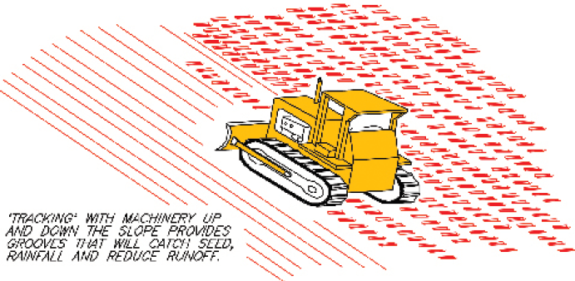
Erosion control BMPs
Soil preparation and roughening
Soil Preparation/Roughening involves assessment and preparation of surface. It includes:
Soil testing (seed base, soil characteristics, or nutrients)
Roughening surface soil with horizontal grooves across the slope, stair stepping, or tracking with construction equipment
Tilling topsoil to prepare a seed bed and/or incorporation of soil amendments
Purposes
Prepares soil for additional BMPs installation
Prepares a seed bed to aid and enhance vegetative establishment
Reduces runoff and increases infiltration
Reduces erosion and provides sediment trapping.

Slide 31
Erosion control BMPs
Soil preparation and roughening (cont’d)
Applications
All construction slopes require enhancing of vegetation stabilization.
Soil preparation is suitable when used with any soil stabilization method.
Roughening should be used with other erosion control as a complementary measure.
Limitations
Must be done prior to installing other erosion control and sediment control BMPs.
Limited effectiveness in anything more than a moderate storm.
Need re-roughened if roughening is washed away by a heavy storm.
Costs
Costs are depends on the labor of tracking or preparation of the slope and the cost of any soil amendment materials.

Slide 32
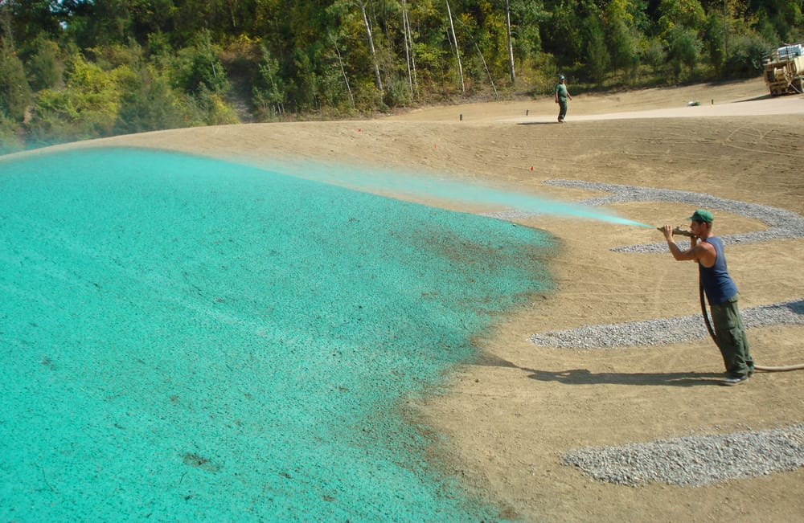
Erosion control BMPs
Hydroseeding
Hydroseeding plants rapid-growing annual grasses, small grains, or legumes with hydro-mulch equipment to provide temporary cover for erosion control on disturbed areas.
It typically consists of applying a mixture of wood fiber, seed, fertilizer, and stabilizing emulsion.
Purposes
Maintain sheet flow, promote infiltration, reduce sediment runoff, and improve visual aesthetics.
Temporarily protect exposed soils from erosion by water and wind.
Application
Suitable for soil disturbed areas requiring temporary protection until permanent stabilization is established.
https://sponzilli.com/hydroseeding-pro/

Slide 33
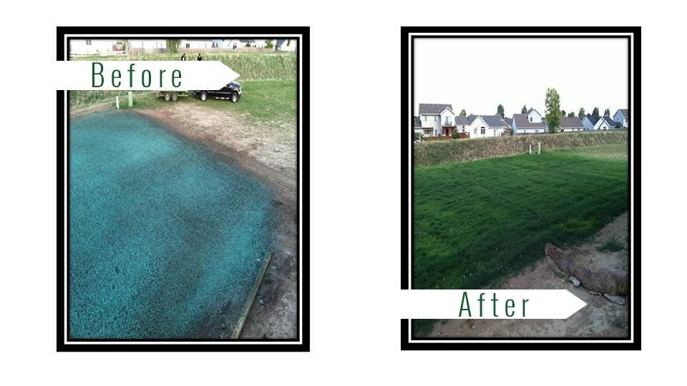
Erosion control BMPs
Hydroseeding (cont’d)

Slide 34
Erosion control BMPs
Hydroseeding (cont’d)
Limitations
It requires sufficient time for plants to grow and establish cover.
Potential over-fertilization can cause pollution of stormwater runoff.
Steep slopes are difficult to protect with temporary seeding.
Irrigation may be needed in dry periods for plants growth.
Costs
Hydroseeding |  | Installed cost per acre
High density | Ornamentals | $400-$600
 | Turf species | $350
 | Bunch grasses | $300-$1300
Fast growing | Annual | $350-$650
 | Perennial | $300-$800
Non-competing | Native | $300-$1600
 | Non-native | $400-$500
Sterile | Cereal grain | $500
Average cost for installation and maintenance:
Flat slope and stable soils:
$300 per acre
Moderate to steep slope and/or erosive soils:
$1600 per acre
Source: Caltrans Guidance for Soil Stabilization for Temporary Slopes, Nov. 1999

Slide 35
Erosion control BMPs
Mulch
Mulch is an application of a protective blanket of straw or other plant residue, gravel or synthetic material to the soil surface.
Purposes
Provides immediate protection to exposed soils for a short period.
Enhances plant growth by conserving moisture and moderating soil temperatures.
Helps hold fertilizer, seed, and topsoil in place in the presence of wind and runoff.
Reduces the speed of storm water runoff over an area.
Application
Suitable for soil-disturbed areas requiring temporary protection until permanent stabilization is established.
Areas which cannot be seeded because of the season, or other unfavorable condition for plant growth.
In areas with greater than 2:1 slope, mulching should immediately follow seeding.

Slide 36
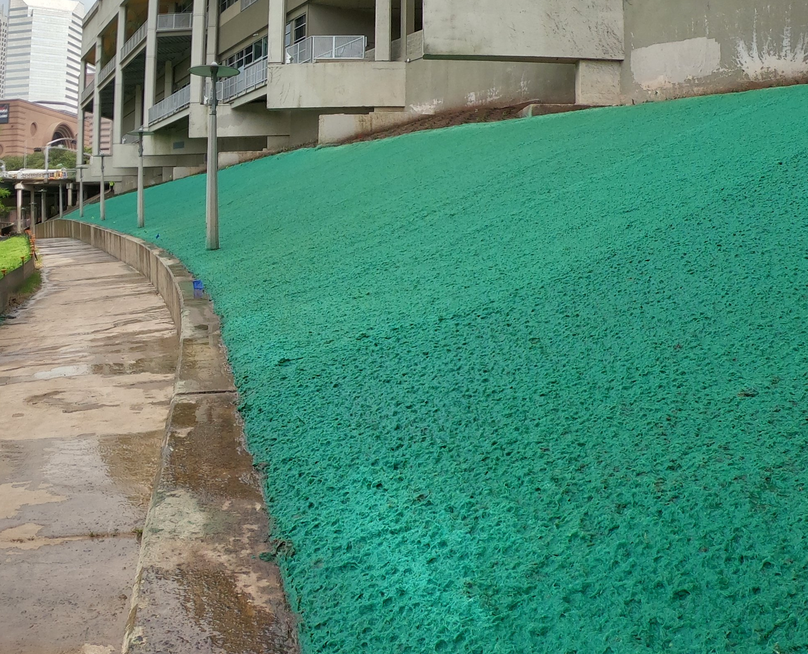
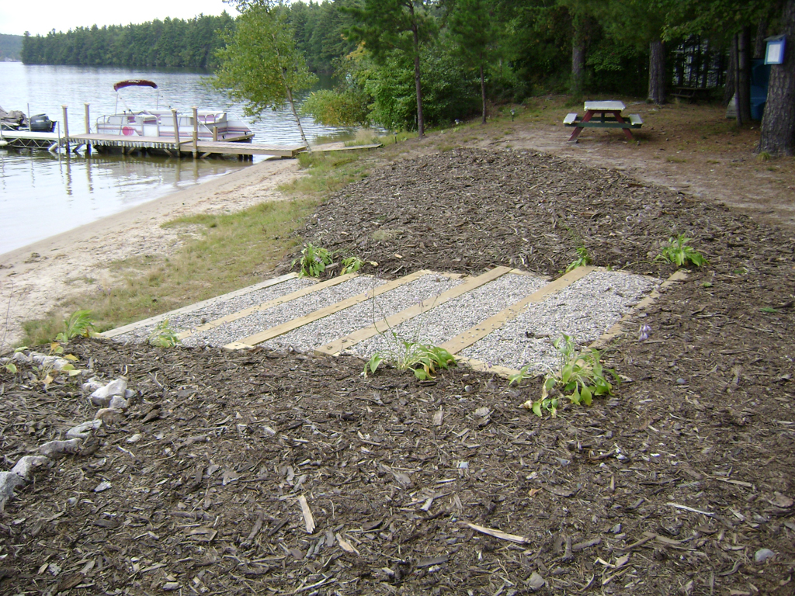
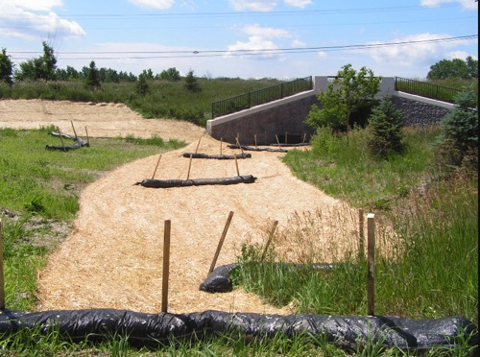
Erosion control BMPs
Mulch (cont’d)
Types of mulches
Hydraulic mulch consists of a mixture of shredded wood fiber or a hydraulic matrix, and a stabilizing emulsion or tackifier with hydro-mulching equipment.
Wood mulching consist of a mixture of shredded wood mulch, bark or compost to disturbed soils.
Straw mulch consists of placing a uniform layer of straw and incorporating it into the soil with a studded roller or anchoring it with a tackifier stabilizing emulsion.
Hydraulic mulch
Wood mulching
Straw mulch
https://www.constructionecoservices.com/stabilization/erosion-control-media
http://prj.geosyntec.com/npsmanual/mulchandnetting.aspx
http://www.erosionworks.net/services/minnesota-mulch-log

Slide 37
Erosion control BMPs
Mulch (cont’d)
Limitations and costs
Hydraulic mulch:
Wood fiber hydraulic mulches need 24 hours to dry before rainfall occurs to be effective.
May require a second application to remain effective for an entire rainy season.
Average cost for installation of wood fiber mulch is $900/acre. Average cost for installation of better matrix — bonded fiber matrix (BFM) is $5,500/acre.
Wood mulching:
Not suitable for slopes steeper than 3:1 (H:V). Best for slopes of 5:1 (H:V) or flatter.
Wood mulch and compost may introduce unwanted species.
Not suitable for areas exposed to concentrated flows.
May need to be removed prior to further earth work.
Average annual cost for installation and maintenance (3-4 months useful life) is around $4,000 per acre, but cost can increase if the source is not close to the project site.
Straw mulch:
There is a potential for introduction of weed seed and unwanted plant material.
Wind may limit application of straw and blow straw into undesired locations.
May have to be removed prior to permanent seeding or prior to further earth work.
Average annual cost for installation and maintenance (3-4 months useful life) is $2,500 per acre. Application by hand is more time intensive and potentially costly.

Slide 38
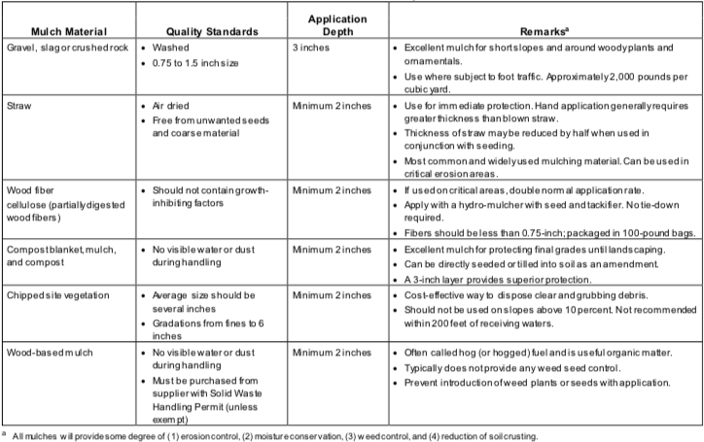
Erosion control BMPs
Mulch (cont’d)
Guide to mulch materials, rates and uses
Source: City of Seattle Stormwater MannualVolume 2: Construction Stormwater Control, Aug. 2017

Slide 39
Erosion control BMPs
Soil binder
Soil binders consist of applying and maintaining a soil stabilizer to exposed soil surfaces.
Purposes
Temporarily prevent water induced erosion and wind erosion of exposed soils on construction sites
Applications
Typically applied to disturbed areas requiring short term temporary protection.
Good alternative to mulches in areas where grading activities will soon resume.
Suitable for use on stockpiles.
Limitations
Temporary in nature and may needed reapplication after a storm event.
Requires a curing time until fully effective, which may be 24 hours or longer.
Will generally experience spot failures during heavy rainfall events.
May not penetrate soil made up primarily of silt and clay, particularly when compacted.
May not perform well with low relative humidity or low temperature.

Slide 40
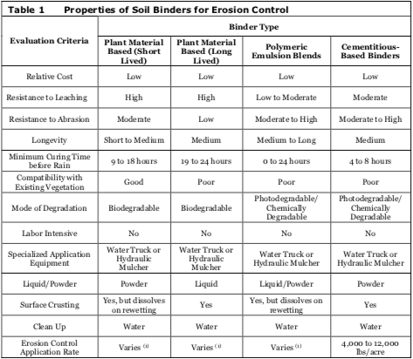
Erosion control BMPs
Soil binder (cont’d)

Slide 41
Erosion control BMPs
Soil binder (cont’d)
Selecting a soil binder
Factors to consider when selecting a soil binder include: Suitability to situation, soil types and surface materials, and frequency of application.
Costs
Soil binder | Average cost per acre
Plant-material based (short lived) binders | $400
Plant-material based (long lived) binders | $1200
Polymeric emulsion blend binders | $400
Cementitious-based binders | $800
Source: Caltrans Guidance for Soil Stabilization for Temporary Slopes, Nov. 1999

Slide 42
Erosion control BMPs
Geotextiles and Mats
Geotextiles are porous fabrics known in the construction industry as filter fabrics, road rugs, synthetic fabrics, construction fabrics, or simply fabrics.
Mattings, or Rolled Erosion Control Products (RECPs), can be made of natural or synthetic materials or a combination of the two.
Purposes
Reduces erosion from rainfall impact and holds soil in place
Absorbs and holds moisture near the soil surface
May be used to stabilized soils until vegetation is established
Applications
Slopes where erosion hazard is high and vegetation will be slow to establish
Stream banks, swales and other drainage channels with flows exceeding 3.3 ft/s
Areas where the soil surface is disturbed and where vegetation has been removed
Slopes adjacent to water bodies.

Slide 43
Erosion control BMPs
Geotextiles and Mats (cont’d)
Advantages
A wide variety of geotextiles to match specific needs
Provides immediate protection from surface erosion
Helps retain soil moisture improving seed germination and vegetation establishment
Longevity of 3 years (not considering vegetation)
Disadvantages
Installed costs are generally higher than other erosion control BMPs
May delay seed germination due to the soil temperature reduction
Not suitable for excessively rocky sites or areas where the final vegetation will be mowed
Should be removed and disposed prior to permanent soil stabilization
May not be suitable near known wildlife habitat when a plastic netting is incorporated
May have limitations based on soil type, slope gradient, or channel flow rate
May cause serious erosion problems in the areas receiving the increased flow when the plastic sheeting is used
Not environmental friendly when the plastic sheeting is used

Slide 44
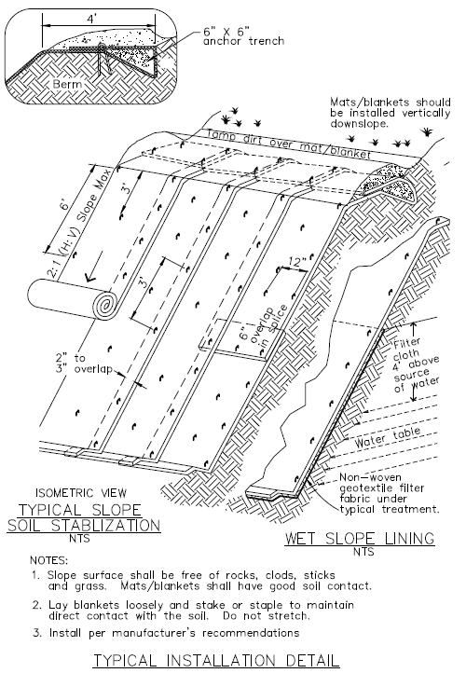
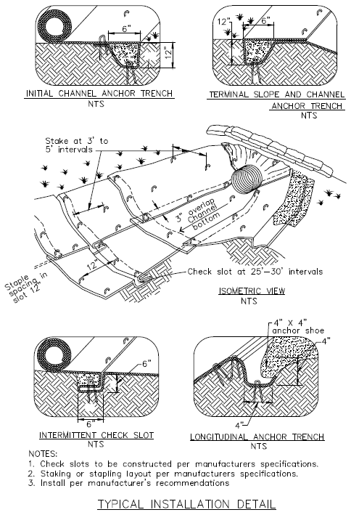
Erosion control BMPs
Geotextiles and Mats (cont’d)
Typical installation detail
Source: California Stormwater BMP Handbook: Construction, November 2009

Slide 45
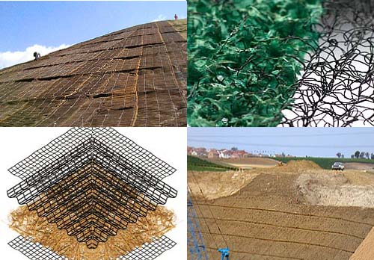
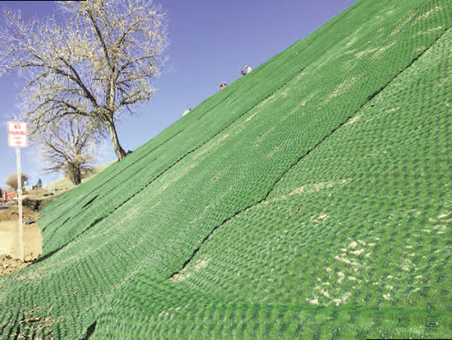
Erosion control BMPs
Geotextiles and Mats (cont’d)
Turf Reinforced Mat (TRMs)
Turf Reinforced Mat (TRMs) is a subset of geotextiles. TRMs combine vegetative growth with synthetic materials to form a high-strength mat that helps prevent soil erosion in drainage ways and on steep slopes.
http://www.dot.ca.gov/design/lap/landscape-design/erosion-control/recp/turf.html
https://www.geosynthetica.net/tencate-geosynthetics-turf-reinforcement-feb2017/

Slide 46
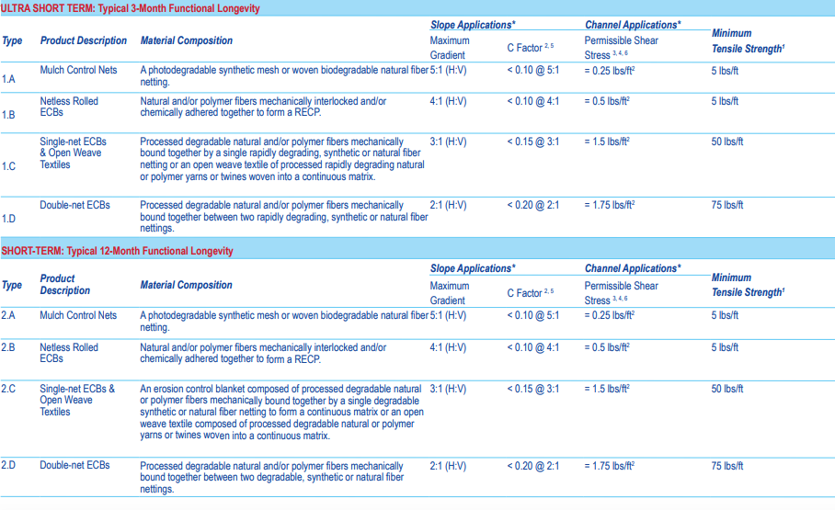
Erosion control BMPs
Geotextiles and Mats (cont’d)
Erosion Control Technology Council Standard Specification for Temporary Rolled Erosion Control Products
ECBs: Erosion Control Blankets
Source: Planning and Technical Specifications Manualfor Stormwater Pollution Prevention Plans, Kentucky Transportation Center, University of Kentucky, Oct 2009

Slide 47
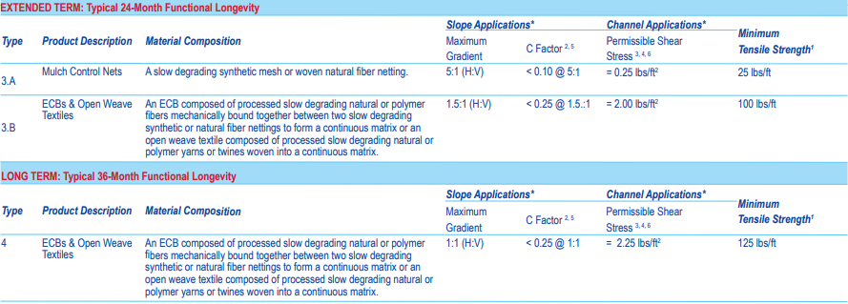
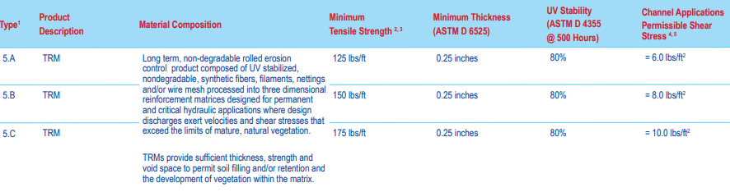
Erosion control BMPs
Geotextiles and Mats (cont’d)
Source: Planning and Technical Specifications Manualfor Stormwater Pollution Prevention Plans, Kentucky Transportation Center, University of Kentucky, Oct 2009

Slide 48
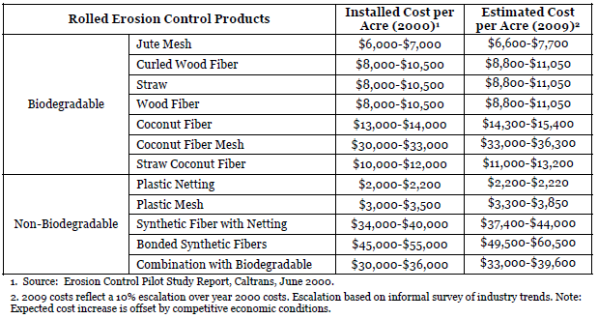
Erosion control BMPs
Geotextiles and Mats (cont’d)
Costs

Slide 49
Erosion control BMPs
Earth dikes and drainage swales
An earth dike is a temporary storm runoff conveyance consisting of an excavation channel and compacted earth ridge.
A drainage swale is a shaped and sloped depression used to convey runoff.
Applications
At the top of slopes to intercept and divert runon from adjacent or undisturbed areas
At midpoints to intercept sheet flow and convey concentrated flows
At bottom of slope to divert sediment laden runoff into sediment basins or traps
Below steep grades where runoff begins to concentrate to avoid sheet flow
Limitations
May create more disturbed area and cause downstream flood damage
Not suitable as the sediment trapping devices
May be necessary to use other soil stabilization and sediment controls
Should not be used for drainage areas greater than 10 acres or along slopes greater than 10 percent

Slide 50
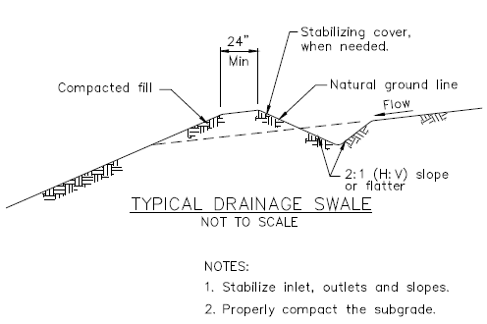
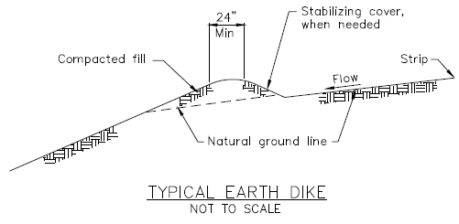
Erosion control BMPs
Earth dikes and drainage swales (cont’d)
Costs
Cost ranges from $15 to $55 per ft for both earthwork and stabilization and depends on availability of material, site location, and access.
Small dikes: $2.50 - $6.50/linear ft; Large dikes: $2.50/yd3.
The cost of a drainage swale increases with drainage area and slope. Typical swales for controlling internal erosion are inexpensive.
Source: California Stormwater BMP Handbook: Construction, November 2009

Slide 51
Erosion control BMPs
Slope drains
A slope drain is a pipe used to intercept and direct surface runoff or groundwater into a stabilized watercourse, trapping device, or stabilized area. Slope drains are generally used with earth dikes and drainage ditches. Available pipe materials include rigid pipe, flexible pipe, section downdrains, and concrete-lined terrace drain.
Applied locations
Areas where concentrated flow of surface runoff must be conveyed down a slope
Drainage for top of slope diversion dikes or swales
Areas where storm water runoff above a cut or fill will cause water accumulation
Emergency spillway for a sediment basin
Limitations
Maximum drainage area for a slope drain should not greater than 10 acres
Care must be taken to site drains correctly and not underdesign the slope drain
Outlet protection of high flow velocities is required to avoid downstream erosion
May cause mosquito breeding issues in energy dissipaters associated with slope drain outlet where water can accumulate.

Slide 52
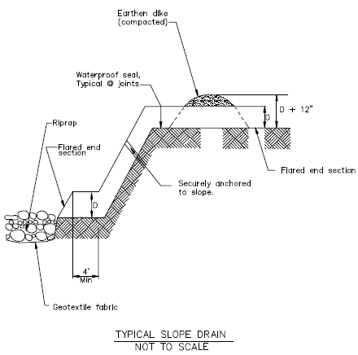
Erosion control BMPs
Slope drains (cont’d)
Design
Supplied and installed costs per linear ft
(No trenching included)
Min. pipe diameter | Max. drainage area
12” | 1.0 acre
18” | 3.0 acre
21” | 5.0 acre
24” | 7.0 acre
30” | 10.0 acre
Size | Corrugated steel pipes | PVC pipes
12” | $19.60 | $24.50
14” | — | $49.00
15” | $22.00 | —
16” | — | $51.00
18” | $26.00 | $54.00
20” | — | $66.00
24” | $32.00 | $93.00
30” | $50.00 | $130.00
Source: California Stormwater BMP Handbook: Construction, November 2009
Source: California Stormwater BMP Handbook: Construction, November 2009

Slide 53
Erosion control BMPs
Outlet protection
Outlet protection uses a physical device composed of rock, grouted riprap, or concrete rubble, preventing scour of the soil caused by concentrated, high velocity flows.
Applied locations
Outlets of pipes, drains, culverts, diversion, ditches, swales, conduits, or channels
Outlets located at the bottom of mild to steep slopes
Discharge outlets that carry continuous flows of water
Outlets subject to short, intense flows of water, such as flash floods
Points where lined conveyances discharge to unlined conveyances
Limitations
Large storms or high flows can wash away the outlet protection rock
Sediment captured may be difficult to remove without removing the rock
Outlet protection may negatively impact the channel habitat
Grouted riprap may break up in areas of freeze and thaw
Sediment accumulation, scour depressions, and/or persistent non-stormwater discharges can result in areas of standing water and mosquito breeding issues.

Slide 54
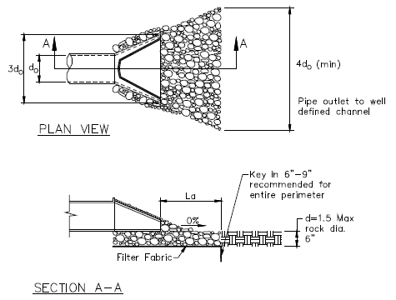
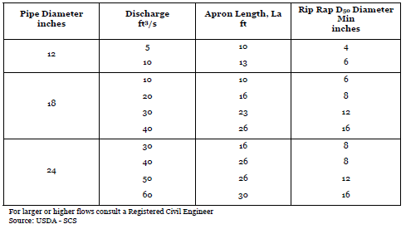
Erosion control BMPs
Outlet protection (cont’d)
Costs
Average installed cost is $150 per device. Costs will be low if the material is available. If material is imported, costs will be higher.
Typical outlet protection design
Source: California Stormwater BMP Handbook: Construction, November 2009

Slide 55
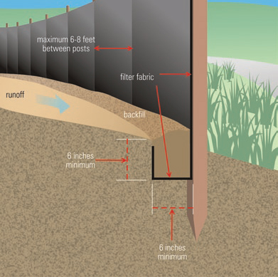
Sediment control BMPs
Silt fence
A silt fence is a temporary sediment barrier consisting of filter fabric that has been entrenched into the soil, attached to supporting poles, and backed by wood stakes or wire mesh for support. It detains sediment-laden water and provides physical filtration for large sediment particles.
Applied locations
Along the banks of streams or lakes
Along the perimeter of the construction site
Around inlet and areas where sheet flows discharge from the site
Limitations
Cannot be used in streams, channels, inlets, or anywhere large flow is involved (Q<0.5cfs)
Not suitable for concentrated flow
Not adequate for runoff control for anything deeper than sheet flow
https://en.wikipedia.org/wiki/Silt_fence

Slide 56
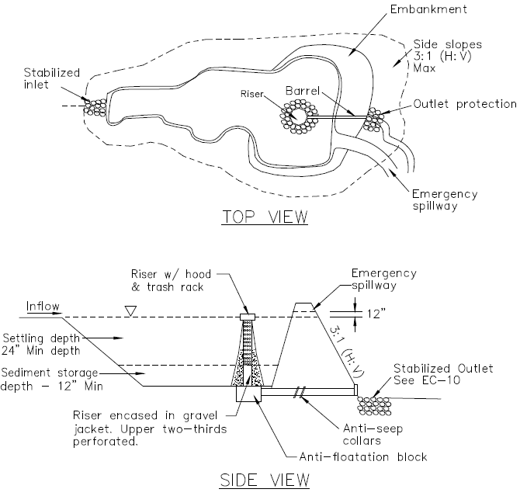
Sediment control BMPs
Sediment basin/trap
A Sediment basin/trap is a temporary pond built by excavation or by constructing an embankment so that runoff is temporarily detained under quiescent conditions, allowing sediment-laden soil to settle out before the runoff is discharged.
Suitable applications
Areas where sediment-laden water may enter the drainage system or watercourses
At the outlet of disturbed watersheds with area less than 75 acres
Areas where detention basins are required after the construction
Disturbed areas during rainy season
Integrated with dikes, temporary channels, and pipes used to convey runoff from disturbed areas
Source: California Stormwater BMP Handbook: Construction, November 2009

Slide 57
Sediment control BMPs
Sediment basin/trap (cont’d)
Limitations
Not suitable for drainage areas greater than 75 acres
May require fences if safety is a concern
May require longer detention time or chemical treatment to remove small size sediment (fine silt and clay) effectively
Requires large surface areas to settle sediment
Costs
Average annual costs for installation and maintenance (2-year life)
Basin size less than 50000 ft³:
$0.24 - $1.58/ft³. Average: $0.73 per ft³
$400 - $2400 per drainage acre. Average: $1200 per drainage acre
Basin size greater than 50,000 ft³:
$0.12 – $0.48/ft3. Average: $0.36 per ft3
$200 - $800per drainage acre. Average: $600 per drainage acre

Slide 58
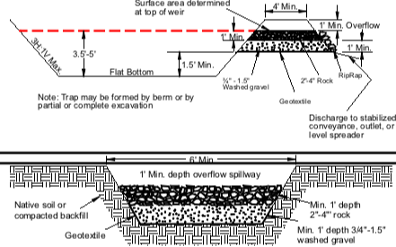
Sediment control BMPs
Sediment basin/trap (cont’d)
Cross Section of Sediment Trap and Outlet
Source: City of Seattle Stormwater Mannual Volume 2: Construction Stormwater Control, Aug. 2017

Slide 59
Sediment control BMPs
Check dams
A check dam is a small barrier constructed across a swale, channel, or drainage ditch. It may be constructed of stone, sandbags, gravel bags, fiber rolls, or reusable products. Check dams reduce the velocity of flow and settle the sediment to reduce erosion.
Suitable applications
In channels or temporary swales where stormwater runoff velocity exceed 5 ft/s
In ditches or channels before vegetation linings are established
In open channels that drain 10 acres or less
In ditches that do not have enough length to resist erosion
Limitations
Not suitable in live streams or in channels with extended base flows
Not appropriate in channels that drain areas greater than 10 acres
May damage grass linings in channels if the water level remains high after rainstorms or if there is significant sedimentation
Reduce the hydraulic capacity of the channel
Sediment can be released during subsequent storms or removal of the check dam.

Slide 60
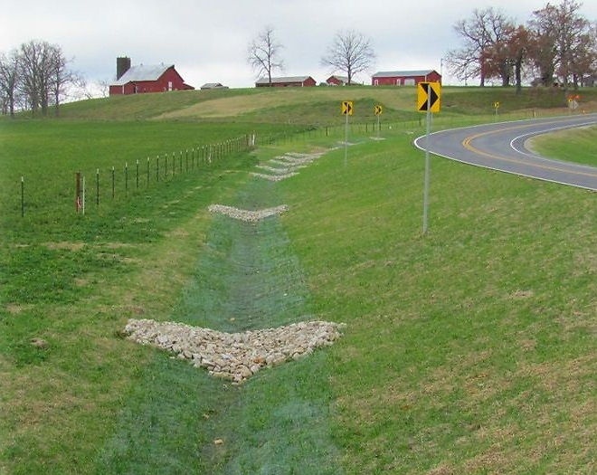
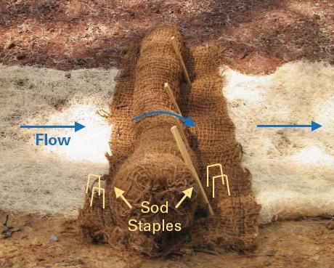
Sediment control BMPs
Check dams (cont’d)
http://prj.geosyntec.com/npsmanual/checkdams.aspx
https://content.ces.ncsu.edu/fiber-check-dams-and-polyacrylamide-for-water-quality-improvement

Slide 61
Sediment control BMPs
Fiber rolls & Gravel bag berms & Barriers
Fiber rolls are are tubular erosion and sediment control devices filled with straw, flax, rice, coconut fiber material, or other similar materials.
A gravel bag berm is a series of gravel-filled bags used for erosion and sediment control.
A sandbag barrier is a series of sand-filled bags used for erosion and sediment control.
A straw bale barrier is a row of entrenched and anchored straw bales.
Functions
Intercepts runoff and releases the runoff as sheet flow
Filters runoff and reduces sediment loading to receiving waters
Reduces the flow velocity
Suitable applications
Along the toe, top, face, and at grade breaks of exposed and erodible slopes
At the end of a downslope where it changes to a steeper slope
Along the perimeter of a construction site
As check dams in unlined ditches
Around temporary stockpiles and spoil areas.

Slide 62
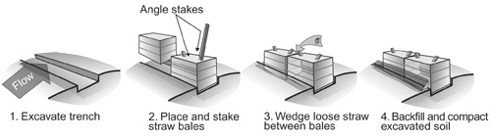
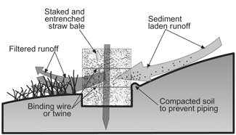
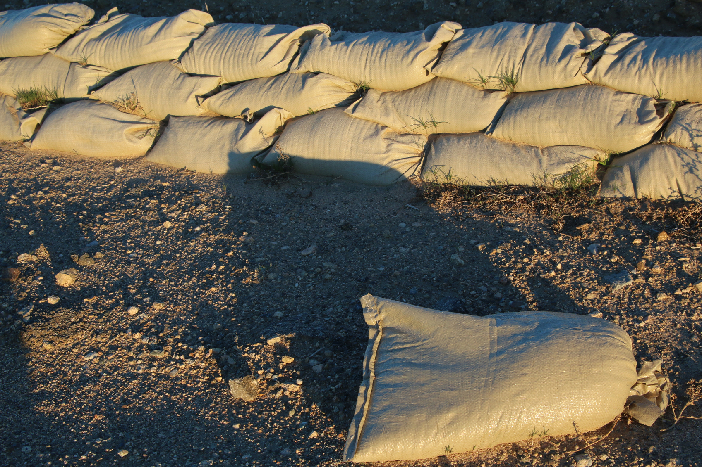
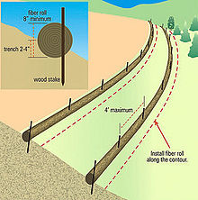
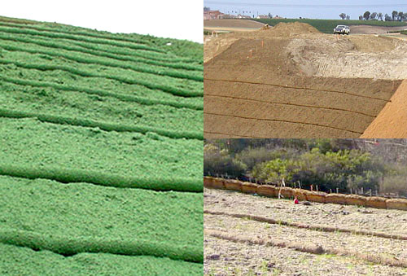
Sediment control BMPs
Fiber rolls & Gravel bag berms & Barriers (cont’d)
Straw bale barriers
http://www.landscapeonline.com/research/article-a.php?number=6456
http://www.landscapeonline.com/research/article-a.php?number=6456
Sandbag barrier
Fiber rolls
Fiber rolls
https://www.ccisupplies.com.au/construction-consumables/erosion-control/
https://en.wikipedia.org/wiki/Fiber_roll
http://www.dot.ca.gov/design/lap/landscape-design/erosion-control/stormwater/fiber_rolls.html

Slide 63
Sediment control BMPs
Fiber rolls & Gravel bag berms (cont’d)
Summaries of different BMPs
 | Limitations | Costs
Fiber rolls | Difficult to remove if saturated Needs to be staked and trenched Has a limited sediment capture zone Should not be used on slopes tend to creep, slumping or landslide | $20 - $30 per 25 ft roll
Gravel bag berms | Difficult to remove Not suitable for drainage areas greater than 5 acres Runoff will pond upstream and may cause flooding Bags may rupture and spill when removed Needs intensive labor for installation | Empty gravel bags: $2.5 per bag Gravels: $20-$35 per yd³
Sandbag barrier | Not suitable for drainage areas greater than 5 acres Degraded sandbags may rupture and spill when removed Needs intensive labor for installation May have limited durability for long-term projects | ^{Empty sandbags:} ^{$0.25-$0.75 per bag} ^{Average fill material:} ^{$8 per yd3} ^{Pre-filled sandbags:} ^{$1.5-$2 per bag}
Straw bale barrier | Not suitable for concentrated flow, inlet protection, and channel flow May require intensive labor for installation and maintenance Not suitable for long-term projects due to rotting and falling apart Not suitable for drainage areas greater than 1 acre | $5 - $7 each

Slide 64
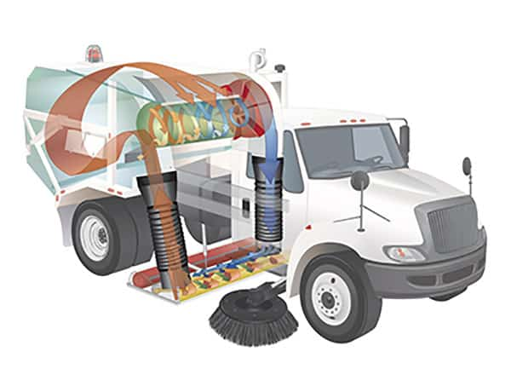
Sediment control BMPs
Street sweeping and vacuuming
Street sweeping and vacuuming is a non-structural method, using mechanical or vacuum pavement cleaning equipment, sometimes manual labor, to remove sediment from construction site and prevent sediment from entering storm drains or receiving waters.
Should be conducted regularly to be effective in stormwater pollution control
Vacuum sweepers are more effective than brush or broom sweepers because they do a better job at picking up fine particles
Suitable anywhere sediment is tracked on paved roads, streets, and exit
May not be effective when sediment is wet or when tracked soil is caked.
https://www.tymco.com/environment/street-cleaning-technologies/

Slide 65
Sediment control BMPs
Storm drain inlet protection
Storm drain inlet protection consists of a sediment filter or an excavated impounding area around a storm drain, drop inlet, or curb inlet.
Every storm drain inlet receiving sediment-laden runoff should be protected
Some protection structures remove sediment by filtering, but usually the ponding contributes to the greatest sediment removal
Limitations
Requires an adequate area for ponding
Need to be routed through sediment trapping techniques when drainage areas are greater than 1 acre
May be difficult to remove sediment for high flow condition and heavy sediment loading runoff
Requires frequent maintenance
May be difficult to remove collected sediment, especially under high flow conditions
Costs
Average annual cost for installation and maintenance (1-year useful life) is $200 per inlet.

Slide 66
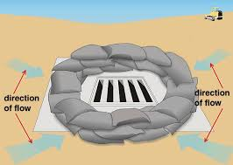
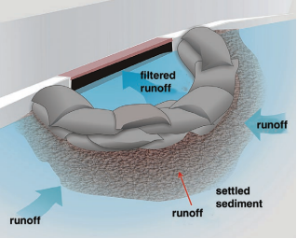
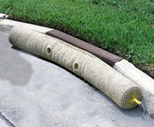
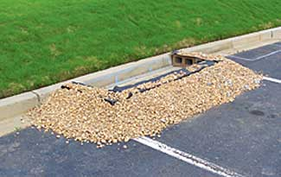
Sediment control BMPs
Storm drain inlet protection (cont’d)
Stormwater Construction Inspector’s Field Guide, Minnesota Pollution Control Agency
Stormwater Construction Inspector’s Field Guide, Minnesota Pollution Control Agency
https://www.erosioncontrol-products.com/stormdraininletprotection.html
https://landscapeonline.com/articles/preventing-site-runoff-its-the-federal-law/7990

Slide 67
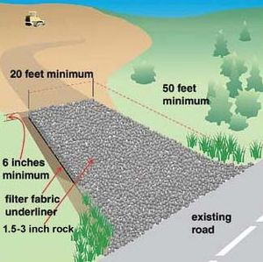
Tracking control BMPs
Construction entrance/exit/roadway stabilization
Stabilization of temporary construction access routes, vehicle transportation routes, and construction parking areas is important to prevent erosion and control dust.
Stabilize roadway may use aggregate, asphalt concrete, or concrete based on longevity, required performance, and site conditions
Suitable applications
Areas where mud tracking is a problem during wet weather
Areas where dust is a problem during dry weather
Adjacent to water bodies
Limitations
Source: Created by Tetra Tech for US EPA and State of Kentucky
The roadway need to be removed after the construction
Should not use chemicals that may cause potential stormwater or soil pollution
Materials may need to be removed prior to final project grading and stabilization
It may not suitable for very short period construction.

Slide 68
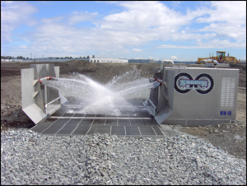
Tracking control BMPs
Entrance/outlet tire wash
A tire wash is used at construction access points to remove sediment from vehicles’ tires to prevent sediment from being transported onto public roadways. It may be used on construction sites where dust and mud tracking could be a problem.
Limitations
Requires a water supply for tire washing
Requires a doublewide access to prevent entering vehicles from driving through the wash area
May cause the road slick where the wet tire vehicles drive through.
https://stormwater.pca.state.mn.us/index.php?title=File:Tracking_1.png

Slide 69
Non-structural BMPs
Disposal of construction materials
Concrete finish, mortar and masonry work
Concrete washout area
Stucco work and painting
Lime/fly ash and cement treating
Process discharge containment
Boring operating and concrete saw-cutting
Paving and grinding operations
Dewatering operations
Site management
Water conservation
Liquid pollutant management
Sanitary septic management
Vehicle and equipment cleaning, fueling, and maintenance
Hazardous waste management
Contaminated soil, fertilizers, and pesticides
Solid waste management
Stockpile management
Material use, delivery and storage
Spill prevention and control

Slide 70
Non-structural BMPs
Disposal of construction materials
Concrete finish, mortar and masonry work
Follow proper procedures in performing concrete finish, mortar and masonry work
Cannot wash out mixers, buckets, mortar boxes, or tools directly onto bare ground
Contain washout and rinse water for treatment and appropriate disposal
Do not perform concrete, mortar or masonry work during or just before rain events
Protect all inlets that may receive water from concrete finishing, or masonry work
Vacuum up or direct contaminated water to collection areas for treatment or disposal
Concrete washout area
Do not dispose of concrete washout water into the street, storm drains, watercourses, or by infiltration into the ground due to the high pH level and heavy metals
Build recycle system in the truck from concrete washout services or concrete provider
Construction managers build their own concrete washout basin from straw bales and plastic sheeting.

Slide 71
Non-structural BMPs
Disposal of construction materials (cont’d)
Stucco work and painting
All materials should be placed on plastic sheets that are large enough to collect drips and spills during the activities. After work has completed, sheets should be rolled and placed in a waste receptacle designated to receive this type of waste
All leftover paint needs to be removed from the site, or disposed in a paint washout bin designed to contain paint
Do not wash paint and/or stucco into a gutter, on the ground or into a storm drain inlet
Lime/fly ash and cement treating
Based on the project, lime/fly ash or cement treated sub-base may be an acceptable alternative for placement of compacted aggregate base material
The amendment addressing lime/fly ash or cement treated sub-base shall be added to the on-site SWPPP before the activity takes place.

Slide 72
Non-structural BMPs
Process discharge containment
Boring operating and concrete saw-cutting
Pumps the discharge fluid into a tank and hauls it away
Residual from concrete and asphalt concrete saw-cutting operations shall be removed with a commercial vacuum or pumped
The drain inlets that may be affected should be protected during these activities
Paving and grinding operations
Grindings and wastes from removal of pavement and related materials need to be removed as the work moves forward
Asphalt concrete placement and removal equipment needs to be cleaned off-site
Do not apply seal coat, tack coat, slurry seal or fog seal if it rains heavily during the application or curing period
Verify that shut-off valves are workable on painting and thermoplastic applying equipment before operation. When filling the thermoplastic pre-heater make sure there is a six inch space at the top of the container to prevent spills.

Slide 73
Non-structural BMPs
Process discharge containment (cont’d)
Paving and grinding operations (cont’d)
Do not transfer or load bituminous materials near storm drains or natural waterways. Verify all pressure is released prior to filling melting tank. Leave a six inch space at the top of the container to prevent spills.
Dewatering operations
Dewatering sources may include groundwater accumulation, flushing of water mains, water from diversions, and water from rain events.
Discharge to the storm drain system should be avoided. Other disposal choices include: (a) retain the water on site for construction use, (b) discharge to sanitary sewer or adjacent property with obtaining corresponding written permission in advance,
(c) collect, treat, and dispose the effluent offsite
If the effluent is not obviously clear, it must be treated to remove sediment prior to discharge. Available portable water treatment equipment includes: sand media filters, pressurized bag filters, and cartridge filters.

Slide 74
Non-structural BMPs
Site management
Water conservation
Keep water equipment in good condition and repair water leaks promptly.
Avoid cleaning construction site by water. If water must be used for cleaning, surface should be swept and vacuumed first
Direct non-polluted runoff to areas where it can soak into the ground
Liquid pollutant management
Capture all liquid wastes that have the potential to affect the storm drain system.
Liquid wastes should be contained in appropriate controlled areas include holding pits, sediment basins, roll-off bin, or portable tanks
The containment devices should be structurally sound and leak free, providing sufficient volume for anticipated wastes
Locate the containment areas or devices far away from storm drains, water bodies, or drainage channels
Some liquid wastes may require testing and certification whether they are hazardous before determine the disposal method.

Slide 75
Non-structural BMPs
Site management (cont’d)
Sanitary septic management
Temporary sanitary facilities need be located away at least 50 feet from drainage conveyances and traffic areas. If high wind may occur at the site, they should be anchored to prevent overturning
Ensure the sanitary facilities are maintained in good working condition and wastes are regularly removed offsite by a licensed hauler
Wastewater shall not be discharged or buried at the project site or private properties
Temporary septic systems should get the waste discharge permit and treat wastes to certain levels before discharging.
Hazardous waste management
Hazardous waste in construction site includes: petroleum products, asphalt products, concrete curing compounds, pesticides, palliatives, acids, septic wastes, paints, stains, solvents, wood preservatives, roofing tar, heavy metals, asbestos, PCBs, and any materials deemed a hazardous waste in California, Title 22 Division 4.5, or listed in 40 CFR Parts 110, 117, 261, or 302.

Slide 76


Non-structural BMPs
Site management (cont’d)
Hazardous waste management (cont’d)
Provide adequate waste storage and locate at least 50 ft away from storm drains, natural waterways, and drainage channels
Store hazardous waste in suitable sealed containers which are labeled with the contents and date of the accumulation
Temporary containment facilities should be maintained free of rainwater accumulations and spills
Use containment berms in fueling and maintenance areas and where the potential for spills is high
Provide sufficient separation between containers for spill cleanup and emergency respond access
Place hazardous waste containers in secondary containment
Do not store different wastes or incompatible materials in the same containers or containment facility. Do not mix wastes
Recycle useful materials such as used oil or water-based paint.
Prior to rain events, cover the containment area.
http://www.summitreworks.com/recycling/details/household-hazardous-waste-hhw/c86/
https://waste-management-world.com/a/epa-e-manifest-compliance-advice-for-hazardous-waste-producers

Slide 77
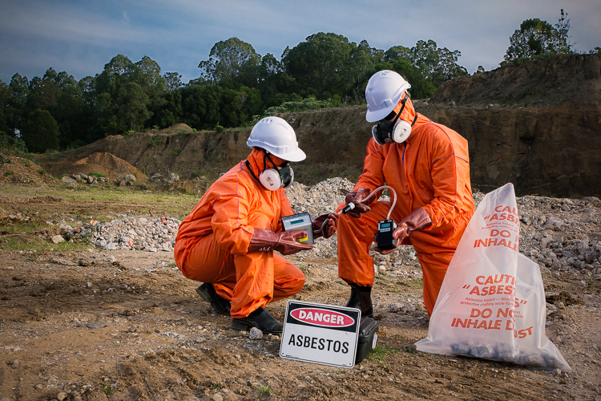
Non-structural BMPs
Site management (cont’d)
Hazardous waste management (cont’d)
Paint brushes and equipment for paints should be cleaned within a contained area and should not contaminate site soils, natural waterways, or drainage systems
Waste should be disposed at an authorized and licensed disposal facility or recycling facility within 90 days of being accumulated
Properly dispose of rainwater removed from temporary containment areas that may have mixed with hazardous waste
Educate contractors and subcontractors regarding identification, storage, and disposal of hazardous waste.
Contaminated soil, fertilizers, and pesticides
Typical soil contamination may be caused by spills, illicit discharges, aerial deposition, past use and leaks from underground storage tanks.
http://ecoteam.com.au/services/soil-testing-and-contamination/

Slide 78
Non-structural BMPs
Site management (cont’d)
Contaminated soil, fertilizers, and pesticides
Conduct pre-construction environmental assessment of the site
In some cases, contaminated soils may need to be placed in steel barrels, sealed and removed from the site to a licensed hazardous waste disposal site
Avoid temporary stockpiling of contaminated soils. If necessary, cover the stockpile with plastic sheeting or tarps, install a berm around the stockpile to keep runoff in the area, and locate the stockpile at least 50 ft from storm drains or watercourses
Pesticides and herbicides must be applied by a licensed applicator
Do not over-apply fertilizers or pesticides and follow product recommendations.
Apply appropriate amounts to allow product to absorb prior to rain events.
Solid waste management
Solid waste should be stored at least 50 ft from drainage facilities and watercourses and at a location which is not likely to flooding or ponding
Prevent solid waste from contacting stormwater by using berms, dikes or other temporary diversion structures

Slide 79
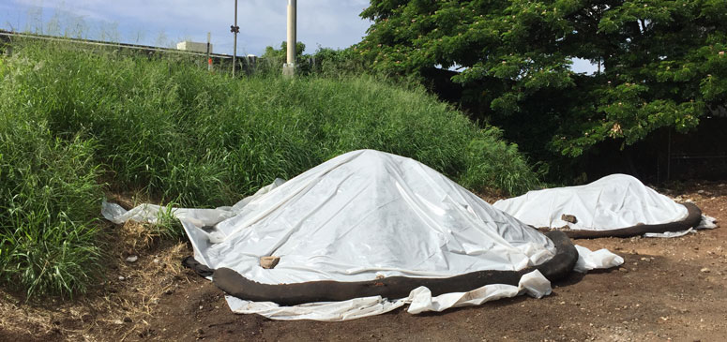
Non-structural BMPs
Site management (cont’d)
Solid waste management (cont’d)
Provide adequate trash receptacles at the site and collect trash periodically
Waste materials need to be stored in watertight dumpsters with tarps or plastic covers.
Remove litter and debris from drainage grates and ditch lines
Provide an adequate amount of watertight dumpsters to collect the anticipated volume of construction waste. Plan for additional dumpsters and schedule more frequent pickups during demolition phases
Do not dispose of toxic liquid wastes and chemicals in dumpsters designated for construction debris.
Stockpile management
Construction stockpiles of material such as soil, portland cement concrete (PCC), asphalt concrete (AC), aggregate base, aggregate sub-base and asphalt base cold mix (cutback) may cause air and stormwater pollution
https://www.stormwaterhawaii.com/latest-news/construction-bmps/construction-bmps-for-protecting-stockpiles/

Slide 80
Non-structural BMPs
Site management (cont’d)
Stockpile management (cont’d)
Locate stockpiles at least 50 ft away from drainage courses and stormwater inlets
Prevent stockpile from contacting with stormwater through installing temporary barriers around stockpile perimeters, including berms, dikes, silt fences, straw wattles, and sand bag or gravel barriers
For stockpile of soil, PCC, AC rubble, aggregate base, or aggregate sub bas, protect them with covers and temporary perimeter sediment barrier at all time
For stockpiles of cold-mix, place them on and cover with plastic or similar materials prior to rain events.
Material use and storage
Do not use hazardous materials when alternative materials are available
Do not over-apply fertilizers, herbicides, and pesticides
Provide Material Safety Data Sheets (MSDS) for all materials.
Store hazardous materials in the original containers with their original labels attached.
http://proquologistics.com/material-waste-management-construction-sites-effect-environment/

Slide 81

Non-structural BMPs
Site management (cont’d)
Material use, delivery and storage (cont’d)
Use environmental-friendly and less hazardous materials when available
Material delivery and storage areas should near the entrances, away from waterways
Do not store hazardous materials directly on the ground. Place them on a pallet in covered areas with secondary containment
Keep sufficient spill clean up materials near the use and storage areas
Employees trained in emergency storage delivery, and spill clean up procedures
Provide sufficient space between containers to allow for spill clean up and emergency response access.
http://proquologistics.com/material-waste-management-construction-sites-effect-environment/

Slide 82
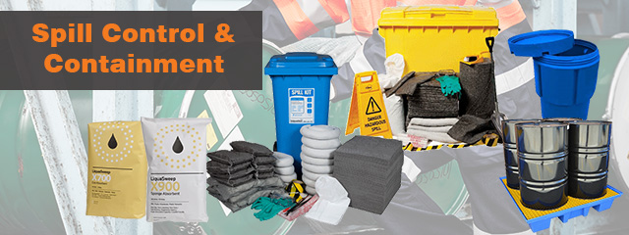
Non-structural BMPs
Site management (cont’d)
Spill prevention and control
Educate employees on identifying spill severity of each materials they use and proper respond for significant and insignificant spills
Educate employees on potential dangers and impact from spills and leaks
Train employees in spill prevention and clean up
Clean up leaks and spills immediately
Locate clearly-labelled spill-kits and disposal containers near areas are prone to spill.
Water used for clean up is not allowed to enter storm drains or watercourses
https://www.hicraftsafety.com.au/products/spill-control

Slide 83
Non-structural BMPs
Site management (cont’d)
Spill prevention and control
For minor spills, small quantity of oil, gas, paint, etc., which can be controlled by the first responder:
  Contain the spill, recover the spilled material, clean the spill area and dispose of cleanup materials properly
For semi-significant spills, which can be controlled by the first responder with others:
  On impervious areas, contain and clean spills using absorbent material
  On dirt areas, construct an earthen dike to contain the spill. Remove contaminated soil and dispose of properly
  If occurs in rain, cover the spills to prevent stormwater runoff contamination
For significant spills that cannot be controlled by personnel in the immediate vicinity:
  Cleanup can only be conducted by qualified assistance
  Need to obtain the services of a professional HazMat team immediately
  Notification should first be made and followed up with a written report
  In addition to calling 911, the contractor will notify the proper county officials.

Slide 84

Non-structural BMPs
Site management (cont’d)
Vehicle and equipment cleaning, fueling, and maintenance
Fuel, maintain and wash vehicles offsite or in the designated area
Properly maintain vehicles and equipment to prevent leaks and spills
The residue after cleaning vehicles shall be collected and hauled offsite to an approved disposal location
Spilled fuel shall be prevented from entering the storm drain system, natural waterways or ditches
Absorbent spill clean-up materials need to be available in areas where spill prone to occur
Cover and berm work areas as necessary
Fueling areas should be elevated and located at least 50 ft away from drain inlet and natural waterway
Drip pans or absorbent pads is needed below the vehicle or equipment when performing maintenance.
https://en.clipdealer.com/vector/media/A:68887362

Slide 85
Non-structural BMPs
Education& Employee training
Mark on all trash containers which materials are acceptable
Identify the potential dangers of pollutants to humans and the environment
Establish a continuing education program to train new employees
Educate employees:
  - Training programs on spill prevention and emergency response
  - Provide information of chemical storage and disposal procedures
  - Increase awareness on waste handling and disposal.

Slide 86
Non-structural BMPs
Education& Employee training (cont’d)
Education for Homeowners | Education for Businesses
Alternatives to Toxic Substances Chlorinated Water Discharge Options Landscaping and Lawn Care Pest Control Pet Waste Management Proper Disposal of Household Hazardous Wastes Residential Car Washing Trash and Debris Management Water Conservation Practices for Homeowners | Automobile Maintenance Pollution Prevention for Businesses Promoting Low Impact Development (LIP); land planning and engineering design approach

Slide 87
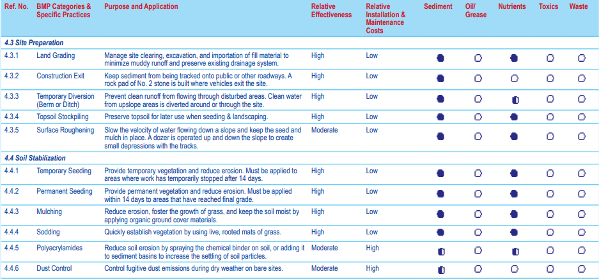

BMP purpose, effectiveness, and relative costs for various construction site runoff pollutants
Source: Planning and Technical Specifications Manualfor Stormwater Pollution Prevention Plans, Kentucky Transportation Center, University of Kentucky, Oct 2009

Slide 88
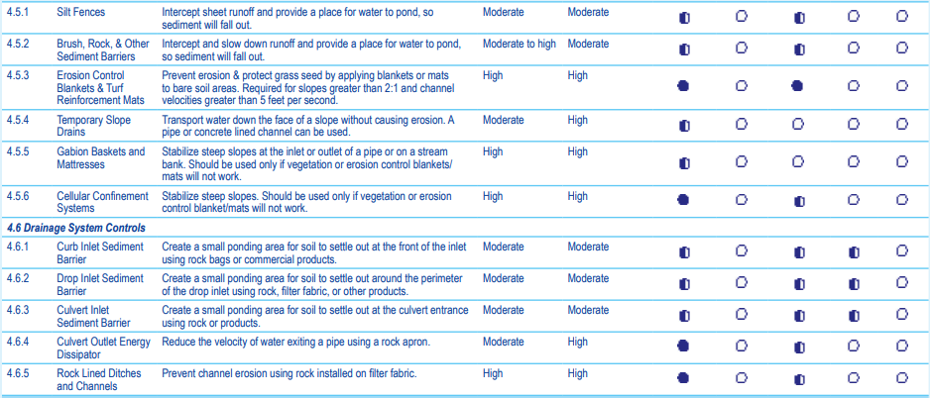
BMP purpose, effectiveness, and relative costs for various construction site runoff pollutants (cont’d)
Source: Planning and Technical Specifications Manualfor Stormwater Pollution Prevention Plans, Kentucky Transportation Center, University of Kentucky, Oct 2009

Slide 89


BMP purpose, effectiveness, and relative costs for various construction site runoff pollutants (cont’d)
Source: Planning and Technical Specifications Manualfor Stormwater Pollution Prevention Plans, Kentucky Transportation Center, University of Kentucky, Oct 2009

Slide 90


BMP purpose, effectiveness, and relative costs for various construction site runoff pollutants (cont’d)
Source: Planning and Technical Specifications Manualfor Stormwater Pollution Prevention Plans, Kentucky Transportation Center, University of Kentucky, Oct 2009

Slide 91

Treatment technologies
Active treatment system
Active treatment system (ATS) employs chemicals to enhance flocculation, coagulation, and settling of the suspended solid, adjusting pH and providing reliable reduction of fine suspended sediments and stormwater runoff turbidity.
Treatment system design
ATS consists of the stormwater collection system, pumps, chemical feed system, treatment cells, and connecting piping
Batch treatment systems using ponds or portable trailer-mounted tank
Should use at least two lined treatment cells for clarification of treated water
Required equipment at operation place:
Chemical injector
Containment for acid, caustic, and treatment chemicals
Emergency shower and eyewash
pH meter and tubidimeter
Source: California Stormwater BMP Handbook: Construction, November 2009

Slide 92

Treatment technologies
Active treatment system (cont’d)
Stormwater Treatment with Ultrafiltration Systems
Source: https://porelogix.com/wp-content/uploads/2013/11/Stormwater-Info-pic.pdf

Slide 93
Case studies
1. Minnesota stormwater manual on small residential construction site
    10 steps to stormwater pollution prevention on small residential construction site:
    Protect any areas reserved for vegetation or infiltration and preserve existing trees
    Stockpile your soil
    Protect construction materials from run-on and runoff
    Designate waste disposal areas
    Controls on downhill lot line
    Install inlet controls
    Install a concrete/stucco washout basin
    Maintain a stabilized exit pad
    Keep an up-to-date of the SWPPP on site
    Site Stabilization

Slide 94

Case studies
1. Minnesota stormwater manual on small residential construction site (cont’d)
https://stormwater.pca.state.mn.us/index.php?title=10_Steps_to_Stormwater_Pollution_Prevention_on_Small_Residential_Construction_Sites

Slide 95


Case studies
2. Kentucky case study: slope protection
Soil conditions vs. erosion
Source: Best Management Practices (BMPs) for controlling Erosion, Sediment, and Pollutant Runoff from Construction sites. Rep. University of Kentucky: Kentucky Transportation Center , 2009.
Slope Angle and Soil Type vs. Erodibility

Slide 96

Case studies
2. Kentucky case study: slope protection (cont’d)
Determine the type of slope protection measures that should be used,
given the slope angle.
Slope protection chart
Source: Best Management Practices (BMPs) for controlling Erosion, Sediment, and Pollutant Runoff from Construction sites. Rep. University of Kentucky: Kentucky Transportation Center , 2009.

Slide 97



Case studies
3. San Diego stormwater management plan
Left: Stormwater BMPs plot plan
Right: Minimum required construction stormwater BMPs
Source: Stormawter Best Management Practices (BMPs) Reference Guide, County of San Diego Department of Planning and Land Use, April 2010

Slide 98


Case studies
3. San Diego stormwater management plan (cont’d)
Minor stormwater management plan
Identify relevant project information
Identify construction stormwater BMPs
Identify Low Impact Development BMPs
Identify post-construction BMPs
Certification
Source: Stormawter Best Management Practices (BMPs) Reference Guide, County of San Diego Department of Planning and Land Use, April 2010

Slide 99
Table of Contents
    Background: LA River Revitalization
    Stormwater BMPs for Construction Site
    Stormwater BMPs for Parking Lot
      Introduction
      Common pollutants in parking lot
      Stormwater BMPs
      Case studies
    Summary and Discussion
    References

Slide 100
Part 3
Stormwater BMPs for
Parking Lot

Slide 101

Introduction
  Stormwater runoff at parking lot can carry many contaminants to storm drain.
  Stormwater BMPs can effectively intercept stormwater runoff before it infiltrates into ground or flow to storm drain, achieving pollutants source control in stormwater.
https://stormwater.pca.state.mn.us/index.php?title=File:Bioretention_parking_lot_island.jpg

Slide 102


Common pollutants in parking lot
Parking lots areas can contribute a lot of pollutants such as:
  Trash, suspended solids (sediments), hydrocarbons, oil and grease, heavy metals, and bacteria
Commercial or industrial site can potentially generate oily stormwater runoff:
  Gas stations, bus depots, trucking operations, wrecked vehicle storage, and junk yards
https://www.pca.state.mn.us/featured/when-it-rains-it-flows
http://switchboard.nrdc.org/blogs/rhammer/nrdc_petitions_epa_to_tackle_w.html

Slide 103

Stormwater BMPs
Source control BMPs
The following stormwater BMPs are effective to prevent or reduce the discharge of pollutants from parking areas:
Keep the parking areas clean and orderly
Remove debris in a timely manner
Clean and sweep parking lots regularly
https://countrysidepropertymaintenance.com/parking-lot-sweeping/

Slide 104
Stormwater BMPs
Source control BMPs (cont’d)
Post “No Littering” signs and enforce anti-litter laws
Provide an adequate number of litter receptacles
Clean out and cover litter receptacles frequently
Conduct inspections of parking facilities and stormwater systems regularly.
Inspect cleaning equipment/sweepers for leaks on a regular basis.
http://www.safetysign.com/products/p7921/no-littering-use-trash-can-sign
http://victoriapann.blogspot.com/2014/07/littering-and-holy-ground.html

Slide 105


Stormwater BMPs
Oil/Water (O/W) separators
Main types of O/W separators used for parking lot: gravity and coalescing
Remove sediments, free oils, gasoline, and greases from stormwater prior to infiltration or discharge to storm inlets
Cannot handle concentrated amounts of oily products and sediment in stormwater
Antifreeze, degreasers, and detergents will break up oil into small droplets so it will allow the oil to pass through the separator
Source: Fact Sheet: The Oil/Water Separator , Department ofNatural Resources and ParksWastewater Treatment Division, King County

Slide 106


Stormwater BMPs
Oil/Water (O/W) separators (cont’d)
American Petroleum Institute (API) O/W separator
Coalescing O/W separator
https://en.wikipedia.org/wiki/API_oil%E2%80%93water_separator
http://www.elliswastewater.com/products/oil-water-separator/

Slide 107

Stormwater BMPs
Catch basins
Typically located at low spots in parking lots or along curbs and road edges
Can be installed before oil/water separator
Most catch basins have storage in the bottom that never drains out
Captures sediments and debris
Must be regularly inspected and cleaned
https://www.brickkicker.com/catch-basins/

Slide 108

Stormwater BMPs
Catch basin (cont’d)
Different types of catch basin selection matrix
Source: Reference Guide For Stormwater Best Management Practice, Stormwater Management Division Bureau of Sanitation, Department of Public Works City of Los Angeles, July 2000

Slide 109

Stormwater BMPs
Catch basin and oil/water separator
https://commons.wikimedia.org/wiki/File:Oil-grit_separator_USGS_2002.png

Slide 110

Stormwater BMPs
Rain garden
Rain garden is a vegetated shallow depression, using soil, plants, and microbes system to retain and treat stormwater before it is infiltrated and/or discharged.
The runoff percolates through the soil media that acts as a filter
There are two types of rain garden used in parking lot:
  Rain garden with underdrain system so that the runoff is conveyed to a discharge outlet or other BMPs
  Rain garden without underdrain system to enhance groundwater recharge
Can remove TSS, nutrients, and metals
Can be used as a stormwater retrofit if a parking lot is being resurfaced
Can be used on small lots with space constraints
Requires careful landscaping and maintenance
http://www.ecolandscaping.org/03/rain-gardens/native-plant-selection-for-biofilters-and-rain-gardens/

Slide 111

Stormwater BMPs
Dry detention basin
Dry detention basin is designed to hold stormwater for at least 24 hours to allow solids to settle and to reduce local and downstream flooding.
Can remove significant levels of sediment and absorbed pollutants
Limited infiltration and groundwater recharge
Removal of soluble pollutants is minimal
Requires relatively large land area.
https://www.canr.msu.edu/news/either_detention_or_retention_equals_storm_water_runoff_reductions

Slide 112

Stormwater BMPs
Wet retention basin
Wet retention basin is designed to cap­ture, filter, and store stormwater, providing two primary services: control the flow and remove both solids and soluble pollutants through settling and biological process.
Has a moderate to high capacity to remove most urban pollutants, depending on the size of the basin
Bottom should be lined and sealed with higher potential pollutant loads
Must have additional dry storage capacity to control peak discharge rates
Not suitable for smaller areas
Limited infiltration and groundwater recharge
https://www.epa.gov/region8/green-infrastructure

Slide 113

Stormwater BMPs
Swales
Swales are open channels with dense vegetation in a linear structure.
Swales are used to transport water from one point to another and treat runoff.
Swales can come in the forms of
  Dry swale
  Wet swale (functions as wetland)
Swales are used to treat runoff from roads and highways because of their linear nature.
Swales remove sediments and bacteria through infiltration.
Sometimes check dams are used in swales to reduce the flow and remove suspended solids.
https://wiki.sustainabletechnologies.ca/wiki/Swales

Slide 114

Stormwater BMPs
Infiltration trenching
Infiltration trenches are linear ditches that collect rain from adjacent surfaces surfaces.
Their highly permeable soils allow the water to quickly seep into ground
The primary purpose of infiltration trench is to treat stormwater quickly
http://www.saveitlancaster.com/local-projects/parking-lots/

Slide 115

Stormwater BMPs
Infiltration trenching(cont’d)
They are shallow excavated trench that is backfilled with stones and sand to create underground storage of stormwater runoff .
The runoff pollutants are stored in the spaces between the stones then they slowly infiltrated through the soil layers.
Typically used in small storm flow.

Slide 116

Stormwater BMPs
Pervious pavement
Permeable pavement surface with stone reservoir underneath
Runoff is temporarily stored in the reservoir before infiltrating into the subsoil
Targeted pollutants: sediments, phosphorus, trace metals.
http://www.clemson.edu/extension/hgic/water/resources_stormwater/introduction_to_porous_pavement.html

Slide 117
Cost and effectiveness of stormwater BMPs
Removal effectiveness depends on:
  BMP type
  The quantity of runoff treated
  Type of pollutant being removed
Variation is one of the above factors that can affect a BMP’s efficiency.
Effectiveness ranges can vary based on the climate, soil, and land type of a particular site.
As shown in following table (BMP effectiveness), not all BMPs have a high level of pollutant removal.

Slide 118
Cost and effectiveness of stormwater BMPs (cont’d)
Source: U.S. EPA, 1993, Handbook Urban Runoff and Pollution Prevention Planning, EPA-625-R-93-004, taken from Purdue Uni- versity Engineering Department’s Long-Term Hydrologic Impact Assessment (L-THIA): http://cobweb.ecn.purdue.edu/~sprawl/ LTHIA7/lthia/lthia_index.htm.
BMP Type | Typical Pollutant Removal (%)
 | Suspended Solids | Nitrogen | Phosphorus | Pathogens | Metals
Porous Pavement | 65-100 | 65-100 | 30-65 | 65-100 | 65-100
Retention Basins | 50-80 | 30-65 | 30-65 | <30 | 50-80
Constructed Wetlands | 50-80 | <30 | 15-45 | <30 | 50-80
Infiltration Basins | 50-80 | 50-80 | 50-80 | 65-100 | 50-80
Infiltration Trenches | 50-80 | 50-80 | 15-45 | 65-100 | 50-80
Grassed Swales | 36-65 | 15-45 | 15-45 | <30 | 15-45
Vegetated Filter Strips | 50-80 | 50-80 | 50-80 | <30 | 30-65
Dry Detention Basins | 30-65 | 13-45 | 15-45 | <30 | 15-45

Slide 119
Cost and effectiveness of stormwater BMPs (cont’d)
Calculating the cost-effectiveness of a stormwater BMP is quite difficult, and current cost information is limited and inconsistent.
The main factors affecting the relative costs of BMPs are:
  Cost of land
  Engineering and design
  Permitting
  Construction
  Operation and maintenance
These costs can vary greatly due to individual site features such as:
  Climate
  Topography
  Government regulations
  Time of year of construction
  soil type
  Accessibility of equipment
  Economics of scale

Slide 120

Cost and effectiveness of stormwater BMPs (cont’d)
Which BMPs to choose ?
BMPs that remove the largest amount of pollutants ( nitrogen , metals phosphorus or sediments) for the lowest cost .
Analyzing the cost of a BMPs

Slide 121

Case studies
1. Pennsylvania State University, Berks County Campus, Berks County, Pennsylvania
Porous asphalt parking lots underlain with subsurface infiltration beds
The new porous asphalt parking lot was designed to mitigate incident rainfall and direct runoff from the nearby access road and existing dormitories.
Polluted runoff from the site, usually described as nonpoint source pollution (NPS), was significantly removed by the overall plan.
The new improvements at the PSU Berks County campus have had virtually zero impact on regional water resources.
The cost of the new porous asphalt parking lot with subsurface aggregate infiltration bed:
  Around $1100 per space in 1999
  Final cost per space was around $2200, when all related site work (lighting, landscaping, erosion and sedimentation control, etc.) was considered.
Porous asphalt pavement underlain with subsurface infiltration beds

Slide 122

Case studies
2. Lebanon Valley Agricultural Center, Lebanon County, Pennsylvania
Porous Asphalt parking lot
The center drive lane is conventional asphalt with porous pavement limited to the parking bays.
The porous pavement parking lot was installed on an existing lawn area and is underlain by a 24 -inch infiltration bed.
The bed was excavated and unwoven geotextile fabric was placed on the undisturbed subsoil.
Clean AASHTO #1 aggregate was placed in the bed in 12-inch lifts and lightly rolled to prevent settling.
Finally, a 3-inch choker course comprised of AASHTO #57 was placed over the larger aggregate and was finish graded to prepare for the asphalt pavement.
The project site has been observed during several high intensity storms and appears to be working successfully as there was little or no discharge apparent from the overflow pipes.
Porous asphalt pavement

Slide 123

Case studies
3. Civic Center Back 40 Infiltration Basin Project, Evansville, Indiana
Basic information
Cost: $1.1M construction cost
Scale: 190,000 square feet parking area
BMPs:
  Bioretention islands (landscaped and rock-filled)
  Underground infiltration system
Problem: Evansville’s sewer system has a history of maintenance and system capacity problems that result in it being overwhelmed by rainfall, thus discharging untreated sewage into the Ohio River.
Benefits:
  Redirects approximately 6 million annual gallons stormwater from the combined sewer storm system reducing combined sewer overflow (CSO) events
  Infiltration reduces the grey infrastructure costs of handling CSO discharge
Project boundary

Slide 124


Case studies
3. Civic Center Back 40 Infiltration Basin Project, Evansville, Indiana (cont’d)
Completed bioretention islands (landscaped near building and rock-filled in parking area)
Construction of underground infiltration bed in parking lot

Slide 125
Table of Contents
    Background: LA River Revitalization
    Stormwater BMPs for Construction Site
    Stormwater BMPs for Parking Lot
    Summary and Discussion
      Summary
      Discussion
    References

Slide 126
Part 4
Summary and Discussion

Slide 127
Summary
Regulations to protect LA River:
Construction sites have to obtain the necessary stormwater permits, compliance with Total Maximum Daily Load (TMDL) requirements, installation and monitoring of the Best Management Plans (BMPs), and design and implementation of the Stormwater Pollution Prevention Plan (SWPPP) to minimize the pollutants discharge to LA River.
Pollutions in construction site and parking lots:
Construction site: erosion and sedimentation, metals, nutrients, soil additives, pesticides, construction chemicals, and other construction wastes.
Parking lots: Trash, sediments, hydrocarbons, oil and grease, heavy metals, and bacteria
Stormwater BMPs for construction site:
Erosion control BMPs: scheduling, hydro-seeding, mulch, soil binder, geotextile and mats, earth dikes and drainage swale, slope drain, outlet protection, etc.
Sediment control BMPs: silt fence, sediment basin, sediment trap, check dams, fiber rolls, gravel bag berms, sandbag/straw bale barrier, drain inlet protection, etc.
Tracking control BMPs: construction entrance/exit stabilization, roadway stabilization, and entrance/exit tire wash
Non-structural BMPs: disposal of construction materials, process discharge containment, site management, and education and employee training
Treatment technology: Active treatment system

Slide 128
Summary (cont’d)
Case studies for stormwater BMPs in construction site:
Minnesota stormwater manual on small residential construction site
A typical case that uses erosion and sediment control BMPs and non-structural BMPs in small
residential construction site.
Kentucky case study: slope protection
A guide for choosing a good slope protection measure according to different situation.
San Diego stormwater management plan
A sample of San Diego stormwater management plan for construction site
Stormwater BMPs for parking lots:
Structural BMPs: Oil/water separators, catch basin, rain garden, dry detention basins, wet retention basins, swales, infiltration system, and pervious pavement
Non-structural BMPs: education and source control
Case studies for stormwater BMPs in parking lots:
Pennsylvania State University, Berks County Campus
Uses porous asphalt pavement underlain with subsurface infiltration beds to mitigate stormwater
runoff and prevent pollution.
Lebanon Valley Agricultural Center, Lebanon County, Pennsylvania
A successful application of porous asphalt pavement in parking lot to control stormwater.
Civic Center Back 40 Infiltration Basin Project, Evansville, Indiana
Uses bioretention islands and underground infiltration system to infiltrate stormwater into ground.

Slide 129
Discussion
Stormwater BMPs play a key role in the revitalization of LA River and prevent stormwater pollution from being discharged from construction area and parking lots.
Identifying and selecting appropriate stormwater BMPs according to the different conditions of the construction site is very important.
Regular inspections and good maintenance can ensure the BMPs in good condition and effectively operated.
BMPs’ efficiency depends on the site condition, weather, maintenance, and other related factors.
Role of non-structural BMPs (material management, site management, education, and employee training) is as important as structural BMPs.
Case studies show different examples and guidelines of stormwater BMPs for construction sites and parking lot.

Slide 130
Table of Contents
    Background: LA River Revitalization
    Stormwater BMPs for Construction Site
    Stormwater BMPs for Parking Lot
    Summary and Discussion
    References

Slide 131
Part 5
References

Slide 132
References
  Stormwater Best Management Practice Handbook: Construction, California Stormwater Quality Association (CASQA, 2003)
  https://stormwater.pca.state.mn.us/index.php?title=10_Steps_to_Stormwater_Pollution_Prevention_on_Small_Residential_Construction_Sites
  http://southvault.com/2018/10/08/top-10-construction-site-security-tips-for-contractors/
  https://www.waterboards.ca.gov/rwqcb4/water_issues/programs/regional_program/Water_Quality_and_Watersheds/los_angeles_river_watershed/la_summary.shtml
  http://prj.geosyntec.com/npsmanual/bmpfactsheetmenu.aspx
  http://www.daviscountyutah.gov/docs/librariesprovider20/default-document-library/stormwater-best-management-practices.pdf?sfvrsn=c9cd4053_2
  https://www.kingcounty.gov/~/media/services/environment/wastewater/industrial-waste/docs/TechAssistance/OilWaterFS_0115.ashx?la=en
  http://dev.worryfreewebsites.com/test/OCRA/pdf/Civic-Center.pdf
  https://www.waterboards.ca.gov/rwqcb4/water_issues/programs/regional_program/Water_Quality_and_Watersheds/los_angeles_river_watershed/la_summary.shtml
  http://southvault.com/2018/10/08/top-10-construction-site-security-tips-for-contractors/
  https://h2oc.org/resources/pollution-prevention-for-construction-sites/
  https://sponzilli.com/hydroseeding-pro/

Slide 133
References
  Caltrans Guidance for Soil Stabilization for Temporary Slopes, Nov. 1999.
  Order 2009-0009-DWQ (As amended by 2010-0014-DWQ and 2012-0006-DWQ).
  https://www.constructionecoservices.com/stabilization/erosion-control-media
  http://prj.geosyntec.com/npsmanual/mulchandnetting.aspx
  http://www.erosionworks.net/services/minnesota-mulch-log
  http://www.dot.ca.gov/design/lap/landscape-design/erosion-control/recp/turf.html
  https://www.geosynthetica.net/tencate-geosynthetics-turf-reinforcement-feb2017/
  Planning and Technical Specifications Manualfor Stormwater Pollution Prevention Plans, Kentucky Transportation Center, University of Kentucky, Oct 2009.
  https://en.wikipedia.org/wiki/Silt_fence
  City of Seattle Stormwater Mannual Volume 2: Construction Stormwater Control, Aug. 2017.
  http://prj.geosyntec.com/npsmanual/checkdams.aspx
  https://content.ces.ncsu.edu/fiber-check-dams-and-polyacrylamide-for-water-quality-improvement
  http://www.landscapeonline.com/research/article-a.php?number=6456

Slide 134
References
  http://www.landscapeonline.com/research/article-a.php?number=6456
  https://www.ccisupplies.com.au/construction-consumables/erosion-control/
  https://en.wikipedia.org/wiki/Fiber_roll
  http://www.dot.ca.gov/design/lap/landscape-design/erosion-control/stormwater/fiber_rolls.html
  https://www.tymco.com/environment/street-cleaning-technologies/
  Stormwater Construction Inspector’s Field Guide, Minnesota Pollution Control Agency.
  https://www.erosioncontrol-products.com/stormdraininletprotection.html
  https://landscapeonline.com/articles/preventing-site-runoff-its-the-federal-law/7990
  Tetra Tech for US EPA and State of Kentucky.
  https://stormwater.pca.state.mn.us/index.php?title=File:Tracking_1.png
  http://www.summitreworks.com/recycling/details/household-hazardous-waste-hhw/c86/
  https://waste-management-world.com/a/epa-e-manifest-compliance-advice-for-hazardous-waste-producers
  http://ecoteam.com.au/services/soil-testing-and-contamination/

Slide 135
References
  https://www.stormwaterhawaii.com/latest-news/construction-bmps/construction-bmps-for-protecting-stockpiles/
  http://proquologistics.com/material-waste-management-construction-sites-effect-environment/
  https://www.hicraftsafety.com.au/products/spill-control
  https://en.clipdealer.com/vector/media/A:68887362
  Planning and Technical Specifications Manualfor Stormwater Pollution Prevention Plans, Kentucky Transportation Center, University of Kentucky, Oct 2009.
  https://porelogix.com/wp-content/uploads/2013/11/Stormwater-Info-pic.pdf
  https://stormwater.pca.state.mn.us/index.php?title=10_Steps_to_Stormwater_Pollution_Prevention_on_Small_Residential_Construction_Sites
  Best Management Practices (BMPs) for controlling Erosion, Sediment, and Pollutant Runoff from Construction sites. Rep. University of Kentucky: Kentucky Transportation Center, 2009.
  Stormawter Best Management Practices (BMPs) Reference Guide, County of San Diego Department of Planning and Land Use, April 2010 .
  https://stormwater.pca.state.mn.us/index.php?title=File:Bioretention_parking_lot_island.jpg
  https://www.pca.state.mn.us/featured/when-it-rains-it-flows
  http://switchboard.nrdc.org/blogs/rhammer/nrdc_petitions_epa_to_tackle_w.html

Slide 136
References
  https://countrysidepropertymaintenance.com/parking-lot-sweeping/
  http://www.safetysign.com/products/p7921/no-littering-use-trash-can-sign
  http://victoriapann.blogspot.com/2014/07/littering-and-holy-ground.html
  Fact Sheet: The Oil/Water Separator , Department ofNatural Resources and ParksWastewater Treatment Division, King County.
  https://en.wikipedia.org/wiki/API_oil%E2%80%93water_separator
  http://www.elliswastewater.com/products/oil-water-separator/
  https://www.brickkicker.com/catch-basins/
  Reference Guide For Stormwater Best Management Practice, Stormwater Management Division Bureau of Sanitation, Department of Public Works City of Los Angeles, July 2000.
  https://commons.wikimedia.org/wiki/File:Oil-grit_separator_USGS_2002.png
  http://www.ecolandscaping.org/03/rain-gardens/native-plant-selection-for-biofilters-and-rain-gardens/
  https://www.canr.msu.edu/news/either_detention_or_retention_equals_storm_water_runoff_reductions
  https://www.epa.gov/region8/green-infrastructure
  https://wiki.sustainabletechnologies.ca/wiki/Swales

Slide 137
References
  http://www.saveitlancaster.com/local-projects/parking-lots/
  http://www.clemson.edu/extension/hgic/water/resources_stormwater/introduction_to_porous_pavement.html
  U.S. EPA, 1993, Handbook Urban Runoff and Pollution Prevention Planning, EPA-625-R-93-004, taken from Purdue Uni- versity Engineering Department’s Long-Term Hydrologic Impact Assessment (L-THIA): http://cobweb.ecn.purdue.edu/~sprawl/ LTHIA7/lthia/lthia_index.htm.
  http://dev.worryfreewebsites.com/test/OCRA/pdf/Civic-Center.pdf
  Pennsylvania Stormwater Best Management Practices Manual, Chapter 9, Case Studies: Innovative Stormwater Management Approaches and Practices, December 30, 2006.

