Slide 1

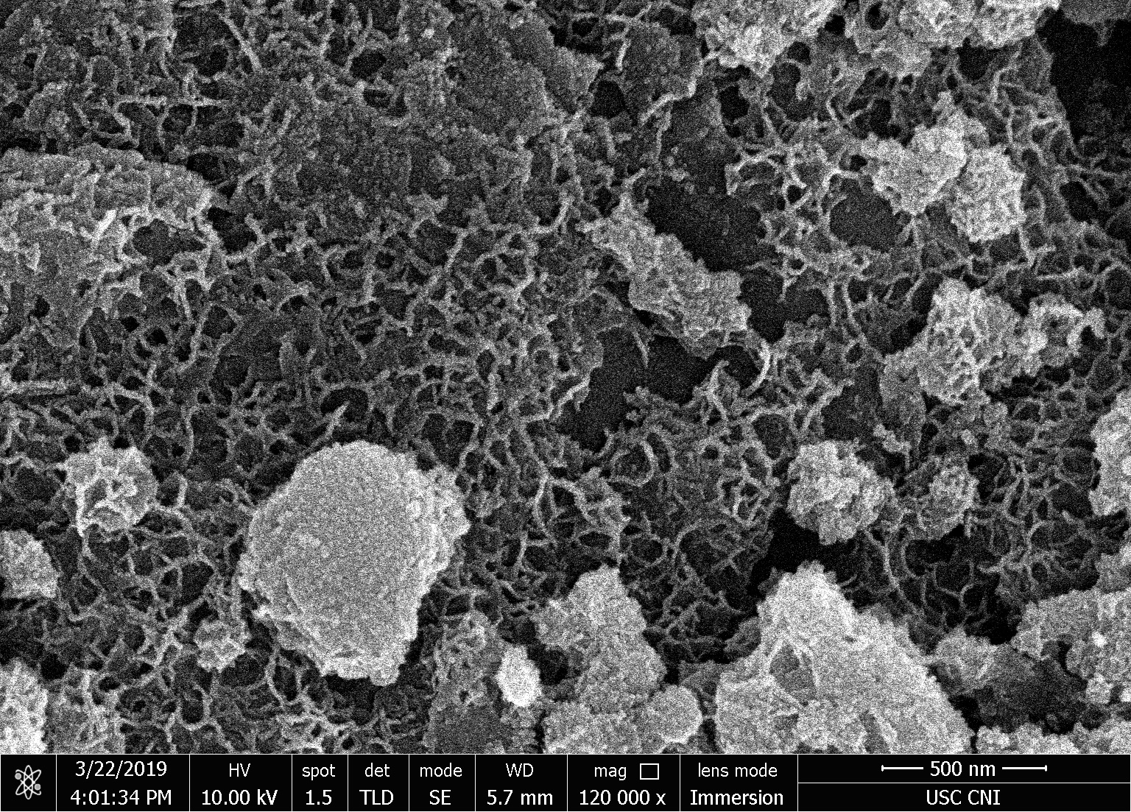
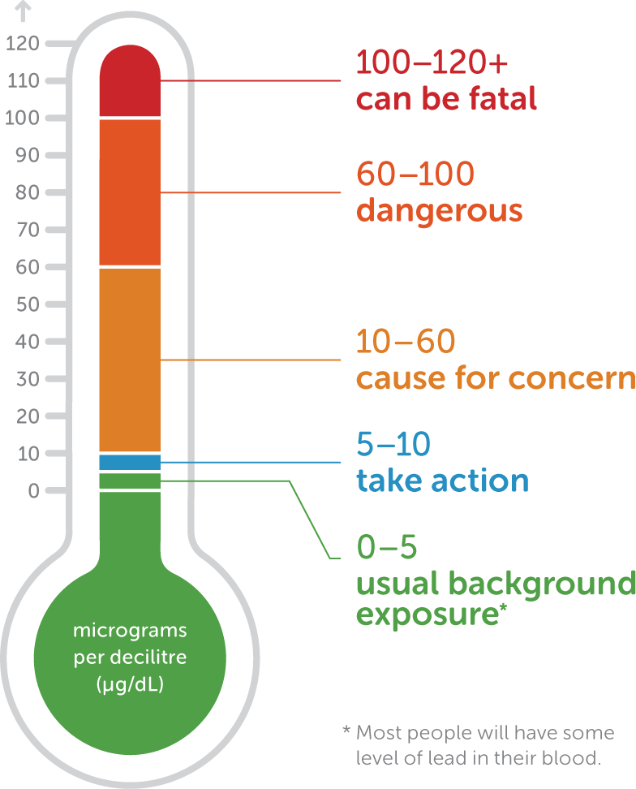
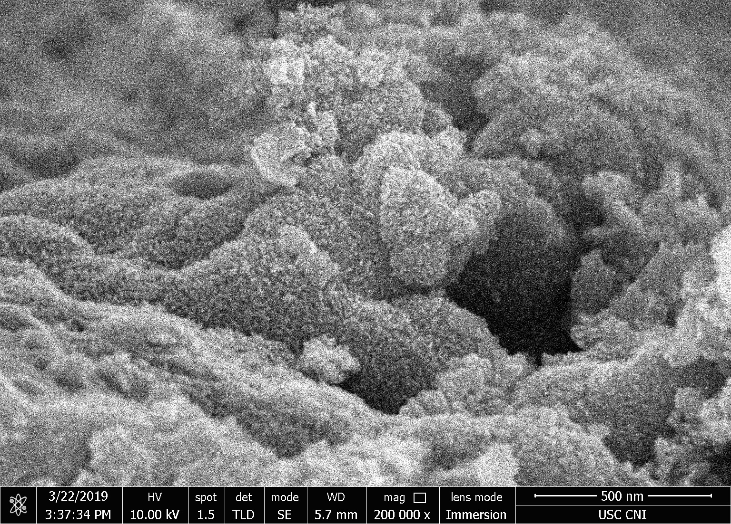
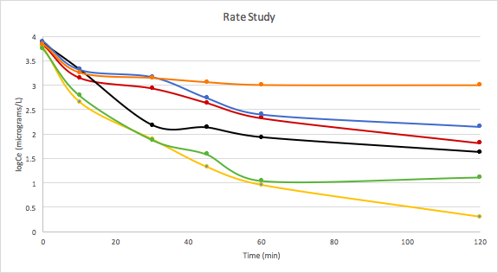
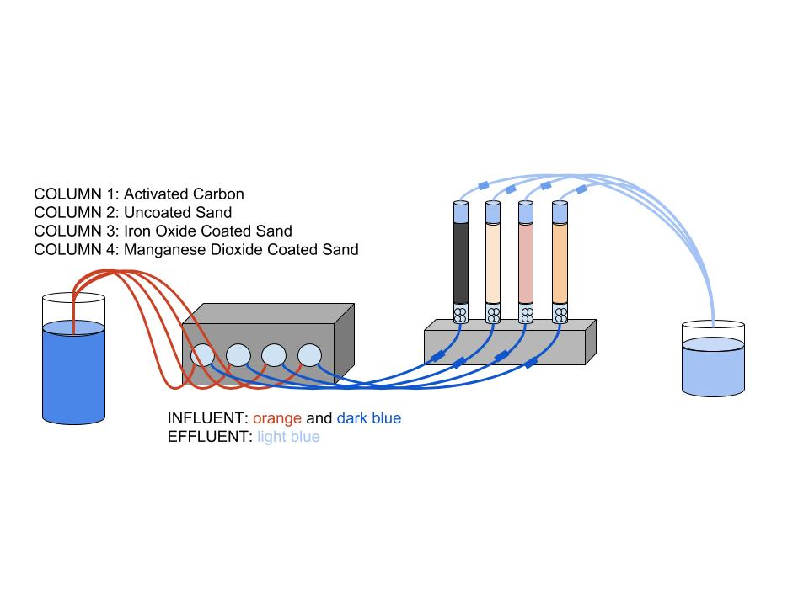
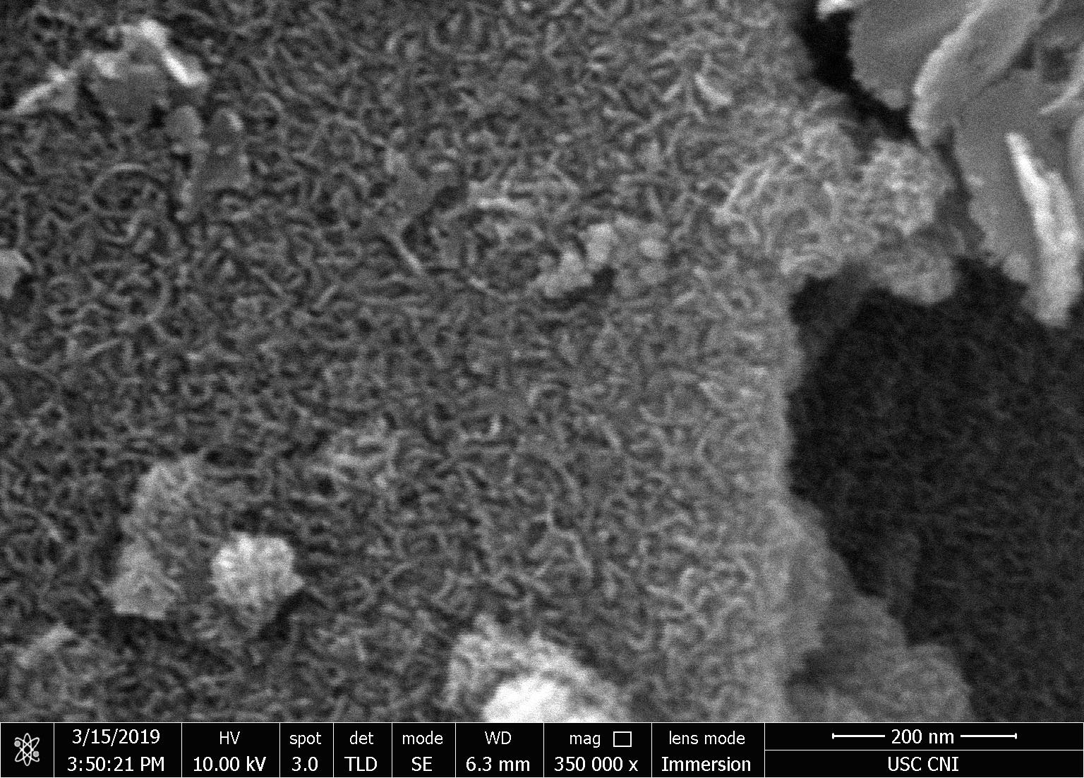
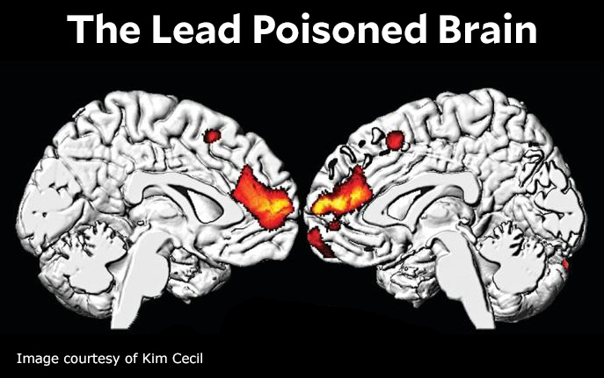
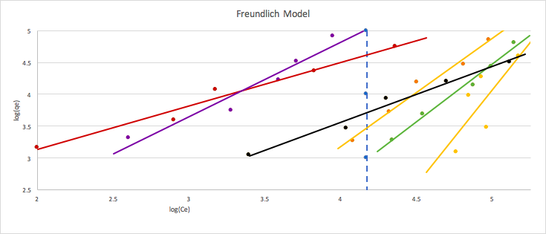
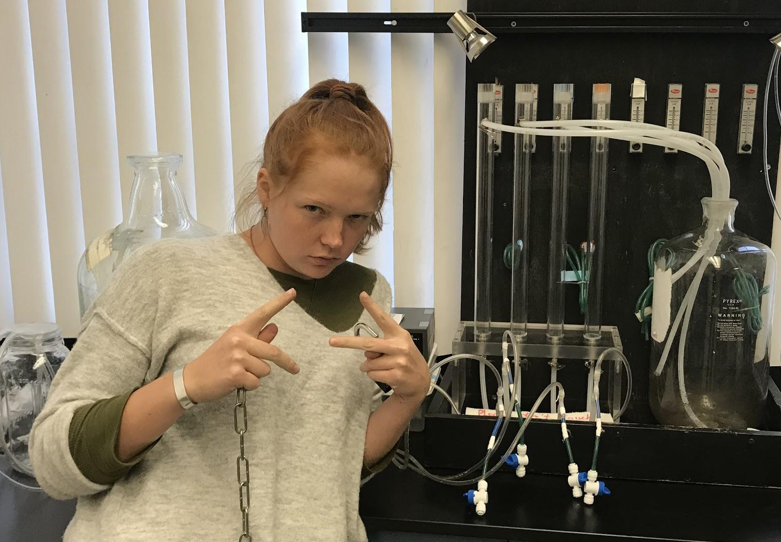
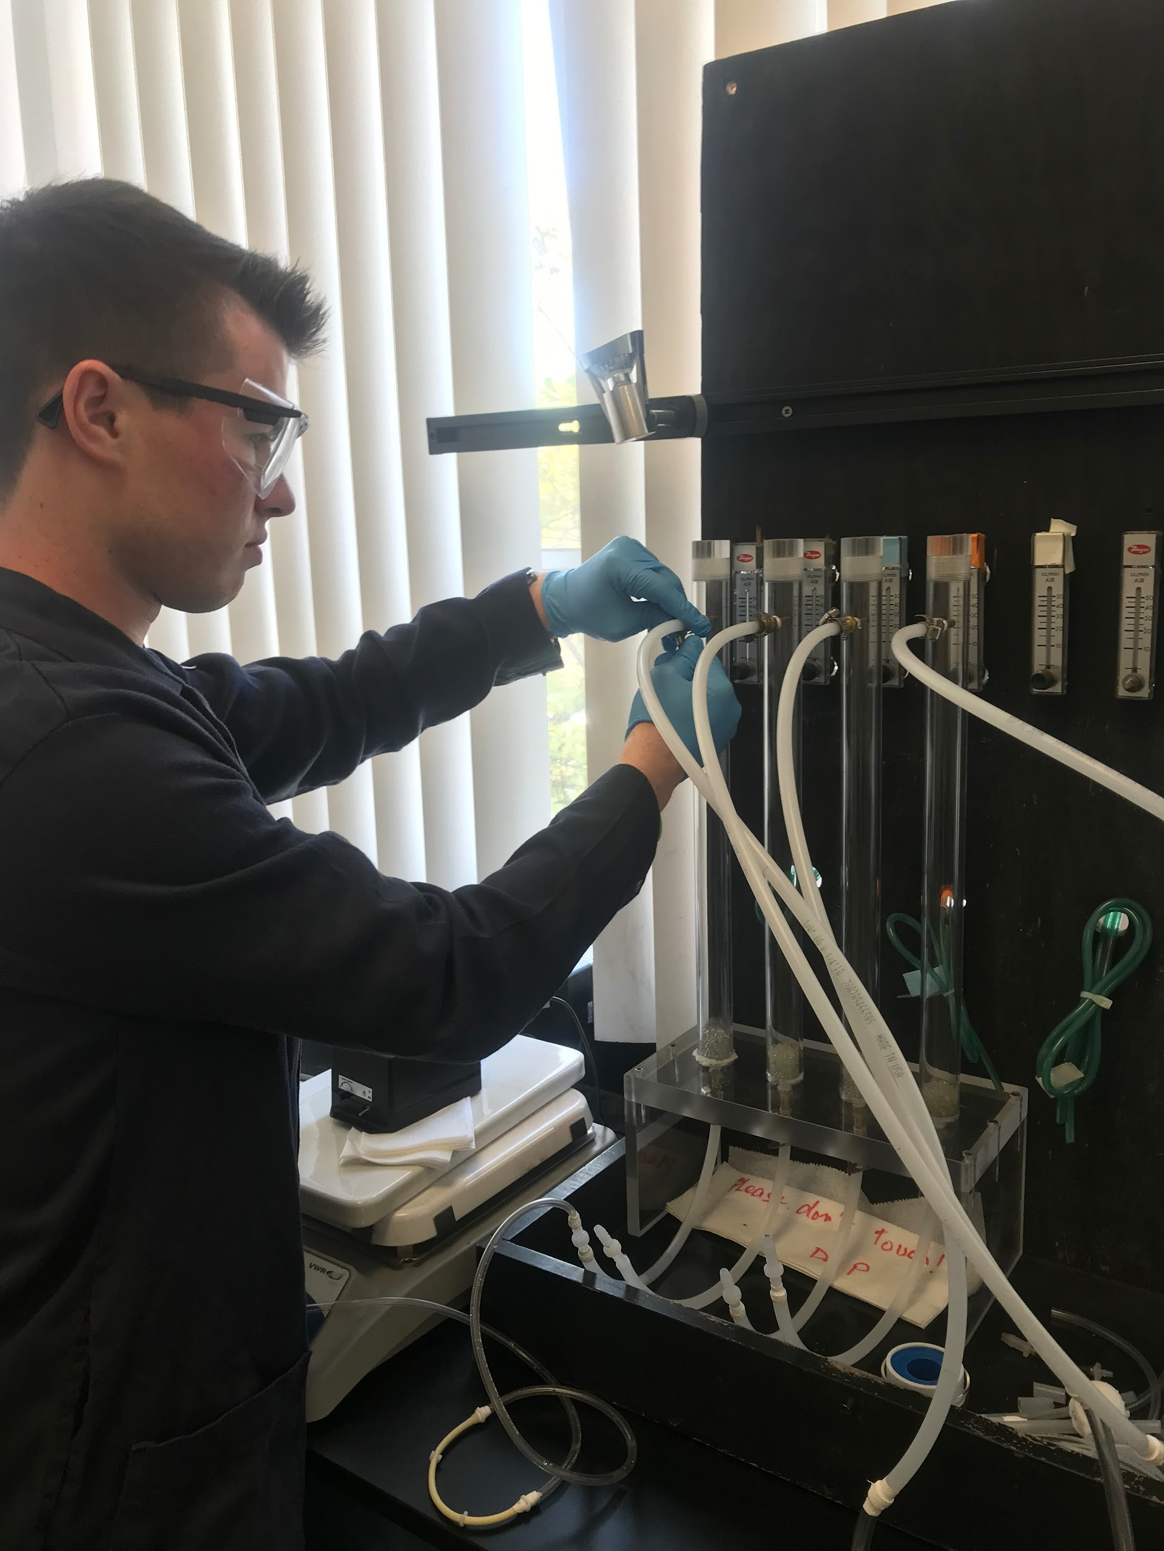

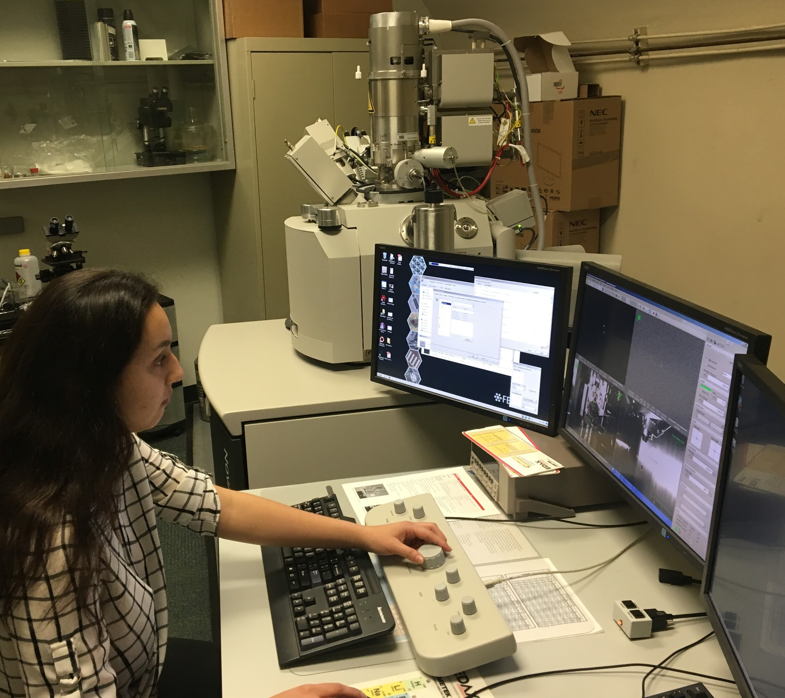
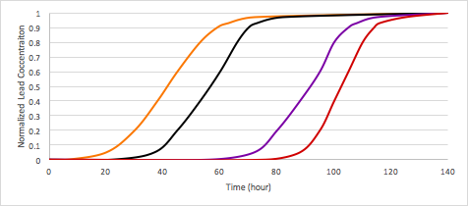

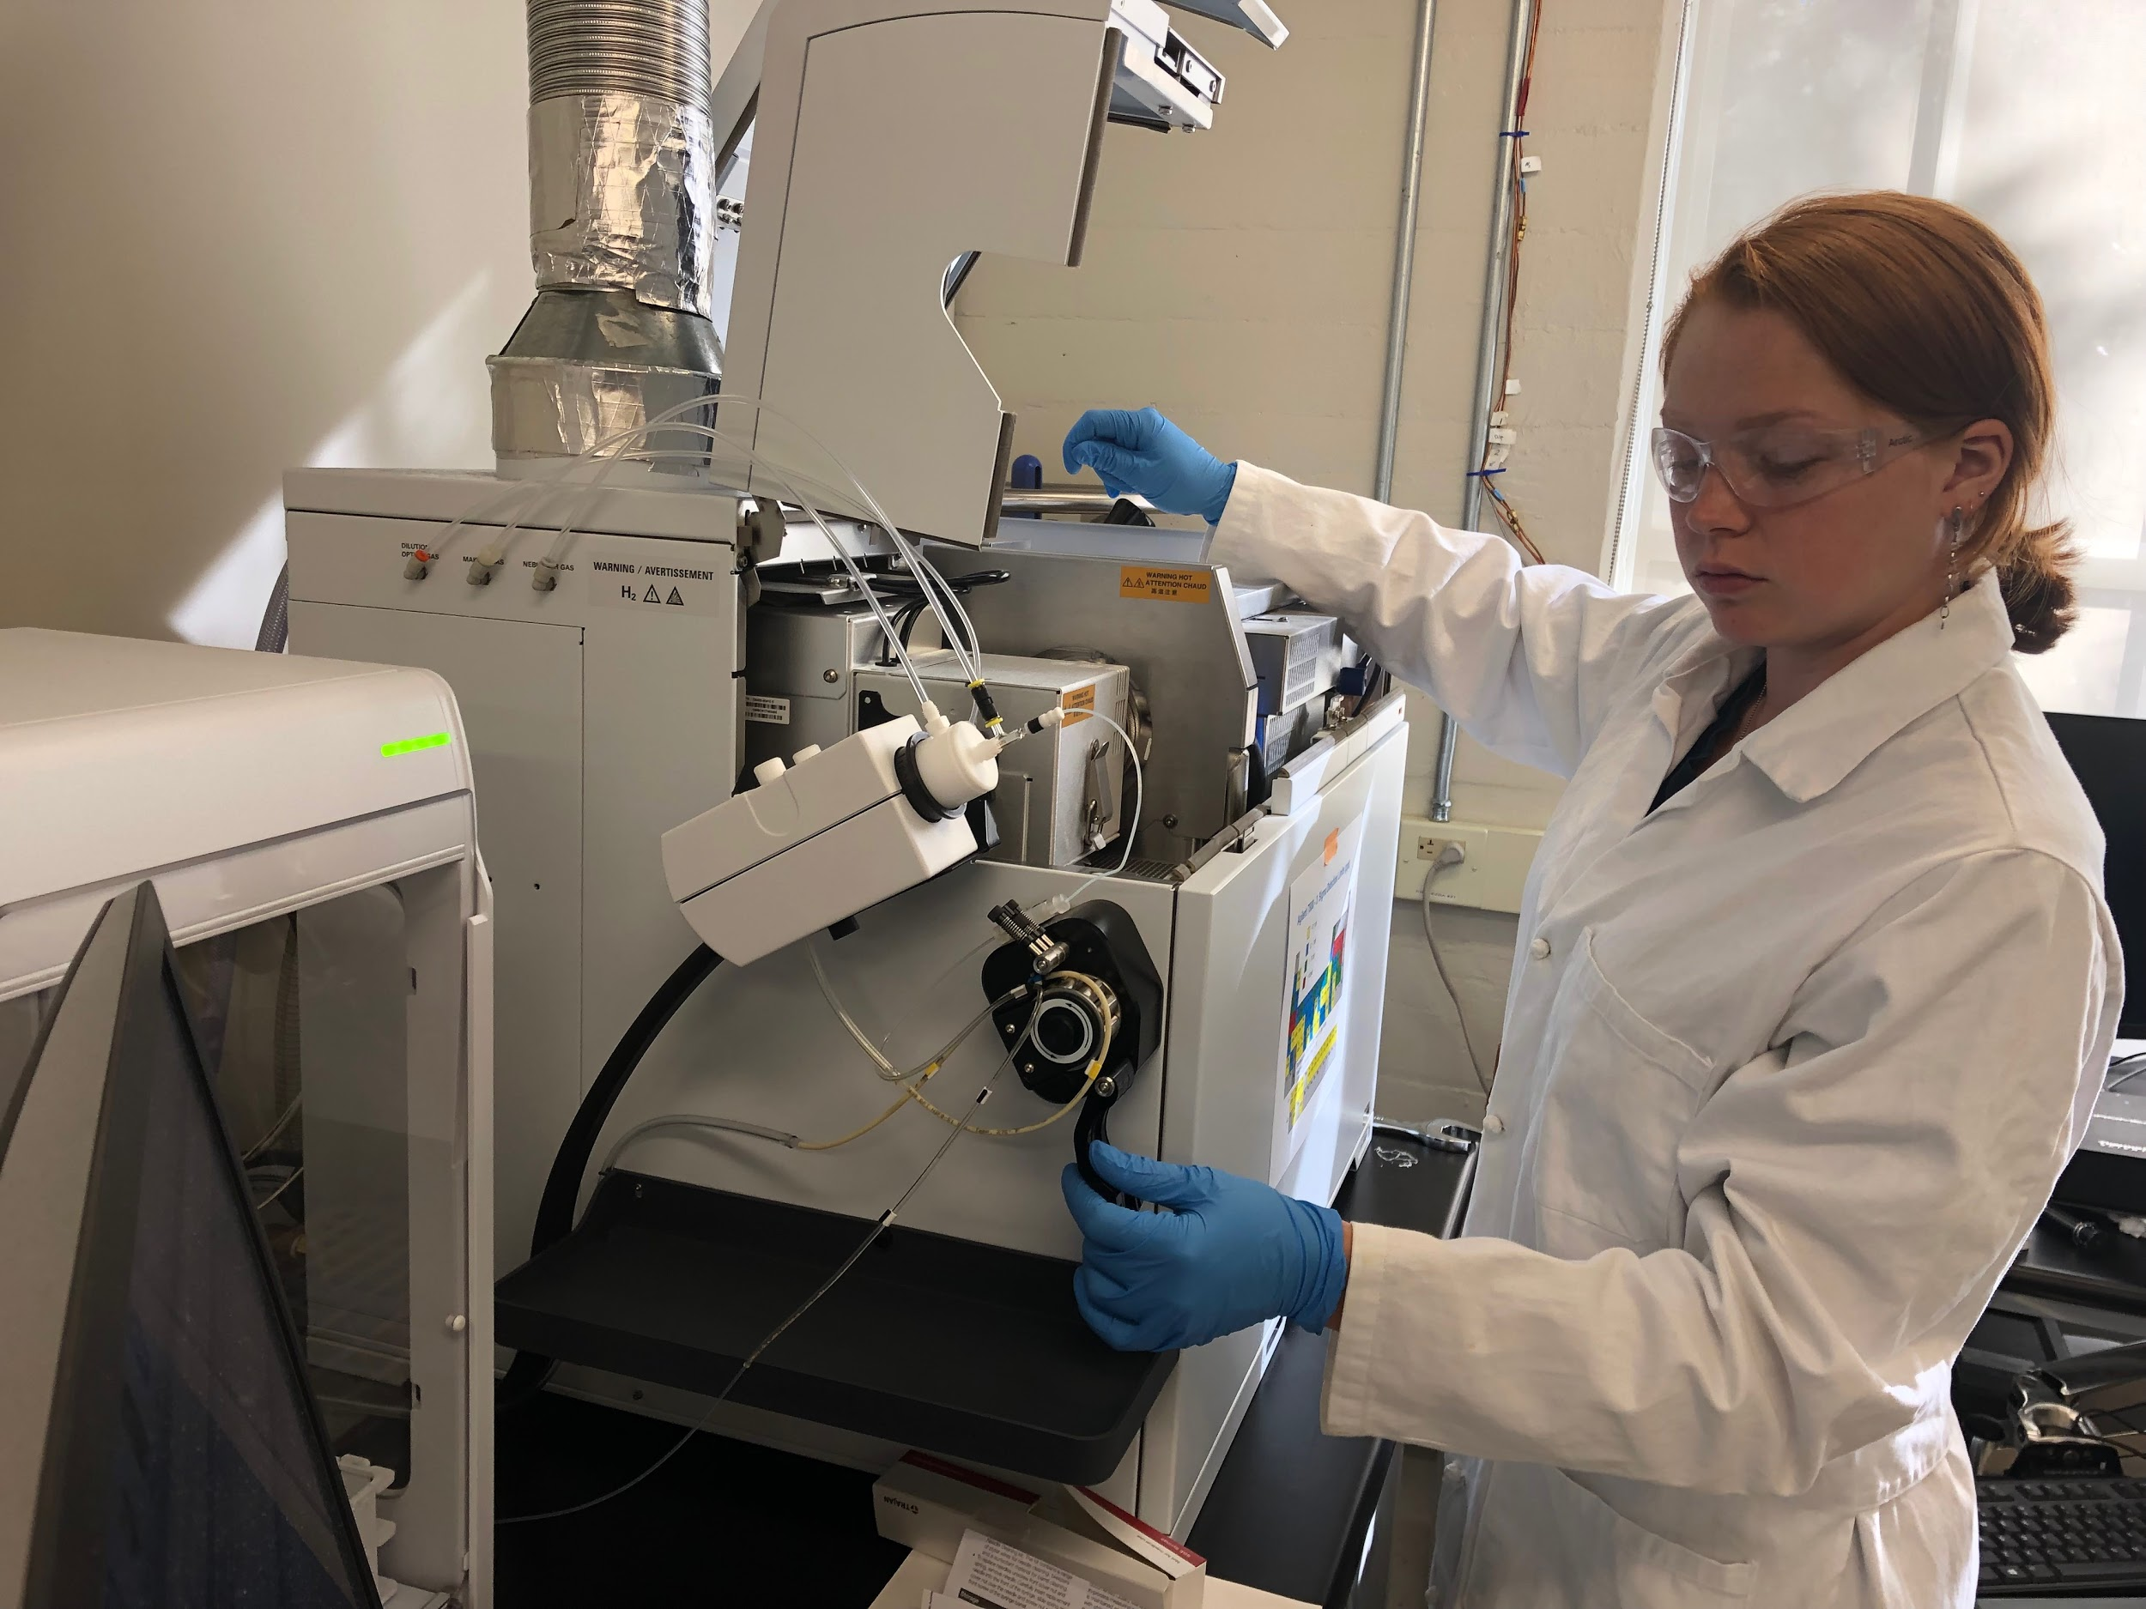
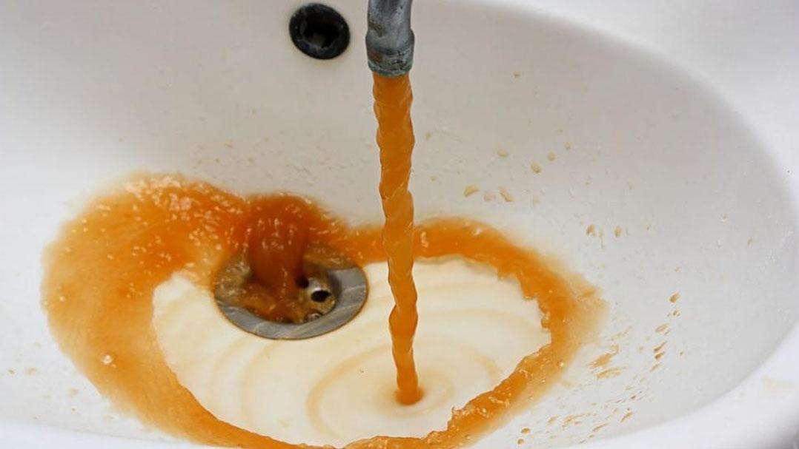

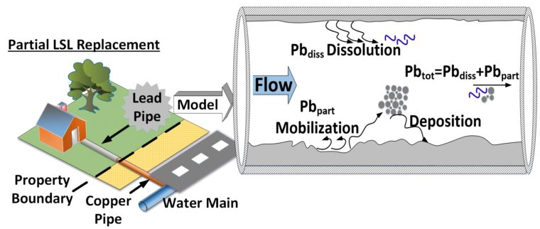




University of Southern California, Undergraduate Symposium for Scholarly and Creative Work, April 11, 2019
Evaluating the Potential of Nanoparticle-Coated Filters for Removal of Lead from Drinking Water
Category: Physical Sciences and Engineering
Undergraduate Research Students: Juliana Tichota (Viterbi, ChemE), Zak Baumann (Viterbi, ISE), Nicole Avendano (Viterbi, ChemE)
Faculty Advisor: Professor Massoud Pirbazari (Viterbi, CEE)
Viterbi School of Engineering, University of Southern California
Research Objectives
Methods
Results and Discussion
This research aimed to predict the performance of various special adsorbents created by nano-deposition of metals onto sand and activated carbon particles for lead removal from contaminated water. Via modeling, it projected the success rate of an inexpensive and sustainable point-of-use system that is efficient, eco friendly, economical, and minimally chemically dependent.
Six adsorbents (activated carbon, iron oxide-coated activated carbon, manganese oxide-coated activated carbon, sand, iron oxide-coated sand, and manganese oxide-coated sand) were tested to investigate their potential in removal of lead from drinking water. ICP-MS was the analytical instrument used to measure lead concentration. Scanning Electron Microscopy (SEM) was employed to observe the morphology and extent of coverage by nanoparticles, nanorods, and nano-sheets on different adsorbents.
Adsorption isotherm represents the capacity of an adsorbent for adsorbing a pollutant from water. Freundlich isotherm model used in these studies (Fig. 1) has the form q_{e} = K_{f} C_{e} ^{n}, where K_{f} and n relate to adsorption capacity.
Adsorption rate represents the velocity of approach to equilibrium capacity. In this context, a more rapid approach to equilibrium signifies that a greater fraction of equilibrium has been utilized in a given contact time.
Role of nanoparticles: This study indicates that iron oxide and manganese oxide nanoparticles have high adsorption capacity for lead.
Nanoparticle-coated adsorbents demonstrate higher adsorption capacities for lead.
Adsorption isotherms indicate that iron oxide and manganese oxide nanoparticles lower the concentration of lead to below one microgram per liter.
Preliminary fixed-bed modeling predictions were successful in forecasting filter performances.
Nanoparticles appear to discourage growth of bacteria on filters.
Lead as a Contaminant
Lead is frequently a component of plumbing materials and solder.
The EPA’s MCL for lead is 15 ppb
EPA’s Lead and Copper Rule states that if more than 10% of tap water samples from a given testing region contain 15 ppb lead or more, immediate treatment is mandatory.
Treatment: replacing pipelines containing lead or optimizing corrosion control by decreasing the corrosive properties of water.
Figure 4A: SEM micrograph: nanorod formation / coverage of MnO₂ coated sand
Future Work
Optimize the oxide coating methodology in terms of nanoparticle coverage on adsorbents
Based on the modeling results, design and construct fixed-bed adsorbers to test lead removal under different operating conditions. (Note: already in progress).
Uncoated sand
Iron sand
Manganese sand
Uncoated GAC
Iron GAC
Manganese GAC
Blood Lead Level (BLL) safety
Figure 4B: SEM micrograph: MnO₂ nanoparticle coverage of GAC macropores
Lead: Risks and Effects
Lead is a probable human carcinogen according to the CDC and EPA.
Lead has a half-life in blood of 1-2 months, in bone of 20-30 years.
In 2004, lead in drinking water caused 143,000 deaths worldwide.
Children represent 80% of the population affected by lead due to immaturity of the blood-brain barrier.
600,000 new childhood intellectual disability cases arise each year from blood lead levels (BLLs) over 10 ppb.
In children especially, lead exposure is linked to central and peripheral nervous system damage, learning disabilities, anemia, and impaired growth and function of blood cells.
Acknowledgements
Figure 1: Experimental data and Freundlich isotherm model describing the adsorption of lead by different adsorbents.
Figure 4C: SEM micrograph: iron nanoparticle coverage on GAC surface
We would like to extend our appreciation to graduate students Xi Chen (Viterbi, ENE) and Harshit Joshi (Viterbi, ENE) for their invaluable assistance. We would also like to thank Dr. Varadarajan Ravindran for his help in this study. This research was partly supported by Viterbi Merit Research Scholar Program.
Lead can enter the body through:
Consumption of or bodily contact with contaminated water
Inhalation of contaminated dust or fumes from paint
Consumption of food cooked with contaminated water
Uncoated sand
Iron sand
Manganese sand
Uncoated GAC
Iron GAC
Manganese GAC
Model Assumptions
The model assumptions are: i) plug-flow system with axial dispersion, ii) the uptake of metal ions is controlled by dual-resistance mass transport mechanisms: external film mass transfer and interparticle diffusion, and iii) the equilibrium is described by the Freundlich isotherm model.
Lead in Homes
Liquid-phase mass balance of the adsorbate (lead):
The destabilization of rust layers containing significant quantities of lead is most linked to current lead crises.
Water conditions affect the corrosion rate of piping; both hard and soft water are slightly corrosive.
Current Point-of-Use systems mainly involve activated carbon block filters. Though they remove some lead, they increase bacteria count 100-fold.
Figure 2: Experimental adsorption rate data for different adsorbents in removal of lead from water
Iron Oxide GAC
Iron Oxide Sand
Uncoated GAC
Manganese Oxide GAC
Adsorbate concentration on adsorbent particle:
Surface diffusion relationship for adsorbent particle:
Equilibrium relationship between liquid-phase and solid-phase concentration of the adsorbate:
Excess lead in drinking water, Flint, MI, 2014
Axial dispersion coefficient using correlation technique:
Destabilization of rust containing lead
Figure 3: Predictive Model Simulation for fixed-bed filters for the removal of lead from drinking water

