Slide 1
Removing Lead from Drinking Water
Students: Jessica Kim, Juliana Tichota, Harshit Joshi, and Xi Chen
Faculty Supervisor: Professor Massoud Pirbazari
Notes:
done

Slide 2
This site is under construction. All material included in this presentation have been adapted from sources outlined in the reference section

Slide 3
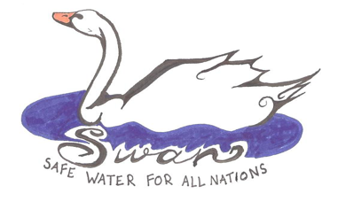
Safe Water for All Nations (S.W.A.N)
S.W.A.N is an initiative started by Dr. Massoud Pirbazari of the University of Southern California focusing on the improvement of drinking water quality for citizens of developing countries. SWAN's goal is to provide comprehensive and visually based information so that people, at the household level, can treat their water, and in turn, improve their health and well-being.
Notes:
done

Slide 4
Problem Statement and Research Objectives
Drinking water in many cities in the United States and around the world contain dangerous levels of lead, causing the populations of these cities to experience high blood lead levels, which leads to serious health problems. Although there are many potential solutions to reduce levels of lead in drinking water, current point-of-use and point-of-entry solutions have caused the growth of harmful bacteria which is also harmful to these populations. The goal of this research is to employ nano-deposition techniques to tailor absorbents that can be incorporated into point-of-use devices that can effectively, economically, and sustainably remove lead in systems without causing biological growth.
Notes:
done

Slide 5
Novelty and Impact
Use of nano-deposition techniques to tailor adsorbents with high efficiencies for lead removal in systems without any biological contamination or growth
Implementation of economical, effective, efficient, and sustainable POU system
Application of system to POE approaches
Foundation for removal systems for other, similarly complex toxins.
5

Slide 6
Glossary of Acronyms
Acronym | Full Name | Acronym | Full Name
POU | Point of Use | LSL | Lead Service Line
POE | Point of Entry | WHO | World Health Organization
GAC | Granular Activated Carbon | MCLG | Maximum Contaminant Level Goal
SEM | Scanning Electron Microscopy | CCR | Consumer Confidence Report
n-IONP, p-IONP | Negative surface charge iron-oxide nanoparticles, positive surface charge iron-oxide nanoparticles | SODIS | Solar Water Disinfection
CDC | Centers for Disease Control and Prevention | ppb | Parts Per Billion
BLL | Blood Lead Levels
Notes:
parts per billion (ppb)

Slide 7
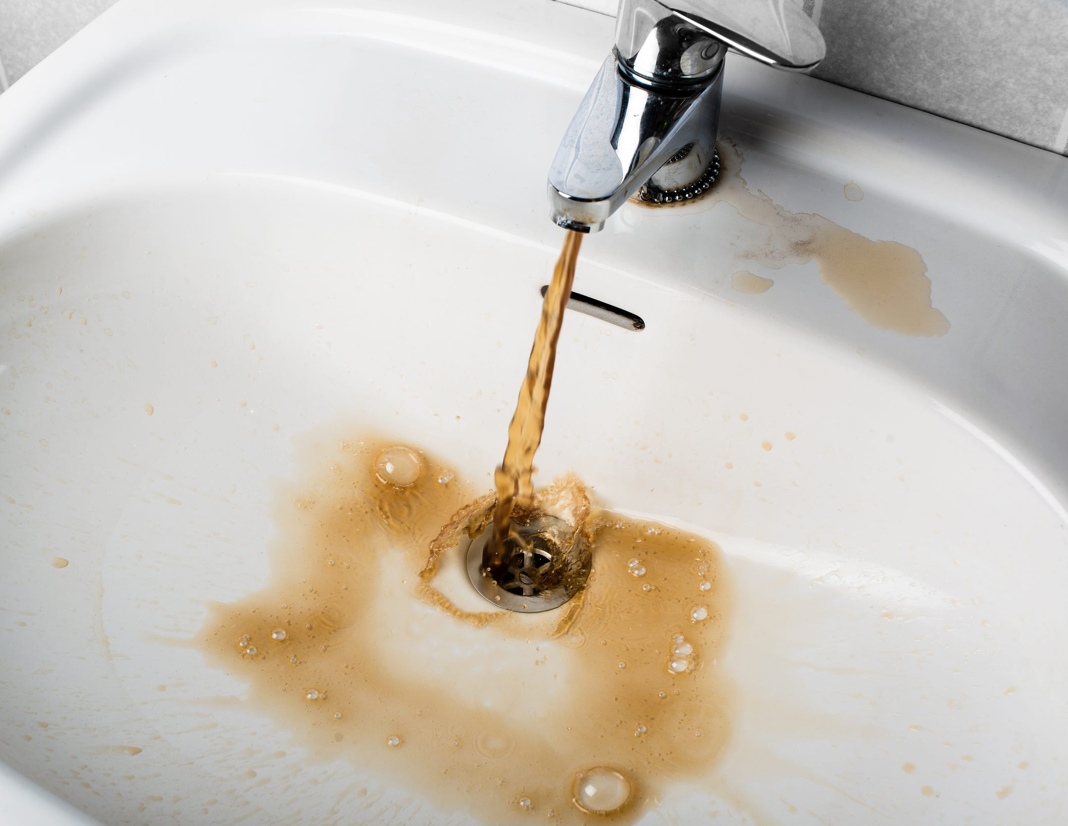
Research Scope
In this research, we will be:
comparing the adsorption capacity and efficiencies of various adsorbents for lead removal,
evaluating the efficacy of metal oxide deposition on sand and activated carbon and compare results from all 5 trial conditions,
studying the extent of biological growth using colony counting to investigate the biocidal effects of nano-deposition of metal oxides on sand and activated carbon,
and determining practical applications for system in terms of Point of Use (POU) and Point of Entry (POE) systems.
Fig 1. Lead contaminated tap water ^{[1]}.
Notes:
[1} Bendix, Aria. “11 Cities with the Worst Tap Water in the US.” Business Insider, Business Insider, 19 Mar. 2019, www.business
insider.com/cities-worst-tap-water-us-2019-3.

Slide 8
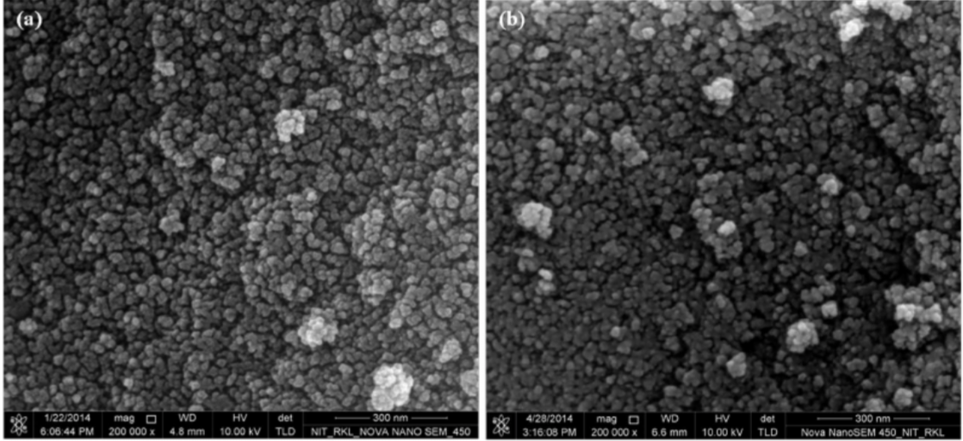
Rationale
According to a 2015 study led by Manoranjan Arakha ^{[2]}, nano-deposition of metal oxides on sand particles or activated carbon impregnated with these oxides can:
yield excellent adsorbents with high capacities,
and treat water contaminated with these ions.
The study also shows that nano-deposition of these oxides on sand or granular activated carbon (GAC) particles will:
facilitate modulation of nano-particle-bacteria interface to manifest antimicrobial activity,
prevent biological growth in these adsorbent media,
and promote antimicrobial activity to prevent the formation of biofilms in adsorbent treatment systems over sustained use.
Fig 2. Scanning Electron Microscopy (SEM) images of n-IONP (negative surface charge iron-oxide nanoparticles) and p-IONP (positive surface charge iron-oxide nanoparticles) ^{[2]} .
Notes:
[2] Arakha, Manoranjan, et al. “Antimicrobial Activity of Iron Oxide Nanoparticle upon Modulation of Nanoparticle-Bacteria Interface.” Scientific Reports, vol. 5, no. 1, June 2015, doi:10.1038/srep14813.

Slide 9
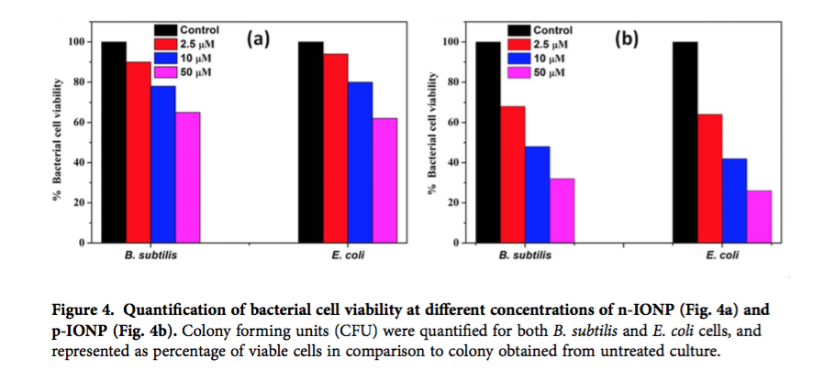
Rationale (cont’d)
Figure 3 displays the viability of 2 strains of bacteria (E. coli and B. subtilis) in the presence of different concentrations of n-IONP (negative surface charge iron-oxide nanoparticles) and p-IONP (positive surface charge iron-oxide nanoparticles). Less significant growth in inhibition compared to control were observed for n-IONP, whereas the inhibition is relatively dominant for p-IONP. Furthermore, the figure indicates that the viability of both bacteria cells were reduced by approximately 30% in the presence of 50 µM n-IONP. However, the coated IONP has significant effect on bacterial viability, with viability being reduced by 70% in the presence of 50 µM p-IONP. The data indicates strong antimicrobial propensity of p-IONP against studied bacterial strains^{[2]}.
Fig 3. Quantification of bacterial cell viability at different concentrations of n-IONP (a) and p-IONP (b) ^{[2]}.
Notes:
[2] Arakha, Manoranjan, et al. “Antimicrobial Activity of Iron Oxide Nanoparticle upon Modulation of Nanoparticle-Bacteria Interface.” Scientific Reports, vol. 5, no. 1, June 2015, doi:10.1038/srep14813.

Slide 10
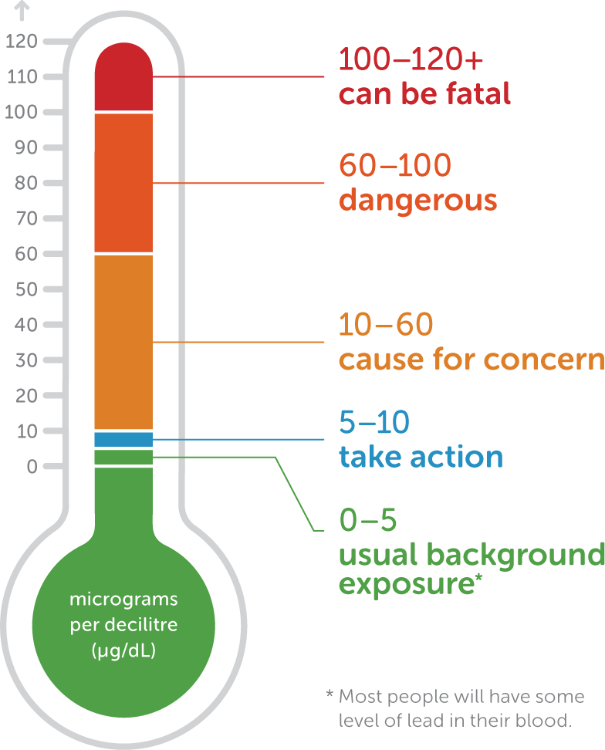
Lead as a Contaminant
Introduction:
According to the Oregon Department of Human Services, lead poisoning occurs where there is heavy presence of lead in the body. It is the common preventable pediatric health problem in the United States ^{[3]}.
According to the Centers for Disease Control and Prevention (CDC), lead is a probable human carcinogens ^{[4]}.
Children represent 80% of the population that incurred a lead-related disease; about 600,000 new childhood intellectual disability cases arise each year from Blood Lead Levels (BLLs) over 10 𝜇g/dL ^{[4]}.
According to the Institute for Health Metrics and Evaluation, lead exposure accounted for 540,000 deaths, 13.9 million years of healthy life lost, 63.8% of global idiopathic developmental intellectual disability, 3% of global ischaemic heart disease, and 3.1% of global stroke in 2016 ^{[5]}.
According to the World Health Organization (WHO), most of the people impacted by lead poisoning come from low and middle income countries ^{[6]}.
Fig 4. The effects of different concentrations of lead on humans ^{[7]}.
Notes:
[3] “Health Effects of Lead Exposure.” Oregon.gov, Oregon Department of Human Sciences, www.oregon.gov/oha/ph/HealthyEnvironments/HealthyNeighborhoods/LeadPoisoning/MedicalProvidersLaboratories/Documents/introhealtheffectsmedicalprovider.pdf.
[4] Brown, Mary Jean, and Stephen Margolis. “Lead in Drinking Water and Human Blood Lead Levels in the United States.” Morbidity and Mortality Weekly Report (MMWR), Centers for Disease Control and Prevention, 9 Aug. 2012, www.cdc.gov/mmwr/preview/mmwrhtml/su6104a1.htm.
[5] “GBD Compare.” Data Visualizations, vizhub.healthdata.org/gbd-compare/.
[6] “Lead Poisoning and Health.” World Health Organization, World Health Organization, 23 Aug. 2018, www.who.int/news-room/fact-sheets/detail/lead-poisoning-and-health.
[7] “Effects of Lead.” LeadSmart, http://leadsmart.nsw.gov.au/effects-of-lead/.

Slide 11
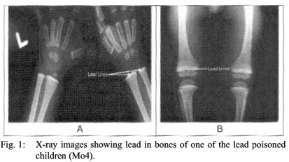
Lead as a Contaminant (cont’d)
How Lead Specifically Impacts Human Bodies:
When lead enters the body, it will travel by blood to soft tissues like the liver, kidneys, lungs, brain, spleen, muscles, and heart ^{[3]}.
Lead accumulates mostly in bones but can also re-enter the bloodstream during pregnancy, breastfeeding, and bone fracture ^{[3]}.
Children, especially those undernourished, are most vulnerable. Approximately, only 32% of lead that enters a child’s body will exit as waste ^{[6]}.
The half life of lead in the human body varies:
In blood, the half life is 12 - 30 days.
In soft tissue, the half life is 7 - 73 day.
In bone, it is 1.2 years to 59 years ^{[8]}.
Fig 5. X-ray images of acute lead poisoning in bones of children associated with backyard lead smelting in Jamaica ^{[8]}.
Notes:
[3] “Health Effects of Lead Exposure.” Oregon.gov, Oregon Department of Human Sciences, www.oregon.gov/oha/ph/HealthyEnvironments/HealthyNeighborhoods/LeadPoisoning/MedicalProvidersLaboratories/Documents/introhealtheffectsmedicalprovider.pdf.
[6] “Lead Poisoning and Health.” World Health Organization, World Health Organization, 23 Aug. 2018, www.who.int/news-room/fact-sheets/detail/lead-poisoning-and-health.
[8] Lalor, Gc, et al. “Acute Lead Poisoning Associated with Backyard Lead Smelting in Jamaica.” West Indian Medical Journal, vol. 55, no. 6, 2006, doi:10.1590/s0043-31442006000600005.

Slide 12

Lead as a Contaminant in 2020
The report The Toxic Truth: Children’s exposure to lead pollution undermines a generation of potential states that around 1 in 3 children (800+ million globally) have blood lead levels at or above 5 µg/dL.
  Most of these children are located in South Asia.
  The report conducted case studies of Kathgora, Bangladesh; Tbilisi, Georgia; Agbogbloshie, Ghana; Pesarean, Indonesia; and Morelos State, Mexico.
Childhood lead exposure impacts developing countries the most heavily. These lead poisonings cost USD $1 trillion due to the lost economic potential of these children over their lifetime.
Informal and substandard recycling of lead-acid batteries is a major cause of lead poisoning of children in developing countries. Due to the lack of vehicle battery recycling regulation and infrastructure, and a 3 times increase in the number of vehicles since 2000, almost 50% of lead-acid batteries are recycled unsafely.
Due to the phase-out of leaded gasoline and paints, lead poisoning in children is less prevalent in developed countries^{[70]}.
Fig 6. UNICEF has played a primary role in conducting research on lead contamination worldwide ^{[70]}.

Slide 13
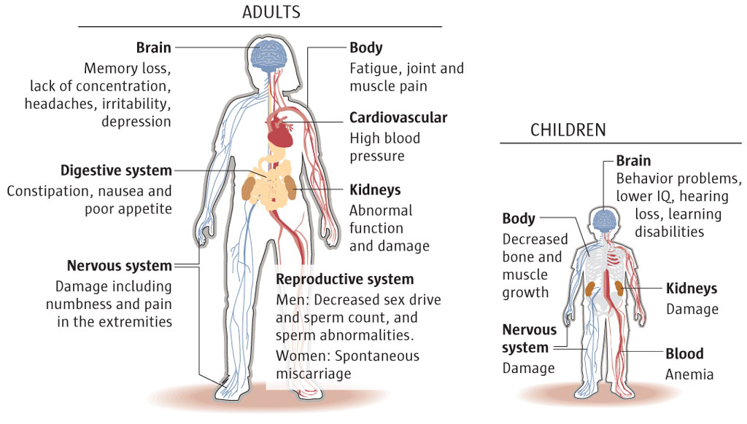
Health Effects
Fig 7. The various health impacts of lead on adults and children ^{[9]}.
Notes:
[9] Greenkidsdoc. “Lead In My Water Supply! Now What?” Green Kids Doc, 20 Mar. 2015, https://greenkids
doc.wordpress.com/2015/03/20/lead-in-my-water-supply-now-what/.

Slide 14
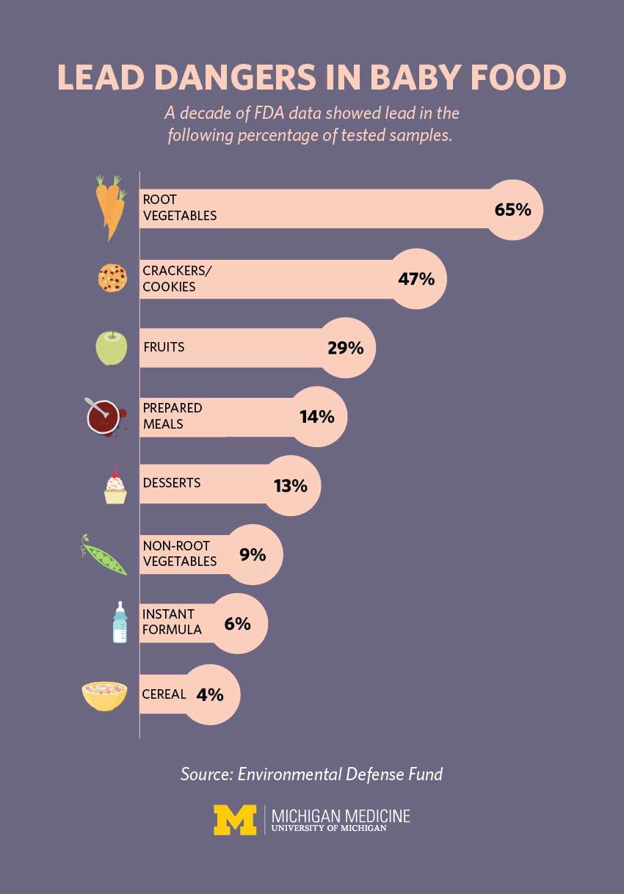
Forms of Lead Ingestion
Lead can be ingested through food:
If the food naturally contains lead or if the food is prepared with lead-contaminated water ^{[10]}.
Research by the University of Michigan found that 20% of baby food contained detectable levels of lead ^{[11]}.
Inhalation of lead particles generated during processes such as smelting, recycling, and using leaded gasoline also lead to lead ingestion ^{[6]}.
Old homes that were built before 1978 tend to have lead-based paint. People can ingest the lead dust when the paint peels and cracks ^{[12]}.
Objects such as toys and jewelry can also contain lead ^{[13]}.
The EPA estimates that more than 20% of a person’s lead intake comes from water ^{[10]}.
Fig 8. The percentage of baby food samples tested that contained lead ^{[11]}.
Notes:
[10] “Basic Information about Lead in Drinking Water.” EPA, Environmental Protection Agency, 28 Mar. 2019, www.epa.gov/ground-water-and-drinking-water/basic-information-about-lead-drinking-water#getinto.
[11] Joy, Kevin. “Lead in Baby Food: How Parents Can Reduce the Risk.” Health & Wellness Topics, Health Tips & Disease Prevention, 27 July 2017, healthblog.uofm
[6] “Lead Poisoning and Health.” World Health Organization, World Health Organization, 23 Aug. 2018, www.who.int/news-room/fact-sheets/detail/lead-poisoning-and-health.
[12] “CDC - Lead - Sources of Lead Infographic.” Centers for Disease Control and Prevention, Centers for Disease Control and Prevention,
https://www.cdc.gov/nceh/lead/prevention/infographic-lead-in-environment.htm.
[13] “Protect Your Family from Exposures to Lead.” EPA, Environmental Protection Agency, 26 Mar. 2019, www.epa.gov/lead/protect-your-family-exposures-lead.

Slide 15

Lead Ingestion Through Water is Caused Mainly due to Plumbing Material
Lead enters water after it leaves water treatment plants due to the corrosion of plumbing materials and solder that contains lead ^{[14]}.
This lead is often not adequately filtered out before it enters homes and public spaces because it is not anticipated ^{[15]}.
Although the American congress banned lead water pipes over 30 years ago, around 3.3 million to 10 million older lead pipes remain. Even jostling during repairs or sudden change in water chemistry can cause lead to enter the water that travels through these pipes ^{[15]}.
Solder and brass plumbing advertised as “lead free” still contains 8% lead ^{[14]}.
Fig 9. A lead pipe being removed ^{[16]}.
Notes:
[14] Renner, Rebecca. “Exposure on tap: drinking water as an overlooked source of lead.” Environmental health perspectives vol. 118,2 (2010): A68-72. doi:10.1289/ehp.118-a68.
[15] Wines, Michael, and John Schwartz. “Unsafe Lead Levels in Tap Water Not Limited to Flint.” The New York Times, The New York Times, 8 Feb. 2016, www.nytimes.com/2016/02/09/us/regulatory-gaps-leave-unsafe-lead-levels-in-water-nationwide.html.
[16] Wines, Michael, and John Schwartz. “Unsafe Lead Levels in Tap Water Not Limited to Flint.” The New York Times, The New York Times, 8 Feb. 2016, www.nytimes.
com/2016/02/09/us/regulatory-gaps-leave-unsafe-lead-levels-in-water-nationwide.html.

Slide 16
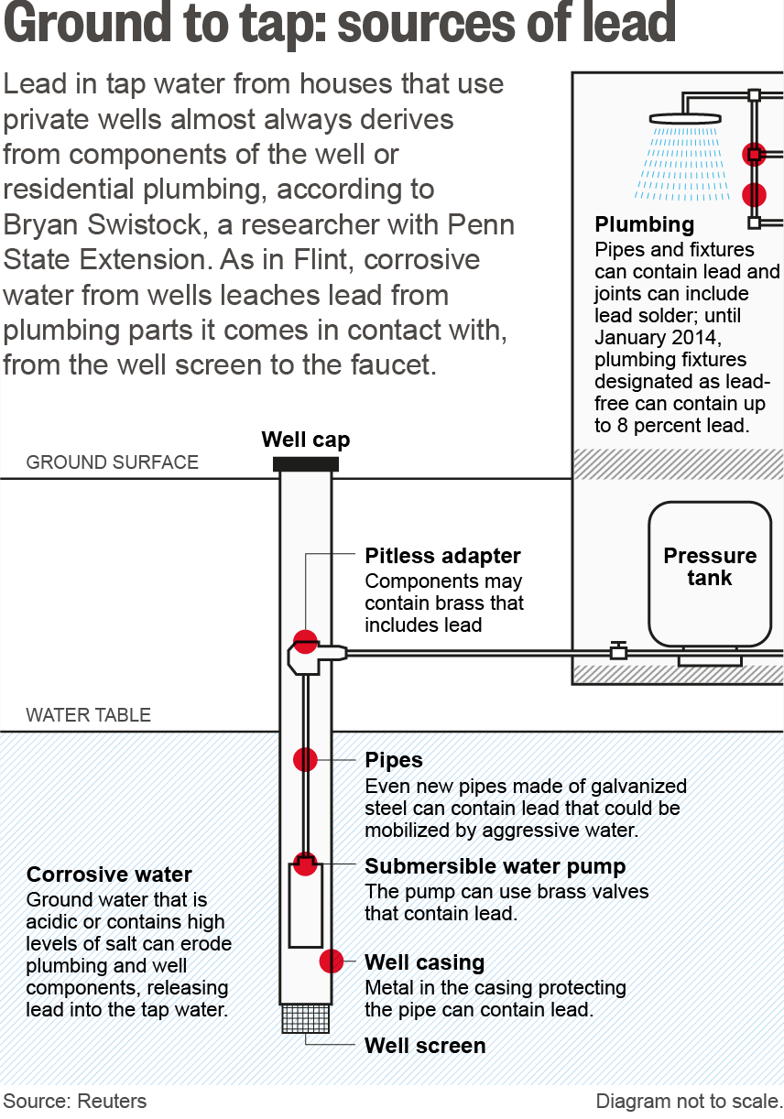
Other Causes of Lead Contamination in Water
Lead contamination in water can be due to other reasons such as:
The usage of copper fixtures.
The usage of copper or brass pipes.
The usage of brass or chrome-plated brass faucets ^{[10]}.
The reliance on well water ^{[17]}.
Homes built before 1986 are most likely to contain lead pipes, fixtures, and solder ^{[9]}.
Fig 10. Well water most likely contains lead due to residential plumbing systems ^{[18]}.
Notes:
[10] “Basic Information about Lead in Drinking Water.” EPA, Environmental Protection Agency, 28 Mar. 2019, www.epa.gov/ground-water-and-drinking-water/basic-information-about-lead-drinking-water#getinto.
[17] “Lead and Drinking Water from Private Wells, Wells, Private Water Systems, Drinking Water, Healthy Water, CDC.” Centers for Disease Control and Prevention, Centers for Disease Control and Prevention, www.cdc.gov/healthywater/drinking/private/wells/disease/lead.html.
[12] “CDC - Lead - Sources of Lead Infographic.” Centers for Disease Control and Prevention, Centers for Disease Control and Prevention, https://www.cdc.gov/nceh/lead/prevention/infographic-lead-in-environment.htm.
[18] Reports, Special. “Lead in the Water: A Corrosive Danger Lurks in U.S. Water Wells.” Reuters, Thomson Reuters, 9 Mar. 2016, www.reuters.com/investigates/special-report/usa-water-lead/.

Slide 17
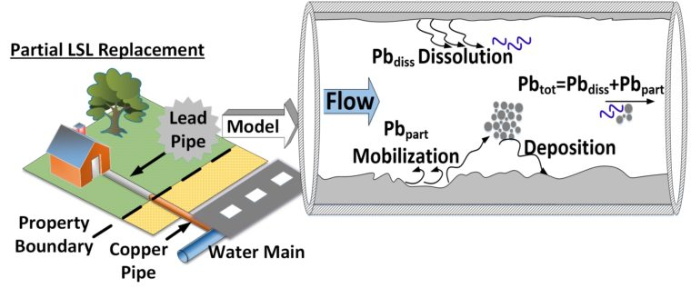
Various Factors Impact the Level of Lead Contamination in Water
There are many factors that influence how much lead enters water:
Water with an abnormally high or low pH is corrosive.
Types and amounts of minerals in the water.
Amount of lead it comes into contact with.
Temperature of the water.
Amount of wear in the pipes.
Duration of the water in pipes: Population decreases lead to less usage and longer duration of water in pipes ^{[14]}.
Presence of protective scales or coatings inside the plumbing materials ^{[10]}.
Lead particles and mineral scales can detach from piping or solder as a result of changes in water chemistry and quality due to new water treatment techniques ^{[14]}.
Fig 11. Partial lead pipe replacement models can be developed using factors such as water use patterns and water chemistry. Engineers can then accordingly figure out where lead will enter the water for partial lead service line (LSL) replacement ^{[19]}.
Notes:
[14] Renner, Rebecca. “Exposure on tap: drinking water as an overlooked source of lead.” Environmental health perspectives vol. 118,2 (2010): A68-72. doi:10.1289/ehp.118-a68.
[10] “Basic Information about Lead in Drinking Water.” EPA, Environmental Protection Agency, 28 Mar. 2019, www.epa.gov/ground-water-and-drinking-water/basic-information-about-lead-drinking-water#getinto.
[19] WUSTLnews. “Partial Lead Pipe Replacement Model.” EurekAlert!, 16 Mar. 2017, https://www.eurekalert.org/multimedia/pub/135794.php.

Slide 18
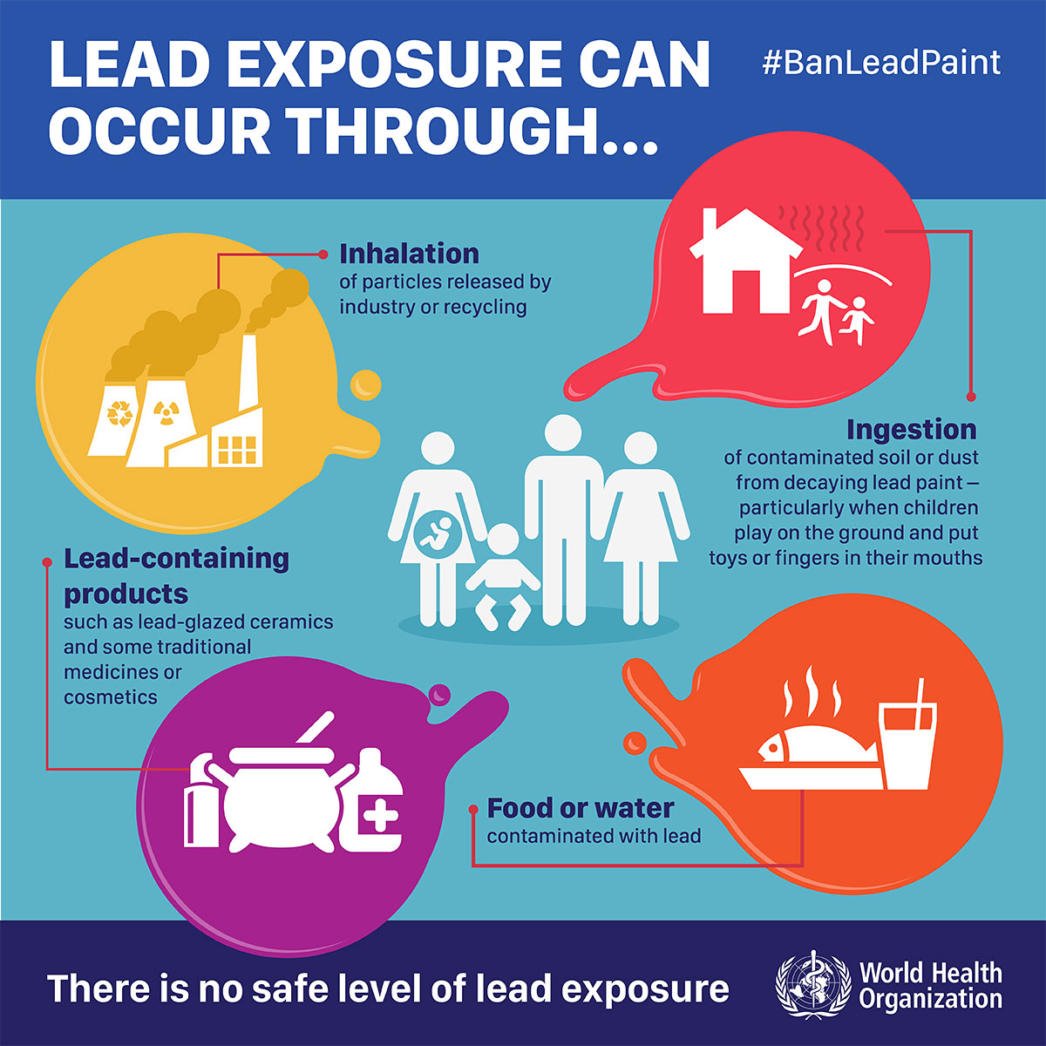
World Health Organization
(WHO)’s Regulation on Lead
The World Health Organization (WHO) identifies lead as 1 of 10 chemicals of major public health concern that member states should take action on in order to protect its citizens, especially workers, children, and women of reproductive age.
The Organization provides information to policy makers, technical guidance for countries, and advocacy materials for people.
It is currently developing prevention and treatment guidelines for world leaders and health professionals.
It works in conjunction with the United Nations to eliminate all lead paint usage and exposure.
It set 10 parts per billion (ppb) lead as the acceptable lead level in drinking water ^{[6]}.
Fig 12. An infographic produced by WHO for their Ban Lead Paint campaign ^{[20]}.
Notes:
[6] “Lead Poisoning and Health.” World Health Organization, World Health Organization, 23 Aug. 2018, www.who.int/news-room/fact-sheets/detail/lead-poisoning-and-health.
[20] “Lead Paint - Infographics.” World Health Organization, World Health Organization, 25 Sept. 2019, www.who.int/phe/infographics/lead/en/.

Slide 19
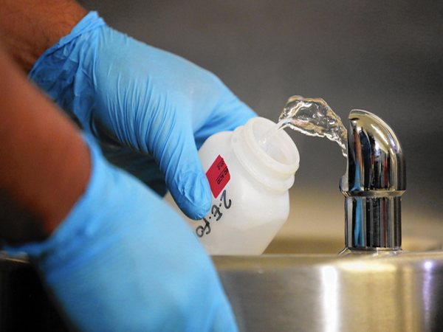
Environmental Protection Agency (EPA)’s Regulations on Lead
The Safe Drinking Water Act of 1974 determined the Maximum Contaminant Level Goal (MCLG), which is the concentration of contaminants where no negative health effects are likely, to be 0.00 for lead. This means even a small amount of exposure to lead can lead to health issues.
Tap samples are required from locations more likely to have plumbing materials containing lead. If more than 10% of tap water samples contain 15 parts per billion lead (federal action level), treatment techniques must ensue.
Lead and Copper rules of 1991, 2000, and 2007 require community water systems to publish a Consumer Confidence Report (CCR) for their customers. A search widget on the EPA website allows consumers to download copies of their local CCR by inputting their state and water system name or city, town, county ^{[21]}. Please see: https://ofmpub.epa.gov/apex/safewater/f?p=ccr_wyl:102
Fig 13. Drinking fountain water sampling in progress ^{[53]}.
Notes:
[21] “Find Your Local CCR.” EPA, Environmental Protection Agency, ofmpub.epa.gov/apex/safewater/f?p=ccr_wyl%3A102.
[53] “Drinking Water Testing.” Suburban Laboratories, Inc., 8 Jan. 2019, suburbanlabs.com/drinkingwater/.

Slide 20

Environmental Protection Agency (EPA)’s Recent Actions on Lead
The EPA announced In 2011 that the maximum allowable lead content is a weighted average of 0.24% calculated across the wetted surface of pipes, pipe fittings, plumbing fitting, and fixture and 0.2% for solder and flux ^{[10]}.
In January 29, 2020, the EPA released $2,221,000 in grant funding for Alaska, Idaho, Oregon, and Washington to identify sources of lead contamination in school and childcare facility drinking water.
New EPA Voluntary Lead Testing in School and Child Care grant program released $43.7 million to create and expand programs testing for lead in school and childcare facility drinking water^{[61]}. This grant was made possible through section 2107 of the Water Infrastructure Improvements for the Nation Act (WIIN), which amended Section 1464(d) of the Safe Drinking Water Act (SDWA)^{[62]}. WIIN was established mainly for underserved, smaller communities that are unable to comply to the SDWA without financial help ^{[63]}.
Fig 14. The Alaska Department of Education and Early Development is using the EPA grant to test drinking water that is consumed by higher percentages of young and underserved communities ^{[61]}.
Notes:
[10] “Basic Information about Lead in Drinking Water.” EPA, Environmental Protection Agency, 28 Mar. 2019, www.epa.gov/ground-water-and-drinking-water/basic-information-about-lead-drinking-water#getinto.
[61] https://www.epa.gov/newsreleases/epa-awards-22-million-grants-alaska-idaho-oregon-and-washington-test-lead-school
[62] https://www.epa.gov/dwcapacity/wiin-grant-lead-testing-school-and-child-care-program-drinking-water
[63] https://www.epa.gov/sites/production/files/2019-03/documents/assistance_for_small_and_disadvantaged_communities_frequently_asked_questions_508.pdf

Slide 21
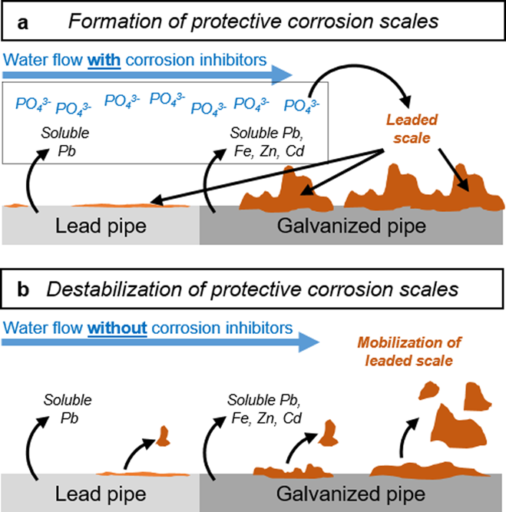
Case Study: Flint, Michigan
Background:
In 2013 when Flint was preparing to change its water source, the city decided to draw water from the Flint River temporarily. Immediately, residents complained about the taste and reported cases of rashes and E. Coli ^{[22]}.
Due to insufficient water treatment, especially in corrosion control, that led to the corrosion of destabilized rust layers in the pipes, over 100,000 residents were potentially exposed to high levels of lead via their drinking water, even after the city stopped drawing water from the Flint River ^{[22]}.
The Michigan Health Department linked lead contamination to the pervasiveness of Legionnaires’ disease in Flint. There has been 12 deaths due to Legionnaires’ disease ^{[23]}.
A federal state of emergency was declared in Flint in January 2016 ^{[24]}.
Fig 15. An illustration of how the lack of corrosion control lead to lead contamination ^{[25]}.
Notes:
[22] Masten, Susan J., et al. “Flint Water Crisis: What Happened and Why?” Journal - American Water Works Association, vol. 108, Jan. 2016, pp. 22–34., doi:10.5942/jawwa.2016.108.0195.
[23] Winowiecki, Emma. “Does Flint Have Clean Water? Yes, but It's Complicated.” Michigan Radio, 21 Aug. 2019, www.michiganradio.org/post/does-flint-have-clean-water-yes-it-s-complicated.
[24] Kennedy, Merrit. “Lead-Laced Water In Flint: A Step-By-Step Look At The Makings Of A Crisis.” NPR, NPR, 20 Apr. 2016, https://www.npr.org/sections/thetwo-way/2016/04/20/465545378/lead-laced-water-in-flint-a-step-by-step-look-at-the-makings-of-a-crisis.
[25] Pieper, Kelsey J., et al. “Flint Water Crisis Caused By Interrupted Corrosion Control: Investigating ‘Ground Zero’ Home.” Environmental Science & Technology, vol. 51, no. 4, 2017, pp. 2007–2014., doi:10.1021/acs.est.6b04034.

Slide 22
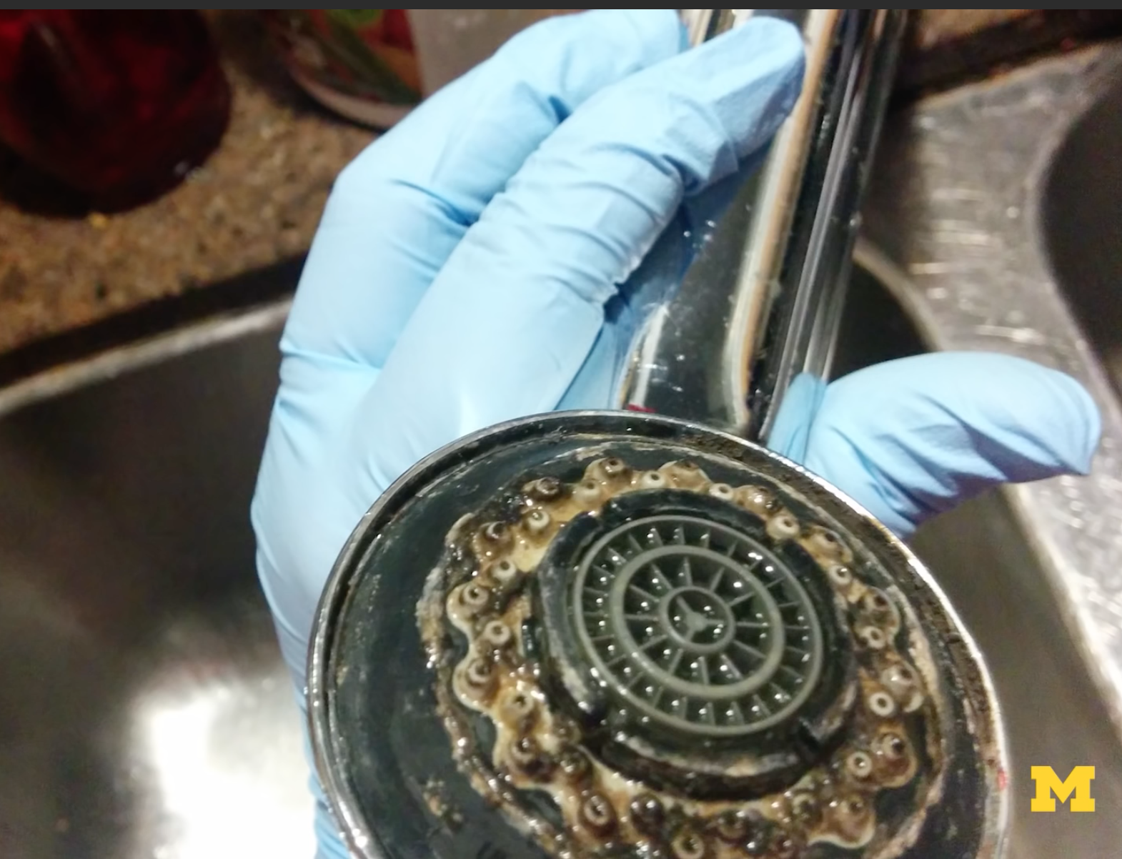
Case Study: Flint, Michigan (Cont’d)
What action has been taken to solve the problem?
Current lead removal techniques for drinking water mainly include point of use filtration systems, especially activated carbon block filters.
Since October 2015, more than 100,000 of these filters have been distributed to Flint residents.
The filters are largely successful, but increase harmful bacterial growth by 100-fold.
This bacteria is harmful in drinking water and in aerosolized gas during showers.
Flushing the filters before use helps reduce the bacteria count by 10 to 100 times, but is not entirely effective ^{[26]}.
Fig 16. A point of use filter with harmful bacterial growth ^{[27]}.
Notes:
[26] Cite: michigan engineering handout
[27] Michigan Engineering. Flint water filter warning“.” YouTube, 25 Jan. 2016, https://www.youtube.com/watch?v=uVSUkmwwDPE.

Slide 23
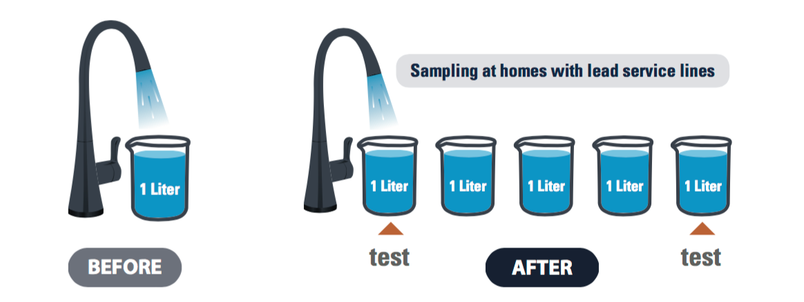
Case Study: Flint, Michigan (Cont’d)
What legislation has been passed?
  As a response to the Crisis, the state established the Michigan Lead and Copper Rule of June 2018 that states the following:
  The city must identify the material of all public and private service pipes and inform the residents if they live in a house with lead service pipes.
  All lead pipes need to be replaced by January, 2041.
  Action level of lead will be lowered from 15 parts per billion to 1 parts per billion in January, 2025.
  Stricter rules for sampling must be followed, with more water being tested at each location.
  There is to be more communication and transparency with the public through awareness campaigns and committees ^{[28]}.
Fig 17. The first and last liter of 5 total liters drawn must be sampled ^{[28]}.
Notes:
[28]“What Changed with Michigan's 2018 Lead and Cooper Rule?” Graham.umich.edu, University of Michigan, graham.umich.edu/media/files/Lead-and-Copper-Rule-Info-Brochure-LTR-042319.pdf.

Slide 24
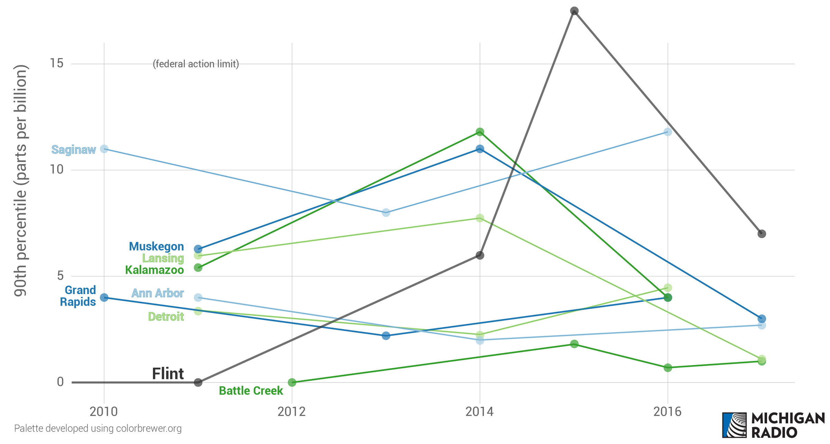
Case Study: Flint, Michigan (Cont’d)
What have been the results of these actions and legislation?
In 2016, the highest measured lead level was 23,100 µg/L.
In contrast, in 2018 Flint reduced its lead levels to below the federal action level of 15 parts per billion.
Flint tested 4 parts per billion in most high risk homes.
However, people remain highly sceptical of these data and continue to depend on bottled water due to distrust ^{[23]}.
Fig 18. A comparison of lead levels in Flint and other nearby cities ^{[23]}.
Notes:
[23] Winowiecki, Emma. “Does Flint Have Clean Water? Yes, but It's Complicated.” Michigan Radio, 21 Aug. 2019, www.michiganradio.org/post/does-flint-have-clean-water-yes-it-s-complicated.

Slide 25
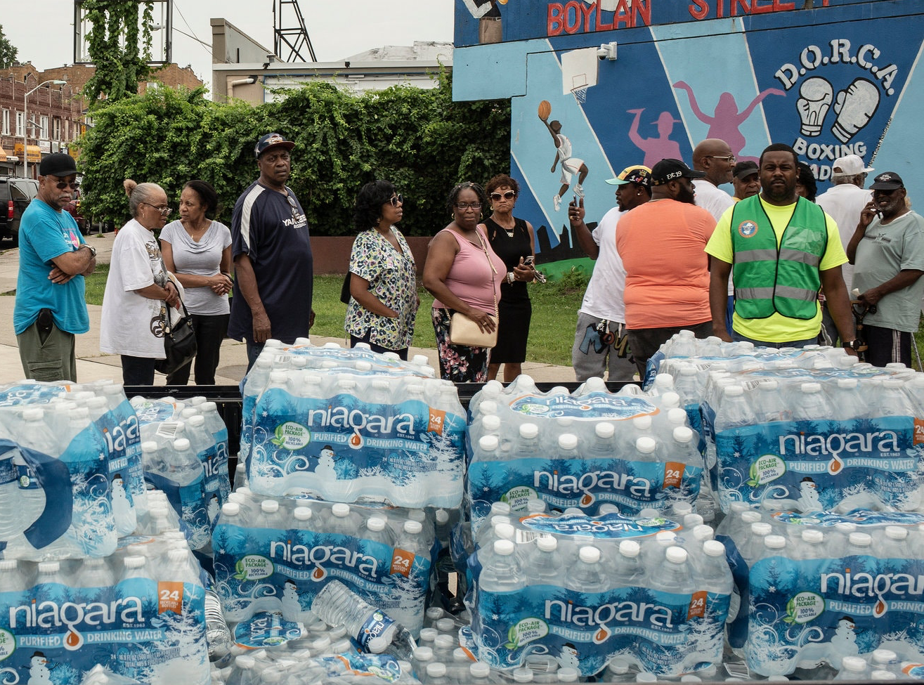
Case Study: Newark, New Jersey
Background:
In March 2016, drinking fountains in 30 public schools were shut down after testing high lead levels.
In 2018, more than 100 of 240 sampled homes surpassed federal standards.
The source of lead were the pipes.
What action has been taken to solve the problem?
The city has tried many temporary solutions such as the following:
They distributed POU filters to 40,000 resident before announcing they may not be effective.
EPA ordered distribution of bottled water, which resident said did not last them through the day.
The city started replacing pipes in 18,000 homes, but home owners will still have to pay and this operation is expensive for the city ^{[29]}.
Fig 19. Residents lining up for bottled water in Newar ^{[30]}.
Notes:
[29] Aratani, Lauren. “'Damage Has Been Done': Newark Water Crisis Echoes Flint.” The Guardian, Guardian News and Media, 25 Aug. 2019, www.theguardian.com/us-news/2019/aug/25/newark-lead-water-crisis-flint.
[30] Corasaniti, Nick, et al. “Lead Crisis in Newark Grows, as Bottled Water Distribution Is Bungled.” The New York Times, The New York Times, 14 Aug. 2019, https://www.nytimes.com/2019/08/14/nyregion/newark-water-lead.html.

Slide 26
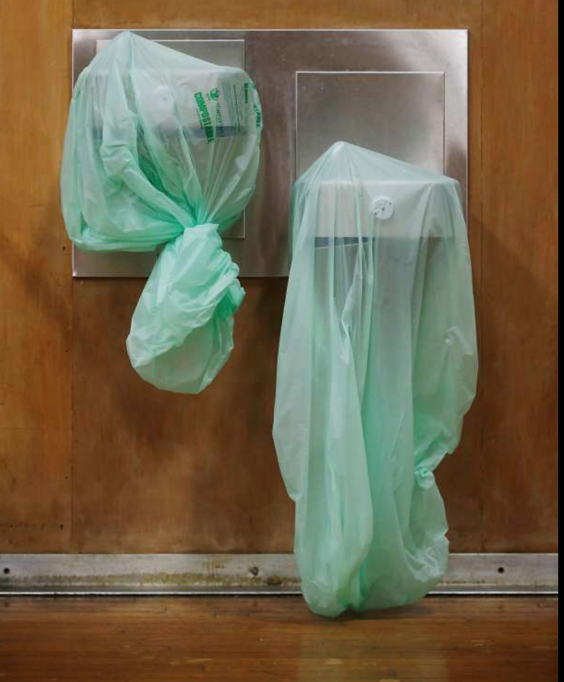
Case Study: California
According to the State Water Resources Control Board, a 2017 voluntary testing program reported that 35 of 1,600 schools in California had tap or fountain water that have unsafe lead levels in due to old plumbing containing lead ^{[31]}.
An 81 page report published by the state auditors revealed that more than 1.4 million children under California’s Medicaid healthcare program have not received required testing for lead poisoning^{[64]}. The report placed the blame of these missed testings on the California Department of Health Care Services, who “has not met its responsibility to ensure that children enrolled in Medi-Cal receive required tests ... to determine whether they have elevated lead levels” and the California Department of Public Health, “which is charged with the prevention and management of lead poisoning cases, has failed to focus on addressing lead hazards before children are exposed to them and has not met legislative requirements concerning lead poisoning” ^{[64]}.
Fig 20. Water fountains being closed down before further action can be taken to ensure students are not drinking water with unsafe levels of lead ^{[31]}.
Notes:
[31] Tucker, Jill. “3 San Francisco Public Schools Show High Levels of Lead in Water.” SFGate, San Francisco Chronicle, 27 Oct. 2017, https://www.sfgate.com/news/article/Three-San-Francisco-public-schools-show-high-12306785.php.

Slide 27
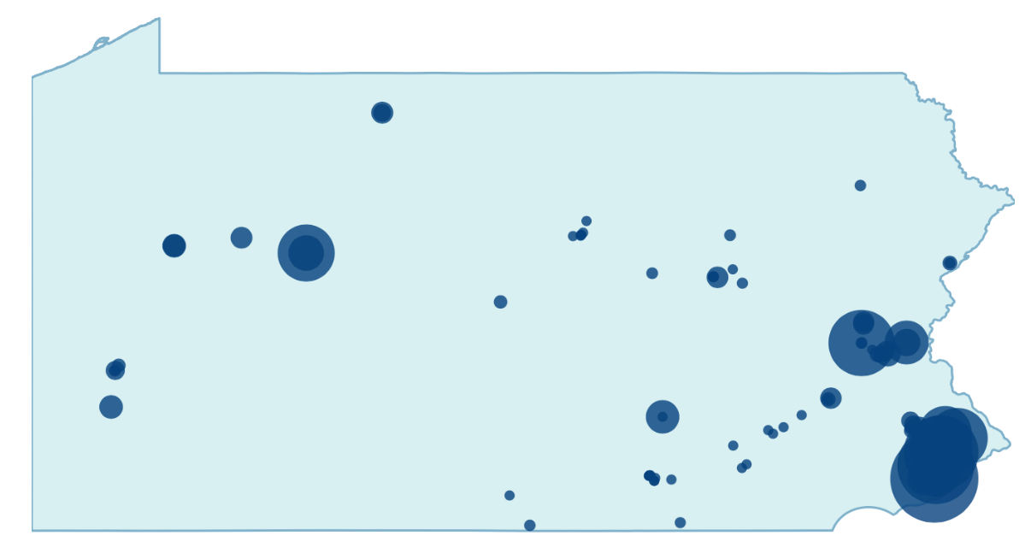
Case Study: Pennsylvania
Pennsylvania does not require mandatory lead testing in schools or homes. However, due to a 2018 law that requires schools that conduct water quality tests to report elevated lead levels, the state found out that more than 100 buildings in 32 school systems have elevated lead levels in their drinking water ^{[65]}.
  The highest level of lead detected was 3,750 ppb, 250 times the state’s limit.
  There was no apparent trend to these results: the schools with elevated lead levels were found in cities, rural areas, and suburban areas.
  These schools were forced to replace plumbing fixtures, disable drinking fountains, and provide bottled water. They also needed to tell the Education department their remediation plan to make sure students and staffs will not be exposed to lead in drinking water.
  Teachers unions have been asking lawmakers to increase education funding in order to hasten the lead eradicating process ^{[65]}.
Fig 21. This map illustrates the location of the elevated lead level cases. The bigger the circle, the higher the detected lead level ^{[65]}.

Slide 28
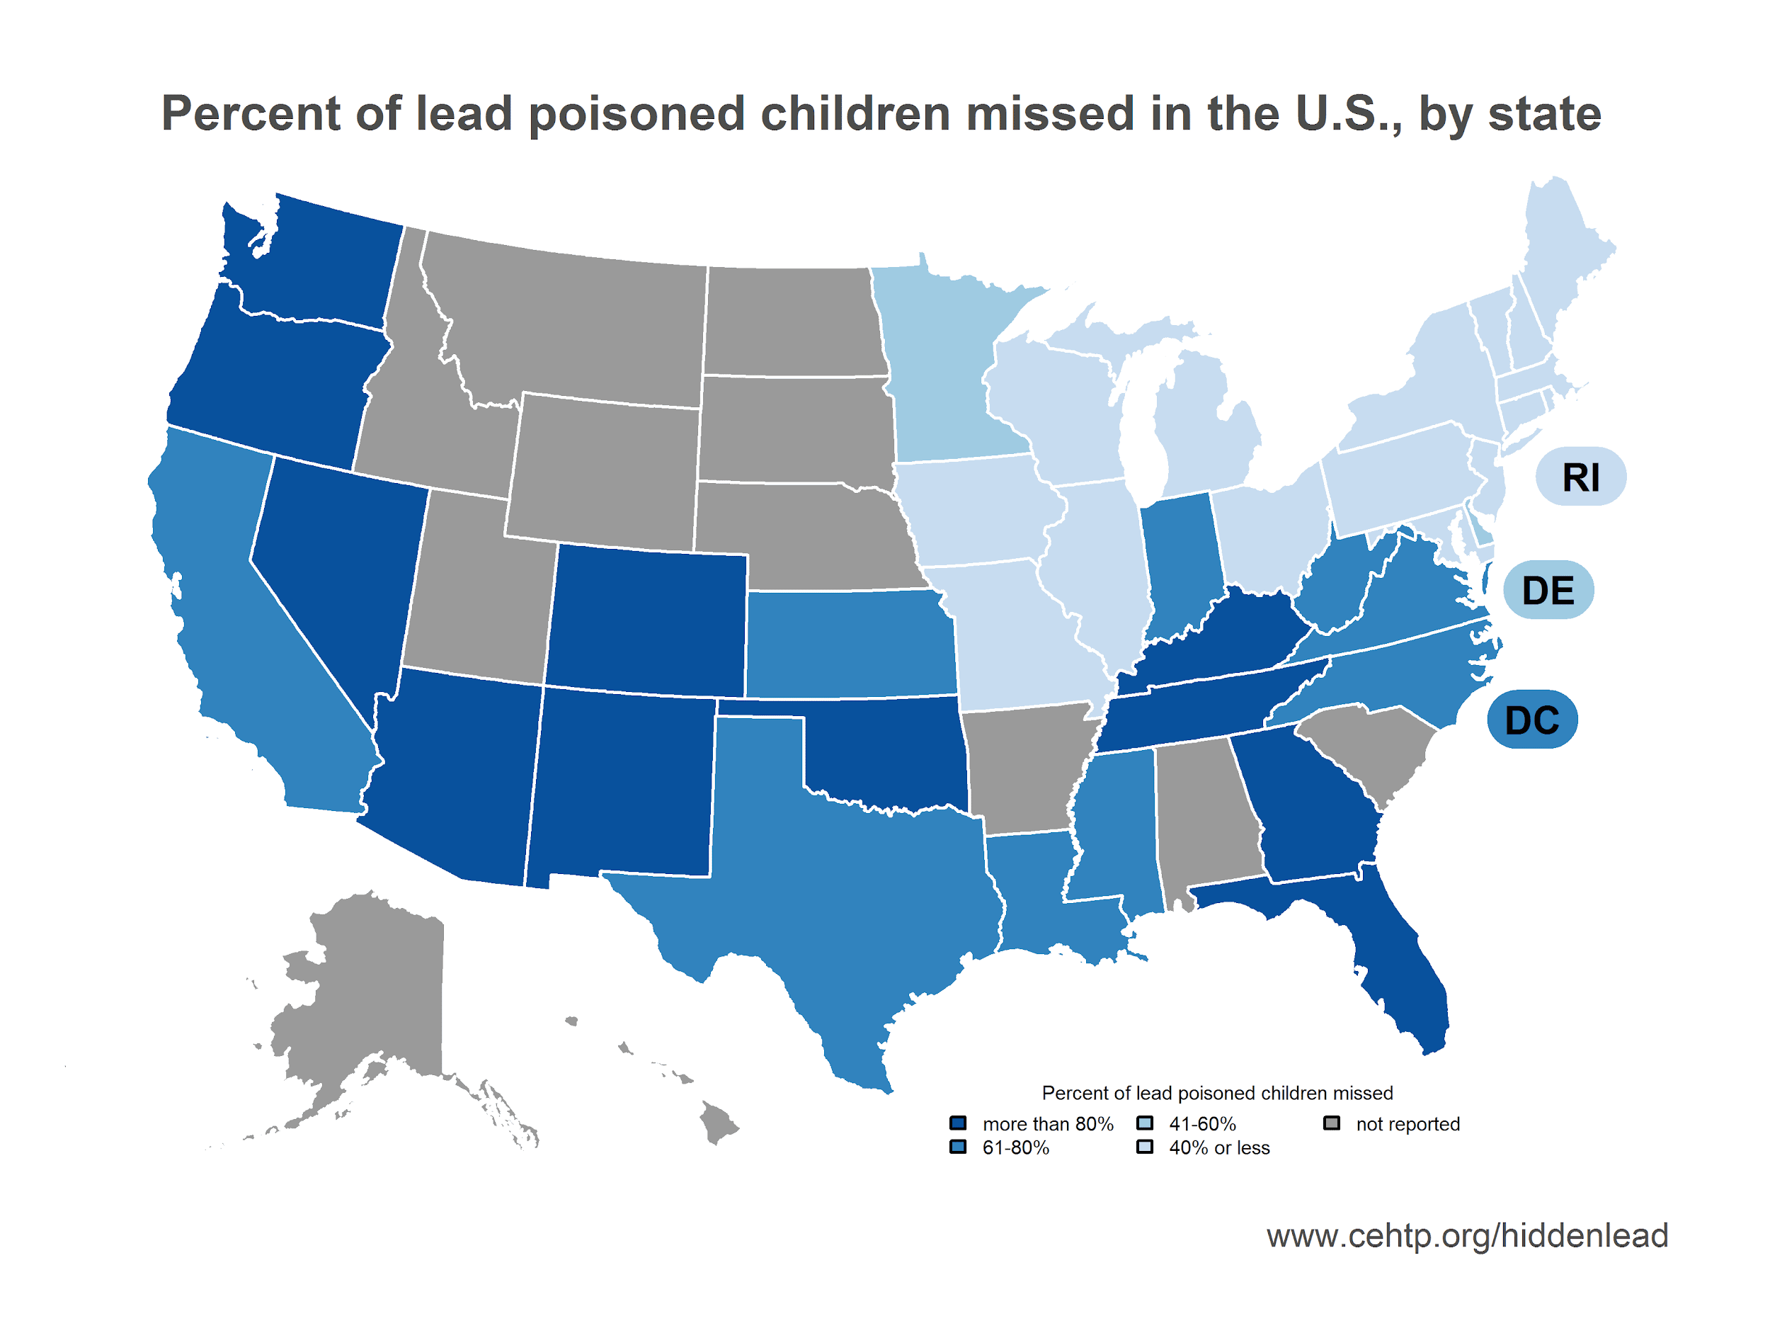
Lead in Drinking Water as a
Domestic Crisis
More than 2000 water systems in 50 states tested for excessive lead levels over the past four years ^{[33]} .
  In New Mexico, a 2016 study found that due to old plumbing containing lead, more than 20 small water systems were found to contain elevated, unsafe lead levels ^{[32]}.
  In Ithaca, NY, an elementary school reported over 5000 ppb of lead ^{[55]}.
  The highest reported lead levels were found at schools and daycares ^{[32]}.
Fig 22. Another source of concern is the high percentage of lead poisoning in children that are undiagnosed. The percent of undiagnosed lead poisoning in children varies across the country; the darker the blue the higher the percentage ^{[34]}.
Notes:
[31] Tucker, Jill. “3 San Francisco Public Schools Show High Levels of Lead in Water.” SFGate, San Francisco Chronicle, 27 Oct. 2017, https://www.sfgate.com/news/article/Three-San-Francisco-public-schools-show-high-12306785.php.
[32] Bryan, Susan Montoya. “20 New Mexico Water Systems Exceed Federal Lead Standard.” Albuquerque Journal, https://www.abqjournal.com/754724/20-nm-water-systems-exceed-federal-lead-standard.html.
[33] Young, Alison, and Mark Nichols. “Beyond Flint: Excessive Lead Levels Found in Almost 2,000 Water Systems across All 50 States.” USA Today, Gannett Satellite Information Network, 27 Mar. 2017, https://www.usatoday.com/story/news/2016/03/11/nearly-2000-water-systems-fail-lead-tests/81220466/.
[34] Corasaniti, Nick, et al. “Lead Crisis in Newark Grows, as Bottled Water Distribution Is Bungled.” The New York Times, The New York Times, 14 Aug. 2019, https://www.nytimes.com/2019/08/14/
nyregion/newark-water-lead.html.
[55] Young, Alison, and Mark Nichols. “Beyond Flint: Excessive Lead Levels Found in Maine Water Systems.” WCSH, 17 Mar. 2016, www.newscentermaine.com/article/mobile/news/health/beyond-flint-excessive-lead-levels-found-in-maine-water-systems/86451908.
https://nmhealth.org/publication/view/help/289/
https://www.mv-voice.com/news/2018/02/09/elevated-lead-levels-found-in-theuerkauf-water http://www.latimes.com/local/lanow/la-me-sd-water-lead-20170324-story.html

Slide 29
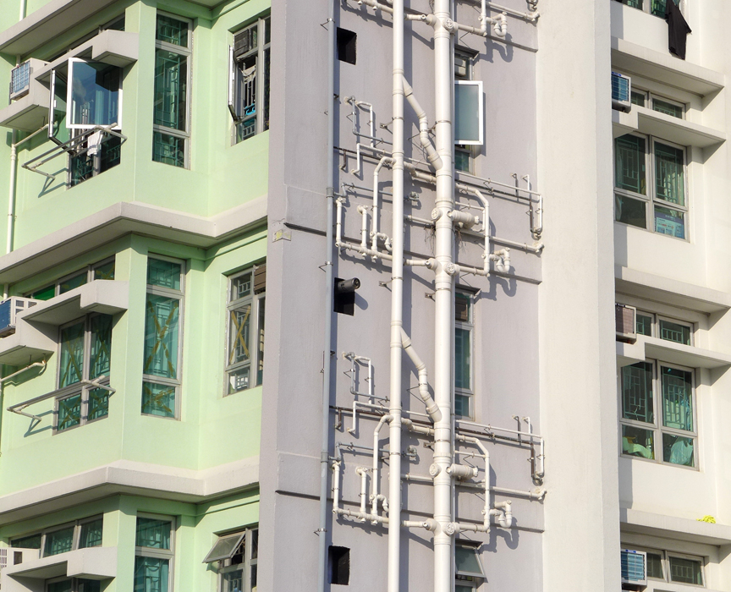
Case Study: Hong Kong
Lead levels up to 3 times higher than the WHO recommended level (10 𝜇g/L) were detected in some public housing estate due to poorly maintained, unregulated pipes.
Water lead level regulations apply only to public property.
In poorly maintained private pipes, chemicals, heavy metals, and bacteria are all present ^{[35]}.
Unauthorized dealers have taken advantage of the situation by selling expensive faulty POU devices that are marketed to purify water but in reality causes diarrhea and headaches ^{[36]}.
In 2018, 3 years after the initial lead in drinking water scare, excessive levels of lead were still detected in public housing estates ^{[54]}.
Fig 23. The first public housing building found to have lead in the water in Hong Kong ^{[37]}.
Notes:
[35] Wescott, Ben, and Samuel Chan. “Hong Kong's Lead-in-Drinking-Water Crisis: Everything You Need to Know.” South China Morning Post, 14 June 2018, www.scmp.com/news/hong-kong/health-environment/article/1840021/hong-kongs-lead-drinking-water-crisis-everything.
[36] Kao, Ernest. “'Beware of Salesmen in Hong Kong Selling Dubious Water Purifiers'.” South China Morning Post, 16 Oct. 2018, www.scmp.com/news/hong-kong/health-environment/article/2168683/beware-door-door-salesmen-hong-kong-selling.
[37] Chan, Holmes. “Tests Show Excessive Lead in Water at New Kwai Fong Housing Estate, as Safety Scandal Reappears.” Hong Kong Free Press HKFP, 19 July 2018, www.hongkongfp.com/2018/07/19/tests-show-excessive-lead-water-new-kwai-fong-housing-estate-safety-scandal-reappears/.
[54] Mok, Danny. “Another Lead Scare in Drinking Water at Hong Kong Housing Estate.” South China Morning Post, 19 July 2018, www.scmp.com/news/hong-kong/health-environment/article/2155910/excessive-lead-levels-found-tap-water-new-hong.

Slide 30
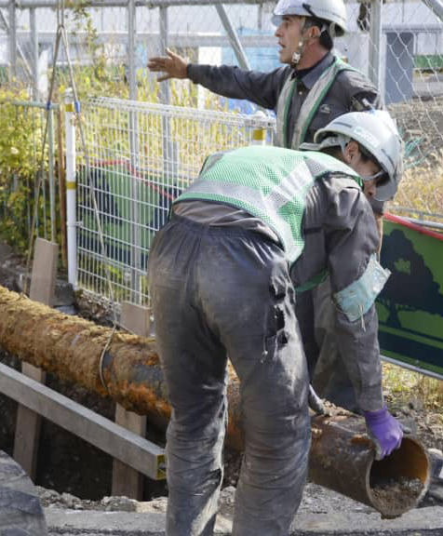
Case Study: Japan
The country prides itself on its clean and readily available drinking water. However, its old infrastructure is leading to lead contamination in drinking water.
In 2017, lead was detected at a school, which led to an immediate closing of the fixtures and supplying of bottled water. None of the children’s blood lead level exceeded 5𝜇g/dL ^{[38]}.
The Water Supply Act in Japan states the following:
180+ cities are retaking public control of water and sanitation services in a process of “re-municipalizing” because of rising water prices and deteriorating water quality.
Because 15% of water pipes across the country has outlived their 40-years expiration date, the country is updating its infrastructure ^{[39]}.
Fig 24. Japan has begun updating its water pipes ^{[39]} .
Notes:
[38] Slavin, Erik. “Lead Detected in Water at Navy Elementary School in Japan.” Stars and Stripes, 6 June 2017, www.stripes.com/news/lead-detected-in-water-at-navy-elementary-school-in-japan-1.472132.
[39] Osaki, Tomohiro. “With Water Privatization, Japan Faces Crossroads in Battling Its Aging Pipes.” The Japan Times, 17 Dec. 2018, www.japantimes.co.jp/news/2018/12/17/reference/water-privatization-japan-crossroads-battling-aging-pipes/#.XZz3US2ZOHp.
Other readings:
https://www.niph.go.jp/soshiki/suido/pdf/h19JPUS/abstract/r01.pdf
https://www.nippon.com/en/views/b06301/drinking-from-the-tap-tokyo’s-high-quality-water-supply.html

Slide 31
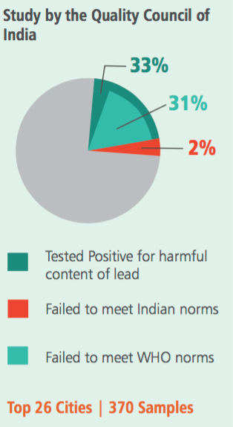
Case Study: India
In India, lead contamination in water results from industrial waste, electroplating waste, and the usage of PVC pipes ^{[40]}.
In 2016, 31% of 370+ samples of water from the top 26 cities of India contained lead above the WHO recommended level (10 𝜇g/L).
70% of the country’s fresh water is contaminated, and farmers use this water ^{[41]}.
73% of spinach contained lead above the national regulated level of 2.5 mg/kg ^{[42]}.
Another reason behind lead contamination in water are the faucets: most faucets in India contain 12% of lead ^{[43]}.
In 2019, these problems still persist. However, there has been a lack of government initiative when it comes to dealing with lead contamination ^{[43]}.
Fig 25. The quality of water in 26 sampled cities ^{[41]}.
Notes:
[40] Möller-Gulland, Jennifer, et al. “Toxic Water, Toxic Crops: India's Public Health Time Bomb.” New Security Beat, 3 Jan. 2019, www.newsecuritybeat.org/2019/01/toxic-water-toxic-crops-indias-public-health-time-bomb/.
[41] “Lead: Poisoning India's Food and Water Supply Chain .” Viskaecotech.com, Vikas Scotch LTD , vikasecotech.com/whitepapers/Vikas_Ecotech_whitepaper_01.pdf.”
[42] “Heavy Metal Contamination of Vegetables in Delhi.” Toxicslink, Mar. 2003, toxicslink.org/docs/06102_Finding_
of_Heavy_Metal_Contamination_of_Vegetables.pdf.
[43] Ani. “Indians at Risk for Ignoring Lead Seeping in Tap Water.” Deccan Chronicle, 17 June 2016, www.deccanchronicle.
com/lifestyle/health-and-wellbeing/170616/indians-at-risk-for-ignoring-lead-seeping-in-tap-water.html.

Slide 32

Case Study: Canada
In 2019, a yearlong investigation conducted by more than 120 journalists revealed that 33% of water samples tested across 11 cities exceeded national safety guidelines of 5 ppb and 18% exceeded the US’s limit of 15 ppb.
Many residents were surprised by these results. Some had replaced their private lead pipes years before thinking this would solve the problem, but the public service lines contained lead.
Montreal Mayor Valerie Plante promised to test 100,000 homes and to speed up replacement of lead pipes immediately ^{[56]}.
Some problems with replacing pipes is many residents do not know they own them and there is a high percentage of renters ^{[57]}.
This may be a result of canadian law not requiring routine testing or notice of lead levels. Also, provinces, not the federal government, set water safety rules.
Some short term solutions they have employed so far include adding anti-corrosives and altering water chemistry.
Health Canada, the department of national health, and proposed the lowering of MAC to 0.005 mg/L ^{[56]}.
Fig 26. Michèle Prévost, an engineering professor who used to work for the government, said transparency is one of the biggest issue^{[58]}.
Notes:
[40] Möller-Gulland, Jennifer, et al. “Toxic Water, Toxic Crops: India's Public Health Time Bomb.” New Security Beat, 3 Jan. 2019, www.newsecuritybeat.org/2019/01/toxic-water-toxic-crops-indias-public-health-time-bomb/.
[41] “Lead: Poisoning India's Food and Water Supply Chain .” Viskaecotech.com, Vikas Scotch LTD , vikasecotech.com/whitepapers/Vikas_Ecotech_whitepaper_01.pdf.”
[42] “Heavy Metal Contamination of Vegetables in Delhi.” Toxicslink, Mar. 2003, toxicslink.org/docs/06102_Finding_
of_Heavy_Metal_Contamination_of_Vegetables.pdf.
[43] Ani. “Indians at Risk for Ignoring Lead Seeping in Tap Water.” Deccan Chronicle, 17 June 2016, www.deccanchronicle.
com/lifestyle/health-and-wellbeing/170616/indians-at-risk-for-ignoring-lead-seeping-in-tap-water.html.

Slide 33
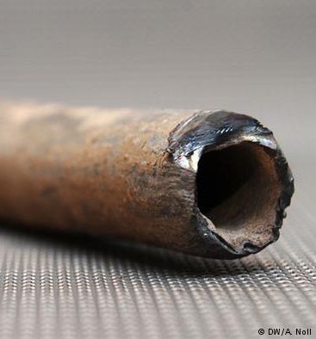
Other International Case Studies
In 2013, Germany adopted the EU regulation of 10 𝜇g/dL lead in tap water and began requiring landlords to inform tenants of lead plumbing in the building. However, the “phasing out” of lead largely depends on the region, with 60-17% of older districts still having lead plumbing ^{[44]}.
In Australia, town drinking water that is supplied to homes is routinely monitored by the state and territory legislation, but because brass fittings are used, lead is still detected. In 2018, public water fountains were shut off due to lead levels exceeding the WHO recommended level (10 𝜇g/L) ^{[45]}.
As more information becomes available, this slide will be updated.
Fig 27. Image of an old pipe in Germany ^{[44].}.
Notes:
[44] Deutsche Welle. “Germany Aims to Rid Drinking Water of Lead: DW: 03.12.2013.” DW.COM, www.dw.com/en/germany-aims-to-rid-drinking-water-of-lead/a-17265851.
[45] “EnHealth Guidance Statement Lead in Drinking Water from Some Plumbing Products.” Health.gov.au, Environmental Health Standing Committee (EnHealth) of the Australian Health Protection Principal Committee, www1.health.gov.au/internet/main/publishing.nsf
/content/A12B57E41EC9F326CA257BF0001F9E7D/$File/Lead-plumbing-products-Guidance-Statement-July2018.pdf.

Slide 34
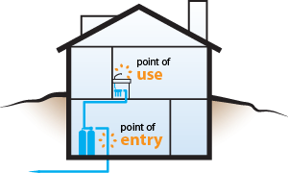
Point of Entry (POE) vs
Point of Use (POU)
POE devices treat all water entering a building or facility
POU devices only treat water used for drinking and cooking at a single tap or limited number of taps
Current Challenges of POE and POU devices are the following:
There is limited research and information on POU and POE performance.
The distribution of these devices requires hours and specialized workers
These devices are often costly ^{[46]}.
Fig 28. An illustration of the placements of POE and POU devices ^{[47]}.
Notes:
[46] SILVERSTEIN, I. Investigation of the Capability of Point-Of-Use/Point-Of- Entry Treatment Devices as a Means of Providing Water Security. U.S. Environmental Protection Agency, Washington, DC, EPA/600/R-06/012 (NTIS PB2006-107461), 2005.
[47] Research, Allied Market. “Point-of-Entry Water Treatment Systems Market Is Expected to Reach $6.6 Billion, Globally, by 2022.” PRLog, 31 Jan. 2017, www.prlog.org/12616657-point-of-entry-water-
treatment-systems-market-is-expected-to-reach-6-6-billion-globally-by-2022.html.

Slide 35
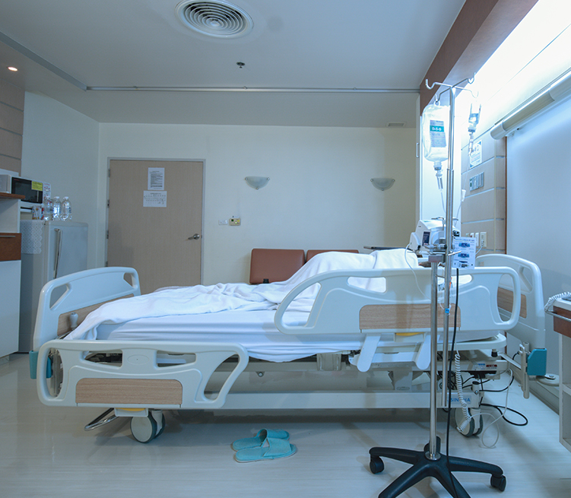
Advantages and Disadvantages of POE & POU
Advantages of POE and POU include:
These treatment devices can, especially in emergency situations, reduce human exposure to contaminants.
They can be used to protect “vulnerable or potential target facilities” and thus play a role in ensuring water security.
They can act as temporary solutions while the community waits for a new water treatment system or until their water supply becomes decontaminated.
POU devices are especially useful in developing countries because this can be used in individual homes without systematic changes.
Disadvantages of POE and POU include:
These treatment devices cannot offer total protection from acute contaminants and all exposure pathways.
Consumers must choose specific POE/POU devices carefully as each type of these devices are useful against different contaminants.
Bacteria tend of accumulate on these devices.
POU should not be used for infectious agents as the device will begin to leech trapped, adsorbed, or absorbed contaminants over time ^{[66]}.
Fig 29. Hospitals and other sensitive places that are vulnerable can be provided more security through POE/POU devices ^{[68]}.
Notes:
[66] Office of Research and Development, and National Homeland Security Research Center. Investigation of the Capability of Point-of-Use/Point-of-Entry Treatment Devices as a Means of Providing Water Security. EPA, 2006, pp. ii-37, Investigation of the Capability of Point-of-Use/Point-of-Entry Treatment Devices as a Means of Providing Water Security.

Slide 36
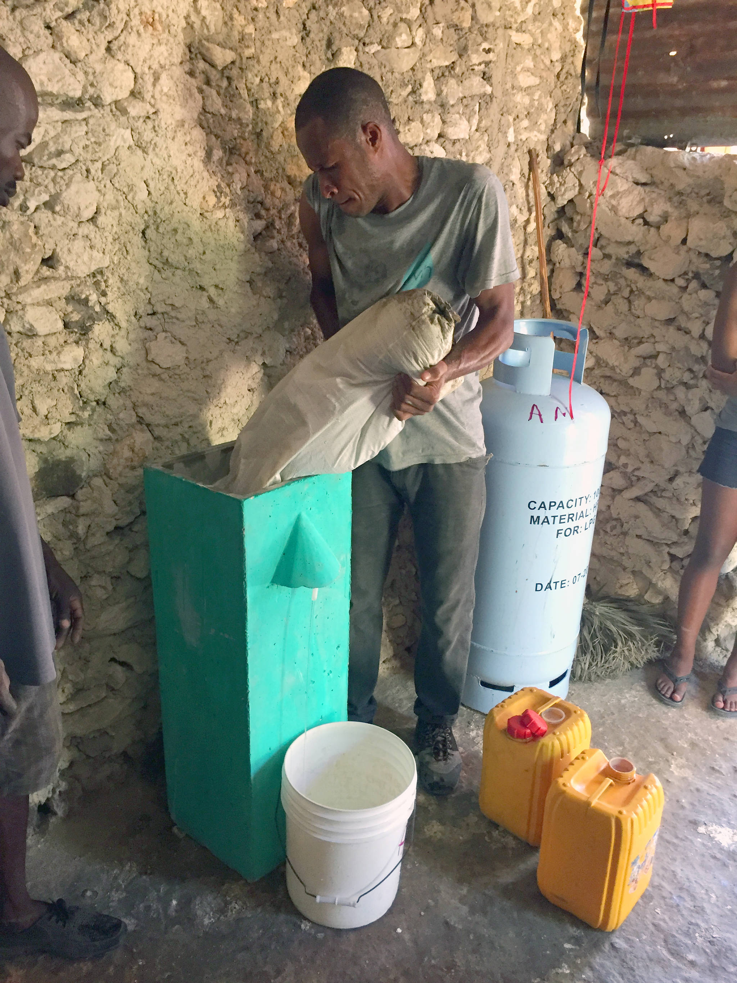
Types of POU Devices
There are five types of POU devices:
Chlorination with safe storage
Combined coagulant-chlorine disinfection systems: used as tablets or flakes that can be added to water
Solar Water Disinfection (SODIS): PET bottles filled with aerated water that are exposed to solar UV and heat
Ceramic Filters: fired clay that filters microbes
Biosand Filters
The factors that should be considered when choosing amongst the five types of POU devices are the following:
Microbial efficacy
Ability to consistently produce enough safe drinking water
Ability to treat different types of water
Time efficiency
Cost
Convenience of buying and installing replacements
If locals will embrace this method for a long period of time ^{[48]}.
Fig 30. An example of biosand filters in Haiti ^{[49]}.
Notes:
[48] Sobsey, Mark D., et al. “Point of Use Household Drinking Water Filtration: A Practical, Effective Solution for Providing Sustained Access to Safe Drinking Water in the Developing World.” Environmental Science & Technology, vol. 42, no. 12, 2008, pp. 4261–4267., doi:10.1021/es702746n.
[49] Crook, Parker. “Armstrong Woman Leads Clean Water for Haiti.” Vernon Morning Star, Vernon Morning Star, 19 Nov. 2018, www.vernonmorningstar.com/community/armstrong-woman-leads-clean-water-for-haiti/.

Slide 37

Challenges to POU Devices
POU devices function as “traps and reservoirs for sludge, scale, rust, algae, or slime deposits, which promote microbial growth and biofilm formation in the household water distribution system.”
This leads to grave potential for health risks as pathogens may grow.
When there is a sudden change in water pressure or chemical disturbance, contaminants and microorganisms may flush into the tap water and enter human bodies.
For example, a POU device that uses activated carbon block filters can effectively filter lead but it also increases bacteria by 100 times. This was seen in Flint, when activated carbon block filters led to an outbreak of legionnaires’ ^{[26]}.
Fig 31. Jassmine McBride was one of the victims of legionnaires’ in Flint ^{[50]}.
Notes:
[26] michigan engineering handout
[50] Ruble , Kayla, et al. “Five Years In, the Flint Water Crisis Continues Its Deadly Toll.” PBS, Public Broadcasting Service, 25 Apr. 2019, www.pbs.org/wgbh/frontline/article/flint-water-crisis-legionnaires-disease-deaths/.

Slide 38
Latest Cost-Benefit Analysis of POU Devices
According to research done at the University of Arizona, if POU devices were used for 70 years and were replaced every 5 years, the average economic breakeven point is when the water lead concentration reaches 0.0374 ppm, or 37.4 μg/L ^{[68]}.
The research calculated that providing POU devices to residents in Flint, Michigan would lead to an economic loss of around $269 million, or $2596 per person. Therefore, it is more economical if POE devices are only used as a temporary solution ^{[68]}.
The breakeven point varies for different types of POU devices. For example, the breakeven point was lower for activated carbon (3.73 µg/L), while higher for other types such as reverse osmosis (7.31 µg/L) and distillation (12.0 µg/L) ^{[69]}.
Some of the economic costs they considered was loss of IQ and the resulting loss in salary. In Flint, an individual who consumed 25 µg/L of lead would lose 0.641 IQ points, and thus have a lifetime economic earning loss of $14,284 ^{[69]}.
They reached the conclusion that activated carbon with lead reduction media is the least expensive device to both maintain and operate ^{[69]}.

Slide 39
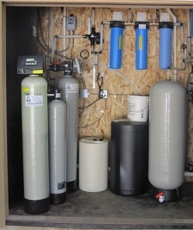
Types of POE Devices
There are 4 types of POE devices:
Ion Exchange Systems that use resin to remove contaminants
Cation Exchange Water Softening that use sulfonated polystyrene balls to soften water
Filtration Systems that can remove “organic and inorganic material like microbiological and virus contaminants”
Electrochemical Systems that use uses electricity and ionization membranes
POE devices clean all the water in the building. Therefore, harmful chemicals like chlorine and radon can be kept out of the building and chemicals ^{[51]}.
Fig 32. An example of a residential POE setup ^{[52]}.
Notes:
[51] Coulter, Brandi. “All About Water Treatment Systems: Point of Entry Filtration.” Skillings & Sons, Inc. NH, New Hampshire, MA, Massachusetts, Skillings & Sons, Inc. NH, New Hampshire, MA, Massachusetts, 8 Dec. 2016, www.skillingsandsons.com/blog/all-about-water-treatment-systems-point-of-entry-filtration.
[52] Well Drilling Services in Washington.” Washington Well Drilling Contractor Services, www.jkawelldrilling.com/well-drilling.html.

Slide 40

Homeland Security Perspective
on POE and POU
In 2002, The Public Health Security and Bioterrorism Preparedness and Response Act gave the EPA the responsibility to protect the country’s drinking water supply. Thus, there has been an increase in the usage of POU/POE devices for water security purposes.
  According to the National Homeland Security Research Center, POE devices can be used at “high-risk or sensitive facilities” such as hospitals, military bases, police stations, and fire stations as a way to ensure water security.
  POE/POU devices can take on proactive roles by being used even before an emergency happens. However, it is difficult to find an appropriate device when there is no way to anticipate what type of contaminant the device might need to be used for.
  POE/POU devices can also take on reactive roles by being used after an emergency happens. For example, while bottled water is being sent into cities with contaminated water, POU devices can be used for sanitary usages.
  POU devices can further their role in providing water security if they can detect water quality and alert the user as “part of a more extensive contamination warning system” ^{[66]}.
  Cities should come up with a local POU devices distribution plan in case of emergencies that may occur ^{[66]}.
Fig 33. The Department of Homeland Security and the Environmental Protection Agency works together on research to further the usage of POE/POU devices for water security issues ^{[67]}.
Notes:
[48] Sobsey, Mark D., et al. “Point of Use Household Drinking Water Filtration: A Practical, Effective Solution for Providing Sustained Access to Safe Drinking Water in the Developing World.” Environmental Science & Technology, vol. 42, no. 12, 2008, pp. 4261–4267., doi:10.1021/es702746n.
[49] Crook, Parker. “Armstrong Woman Leads Clean Water for Haiti.” Vernon Morning Star, Vernon Morning Star, 19 Nov. 2018, www.vernonmorningstar.com/community/armstrong-woman-leads-clean-water-for-haiti/.

Slide 41
Note on Other Possible Solutions
As illustrated through numerous examples of cities, states, and countries, we are aware that replacing all service and private pipes would be the fundamental solution. However, not all cities can afford this solution. Therefore, our affordable point of use devices can alleviate the struggles of people currently living without access to lead-free water in the meantime.

Slide 42
Our Experiment

Slide 43
Outline
The experiment can be divided into four parts:
Adsorbent Preparation
Rate Study
Isotherm Study
Future Steps: Column Study

Slide 44
Materials and Methods
Materials:
Ottawa sand
0.05 M MnCl₂
2.1 M Fe(NO3)
FeCl₃
GAC
2.5M FeCl₃
1.0M NaOH
Beaker
Magnetic Stirrer

Slide 45
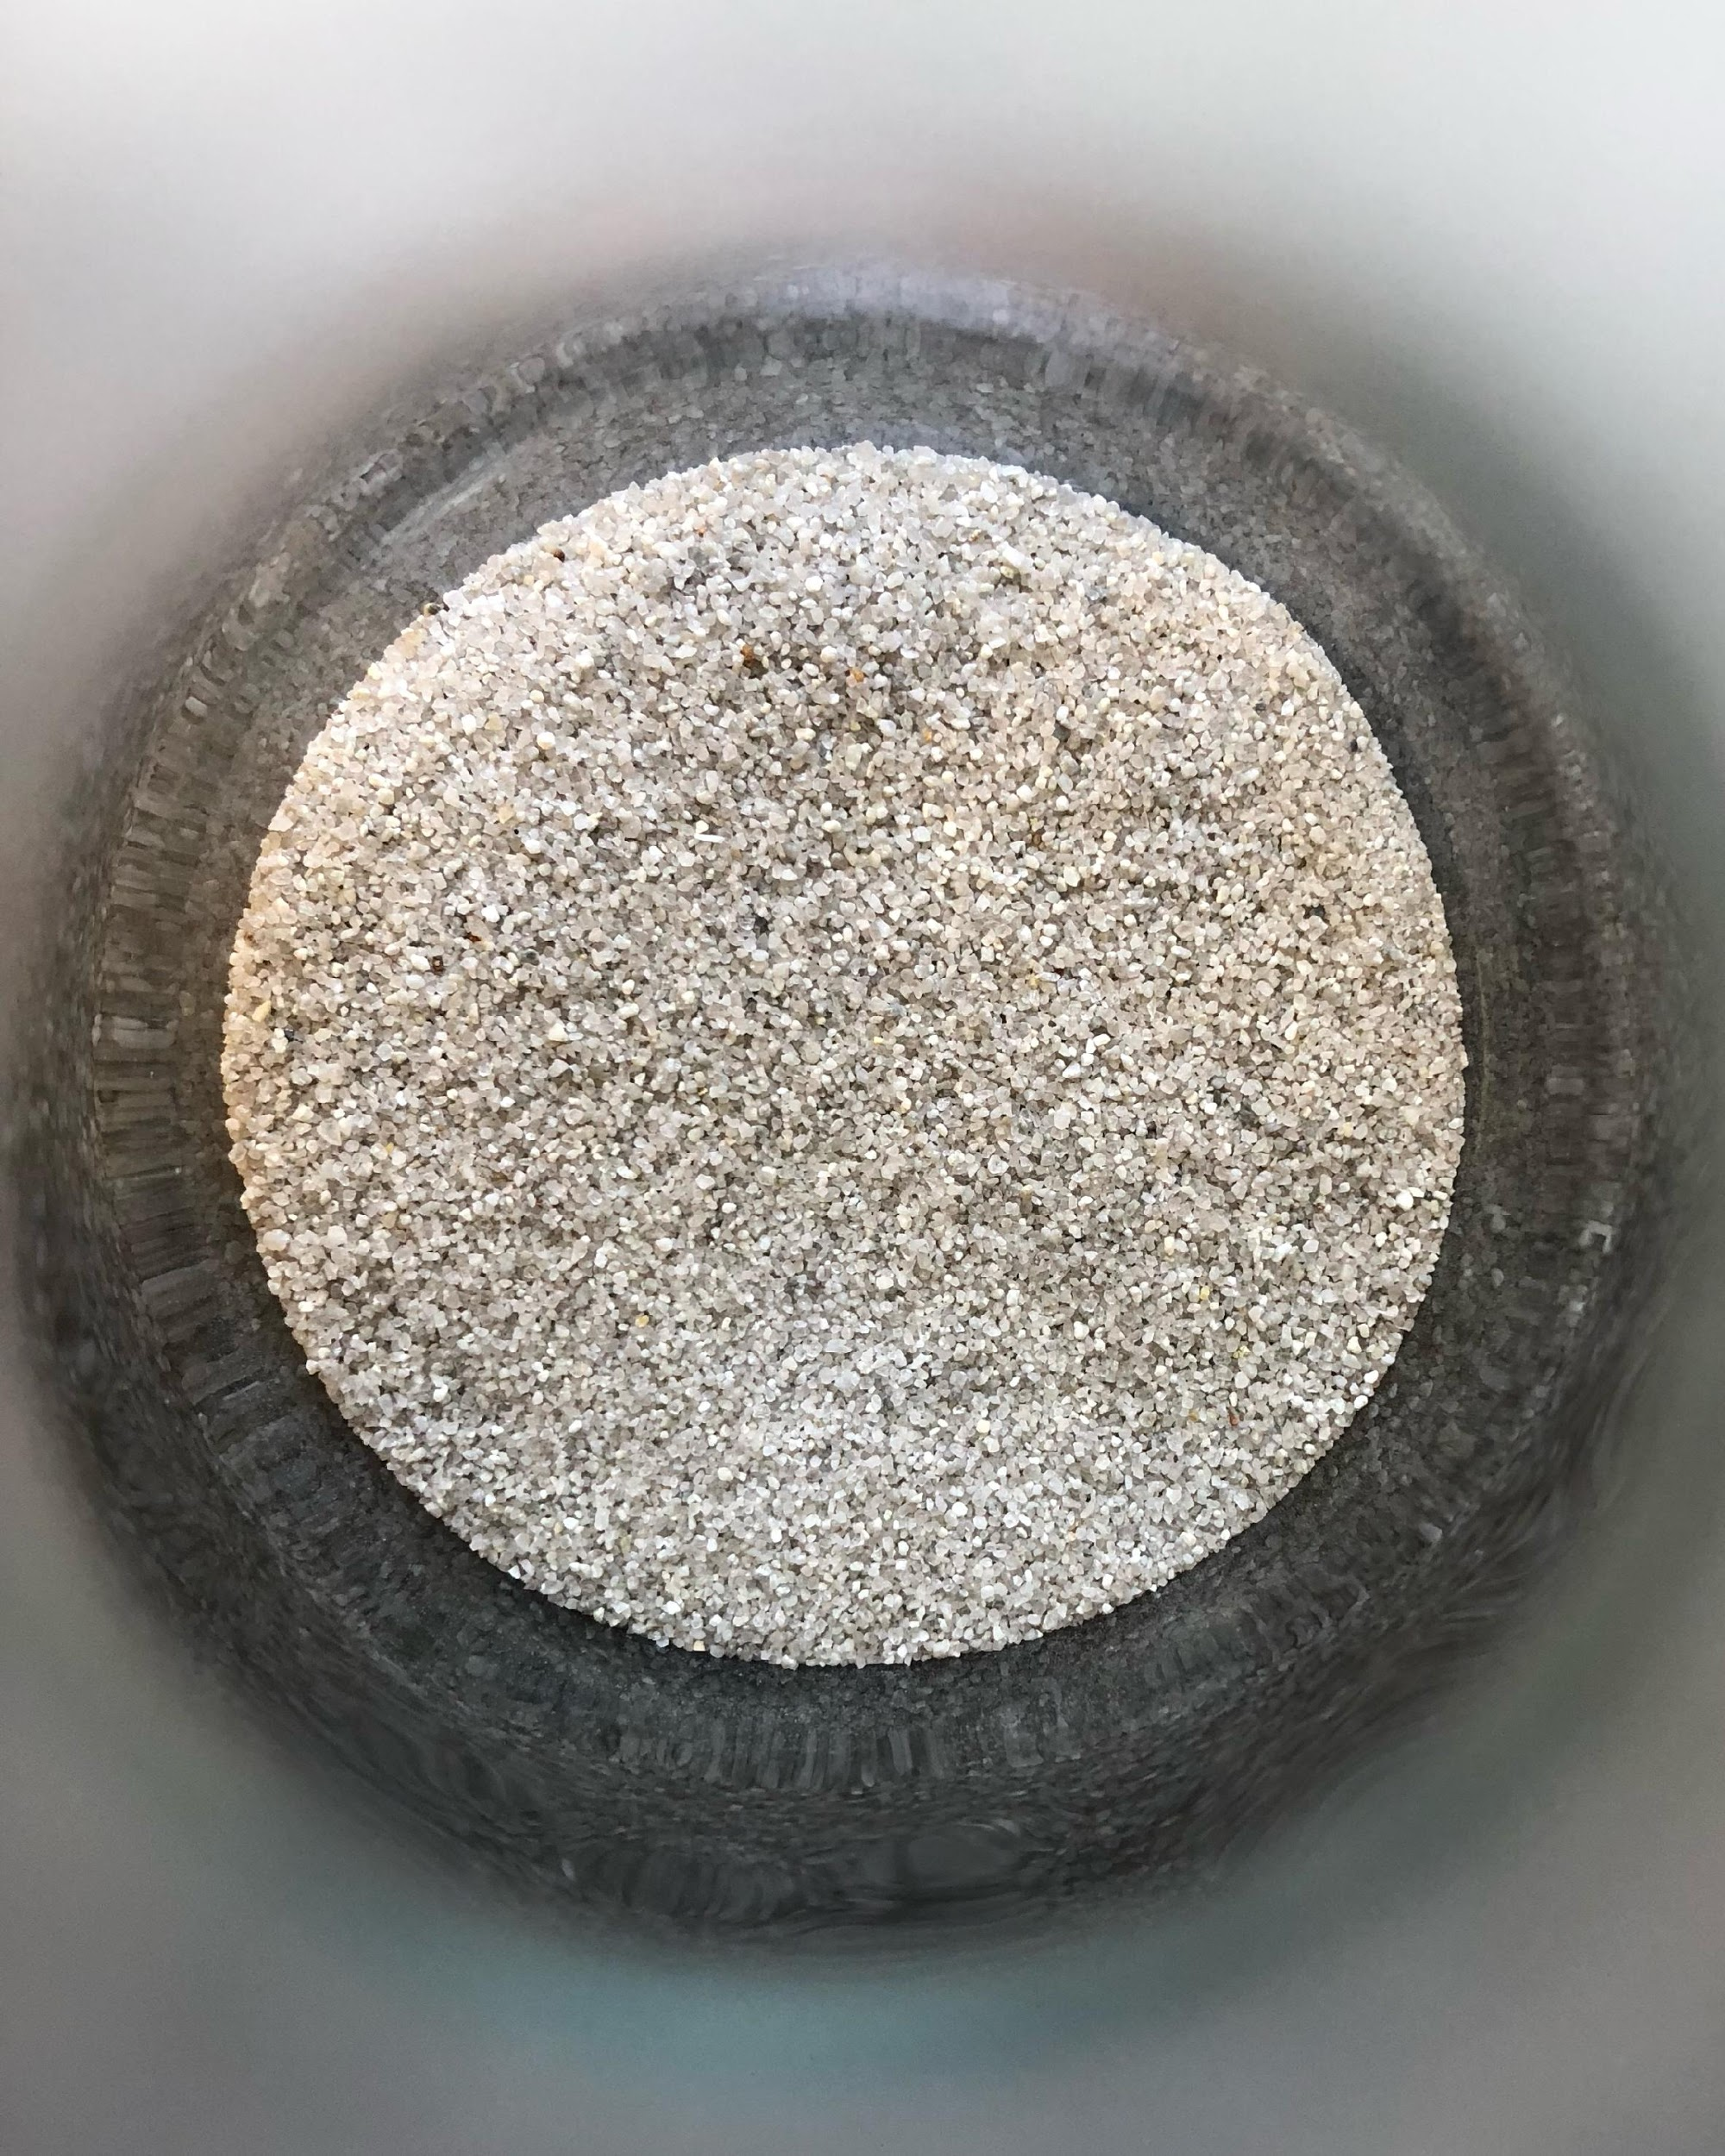
Materials and Methods (Cont’d)
Preparation of Pure Sand
We prepared sand particles coated with various oxides. In order to do this, we prepared the sand for coating through the following procedure:
Sieved pure sand to collect sand particles of the size 106-125 um.
Removed any organic materials and surface deposited oxide by treating the collected sand with hydrogen peroxide (H2O2) and Nitric Acid (HNO₃).
Rinsed with distilled water.
Fig 28. Photos of the sieved sand.
Notes:
Sand was collected from local river Yamuna which was sieved to get different size grains. The sand particles of size 106–125 µm was treated with H2O2 and HNO3 to remove any organic material and surface deposited oxide.

Slide 46
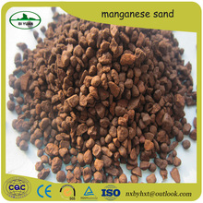
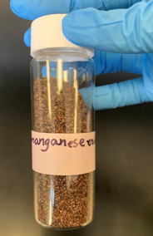
Materials and Methods (Cont’d)
Preparation of Manganese Oxide Coated Sand (MOCS)
We coated the treated sand with manganese to get manganese oxide-coated sand to use as an adsorbent using the methods published by S.M. Maliyekkal and Xiang S detailed below:
We added 50 g of the processed sand to 250 mL of 0.05M manganese chloride (MnCl₂) solution in a 500 mL beaker and constantly stirred the solution with a magnetic stirrer at 60-70℃.
We added 0.1 M sodium hydroxide (NaOH) solution dropwise until the pH became 9.0.
We added 200 mL of 0.05 M potassium permanganate (KMnO4) solution dropwise while stirring vigorously. The solution turned brown to indicate the formation of Manganese(IV) oxide (MnO₄⁻ ) according to the following reaction:
Mn²⁺ + MnO₄⁻ + H₂O → MnO_{2 (s)} + H⁺
We stirred the solution for 24 hours and aged for 10 hours.
We filtered the coated sand, dried at room temperature, and kept it at 160 °C in a furnace for 5 h.
We cooled the coated sand at room temperature and washed the sand to remove loosely attached oxide before drying the sand at 105°C^{[58]}.
Fig 29. Photos of the manganese coated sand.
Notes:
Fifty grams of this sand was added to 250 mL of 0.05 M MnCl2 solution in a 500 mL beaker.
The mixture was constantly stirred on magnetic stirrer at 60–70 °C and 0.1 N NaOH solution was added drop wise to keep pH at 9.0.
Then, 200 mL of 0.05 M KMnO4 solution was added drop wise into the suspension while keeping vigorously stirred.
This mixture was continued under stirring for 24 h and then aged for 10 h.
The coated sand was filtered, dried at room temperature and kept at 160 °C in a furnace for 5 h.
It was subsequently cooled to room temperature, washed to remove loosely attached oxide and finally dried at 105 °C.
This sand was called manganese oxide-coated sand, MOCS, and was kept in polypropylene bottles and used as adsorbent.
S.M. Maliyekkal, A.K. Sharma, L. Philip
Xiang S., Wang S.G., Gong W.X., Liu X.W., GaoB.Y.

Slide 47
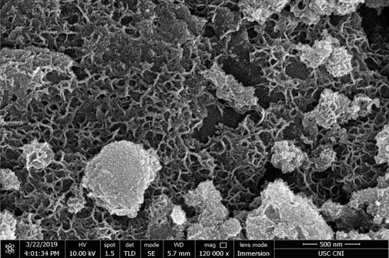
SEM Image
Fig 30. SEM micrograph: nanorod formation / coverage of MnO₂ coated sand

Slide 48
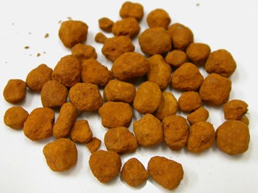
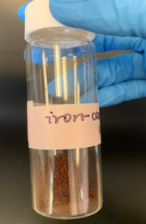
Materials and Methods (Cont’d)
Preparation of Iron Oxide Coated Sand (MOCS)
We coated the treated sand with iron to get iron oxide coated sand (MOCS) to use as an adsorbent using the methods published by Mark M. Benjamin detailed below:
We mixed 200 ml of pure sand with 80 ml Iron (III) Chloride (FeCl₃) solution and transferred the mixture into a 250 ml flask.
We heated the mixture to 110°C and stirred for 3 hours.
We raised the temperature to 550°C for 3 hours, and then cool it at room temperature.
We rinsed the sand.
We placed 40 ml of the sand in a heat-resistant dish in a layer 1-3 cm deep and mixed 80 ml of 2.1 M Fe(NO3) and 0.6 ml of 10 M NaOH.
We loosely covered the dish and heated it at 110°C until it appeared dry
We cooled the treated sand, broke it into pieces, and sieved it. We reheated it at 110°C for another 3 hours^{[59]}.
Fig 31. Photos of the iron coated sand.
Notes:
Pour 80 ml of 2.5 M FeCI3 solution over 200 ml sand
Heat the mixture to 110°C and stir for 3 hours
Raise the temperature to 550°C for 3 hours, and then cool it at room temperature
Rinse the sand
Next, place 40 ml in a heat-resistant dish in a layer 1-3 cm deep and mix 80 ml of 2.1 M Fe(NO3) and 0.6 ml of 10 M NaOH.
Loosely cover and heat this treated sand at 110°C until it appears dry
Cool the treated sand, break it into pieces, and sieve it. Reheat at 110°C for another 3 hours.

Slide 49
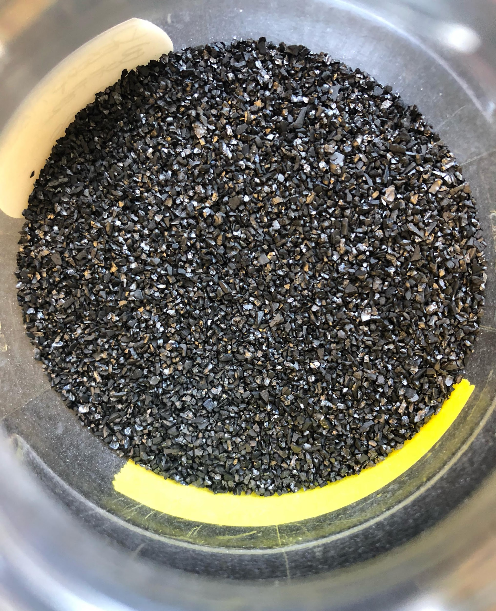
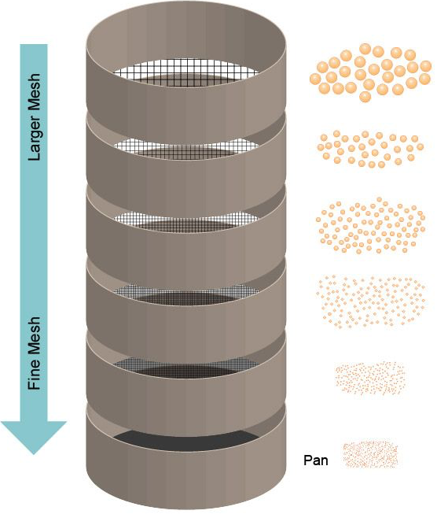
Materials and Methods (cont’d)
Preparation of Virgin Carbon
We prepared granular activated carbon (GAC) coated with various oxides. In order to do this, we first prepared the GAC for coating through the following procedure:
We stacked the different sized sieves by order, with the biggest at the top and smallest at the bottom.
We placed 100 g of GAC at the top of the stack and shaked the sieves for 5 to 10 minutes.
We pick out and save size #16 (1.19 mm) GAC.
Fig 32. Photos of the virgin carbon.
Fig 33. An illustration of the sieving procedure ^{[60]}.

Slide 50
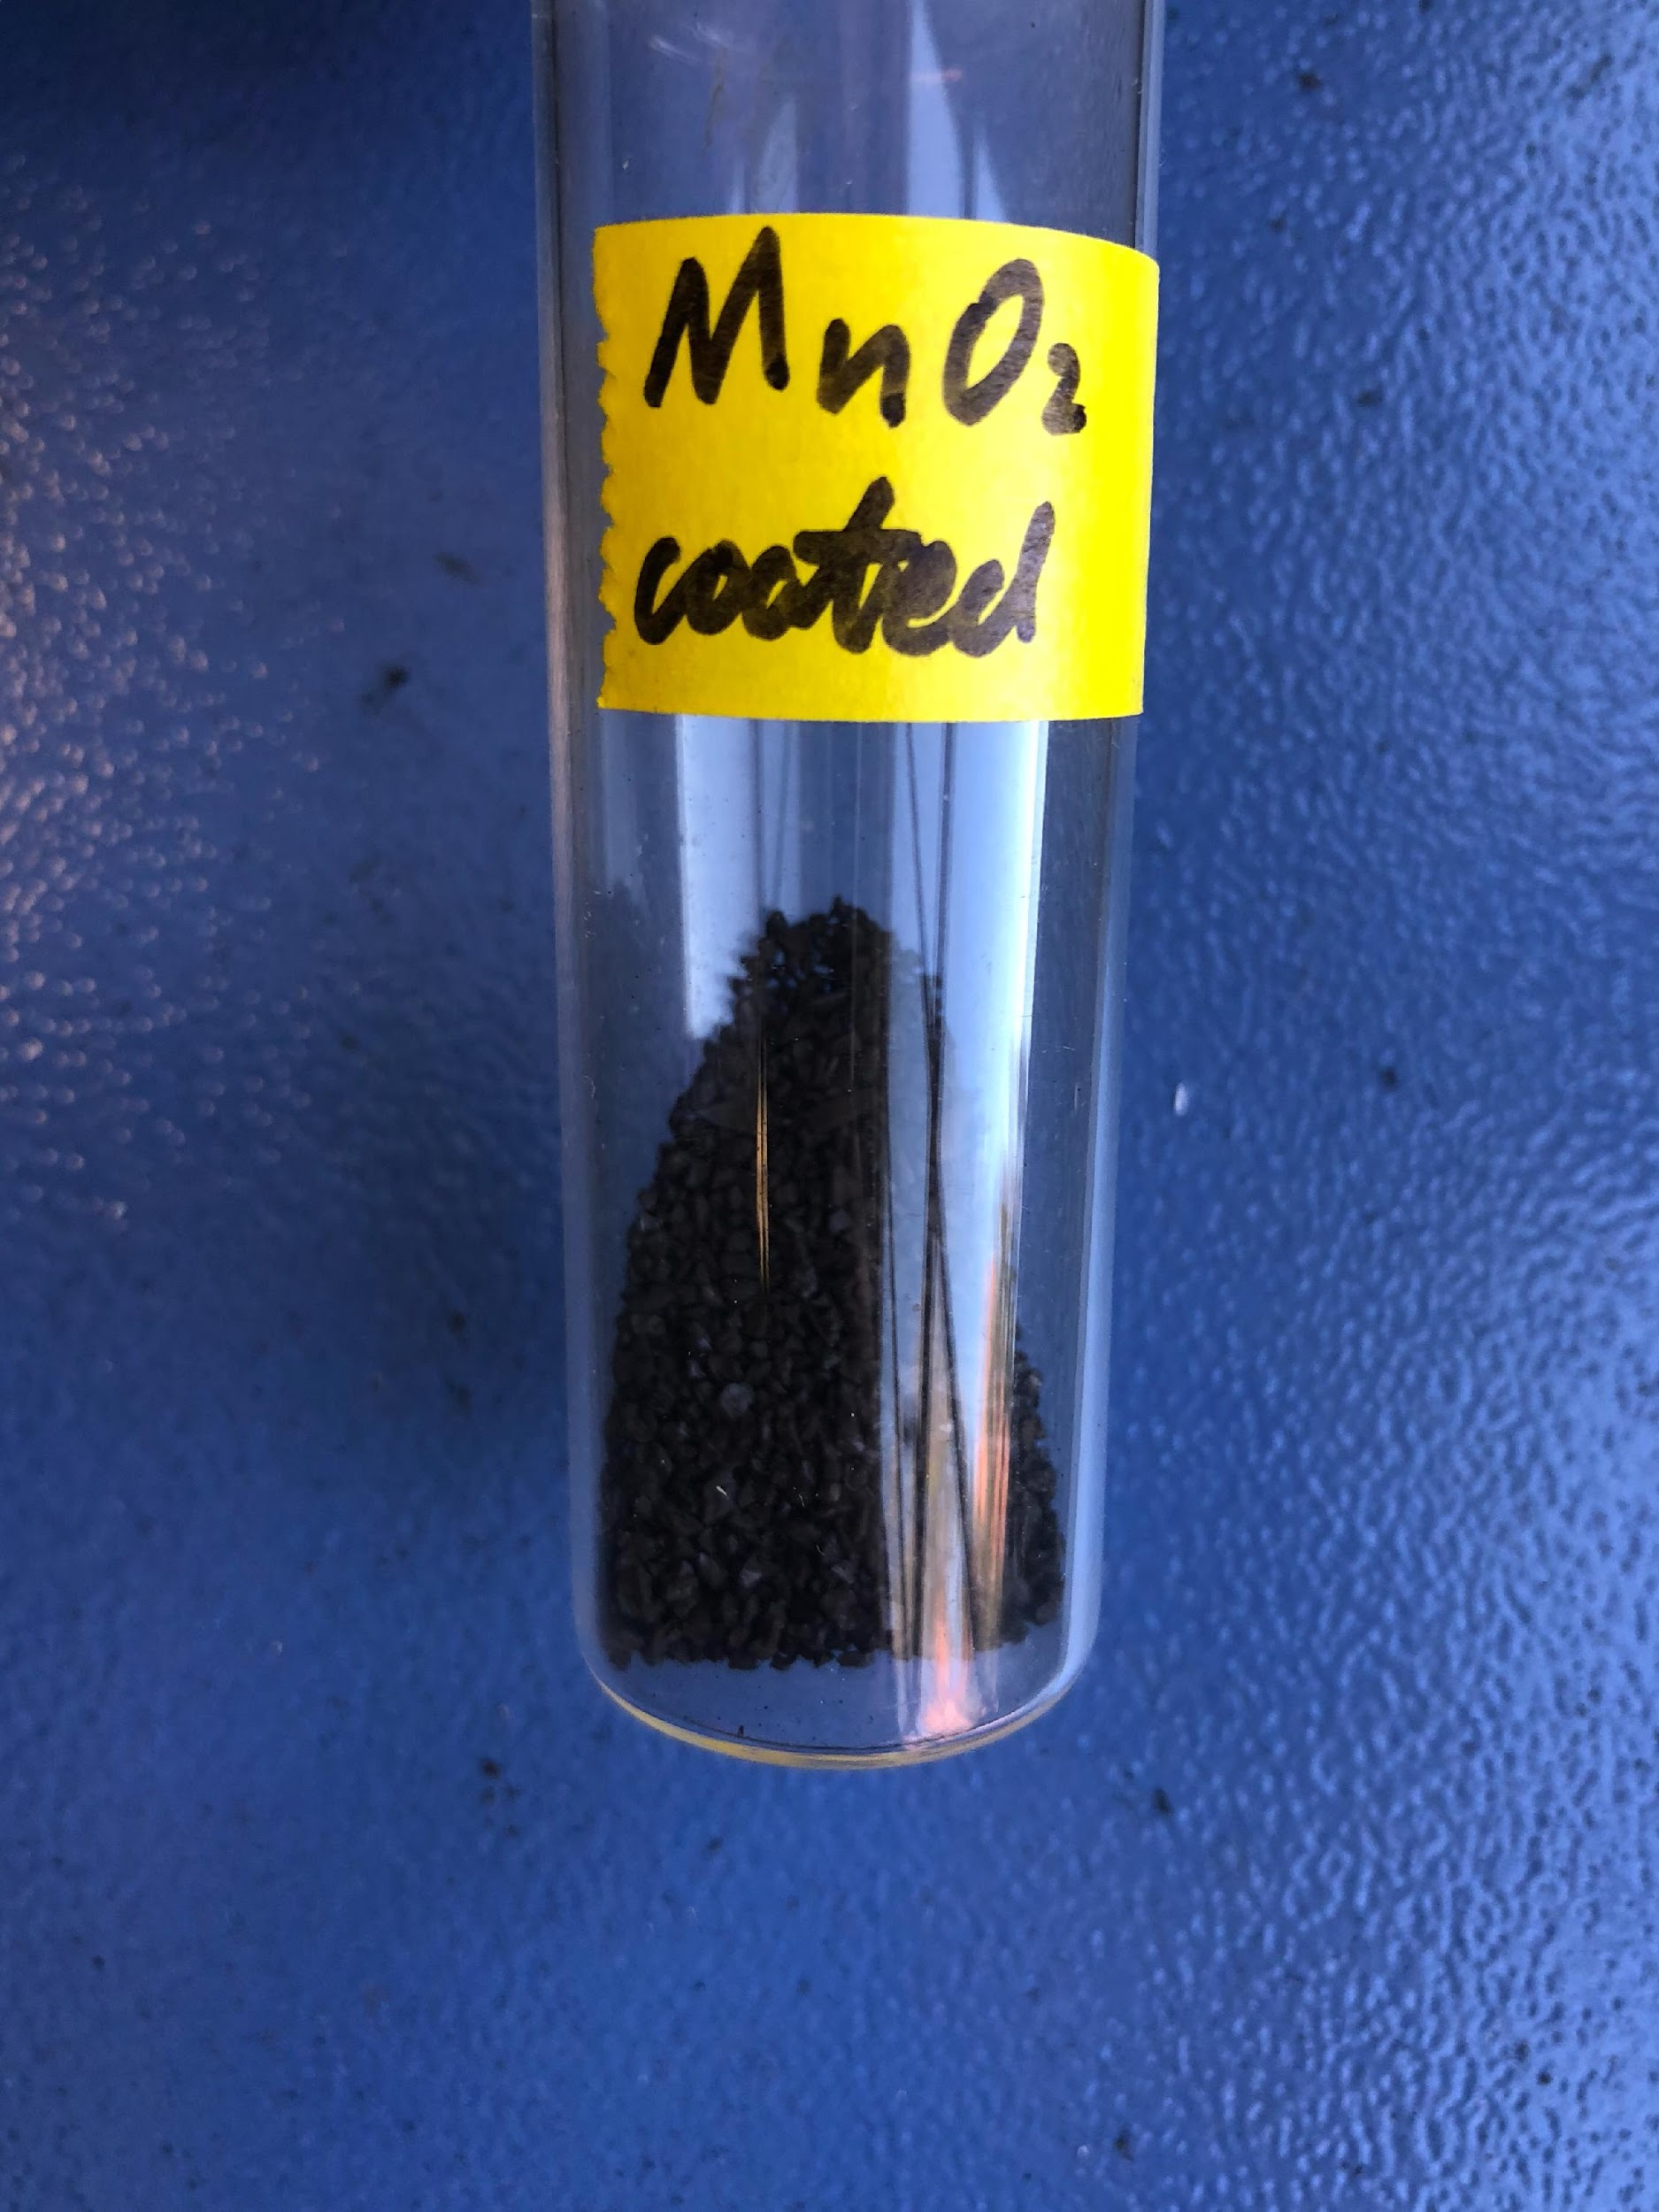
Materials and Methods (Cont’d)
Preparation of Manganese Coated GAC
We coated the virgin carbon with manganese to use as an adsorbent
We added GAC to 250 mL manganese chloride solution and constantly agitated with a magnetic stirrer for a while
We added 1M sodium hydroxide dropwise at 60-70℃ at the pH of 9.0.
We added potassium permanganate, which changes the solution color to brown according to the following reaction:
Mn²⁺ + MnO₄⁻ + H₂O → MnO_{2 (s)} + H⁺
We stirred the solution for 24 hours and aged it for 10 hours.
We filtered the coated sample out and dried it at 150℃ for 5 hours before cooling it at room temperature.
Fig 34. Photos of manganese coated GAC

Slide 51
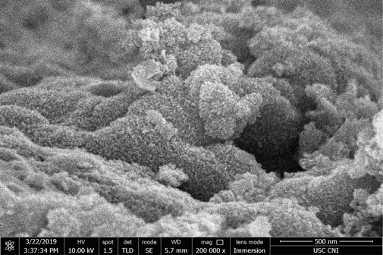
SEM Image
Fig 35. SEM micrograph: MnO₂ nanoparticle coverage of GAC macropores

Slide 52
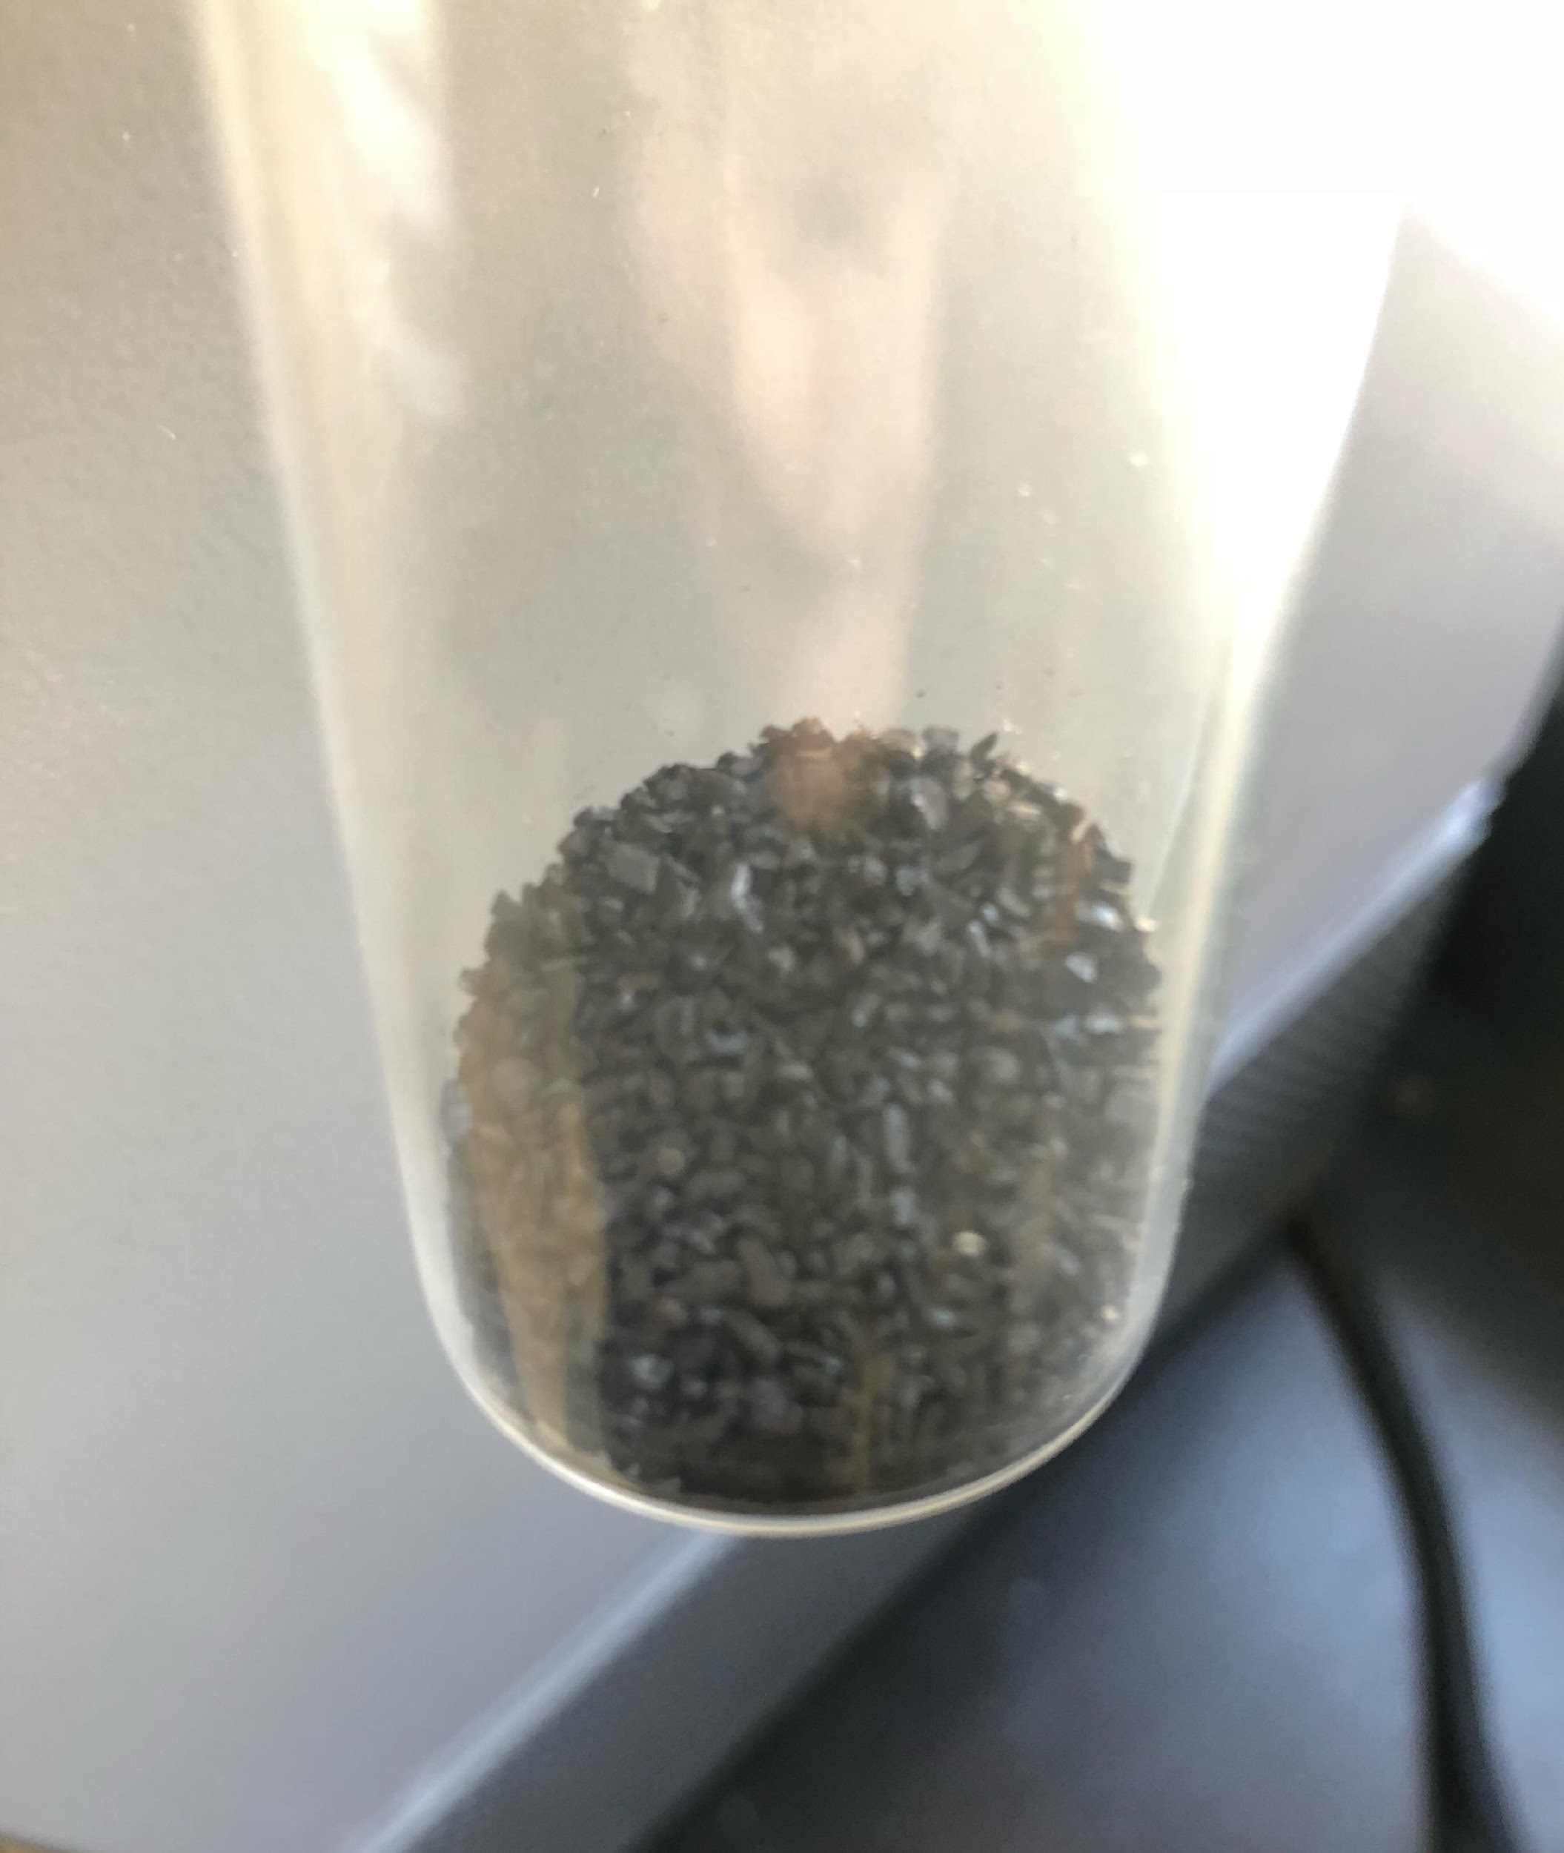
Materials and Methods (Cont’d)
Preparation of Lead Coated GAC
We coated the virgin carbon with iron to use as an adsorbent
We added 50 ml of 2.5M FeCl₃ solution and 50 g of virgin carbon in a 250 ml flask.
We added 0.0036 mL of 1.0M NaOH solution and covered the top of the flask with foil paper
We added some distilled water until it submerged the mixture
We heated the sample and controlled the temperature at 100-110℃ and stirred it with magnetic stirrer
We added distilled water every time the water table in flask dropped too low
We heated and stirred the solution for 3 hours before letting it cool overnight.
We filtered the coated sample and dried it at 150℃ for 5 hours before allowing it to cool at room temperature.
Fig 36. Photos of lead coated GAC

Slide 53
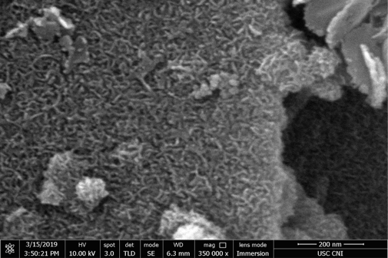
SEM Image
Fig 37. SEM micrograph: iron nanoparticle coverage on GAC surface

Slide 54
Adsorber Design for Removal of Lead
Application of sophisticated mathematical models for the prediction-simulation of fixed-bed adsorber performance in water treatment has made adsorber design more economical by effectively integrating bench-scale experiments with full-scale process implementation.
Available models such as the Homogeneous Surface Diffusion Model (HSDM) and Pore Surface Diffusion Model (PSDM) incorporate intraparticle diffusion and external film transfer coefficients as significant mass transport parameters. Successful implementation of these phenomenological models in adsorber design depends on two important factors:
  The ability of the model to represent the numerous interactions operative at field-scale
  The accuracy, precision, and reliability of methods used for determining model input parameters

Slide 55
Adsorber Design for Removal of Lead (con’t)
It is imperative that these parameters are obtained from well-designed bench-scale experiments on a situation-specific basis.
In this study, the dispersed flow homogeneous surface diffusion model (DFHSDM) was used for performance forecasting and design of fixed-bed GAC adsorbers for lead removal.
The model assumption are:
  Presence of axial dispersion of adsorbate in the liquid phase
  Adsorber particles are spherical in shape
  Surface diffusion of the adsorbate into the adsorbent particle is controlling mechanism
  Film-transfer coefficient is an important consideration
  Sorption of the adsorbate on the adsorbent particle is an instantaneous and reversible process

Slide 56

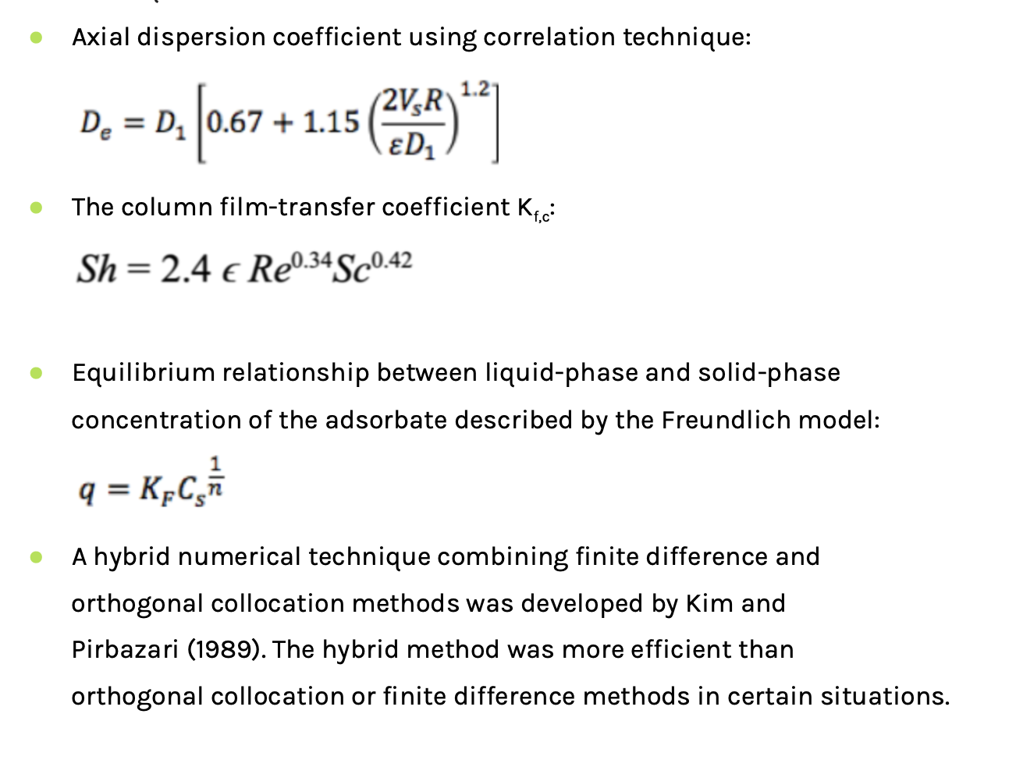
Model Assumptions

Slide 57
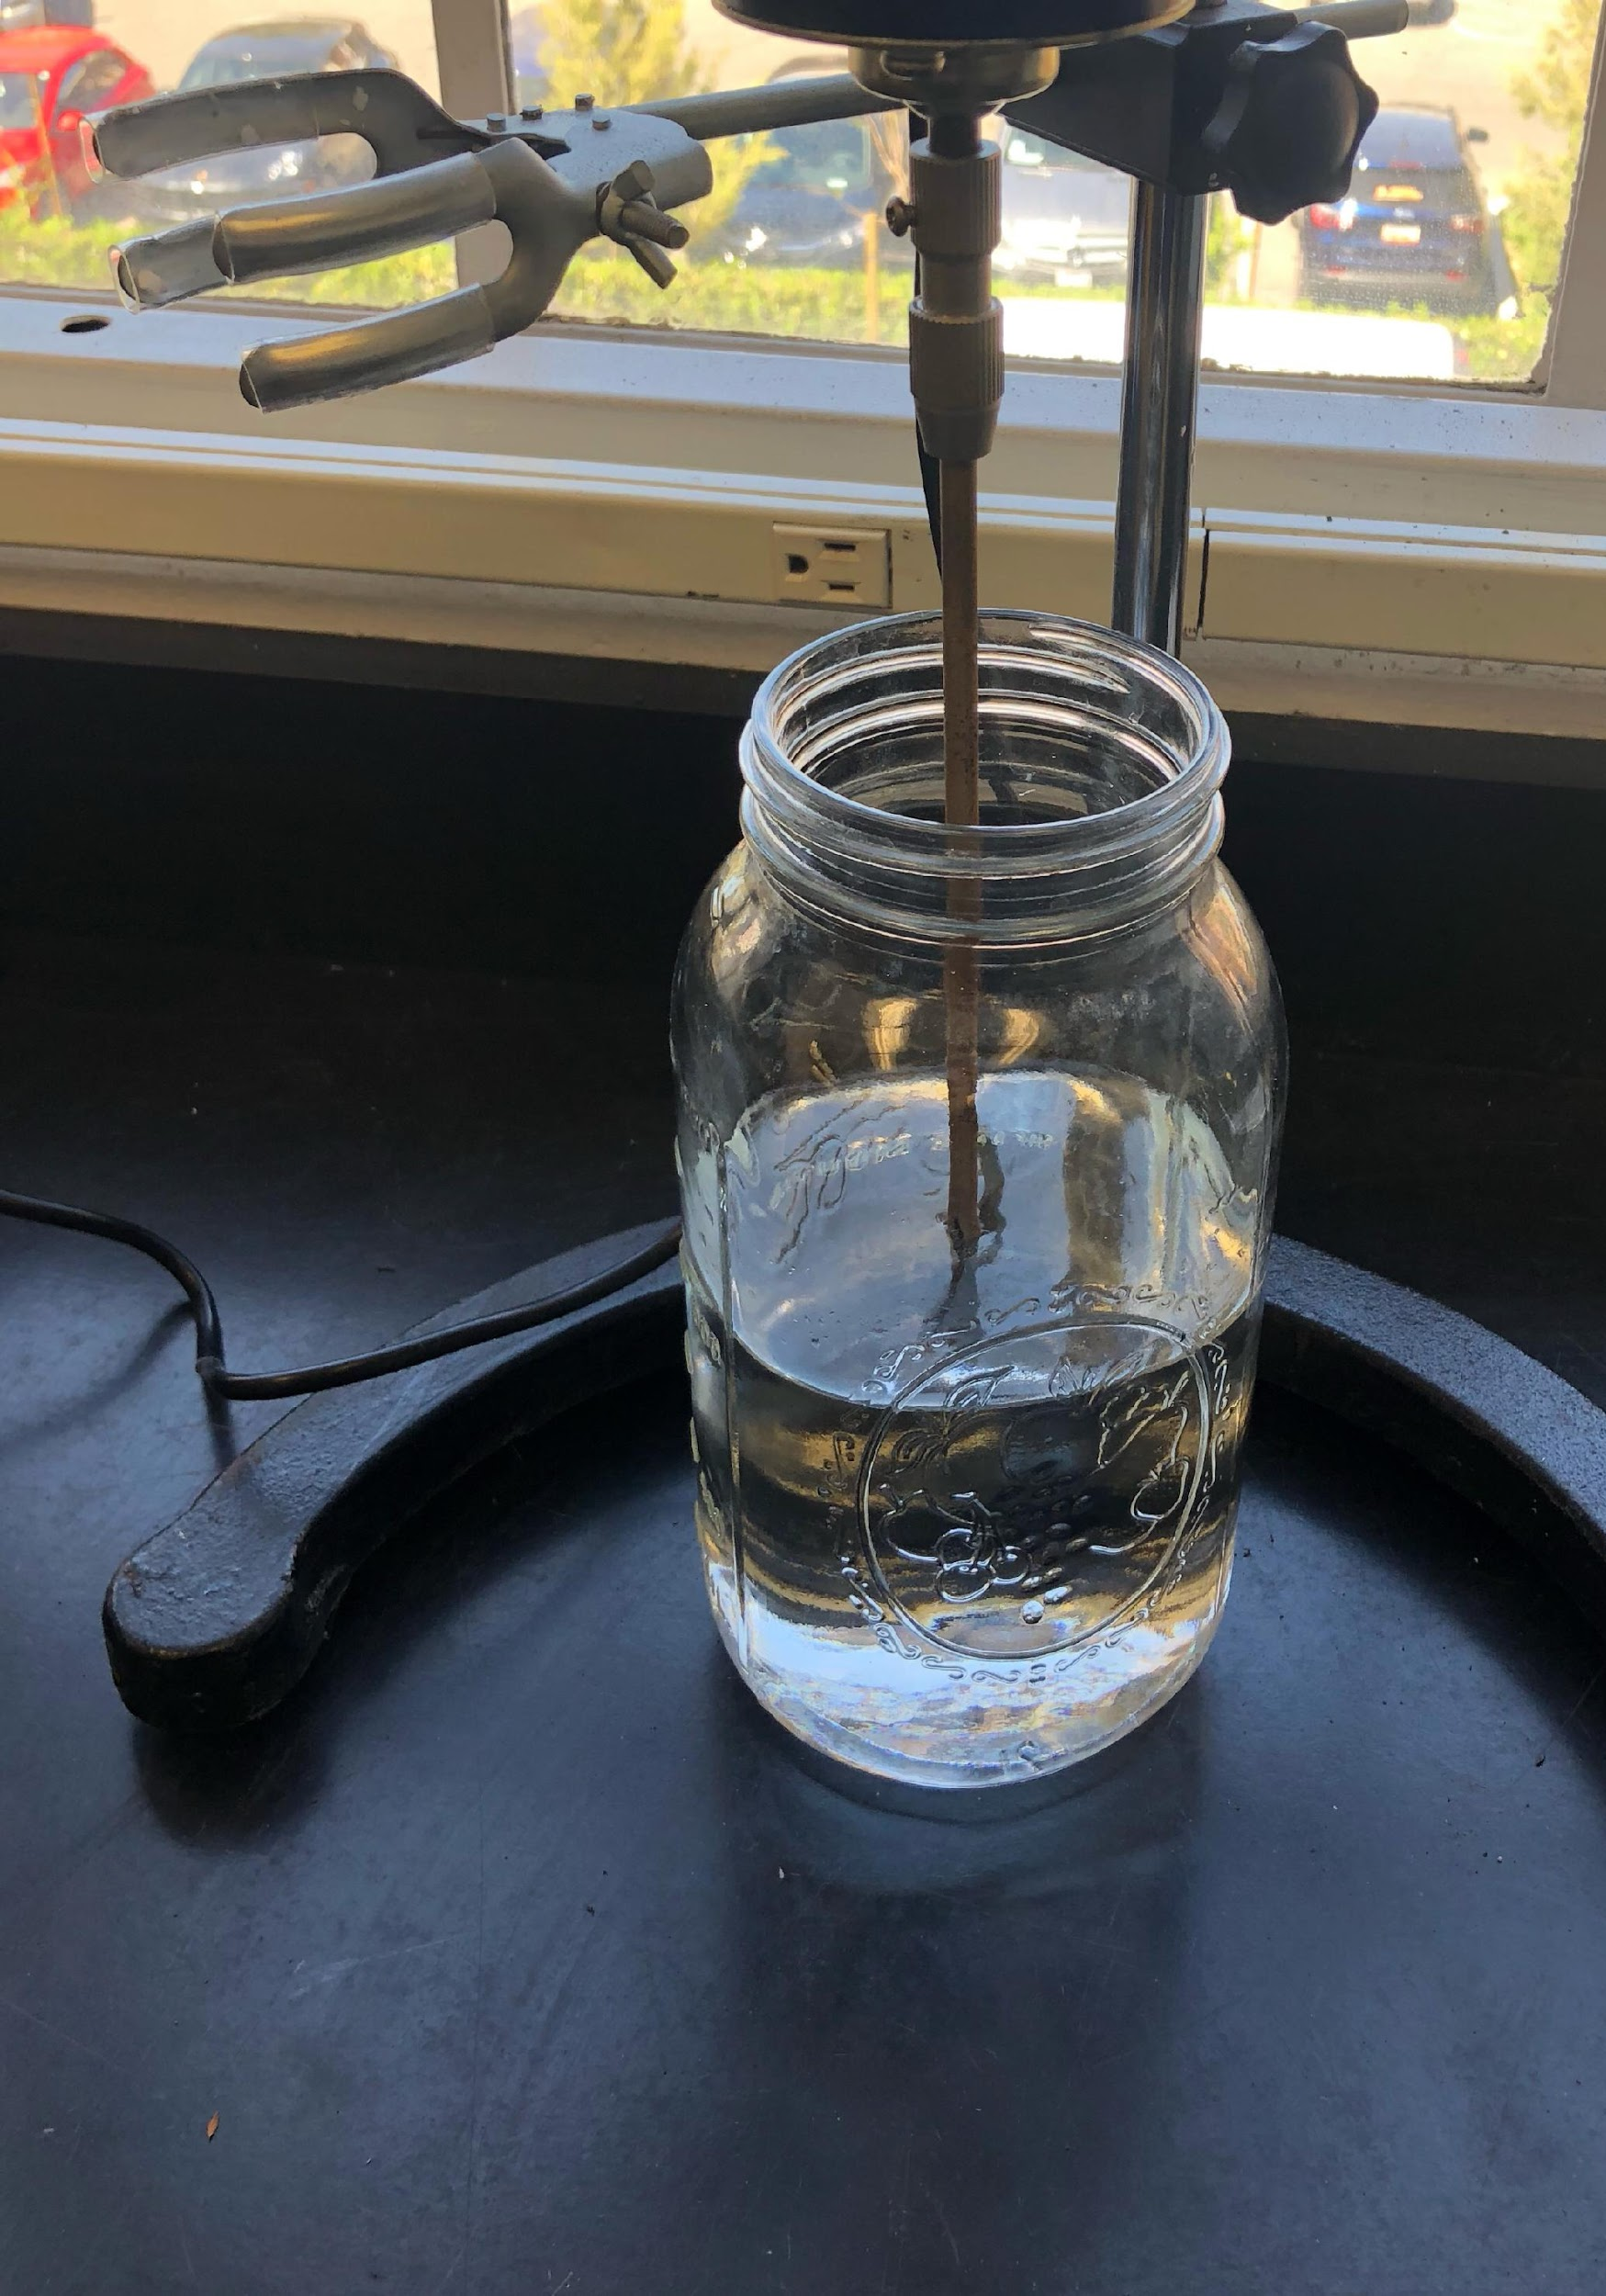
Rate Study Experiments
Add 20 ml lead solution (Pb²⁺ = 2 mg/L) into 6 vials and roll them on the roller for 15-30 minutes
Add 1 L lead solution (Pb²⁺ = 10 mg/L) into the flask and place overnight to make for a saturated solution.
Rinse the adsorbent (uncoated material needn’t) with distilled water until the water runs clear
Prepare 10 mg/L lead solution with 50 ml buffer to keep the pH at 7-8
Add 1 L of lead solution (Pb²⁺ = 10 mg/L) and 4.0 g adsorbent into the saturated flask
Take 20 ml sample from the flask and fill into the first vial
Open the agitator to make the adsorbent and solution mix continually
Take 20 ml sample from the flask after 10, 30, 45, 60, 120nim and make sure fill the original solution with equal quantity of lead solution at concentration of 10 mg/L
Refrigerate the six vials with sample in refrigerator
Fig 38. Photos of the rate study setup

Slide 58
Rate Study Experiments (cont’d)
5 grams of Uncoated Sand, Uncoated GAC, FeO coated Sand, FeO coated GAC, MnO2 coated Sand, MnO2 coated GAC were introduced individually in a jar containing 1L of 10 mg/L of lead solution.
JJ-1 Precise Strength Power Mixer is used to stir the solution having 5 grams of adsorbents.
Samples are taken after certain period of time for analysis.
Readings (samples) were taken at:
Controller (0 mins)
15 mins
30 mins
45 mins
60 mins
120 mins

Slide 59
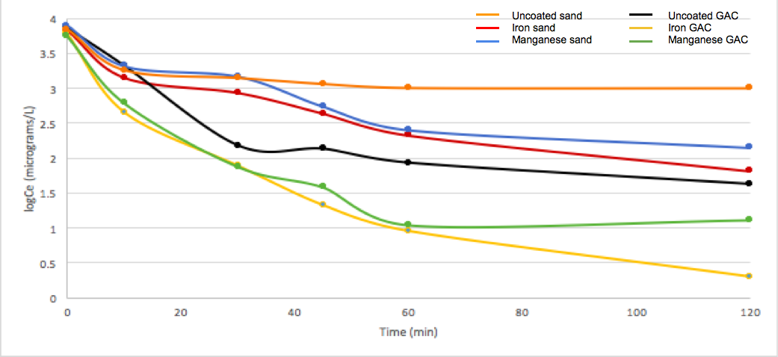
Rate Study Data
Fig 39. Experimental adsorption rate data for different adsorbents in removal of lead from water
Notes:
Figure 1: Experimental data and Freundlich isotherm model describing the adsorption of lead by different adsorbents.

Slide 60
Introduction to Isotherm Study
Adsorption results in the removal of solutes from solution and their concentration at a surface, until the amount of solute remaining in solution is in equilibrium with that at the surface. This equilibrium is described by expressing the amount of solute adsorbed per unit weight of adsorbent q_{e}, as a function of C, the concentration of solute remaining in solution. An expression of this type is termed adsorption isotherm. Two equations, the Langmuir equation and the Freundlich equation, find common use for describing adsorption isotherms for water and wastewater treatment applications.
The Langmuir Equation: q_{e} = QbC/(1+bC)
b = constant related to the energy or net enthalpy of adsorption
Q = ultimate adsorption capacity (maximum value of q_{e}
The Freundlich Equation: q_{e} = K_{F}C^{1/n}
K_{F}= constant
N = constant, N > 1
Data are usually fitted to the logarithmic form of the equation, which gives a straight line with a slope of 1/n and an intercept equal to the value of log K_{F} for C=1 (log C = 0). The intercept is roughly an indicator of sorption capacity and the slope, 1/n, of adsorption intensity. The Freundlich equation generally agrees well with the Langmuir equation and experimental data over moderate ranges of concentration, C. Unlike the Langmuir equation however, it does not reduce to a linear adsorption expression at very low concentrations, nor does it agree well with the Langmuir equation at very high concentrations, since n must reach some limit when the surface is fully covered.

Slide 61
Introduction to Isotherm Study (cont’d)
The adsorption isotherm is useful for representing the capacity of an adsorbent for adsorbing organics from a waste, and in providing description of the functional dependence of capacity on the concentration of pollutant. The steeper the isotherm, the more effective is the adsorbent; that is, the sharper the rise of the isotherm to a given ultimate capacity as concentration increases, the higher will be the effective capacity at the concentration level desired for the treated water.
Experimental determination of the isotherm is routine practice in evaluating the feasibility of adsorption for treatment and in estimating adsorbent dosage requirements.
The Langmuir and Freundlich equations provide means for mathematical description of the experimentally observed dependence of capacity on concentration.
The adsorption isotherm relates to an equilibrium condition, however, and practical detention times used in
most treatment applications do not provide sufficient time for true equilibrium to obtain.
Rates of adsorption are thus significant, for the more rapid the approach to equilibrium, the greater is the fraction of equilibrium capacity utilized in a given contact time. There are 3 primary rate steps in the adsorption of materials from solution by adsorbents.
Film diffusion: Transport of the adsorbate through a surface film to the exterior of the adsorbent
Pore diffusion: Diffusion of the adsorbate within the pores of the adsorbent
Adsorption of the solute on the interior surface bounding pore and capillary spaces.
For most operating conditions, transport of adsorbate through the surface film or boundary layer is rate limiting. If sufficient turbulence is provided, transport of the adsorbate within the adsorbent may control the rate of uptake.

Slide 62
Contact Systems and Reactors
The manner in which to contact adsorbent most effectively with the solution to be treated is of particular significant for large-scale treatment of water. In batch-type contact processes a quantity of adsorbent is mixed continuously with a specific volume of water until the contaminants have been decreased to a deserved level. The adsorbent is then removed and either discarded or regenerated for use with another volume of solution.
Column-type continuous-flow operations have an advantage over batch-type operations because rates of adsorption depend on the concentration of solute in the solution being treated. For column operation the adsorbent is continuously in contact with a fresh solution. Consequently, the concentration in the solution in contact with a given layer of adsorbent in a column changes very slowly. For batch treatment, the concentration of solute in contact with a specific quantity of adsorbent decreases much more rapidly as adsorption proceeds, thereby decreasing the effectiveness of the adsorbent for removing the solute.

Slide 63
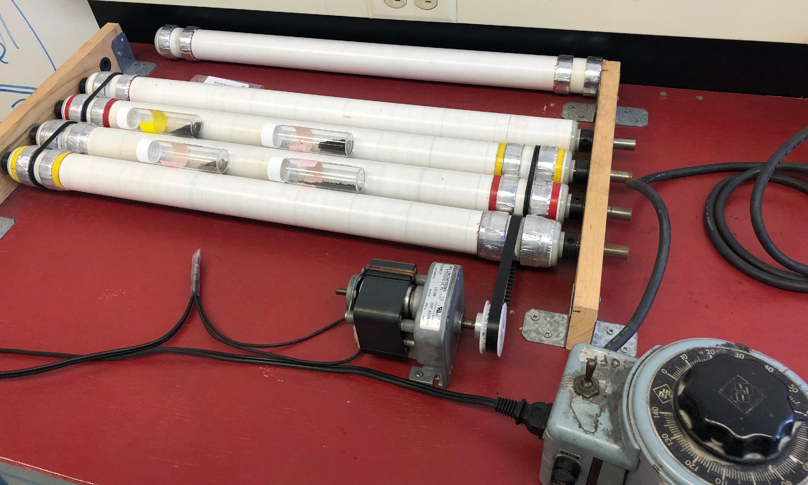
Isotherm Study Experiments
Vials saturation
Add 20ml lead solution (Pb²⁺ = 2mg/L) into 6 vials and roll them on the roller for 15-30min
Rinse the adsorbent (uncoated material needn’t) with distilled water until the color of supernatant doesn’t change any more
Prepared 10mg/L lead solution with 50ml buffer (adjust pH in desire range 7-8) in it
Weighed 0, 0.2, 0.5, 1.0, 3.0, 8.0 g adsorbent into 6 vials
Dilute the lead solution to 2mg/L (200ml initial solution to 1L flask);
Measure the pH of lead solution;
Add 20ml diluted solution to each vial and roll them on the roller for 3h;
Prepare 6 new vials with same saturation process;
Transfer the supernatant into new vials without any solid through filtration
Fig 40. Photos of the isotherm study setup

Slide 64
Isotherm Study Experiments (cont’d)
Vials having different amount of adsorbents were tumbled on the rotator as shown in previous to previous slide.
Vials had 20 ml of 10 mg/L of lead solution alongside adsorbents and were tumbled for 3 hours before taken for the analysis.
Isotherm Study was carried out for :
0 grams of adsorbents
0.5 grams of adsorbents
1 grams of adsorbents
3 grams of adsorbents
5 grams of adsorbents
8 grams of adsorbents

Slide 65
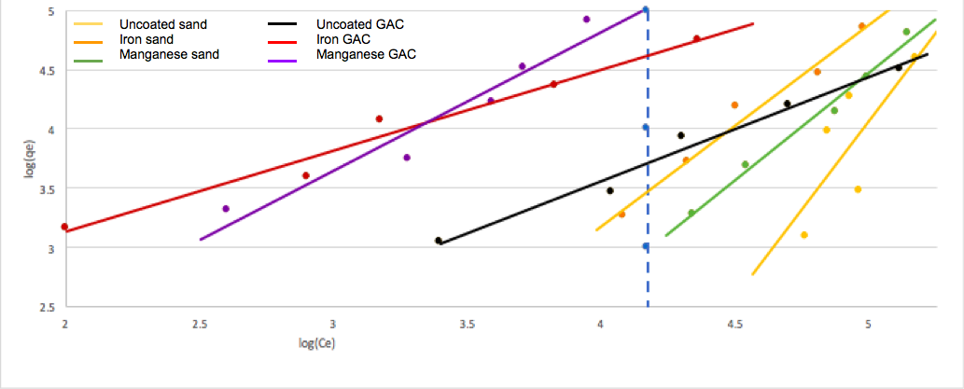
Isotherm Study Data
Fig 41. Experimental data and Freundlich isotherm model describing the adsorption of lead by different adsorbents.

Slide 66
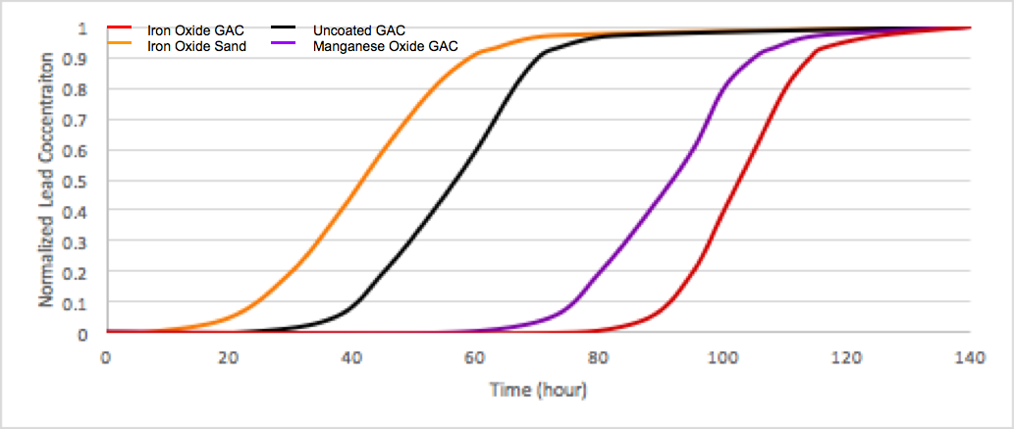
Predictive Model
Fig 42. Predictive Model Simulation for fixed-bed filters for the removal of lead from drinking water

Slide 67
Column Study Experiments
Set up 5 filtration columns containing sand, activated carbon, manganese dioxide coated sand, iron oxide coated sand, and manganese dioxide coated activated carbon
Fill a feed reservoir with a solution of 100 micrograms of lead per liter of water
Pump contaminated water through each filtration column separately
Periodically collect and analyze effluent samples for lead content and microbial colony count
INFLUENT: orange and dark blue
EFFLUENT: light blue
COLUMN 1: Activated Carbon
COLUMN 2: Sand
COLUMN 3: Iron Oxide Coated Sand
COLUMN 4: Manganese Dioxide Coated Sand
Fig 43. A diagram of the column study setup

Slide 68
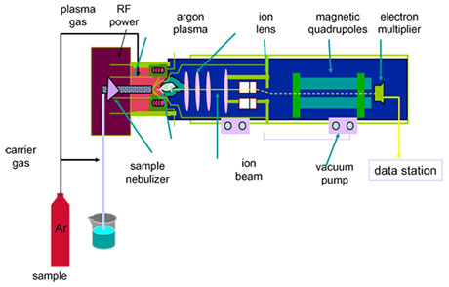
Analytical Methods for Measuring Lead
Measure and analyze lead concentrations from influent and effluent aqueous samples using Inductively Coupled Plasma-Mass Spectrometry (ICP-MS)
ICP-MS is capable of detecting lead levels as low as 1-5 micrograms/L
Analyze biological purity by microbial colony counting using a specified membrane filtration technique
Fig 44. Unknown caption

Slide 69
Future Work
Description of detailed analytical method for measuring lead at below
one microgram per liter in this research
Modeling simulations for predicting performance of full-scale adsorbers
Discussion and Recommendation

Slide 70
Work Cited
[1] Bendix, Aria. “11 Cities with the Worst Tap Water in the US.” Business Insider, Business Insider, 19 Mar. 2019, www.business
insider.com/cities-worst-tap-water-us-2019-3.
[2] Arakha, Manoranjan, et al. “Antimicrobial Activity of Iron Oxide Nanoparticle upon Modulation of Nanoparticle-Bacteria Interface.” Scientific Reports, vol. 5, no. 1, June 2015, doi:10.1038/srep14813.
[3] “Health Effects of Lead Exposure.” Oregon.gov, Oregon Department of Human Sciences, www.oregon.gov/oha/ph/HealthyEnvironments/HealthyNeighborhoods/LeadPoisoning/MedicalProvidersLaboratories/Documents/introhealtheffectsmedicalprovider.pdf.
[4] Brown, Mary Jean, and Stephen Margolis. “Lead in Drinking Water and Human Blood Lead Levels in the United States.” Morbidity and Mortality Weekly Report (MMWR), Centers for Disease Control and Prevention, 9 Aug. 2012, www.cdc.gov/mmwr/preview/mmwrhtml/su6104a1.htm.
[5] “GBD Compare.” Data Visualizations, vizhub.healthdata.org/gbd-compare/.
[6] “Lead Poisoning and Health.” World Health Organization, World Health Organization, 23 Aug. 2018, www.who.int/news-room/fact-sheets/detail/lead-poisoning-and-health.
[7] “Effects of Lead.” LeadSmart, http://leadsmart.nsw.gov.au/effects-of-lead/.
[8] Lalor, Gc, et al. “Acute Lead Poisoning Associated with Backyard Lead Smelting in Jamaica.” West Indian Medical Journal, vol. 55, no. 6, 2006, doi:10.1590/s0043-31442006000600005.
[9] Greenkidsdoc. “Lead In My Water Supply! Now What?” Green Kids Doc, 20 Mar. 2015, https://greenkids
doc.wordpress.com/2015/03/20/lead-in-my-water-supply-now-what/.
[10] “Basic Information about Lead in Drinking Water.” EPA, Environmental Protection Agency, 28 Mar. 2019, www.epa.gov/ground-water-and-drinking-water/basic-information-about-lead-drinking-water#getinto.
[11] Joy, Kevin. “Lead in Baby Food: How Parents Can Reduce the Risk.” Health & Wellness Topics, Health Tips & Disease Prevention, 27 July 2017, healthblog.uofm
[12] “CDC - Lead - Sources of Lead Infographic.” Centers for Disease Control and Prevention, Centers for Disease Control and Prevention,
https://www.cdc.gov/nceh/lead/prevention/infographic-lead-in-environment.htm.

Slide 71
Work Cited
[13] “Protect Your Family from Exposures to Lead.” EPA, Environmental Protection Agency, 26 Mar. 2019, www.epa.gov/lead/protect-your-family-exposures-lead.
[14] Renner, Rebecca. “Exposure on tap: drinking water as an overlooked source of lead.” Environmental health perspectives vol. 118,2 (2010): A68-72. doi:10.1289/ehp.118-a68.
[15] Wines, Michael, and John Schwartz. “Unsafe Lead Levels in Tap Water Not Limited to Flint.” The New York Times, The New York Times, 8 Feb. 2016, www.nytimes.com/2016/02/09/us/regulatory-gaps-leave-unsafe-lead-levels-in-water-nationwide.html.
[16] Wines, Michael, and John Schwartz. “Unsafe Lead Levels in Tap Water Not Limited to Flint.” The New York Times, The New York Times, 8 Feb. 2016, www.nytimes.
com/2016/02/09/us/regulatory-gaps-leave-unsafe-lead-levels-in-water-nationwide.html.
[17] “Lead and Drinking Water from Private Wells, Wells, Private Water Systems, Drinking Water, Healthy Water, CDC.” Centers for Disease Control and Prevention, Centers for Disease Control and Prevention, www.cdc.gov/healthywater/drinking/private/wells/disease/lead.html.
[18] “Copper Bathroom Fixtures.” Networx, www.networx.com/article/copper-bathroom-fixtures.
[19] WUSTLnews. “Partial Lead Pipe Replacement Model.” EurekAlert!, 16 Mar. 2017, https://www.eurekalert.org/multimedia/pub/135794.php.
[20] “The WHO Logo and Emblem.” World Health Organization, World Health Organization, 18 Jan. 2019, www.who.
[21] “Using the EPA Seal and Logo.” EPA, Environmental Protection Agency, 5 Dec. 2017, www.epa.gov/stylebook/using-epa-seal-and-logo.
[22] Masten, Susan J., et al. “Flint Water Crisis: What Happened and Why?” Journal - American Water Works Association, vol. 108, Jan. 2016, pp. 22–34., doi:10.5942/jawwa.2016.108.0195.
[23] Winowiecki, Emma. “Does Flint Have Clean Water? Yes, but It's Complicated.” Michigan Radio, 21 Aug. 2019, www.michiganradio.org/post/does-flint-have-clean-water-yes-it-s-complicated.
[24] Kennedy, Merrit. “Lead-Laced Water In Flint: A Step-By-Step Look At The Makings Of A Crisis.” NPR, NPR, 20 Apr. 2016, https://www.npr.org/sections/thetwo-way/2016/04/20/465545378/lead-laced-water-in-flint-a-step-by-step-look-at-the-makings-of-a-crisis.
[25] Pieper, Kelsey J., et al. “Flint Water Crisis Caused By Interrupted Corrosion Control: Investigating ‘Ground Zero’ Home.” Environmental Science & Technology, vol. 51, no. 4, 2017, pp. 2007–2014., doi:10.1021/acs.est.6b04034.
[26] Cite: michigan engineering handout

Slide 72
Work Cited
[27] “ReplacementBrand 10 in x 2.5 in. Granular Activated Carbon Block Filter-RB-FXSVC-2PK.” The Home Depot, https://www.homedepot.com/p/
ReplacementBrand-10-in-x-2-5-in-Granular-Activated-Carbon-Block-Filter-RB-FXSVC-2PK/205909977.
[28]“What Changed with Michigan's 2018 Lead and Cooper Rule?” Graham.umich.edu, University of Michigan, graham.umich.edu/media/files/Lead-and-Copper-Rule-Info-Brochure-LTR-042319.pdf.
[29] Aratani, Lauren. “'Damage Has Been Done': Newark Water Crisis Echoes Flint.” The Guardian, Guardian News and Media, 25 Aug. 2019, www.theguardian.com/us-news/2019/aug/25/newark-lead-water-crisis-flint.
[30] Corasaniti, Nick, et al. “Lead Crisis in Newark Grows, as Bottled Water Distribution Is Bungled.” The New York Times, The New York Times, 14 Aug. 2019, https://www.nytimes.com/2019/08/14/nyregion/newark-water-lead.html.
[31] Tucker, Jill. “3 San Francisco Public Schools Show High Levels of Lead in Water.” SFGate, San Francisco Chronicle, 27 Oct. 2017, https://www.sfgate.com/news/article/Three-San-Francisco-public-schools-show-high-12306785.php.
[32] Bryan, Susan Montoya. “20 New Mexico Water Systems Exceed Federal Lead Standard.” Albuquerque Journal, https://www.abqjournal.com/754724/20-nm-water-systems-exceed-federal-lead-standard.html.
[33] Young, Alison, and Mark Nichols. “Beyond Flint: Excessive Lead Levels Found in Almost 2,000 Water Systems across All 50 States.” USA Today, Gannett Satellite Information Network, 27 Mar. 2017, https://www.usatoday.com/story/news/2016/03/11/nearly-2000-water-systems-fail-lead-tests/81220466/.
[34] Corasaniti, Nick, et al. “Lead Crisis in Newark Grows, as Bottled Water Distribution Is Bungled.” The New York Times, The New York Times, 14 Aug. 2019, https://www.nytimes.com/2019/08/14/
nyregion/newark-water-lead.html.
[35] Wescott, Ben, and Samuel Chan. “Hong Kong's Lead-in-Drinking-Water Crisis: Everything You Need to Know.” South China Morning Post, 14 June 2018, www.scmp.com/news/hong-kong/health-environment/article/1840021/hong-kongs-lead-drinking-water-crisis-everything.
[36] Kao, Ernest. “'Beware of Salesmen in Hong Kong Selling Dubious Water Purifiers'.” South China Morning Post, 16 Oct. 2018, www.scmp.com/news/hong-kong/health-environment/article/2168683/beware-door-door-salesmen-hong-kong-selling.
[37] Chan, Holmes. “Tests Show Excessive Lead in Water at New Kwai Fong Housing Estate, as Safety Scandal Reappears.” Hong Kong Free Press HKFP, 19 July 2018, www.hongkongfp.com/2018/07/19/tests-show-excessive-lead-water-new-kwai-fong-housing-estate-safety-scandal-reappears/.

Slide 73
Work Cited
[38] Slavin, Erik. “Lead Detected in Water at Navy Elementary School in Japan.” Stars and Stripes, 6 June 2017, www.stripes.com/news/lead-detected-in-water-at-navy-elementary-school-in-japan-1.472132.
[39] Osaki, Tomohiro. “With Water Privatization, Japan Faces Crossroads in Battling Its Aging Pipes.” The Japan Times, 17 Dec. 2018, www.japantimes.co.jp/news/2018/12/17/reference/water-privatization-japan-crossroads-battling-aging-pipes/#.XZz3US2ZOHp.
[40] Möller-Gulland, Jennifer, et al. “Toxic Water, Toxic Crops: India's Public Health Time Bomb.” New Security Beat, 3 Jan. 2019, www.newsecuritybeat.org/2019/01/toxic-water-toxic-crops-indias-public-health-time-bomb/.
[41] “Lead: Poisoning India's Food and Water Supply Chain .” Viskaecotech.com, Vikas Scotch LTD , vikasecotech.com/whitepapers/Vikas_Ecotech_whitepaper_01.pdf.”
[42] “Heavy Metal Contamination of Vegetables in Delhi.” Toxicslink, Mar. 2003, toxicslink.org/docs/06102_Finding_
of_Heavy_Metal_Contamination_of_Vegetables.pdf.
[43] Ani. “Indians at Risk for Ignoring Lead Seeping in Tap Water.” Deccan Chronicle, 17 June 2016, www.deccanchronicle.
com/lifestyle/health-and-wellbeing/170616/indians-at-risk-for-ignoring-lead-seeping-in-tap-water.html.
[44] Deutsche Welle. “Germany Aims to Rid Drinking Water of Lead: DW: 03.12.2013.” DW.COM, www.dw.com/en/germany-aims-to-rid-drinking-water-of-lead/a-17265851.
[45] “EnHealth Guidance Statement Lead in Drinking Water from Some Plumbing Products.” Health.gov.au, Environmental Health Standing Committee (EnHealth) of the Australian Health Protection Principal Committee, www1.health.gov.au/internet/main/publishing.nsf
/content/A12B57E41EC9F326CA257BF0001F9E7D/$File/Lead-plumbing-products-Guidance-Statement-July2018.pdf.
[46] SILVERSTEIN, I. Investigation of the Capability of Point-Of-Use/Point-Of- Entry Treatment Devices as a Means of Providing Water Security. U.S. Environmental Protection Agency, Washington, DC, EPA/600/R-06/012 (NTIS PB2006-107461), 2005.
[47] Research, Allied Market. “Point-of-Entry Water Treatment Systems Market Is Expected to Reach $6.6 Billion, Globally, by 2022.” PRLog, 31 Jan. 2017, www.prlog.org/12616657-point-of-entry-water-
Treatment-systems-market-is-expected-to-reach-6-6-billion-globally-by-2022.html.
[48] Sobsey, Mark D., et al. “Point of Use Household Drinking Water Filtration: A Practical, Effective Solution for Providing Sustained Access to Safe Drinking Water in the Developing World.” Environmental Science & Technology, vol. 42, no. 12, 2008, pp. 4261–4267., doi:10.1021/es702746n.
[49] Crook, Parker. “Armstrong Woman Leads Clean Water for Haiti.” Vernon Morning Star, Vernon Morning Star, 19 Nov. 2018, www.vernonmorningstar.com/community/armstrong-woman-leads-clean-water-for-haiti/.

Slide 74
Work Cited
[50] Ruble , Kayla, et al. “Five Years In, the Flint Water Crisis Continues Its Deadly Toll.” PBS, Public Broadcasting Service, 25 Apr. 2019, www.pbs.org/wgbh/frontline/article/flint-water-crisis-legionnaires-disease-deaths/.
[51] Coulter, Brandi. “All About Water Treatment Systems: Point of Entry Filtration.” Skillings & Sons, Inc. NH, New Hampshire, MA, Massachusetts, Skillings & Sons, Inc. NH, New Hampshire, MA, Massachusetts, 8 Dec. 2016, www.skillingsandsons.com/blog/all-about-water-treatment-systems-point-of-entry-filtration.
[52] Well Drilling Services in Washington.” Washington Well Drilling Contractor Services, www.jkawelldrilling.com/well-drilling.html.
[53] “Drinking Water Testing.” Suburban Laboratories, Inc., 8 Jan. 2019, suburbanlabs.com/drinkingwater/.
[54] Mok, Danny. “Another Lead Scare in Drinking Water at Hong Kong Housing Estate.” South China Morning Post, 19 July 2018, www.scmp.com/news/hong-kong/health-environment/
article/2155910/excessive-lead-levels-found-tap-water-new-hong.
[55] Young, Alison, and Mark Nichols. “Beyond Flint: Excessive Lead Levels Found in Maine Water Systems.” WCSH, 17 Mar. 2016, www.newscentermaine.com/article/mobile/news/health/beyond-flint-excessive-lead-levels-found-in-maine-water-systems/86451908.
[56] Mendoza, Martha. “Investigation: Lead in Some Canadian Water Worse than Flint.” Yahoo! News, The Associated Press , 4 Nov. 2019, news.yahoo.com/investigation-lead-canadian-water-worse-100203293.html
[57] Craik, Steve. “Managing Lead in Canadian Drinking Water.” Water Canada, 26 July 2018, www.watercanada.net/feature/managing-lead-in-canadian-drinking-water/.
[58] Maliyekkal, Shihabudheen M., et al. “Manganese-Oxide-Coated Alumina: A Promising Sorbent for Defluoridation of Water.” Water Research, vol. 40, no. 19, 2006, pp. 3497–3506., doi:10.1016/j.watres.2006.08.007.
[59] Benjamin, Mark M., et al. “Sorption and Filtration of Metals Using Iron-Oxide-Coated Sand.” Water Research, vol. 30, no. 11, 1996, pp. 2609–2620., doi:10.1016/s0043-1354(96)00161-3.
[60] “Sieve Analysis.” Particle Technology Labs, https://www.particletechlabs.com/analytical-testing/particle-size-distribution-analyses/sieve-analysis.
[61] “EPA Awards $2.2 Million in Grants to Alaska, Idaho, Oregon and Washington to Test for Lead in School Drinking Water.” EPA, Environmental Protection Agency, 29 Jan. 2020, www.epa.gov/newsreleases/epa-awards-22-million-grants-alaska-idaho-oregon-and-washington-test-lead-school.
[62] “WIIN Grant: Lead Testing in School and Child Care Program Drinking Water.” EPA, Environmental Protection Agency, 30 Jan. 2020, www.epa.gov/dwcapacity/wiin-grant-lead-testing-school-and-child-care-program-drinking-water.

