Slide 1

A Study of Electrophoresis and Zeta Potential of Kaolinite Colloidal Particles in the Presence of Different Aqueous Solutions of Humic Substances and Metal Ions
Graduate Student: Keyuan Li
Supervisor: Dr. Massoud Pirbazari
December 2023

Slide 2

S.W.A.N is an initiative started by Dr. Massoud Pirbazari of the University of Southern California focusing on the improvement of drinking water quality for all nations.
The goal of S.W.A.N is to provide comprehensive and visually-based information so that people, can treat their water, and in turn, improve their health and well-being.

Slide 3

To the Visitors:
Your comments and suggestions are appreciated.
Please direct your thoughts to Keyuan Li at kyuanl0318@gmail.com
Thank you

Slide 4
Content
Nomenclature
Background and Introduction
Effect of Different Ions and Their Two Concentrations on Zeta Potential
Summary
Effect of HA, Ca²⁺ and Mg²⁺ ions and Their Two Different Concentrations on Zeta Potential.
Effect of sHA, Ca²⁺ and Mg²⁺ ions and Their Two Different Concentrations on Zeta Potential.
Summary and Conclusion
Acknowledgement
References

Slide 5
Nomenclature
HA It’s a terrestrial peat-derived humic material; molecular formular: C₉H₉NO₆ ;
molecular weight: ranging from 2000 – 500,000.
sHA It’s a mixture of humic acid, ammonium sulphate and adipic acid;
molecular formula: C₉H₉NO₆; molecular weight: 226.14.
pzc The pH value giving a zero zeta potential value is called point of zero charge.
mV millivolt, 1/1000 of a volt, a measure of electrical potential.
Zeta potential Zeta potential is an electrokinetic potential at the shear plan near a solid-liquid
interface where the liquid velocity is zero.
Zeta Meter Zeta meter refers to an instrument used in the field of colloid and surface
chemistry to measure the zeta potential.

Slide 6

Part 2: Background and Introduction

Slide 7
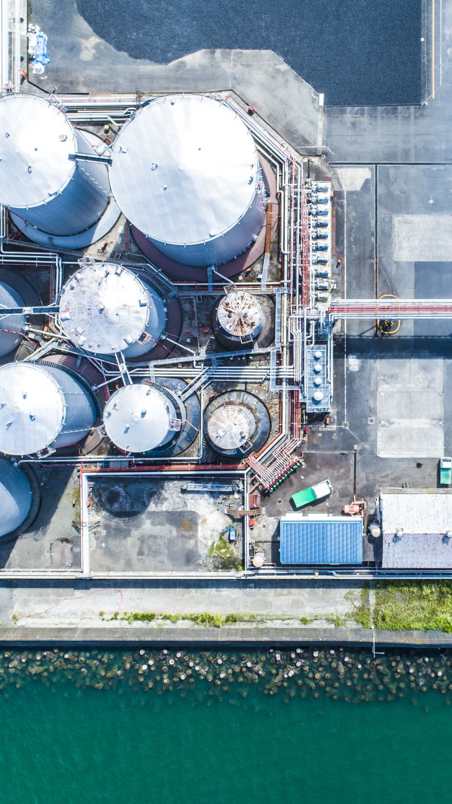
The Colloids in Water and Wastewater treatment
Colloids are the most challenging suspended solids to remove in water and wastewater treatment.
Colloids can easily escape both sedimentation and filtration due to their small size.
Some examples of colloids in water and wastewater spent protein and emulsions from domestic waters, bacterial cells, algae, industrial waste colloids, silts, clays, and organic matter from soil washing.
The primary method for effectively removing colloids is to reduce their zeta potential. Once the charge of colloids is reduced or eliminated, the repulsive force will also disappear. Then, in the flocculation basin, the liquid is gently agitated to cause numerous colloid collisions, forming microflocs and subsequently, visible floc particles. These particles can be readily settled or filtered.

Slide 8
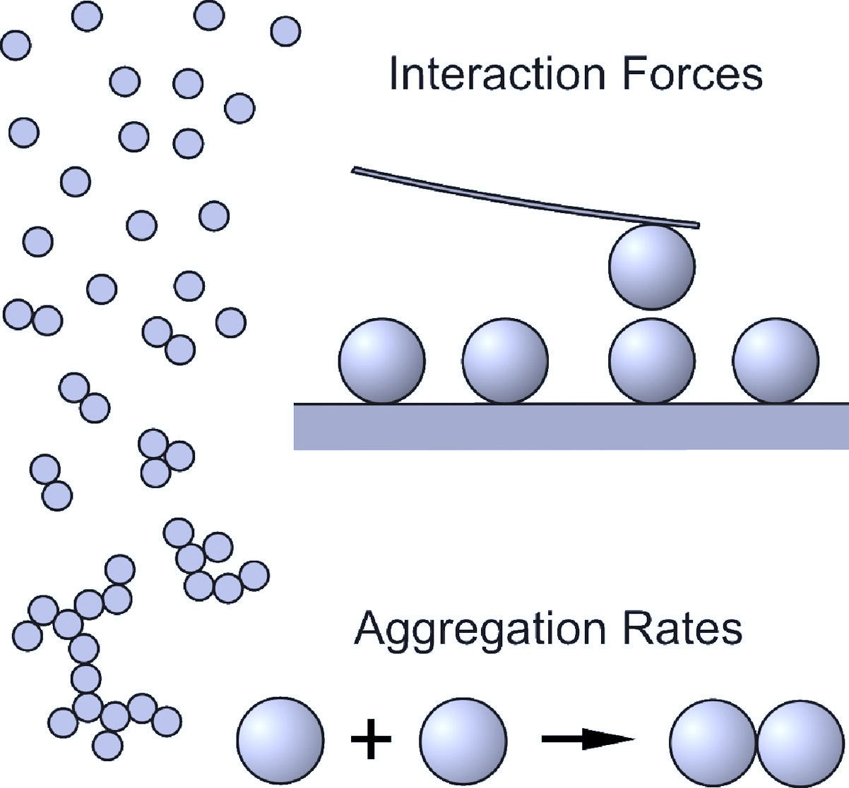
What controls colloid behavior?
The interaction of particles is an important element in determining the characteristics of colloidal suspensions.
Electrokinetic is one of the most significant forces that generates the charge usually found on liquid’s surface particles. If the surface charge is relatively high, the adjacent colloids will repel each other’s and tend to remain separate, and their settling rate will be in inches per hours or per day.
https://pubs.acs.org/cms/10.1021/jz4000609/asset/images/large/jz-2013-000609_0005.jpeg

Slide 9
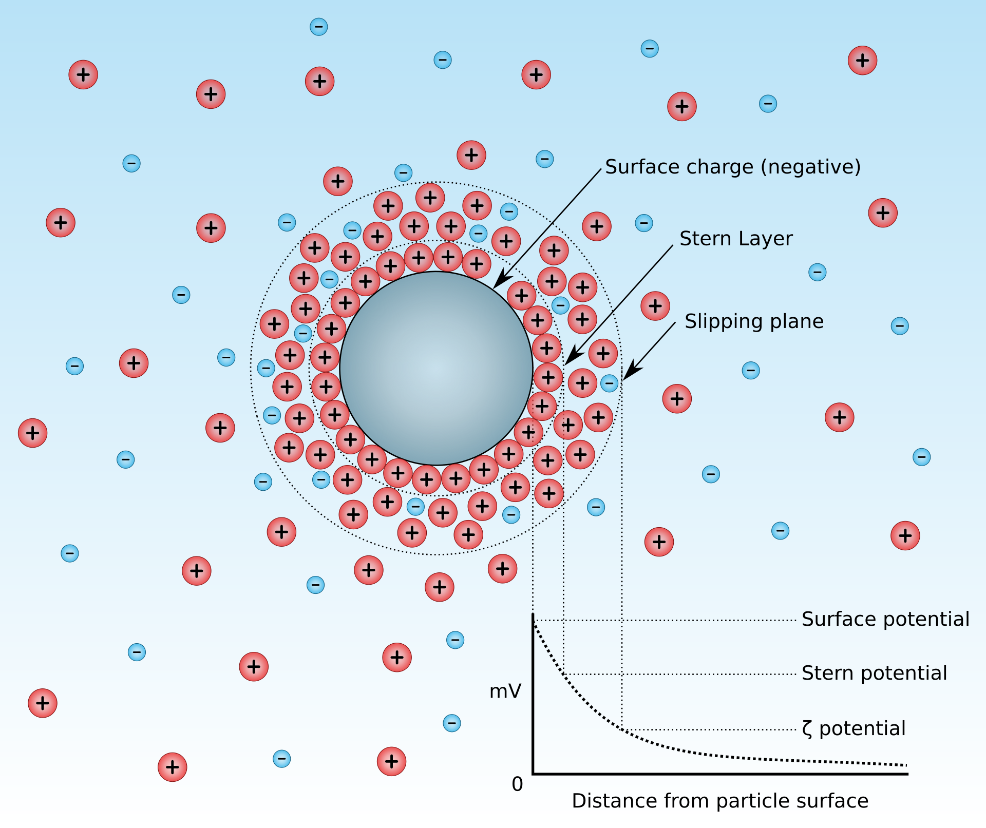
https://en.wikipedia.org/wiki/Zeta_potential
What is Zeta Potential?
Zeta potential is an electrokinetic potential at the shear plane (the boundary between the compact layer and the diffuse layer) near a solid-liquid interface where the liquid velocity is zero.

Slide 10

Why do we need to have zero zeta potential?
Colloids are the most challenging suspended solids to remove in water and wastewater treatment and the primary method for effectively removing colloids is by reducing their zeta potential to facilitate flocculation.
A zero-zeta potential value for colloids at certain pH is called zero charge point. Zero charge on the particles means there are only attractive forces between particles, which will cause flocculation.
Colloids with little or no charge, they tend to follow the natural tendency of small particles---gathering into aggregates. Subsequently, small clumps will form and aggregate into larger flocs that settle quickly or form an interconnected matrix. This process is known as flocculation, and it also changing the physical characteristics of the suspension.

Slide 11
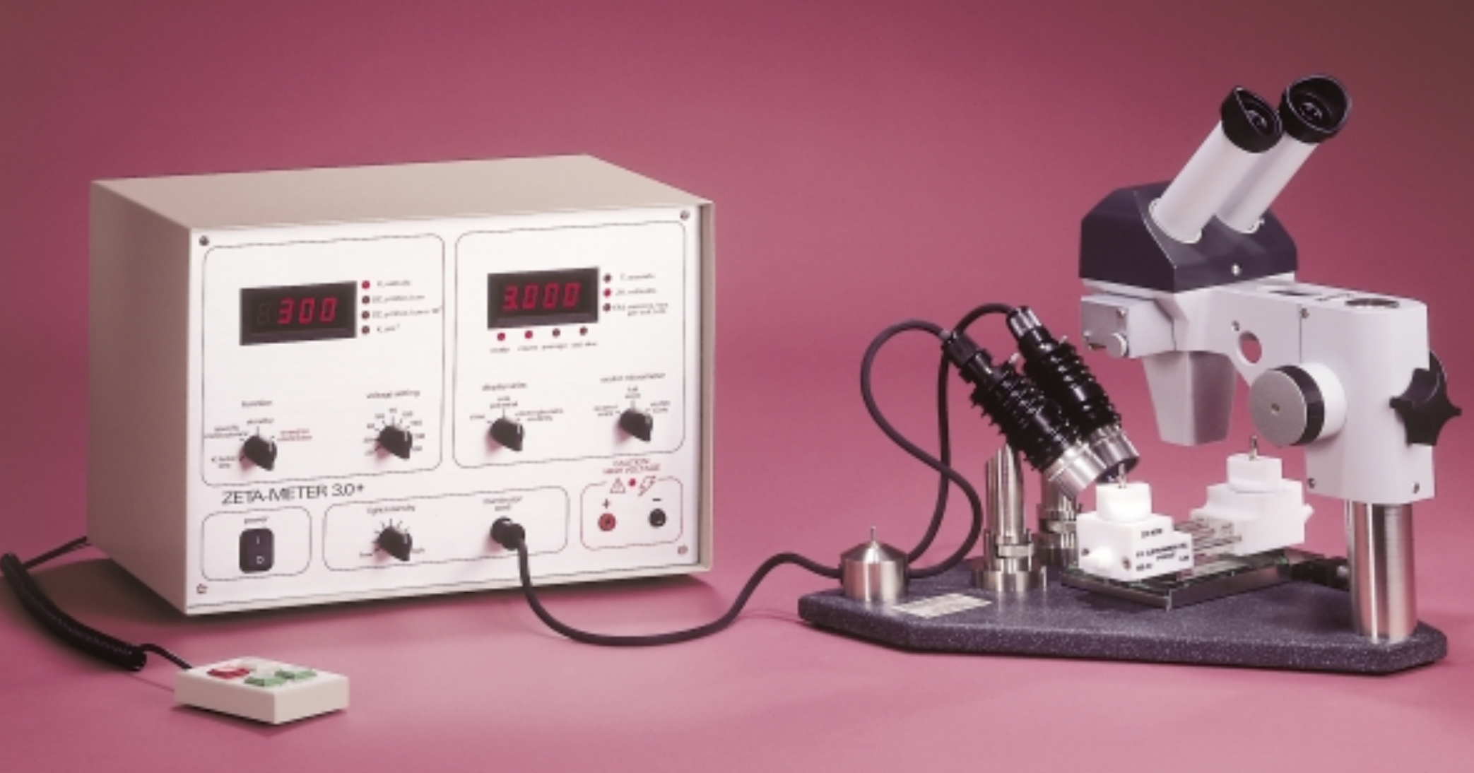
https://www.somatco.com/ZM3-U-G_D390-2.pdf?_gl=1*1vfq22k*_ga*NzA3MzEyMjUuMTY4ODM2MDIzNg..*_ga_WEDBE03J1N*MTY5MjMxNTk2Ny4zLjEuMTY5MjMxNjAwNC4yMy4wLjA.&_ga=2.81828245.2053171968.1692315968-70731225.1688360236
Zeta meter typically refers to an instrument used in the field of colloid and surface chemistry to measure the zeta potential of particles suspended in a liquid.
What is Zeta Meter?

Slide 12
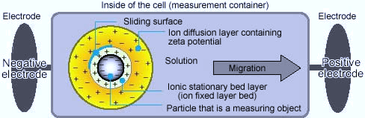
How dose Zeta-Meter work?
A microscope is employed for observing colloidal particles within a chamber called an electrophoresis cell.
Electrodes positioned at both ends of the cell are linked to a power source, generating an electric field that causes the movement of charged colloids.
The journey of individual particles is monitored as they pass beneath a grid in the microscope's eyepiece.
Pressing the "track" button when a colloid enters the starting point and releasing it when the colloid reaches the endpoint, each crossing travel is completed within approximately 3 to 5 seconds.

Slide 13
Zeta Potential Applications
Use zeta potential to find the surface charge:
  When exposed to ionic surfactant CTAB, PE and PP microplastics shows a positive zeta potential value, which means that the PE and PP microplastics exhibit a positive charge; whereas they display a negative charge in the presence of the other ionic surfactant SDBS.
Use zeta potential to find the the stability and transport of the colloid:
  When the zeta potential increased, the increased electrostatic and steric repulsion forces will also improve the stability and transport of the colloid.
Use zeta potential to control the stability of the colloidal particles in the porous medium:
  The large absolute value of Zeta potential will not only enhance the repulsive force between colloidal particles but also reinforces the electrostatic repulsion between colloids and quartz sand. Consequently, this leads to a high mobility of colloidal particles within the porous medium.

Slide 14
Zeta Potential Applications
Use zeta potential to control the aggregate of engineered nanoparticles(ENPs):
  As the pH increases, zeta potential of ENPs is reduce gradually. When pH is around the zero-charge point, where the surface potential is approximately zero, the repulsive force between ENPs is hardly exists, so it is easy for ENPs to aggregate and deposition.
Use zeta potential to control the electrostatic attraction of the microplastics to the heavy metal cation:
  As the pH rises, the zeta potential of microplastics will also be increased, which can capture heavy metal ions(Pb²⁺) more effectively.

Slide 15
Zeta Potential Applications
Use zeta potential to control the sludge dewatering:
  The rising zeta potential (negative) prevents the waste activated sludge flocks from flocculation and decreases dewaterability. Extracellular polymeric reduction leads to the surface charge and zeta potential reduction of sludge particles. Simultaneous decreases of the extracellular polymeric substances and zeta potential, as well as the created mix by ozone bubbles, cause the formation of the larger particles.
Use zeta potential also can control the dilution or washing:
  Dilution or washing reduced ionic strength, thereby reducing the zeta potentials of algal cells. Also, ozonation can gradually reduce the zeta potentials of the original and diluted samples.

Slide 16
Zeta Potential Applications
Use zeta potential to control the catalyst suspensions stability:
  The zeta potential is positive at low pH and decreases as the pH increases, and the catalyst suspensions are stable in both basic and acidic pH, because the electrostatic repulsion due to either positive or negative surface charges.
Use zeta Potential to control the different properties of nano-drug delivery systems:
  Cellular uptake
  Variation of the particle zeta potential control binding to the tissue and direct nanoparticles(NPs) to cellular compartments both in vitro and in vivo.
  Tumor cells targeting
  As the pH became acidic, the zeta potential of NPs became positive, which enhanced the electrostatic interaction between the C-NPs(Chitosan-modified paclitaxel-loaded PLGA nanoparticles) and tumor tissues.
  Brain targeting
  Positive zeta potential on nanoparticles can help the transportation of nanoparticles from blood brain barrier.

Slide 17
What is Humic Acid ?
Definition:
    Humic acids (HA) are macromolecules that comprise humic substances, which are organic matter distributed in terrestrial soil, natural water, and sediment.
Characters:
    HAs are soluble in alkaline media, partially soluble in water, and insoluble in acidic media. Due to their amphiphilic character, HAs form micelle-like structures in neutral to acidic conditions, which are useful in agriculture, pollution remediation, medicine and pharmaceuticals.

Slide 18
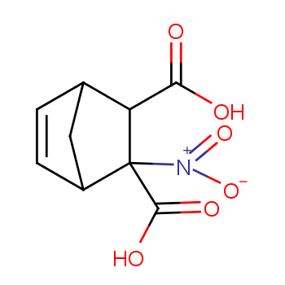
Humic Acid in the Experiment
We use two humic acid in the experiment, Both humic acid is from Sigma Aldrich Company. Aldrich humic acid is a terrestrial peat-derived humic material.
1. Name: Humic acid
  Molecular Formula: C₉H₉NO₆
  Product number: 53680
  Melting point/range: 300 °C (572 °F)
  Strong oxidizing agents
  Chemical Abstracts Service(CAS) Number: 1415-93-6
Humic Acid (1415-93-6) is the organic substances that coagulate when the strong-base extract is acidified. It is of natural origin and composition.
The molecular weight will vary from lot to lot. The true structure is not provided for humic acid of natural origin and not of uniform composition. The product consists of heteropoly condensates of molecular weights ranging from 2,000-500,000.
The product is chemically stable under standard ambient conditions (room temperature) .
https://www.guidechem.com/encyclopedia/humic-acid-dic8628.html

Slide 19
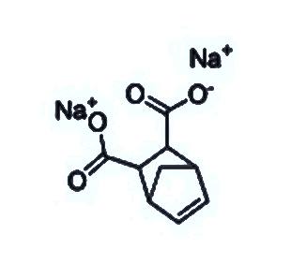
2. Name: Sodium Humic Acid
    Molecular Formula: C₉H₈Na₂O₄
    Molecular Weight: 226.14
    Product number: H16752
    Melting point/range: > 300 °C (> 572 °F) - lit.
    The product is not flammable
    Density: 1.52 at 20 °C (68 °F)
    Water solubility: 369 g/l at 20 °C (68 °F)
    Chemical Abstracts Service(CAS) Number: 68131-04-4
    Autoignition temperature: Autoignition Surface Tension: 66.6 mN/m1 at 20 °C (68 °F)
    Strong oxidizing agents
It’s a commercial synthetic humic acid sodium salt, consisting of a mixture of humic acids, ammonium sulphate and adipic acid, which was dissolved in double distilled water prior to use.
This acid mixture is usually found in dead organic matter via biodegradation, and it also chemically stable under standard ambient conditions (room temperature) .
https://www.scbt.com/p/humic-acid-sodium-salt-68131-04-4

Slide 20
What are the differences between these two humic acid?
Humic acid is the free acid form while sodium humic acid is the sodium salt form of humic acid.
Humic acids are strongly acidic and naturally occurring.
Sodium humic acids exist predominantly in their salt form.
Sodium humic acids is treated with HCl, resulting in the purified free acid form---humic acid.

Slide 21

Part 3: Effect of different metal ions on zeta potential of kaolinite
colloidal particles

Slide 22
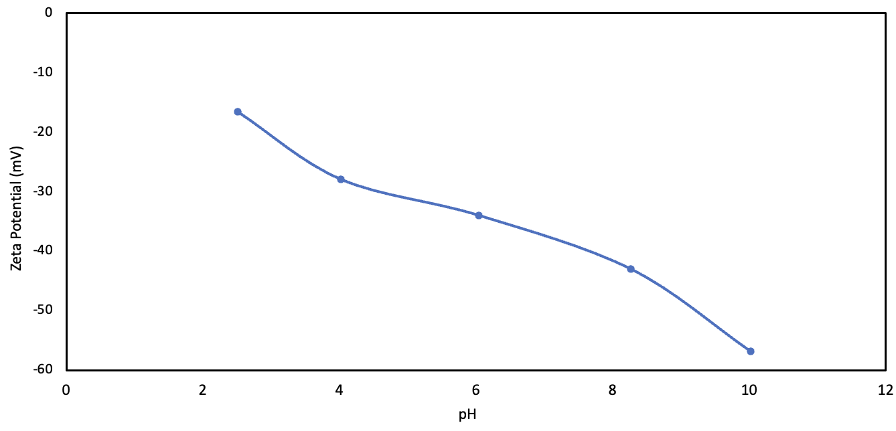
Distilled Water
To evaluate the effect of different metal ions and their concentrations, experiments were conducted with kaolinite in distilled water and two concentrations of five different ions: Ca²⁺, Mg²⁺, Cu²⁺, Pb²⁺ and Co²⁺. The results are depicted in the following:
Figure 1: Zeta potential(mV) vs pH for distilled water
Figure 1 presents the change of zeta potential in water as a function of solution pH.
Zeta potential becomes more negative as pH increases, with no pzcs.

Slide 23
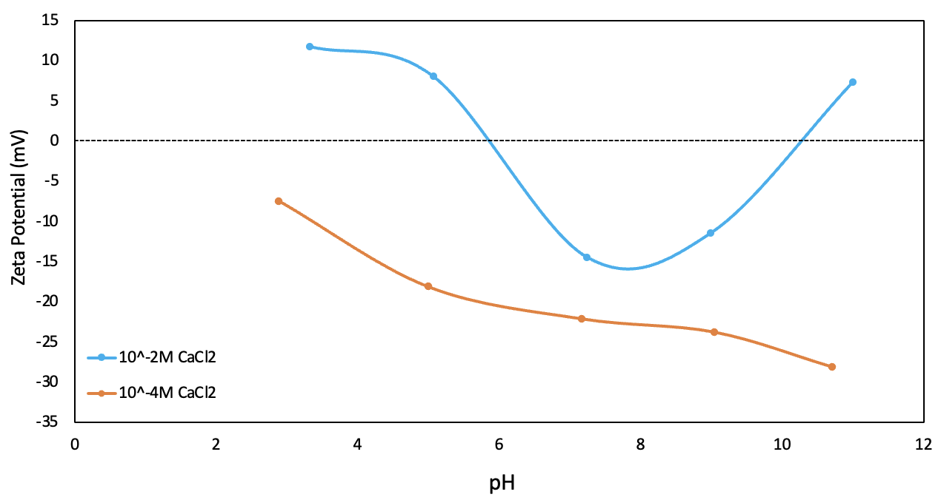
CaCl₂ solution
Figure 2: Zeta Potential(mV) vs. pH for kaolinite in 10⁻²M and 10⁻⁴M CaCl₂
Figure 2 shows the change of zeta potential in different concentrations of CaCl₂ solution.
The zeta potential in 10⁻²M CaCl₂ decreases until pH 8 and then increases towards positive. Besides, 10⁻²M CaCl₂ curve has two pzcs at around pH 6 and pH 10.
The zeta potential in 10⁻⁴M CaCl₂ becomes more negative as the pH goes up. Moreover, 10⁻⁴M CaCl₂ curve does not show any pzcs.

Slide 24
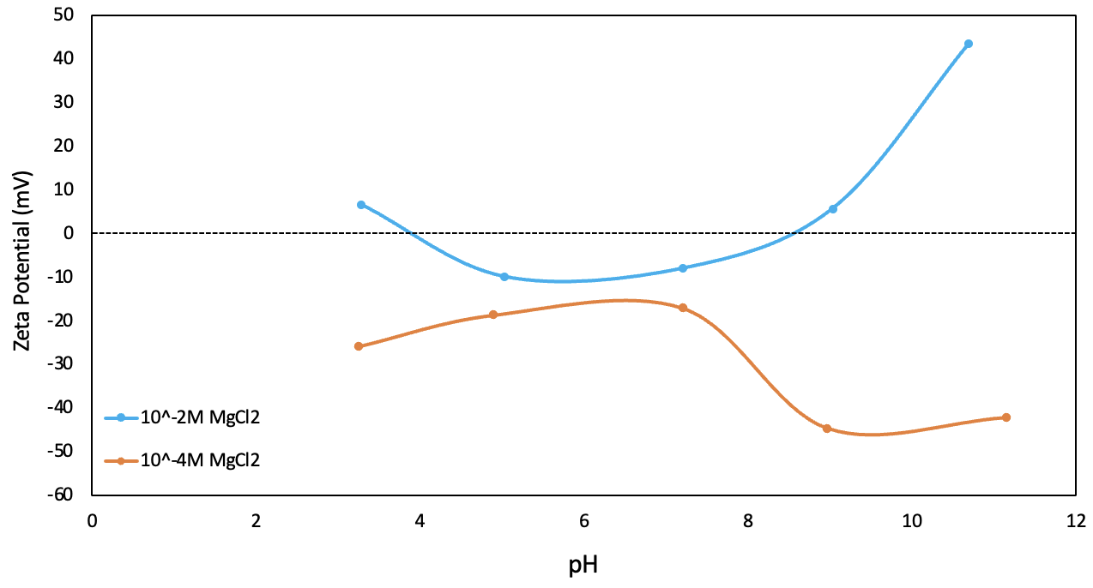
MgCl₂ solution
Figure 3: Zeta Potential(mV) vs. pH for kaolinite in 10⁻²M and 10⁻⁴M MgCl₂
Figure 3 demonstrates the change of zeta potential in different concentrations of MgCl₂ solution.
The zeta potential shows a decrease around neutral pH, and then an increase towards positive. The 10⁻²M MgCl₂ curve has two pzcs at pH 4 and pH 8.5.
The zeta potential in 10⁻⁴M MgCl₂ increases around neutral pH, and then decreases at higher pH. The 10⁻⁴M MgCl₂ curve does not show any pzcs.

Slide 25
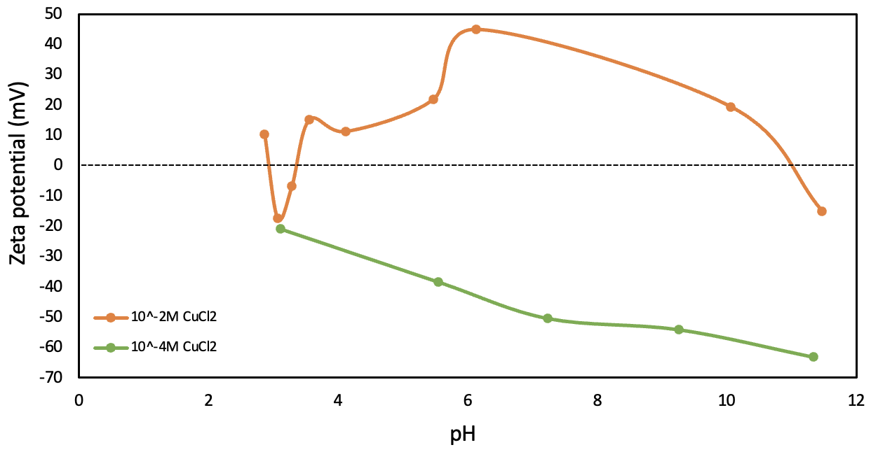
CuCl₂ solution
Figure 4: Zeta Potential(mV) vs. pH for kaolinite in 10⁻²M and 10⁻⁴M CuCl₂
Figure 4 presents the change of zeta potential in different concentrations of CuCl₂ solution.
The zeta potential in 10⁻²M CuCl₂ shows a decrease around pH 3, then an increase until neutral pH, finally a decrease in higher pH. The 10⁻²M CuCl₂ curve has three pzcs, at pH 2.8, pH 3.2 and pH 11.
The zeta potential in 10⁻⁴M CuCl₂ becomes more negative as the pH increases, and it doesn’t have any pzcs.

Slide 26
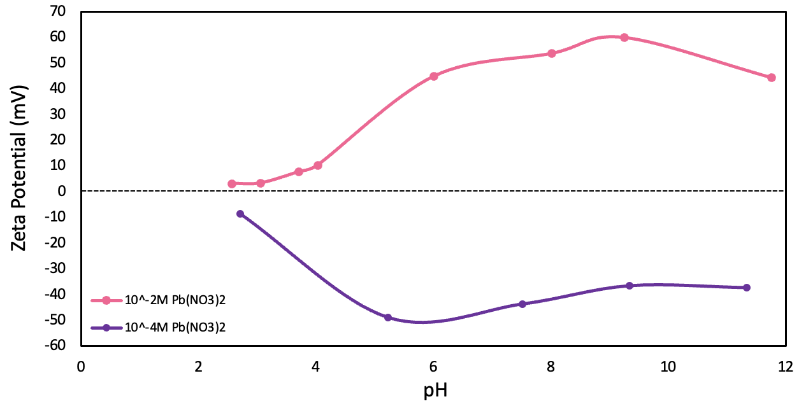
Pb(NO₃)₂ solution
Figure 5: Zeta Potential(mV) vs. pH for kaolinite in 10⁻²M and 10⁻⁴M Pb(NO₃)₂
Figure 5 shows the change of zeta potential in different concentrations of Pb(NO₃)₂ solution.
The zeta potential in 10⁻²M Pb(NO₃)₂ becomes more positive as the pH increases, and it doesn’t have any pzcs.
The zeta potential in 10⁻⁴M Pb(NO₃)₂ decreases to the lowest point at -50mV, and then increases around pH. The 10⁻⁴M Pb(NO₃)₂ curve also has no pzcs.

Slide 27
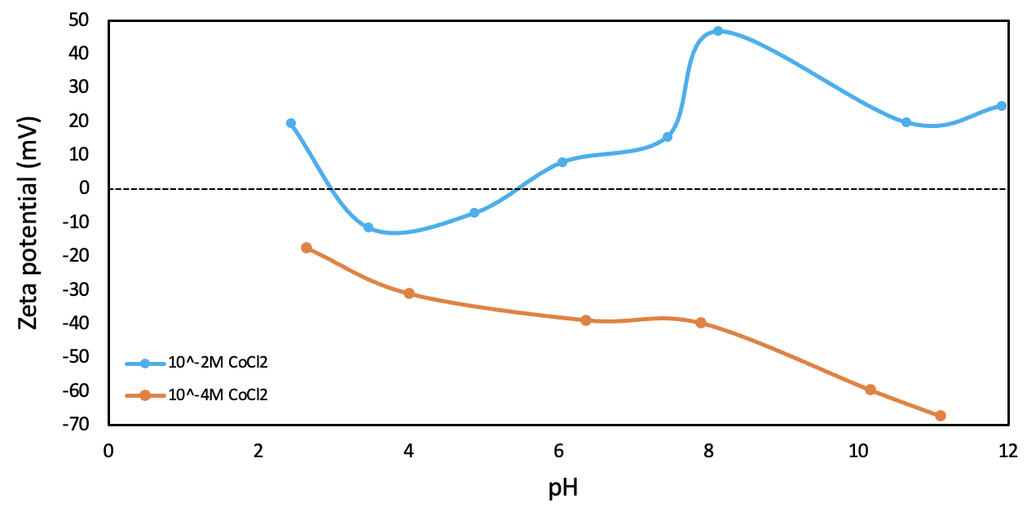
CoCl₂ solution
Figure 6: Zeta Potential(mV) vs. pH for kaolinite in 10⁻²M and 10⁻⁴M CoCl₂
Figure 6 demonstrates the change of zeta potential in different concentrations of CoCl₂ solution.
The zeta potential in 10⁻²M CoCl₂ shows a decrease at lower pH, and then an increase until pH 8, finally decrease at higher pH. The 10⁻²M CoCl₂ curve has two pzcs, around pH 3 and pH 5.5.
The zeta potential in 10⁻⁴M CoCl₂ declines as the pH increases, with no pzcs.

Slide 28
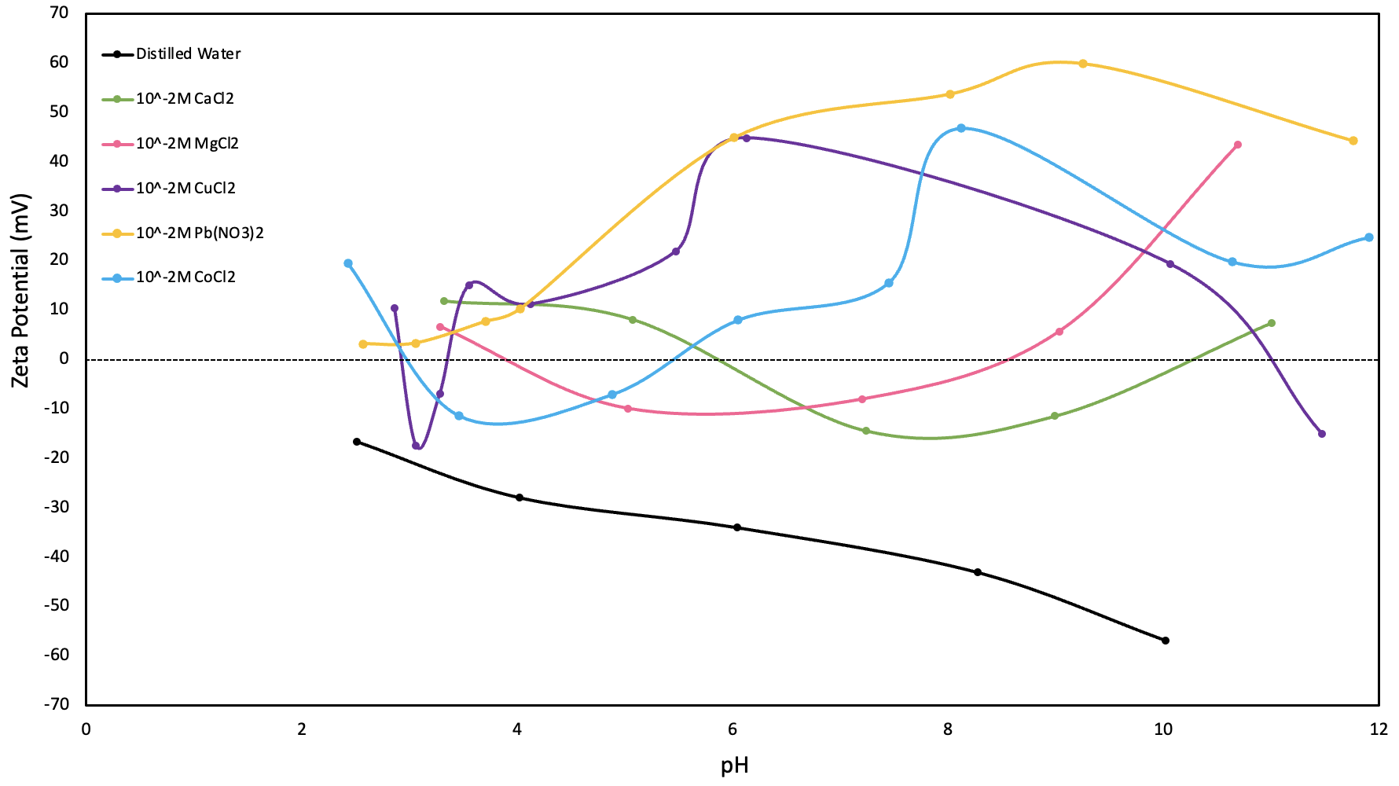
Comparison---10⁻²M ions
Figure 7: Comparison of zeta potential vs. pH for kaolinite in distilled water and salt solutions at 10⁻² M
Figure 7 shows the zeta potential change in 10⁻²M of different metal ions compared with distilled water.
The zeta potential at CaCl₂ shows only one pzc at pH 6. The MgCl₂ curve has two pzcs at pH 4 and pH 8.5.
The trend of CaCl₂ curve is generally increases as the pH increases, while the MgCl₂ curve first decreases and then increases.
The zeta potentials at CuCl₂ show three pzcs at pH 2.5, pH 3.5 and pH 11. The CoCl₂ has two pzcs at pH 2.6 and pH 5.5.
The trend of CuCl₂ and CoCl₂ curves are somewhat the same. The zeta potential in the two curves show a decrease around pH 2.5 and then an increase at pH 3.5, finally they decrease at higher pH.
In conclusion, zeta potential becomes more positive between pH 4 and pH 10. The zeta potential of Pb(NO₃)₂ becomes more positive with increase in pH. However, it exhibits no pzcs.

Slide 29
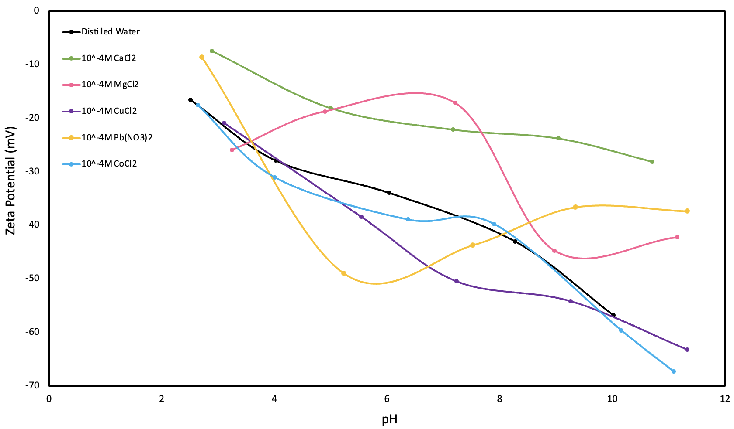
Comparison---10⁻⁴M ions
Figure 8: Comparison of zeta potential vs. pH for kaolinite in distilled water and salt solutions at 10⁻⁴ M
Figure 7 shows the change of zeta potential in 10⁻⁴M different metal ions compared with distilled water.
The zeta potential in various metal ions does not have any pzcs.
The CaCl₂ curve decreases as the pH increases. While the MgCl₂ curve first shows an increase until neutral pH, then a decrease until pH 9 and finally an increase again.
Compared to distilled water, the curves of CaCl₂ and MgCl₂ generally demonstrate an increase in the zeta potential with the increases in pH.
The trend of CuCl₂ and CoCl₂ curves appear somewhat similar, both decrease as the pH increases.
Compared to distilled water, the zeta potential curves of CuCl₂ and CoCl₂ show a decrease as the pH increases.
The trend of Pb(NO₃)₂ curve shows a decrease as the pH increases to 6 and then increases to neutral pH.
In general, compared to distilled water, the zeta potential of Pb(NO₃)₂ generally decrease within pH 4 to pH 8.

Slide 30


Part 4: Summary

Slide 31

Summary:
In summary, for all metal ions (Ca²⁺, Mg²⁺, Cu²⁺, Co²⁺ and Pb²⁺), there is no pzcs at 10⁻⁴M concentration. Furthermore, at 10⁻²M, the pzc for Ca²⁺ occurs at pH 6; for Mg²⁺ at pH 4 and pH 8.5; for Cu²⁺ at pHs 2.5, 3.5, and 11; for Co²⁺ at pHs 2.6 and 5.5.
In general, zeta potential becomes less negative at higher pH as ion concentrations increase from 10⁻⁴M to 10⁻²M. Furthermore, Ca²⁺ and Mg²⁺ increase the zeta potential, but other ions including Cu²⁺, Co²⁺ and Pb²⁺ decrease the zeta potential.

Slide 32

Part 5: Effect of HA,Ca²⁺ and Mg²⁺ ions and their different concentrations on zeta potential

Slide 33
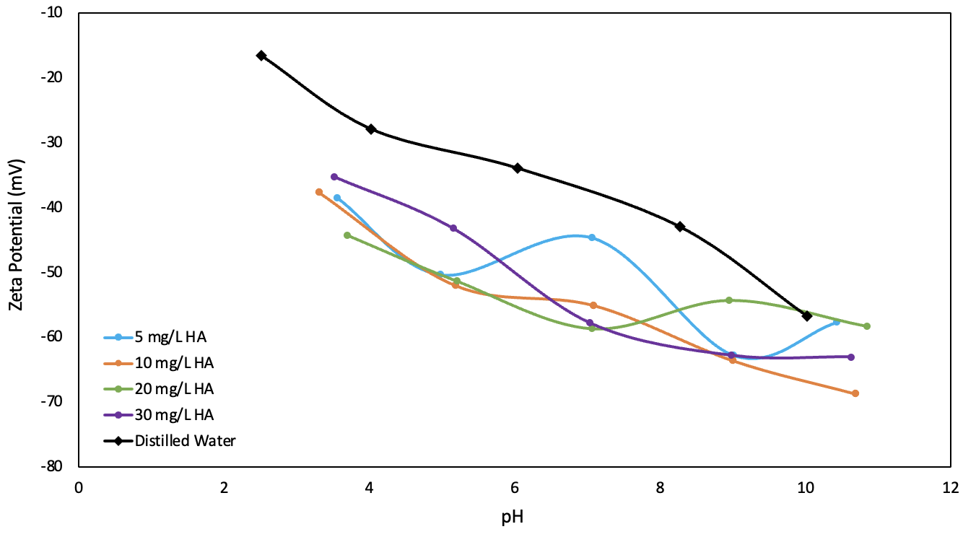
To evaluate the effect of HA with Ca²⁺ and Mg²⁺ ions and their concentrations, experiments were conducted with kaolinite in distilled water, and five concentrations (5mg/L, 10mg/L, 20mg/L, and 30mg/L) of HA, and two concentrations (10⁻²M and 10⁻⁴M) of Ca²⁺ and Mg²⁺. The results are depicted in the following:
Figure 9: Zeta potential(mV) vs. pH for kaolinite in different concentrations of HA and comparison with distilled water
Figure 9 shows the differences in zeta potential at four different concentrations of HA compared with distilled water.
The HA curve has more negative zeta potentials as compared with distilled water alone. Furthermore, it is important to note that as the pH increases, the zeta potential becomes more negative, ranging from -35mV to -70mV.

Slide 34
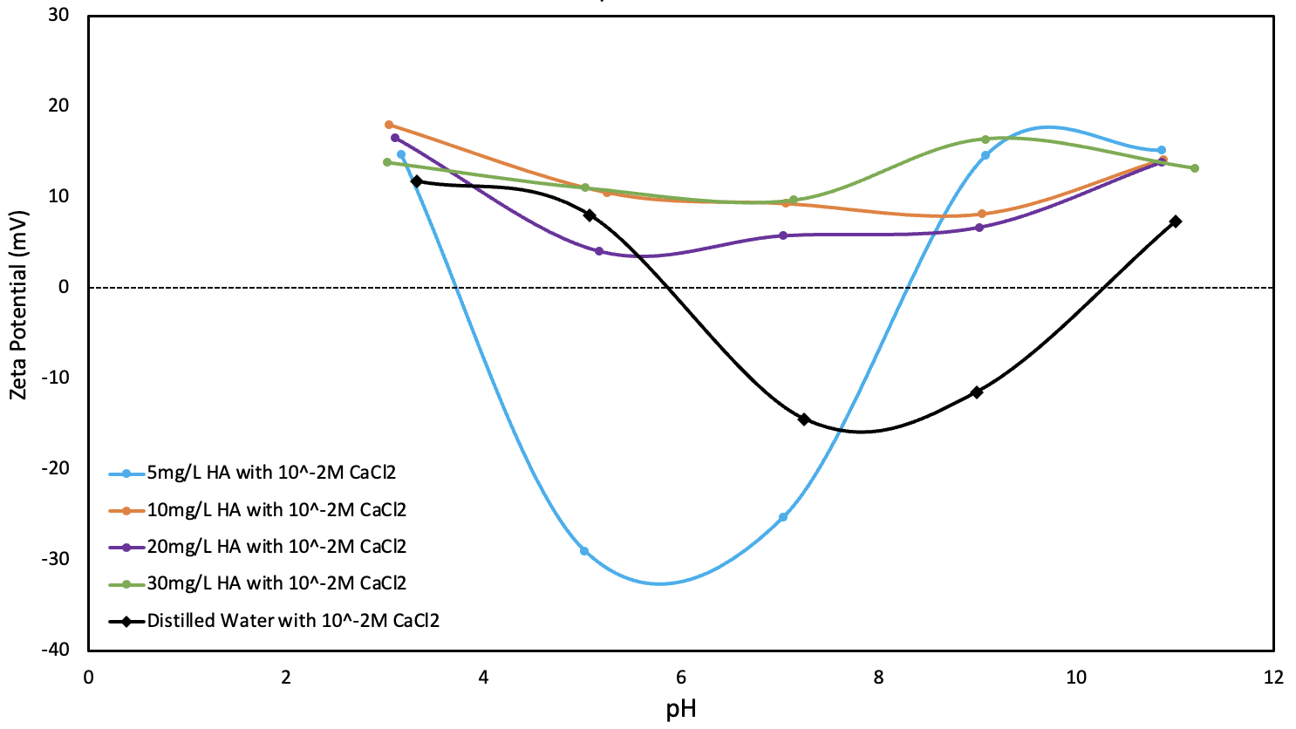
Figure 10: Zeta potential(mV) vs. pH for kaolinite in different concentrations of HA with 10⁻²M CaCl₂ and comparison with distilled water
Figure 10 shows that in the present of 10⁻²M CaCl₂, the differences in zeta potential at four different concentrations of HA compared with distilled water.
The zeta potential in 5mg/L HA with CaCl₂ gives two pzcs, namely at pH 3.8 and pH 8.2. The curve first decreases until pH 6, and then increases towards positive values.
The 10mg/L, 20mg/L, and 30mg/L HA with CaCl₂ does not show any pzcs, with all zeta potentials being between 5mV and 20mV.
For the distilled water with CaCl₂, the curve gives two pzcs at pH 6 and pH 10. The trend decreases to negative values until pH 8 and then increases to positive values. At higher concentrations of HA (10mg/L, 20mg/L, and 30mg/L) the zeta potentials become positive and exhibit no pzcs.
In summary, significant impact on zeta potential was observed at higher concentrations of HA with 10⁻²M CaCl₂.

Slide 35
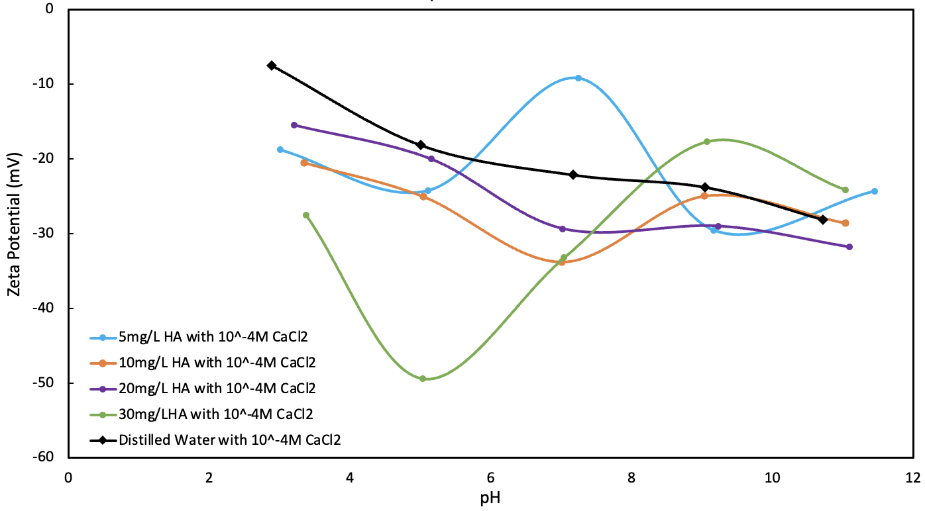
Figure 11: Zeta potential(mV) vs. pH for kaolinite in different concentrations of HA with 10⁻⁴M CaCl₂ and comparison with distilled water
Figure 11 demonstrates that in the present of 10⁻⁴M CaCl₂, the differences in zeta potential at four different concentrations of HA compared with distilled water.
The zeta potential of different concentrations of HA with CaCl₂ does not have any pzcs.
The zeta potentials in 5mg/L HA with CaCl₂ show an increase at neutral pH, followed by a decrease around pH 10, and finally an increase at around pH 11.5.
The 30mg/L HA shows that the zeta potential decreases until around
pH 5, then increases towards pH 9, and finally decreases at pH 11.
Both 10mg/L and 20mg/L HA curves have somewhat similar trends, resulting in a drop in zeta potential as the pH increases.
Generally, as the concentrations of HA increase, zeta potentials become more negative, with fluctuations at high and low concentrations.
In conclusion, compared to the distilled water, the effect of HA in the presence of 10⁻⁴M CaCl₂ tends to generate fluctuations, resulting in an expanded range of zeta potential values, ranging from -10mV to -50mV.

Slide 36
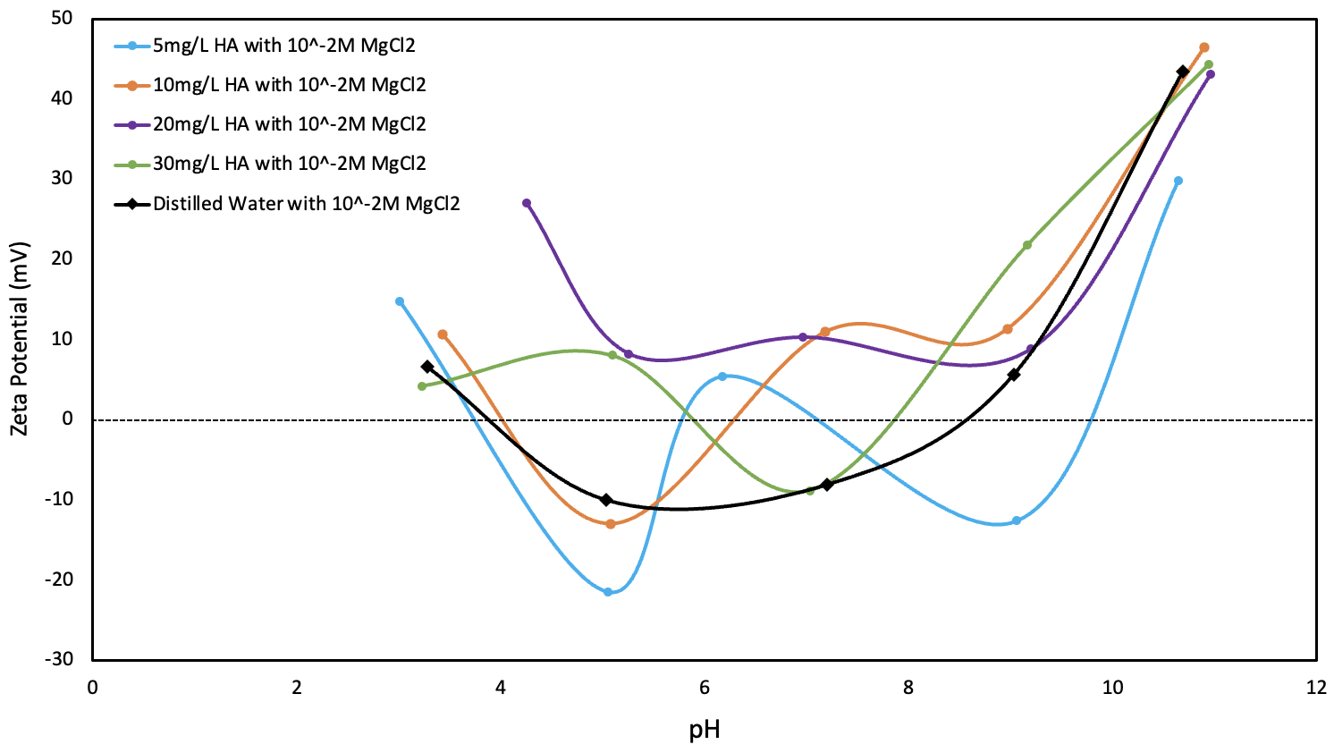
Figure 12: Zeta potential vs. pH for kaolinite in different concentrations of HA with 10⁻²M MgCl₂ and comparison with distilled water
Figure 12 shows that in the present of 10⁻²M MgCl₂, the differences in zeta potential at four different concentrations of HA compared with distilled water.
The zeta potential in 5mg/L HA with 10⁻²M CaCl₂ has four pzcs, which are at pH 3.9, pH 5.8, pH 7.5 and pH 9.8. The 10mg/L HA curve has two pzcs at pH 4.1 and pH 6.2. The trend of both curves is similar, which first decreases until pH 5, followed by an increase until around pH 6.3, and finally a decrease until pH 9 followed by an increase at around pH 11.5.
The 30mg/L HA with MgCl₂ curve has two pzcs at pH 6 and pH 7.9. The trend of this curve first shows an increase until pH 5, followed by a decrease towards neutral pH, and finally increases until around pH 11.5.
The 20mg/L HA curve does not show any pzcs. The trend is somewhat similar to the other three concentrations, but all the zeta potentials are positive.

Slide 37
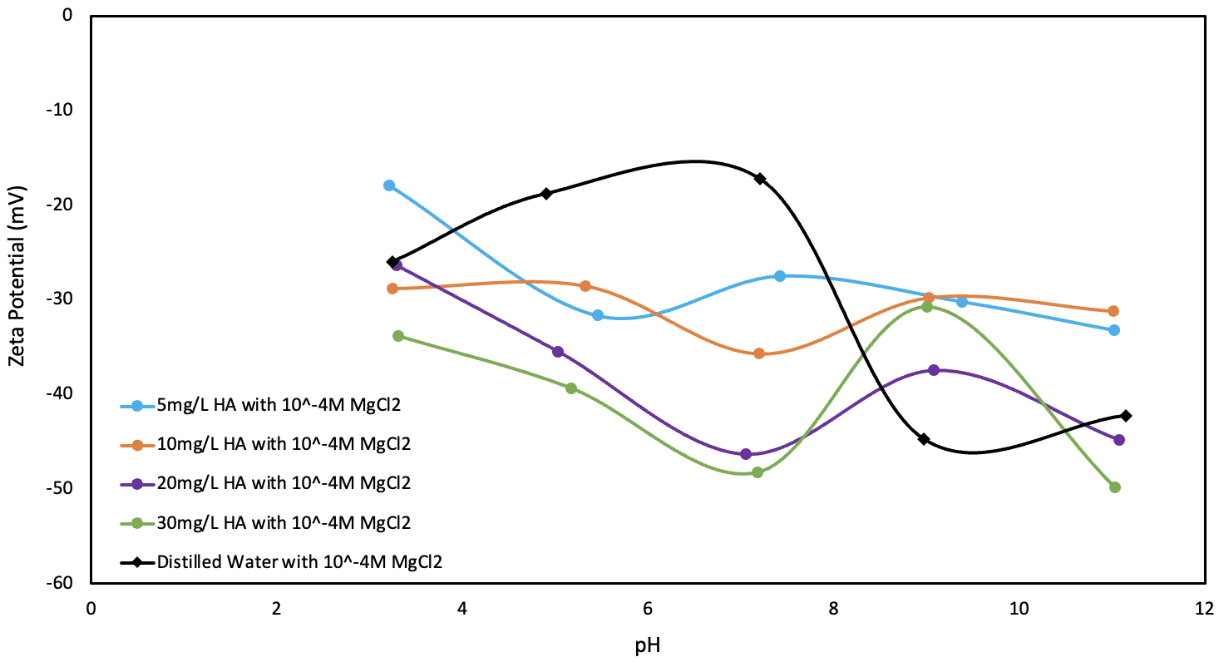
Figure 13: Zeta potential(mV) vs. pH for kaolinite in different concentrations of HA with 10⁻⁴M MgCl₂ and comparison with distilled water
Figure 13 demonstrates that in the present of 10⁻⁴M MgCl₂, the differences in zeta potential at four different concentrations of HA compared with distilled water.
The zeta potential in different concentrations of HA with 10⁻⁴M MgCl₂ does not have any pzcs.
Zeta potential curves in 5mg/L, 10mg/L and 20 mg/L HA show somewhat the same trends; namely decreasing until neutral pH, followed by an increase towards pH 9, and finally a decrease at around pH 11.
The 10mg/L HA curve shows that the zeta potentials increases until around pH 5, then decreases until pH 7.5, and finally increases at around pH 11.
Generally, as the concentrations of HA increases, zeta potential between pH 4 and pH 8 becomes more negative.
HA in the presence of 10⁻⁴M MgCl₂ only impacts the zeta potential between pH 4 and pH 8.

Slide 38


Part 6: Effect of sHA, Ca²⁺ and Mg²⁺ ions and their different concentrations on zeta potential

Slide 39
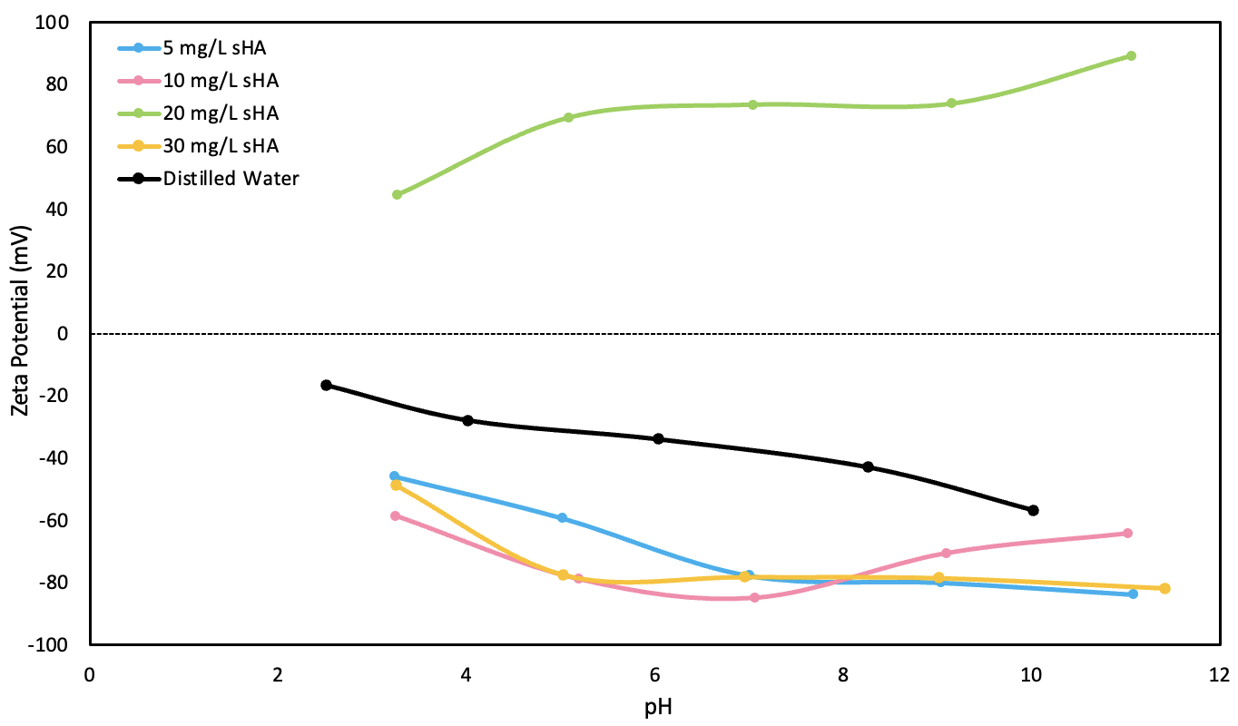
To evaluate the effect of sHA, Ca²⁺ and Mg²⁺ ions and their concentrations, experiments were conducted with kaolinite in distilled water, employing five different concentrations (5mg/L, 10mg/L, 20mg/L and 30mg/L) of sHA, and two different concentrations (10⁻²M and 10⁻⁴M) of Ca²⁺ and Mg²⁺). The results are depicted in the following:
Figure 14: Zeta potential(mV) vs. pH for kaolinite in different concentrations of sHA and comparison with distilled water
Figure 14 shows the differences in zeta potential at four different concentrations of sHA compared with distilled water.
Compared to distilled water, the zeta potential in sHA, except 20mg/L, show more negative zeta potential values as the pH increases, ranging from -40mV to - 90mV.
All the sHA curves do not show any pzcs.
The zeta potential in 20 mg/L sHA curve becomes more positive as the pH increases.

Slide 40
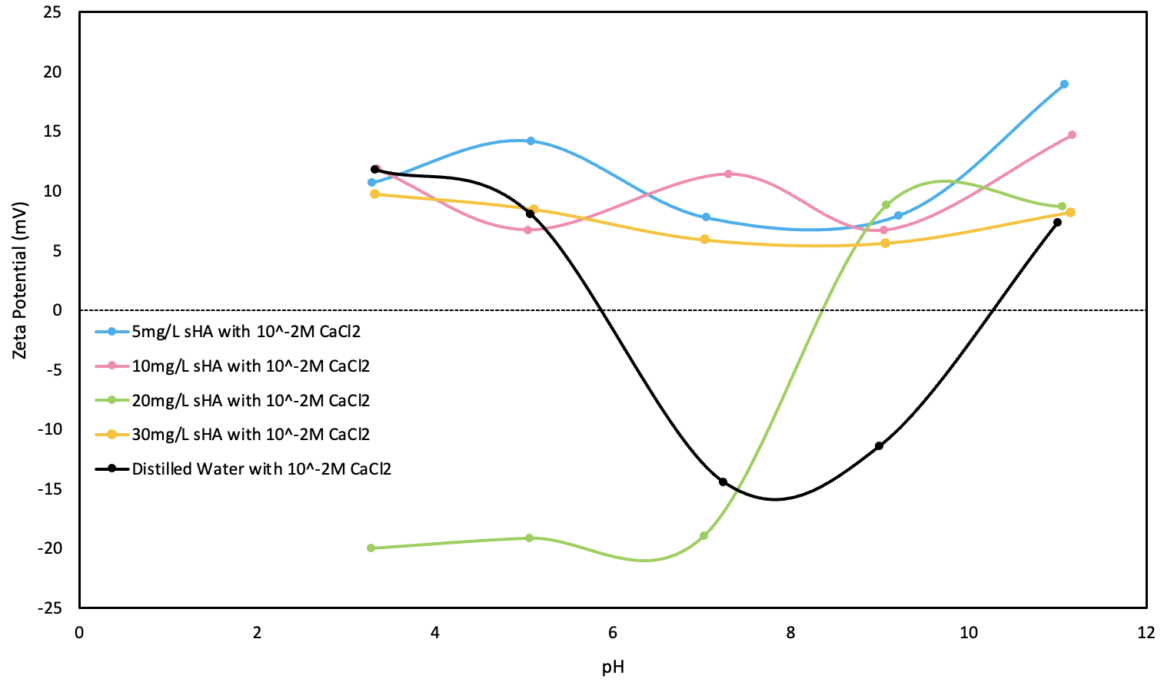
Figure 15: Zeta potential(mV) vs. pH for kaolinite in different concentration of sHA with 10⁻²M CaCl₂ and comparison with distilled water
Figure 15 demonstrates the zeta potential of distilled water and four different concentrations of sHA in the presence of 10⁻²M CaCl₂.
The zeta potential curve in solution of 5mg/L, 10mg/L, and 30mg/L sHA do not show any pzcs, and they all stay in positive zone between +5mV and +20mV.
The zeta potential in solution of 20mg/L sHA have one pzc at pH 8.2, with the curve increases from negative value (-20mV) to positive value (+14mV).
The zeta potential in distilled water has two pzcs at around pH 6 and 10, while zeta potential in the solution of 5mg/L, 10mg/L, and 30mg/L sHA become positive and does not exhibit any pzcs.
In summary, the effect of sHA with 10⁻²M CaCl₂ significantly impact the zeta potential. It appears that the sHA in the presence of 10⁻²M CaCl₂ tends to give positive zeta potential values without pzcs.

Slide 41
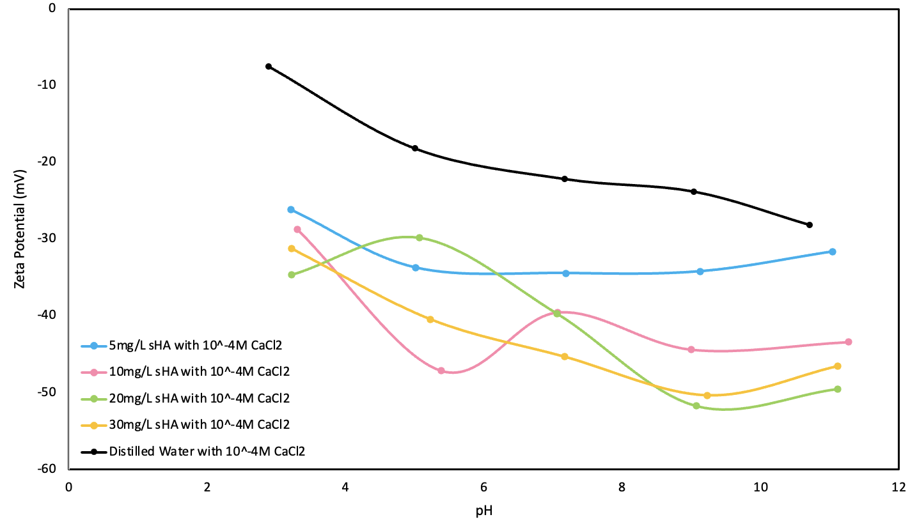
Figure 16: Zeta potential(mV) vs. pH for kaolinite in different concentration of sHA with 10⁻⁴M CaCl₂ and comparison with distilled Water
Figure 16 shows the zeta potential of distilled water and four different concentrations of sHA in the presence of 10⁻⁴M CaCl₂.
The zeta potential curves in different concentrations of sHA with 10⁻⁴M CaCl₂ do not show any pzcs.
The zeta potential in solution of 10mg/L sHA becomes less negative at neutral pH, then it becomes more negative towards pH 9.
The zeta potential in solution of 20mg/L sHA first increases until around pH 5.5, then it decreases until pH 7, and finally it increases to the higher pH value.
The zeta potential in solution of both 5mg/L and 30mg/L sHA shows a similar trend, becoming more negative with increasing pH.
In conclusion, the effect of the sHA with 10⁻⁴M CaCl₂ significantly impact the zeta potential. It appears that the sHA in the presence of 10⁻⁴M CaCl₂ tends to give more negative zeta potential values without pzcs.

Slide 42
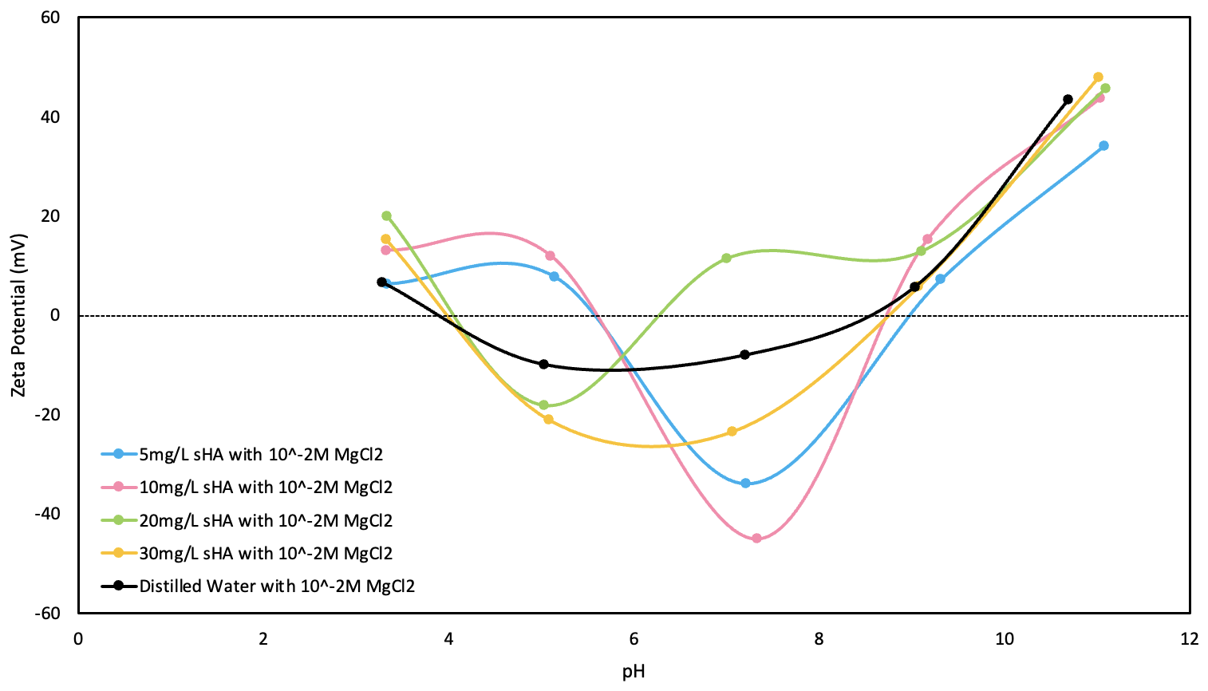
Figure 17: Zeta potential(mV) vs. pH for kaolinite in different concentration of sHA with 10⁻²M MgCl₂ and comparison with distilled water
Figure 17 demonstrates the zeta potential of distilled water and four different concentrations of sHA in the presence of 10⁻²M MgCl₂.
The zeta potential in solution of 5mg/L and 10mg/L sHA show a similar trend. Both curves have pzcs at around pH6 and pH 8.5.
The zeta potential in solution of 20mg/L sHA exhibit two pzcs at around pH 4 and pH 6.
The zeta potential in solution of 30mg/L sHA shows two pzcs similar to 20mg/L curve, at around pH 4, and pH 6.
In conclusion, compared to the distilled water, the effect of sHA in the presence of 10⁻²M MgCl₂ tends to generate fluctuations, resulting in a wide range of zeta potential, ranging from +10mV to -50mV.

Slide 43
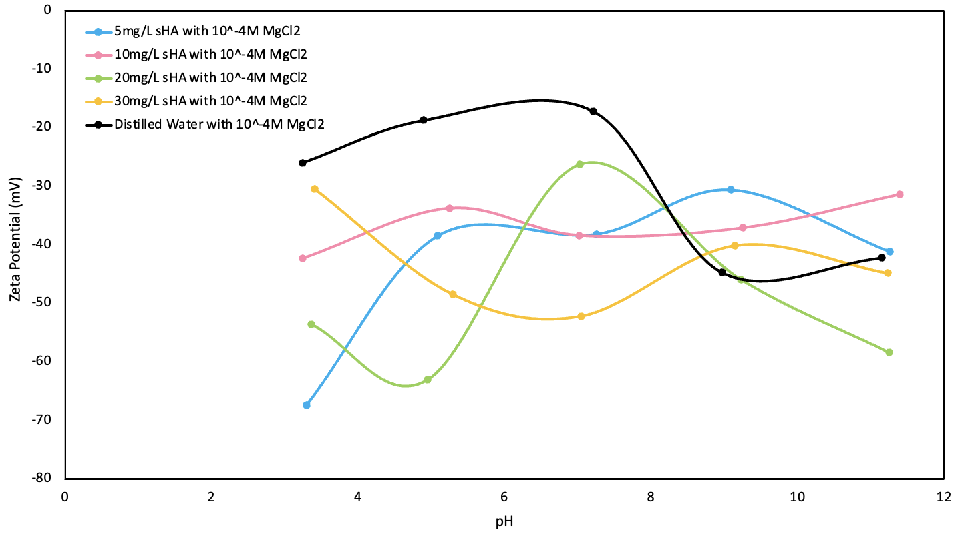
Figure 18: Zeta potential(mV) vs. pH for kaolinite in different concentration of sHA with 10⁻⁴M MgCl₂ and comparison with distilled Water
Figure 18 shows the zeta potential of distilled water and four different concentrations of sHA in the presence of 10⁻⁴M MgCl₂.
The zeta potential curves of distilled water and different concentrations of sHA with 10⁻⁴M MgCl₂ fluctuate markedly and generally stay in negative zone.
In summary, the sHA in the presence of 10⁻⁴M MgCl₂ tends to generate fluctuations and become more negative within pH 3 to pH 8, compared to the distilled water.

Slide 44
Part 7: Summary and Conclusion

Slide 45

For HA:
The zeta potential in the four different concentrations of HA curves becomes more negative as the pH increases. The effect of HA tends to show more negative zeta potential values as compared to distilled water.
Positive values of zeta potential were observed at higher concentration of HA in the presence of 10⁻²M Ca²⁺ .
The zeta potential of the HA in the presence of 10⁻⁴M Ca²⁺ generated marked fluctuations, resulting in values ranging from -10mV to -50mV.
The effect of HA in the presence of 10⁻²M Mg²⁺ tends to generate fluctuations. No pzcs was observed for 20 mg/L HA solution.
The zeta potential of HA in the presence of 10⁻⁴M Mg²⁺ was only increased between pH 4 and pH 8, resulting in negative values.

Slide 46
For sHA:
The zeta potential in sHA, except 20mg/L, show more negative values as the pH increases, ranging from -40mV to - 90mV.
The sHA in the presence of 10⁻²M Ca²⁺ significantly impact the zeta potential values: It appears that the sHA in the presence of 10⁻²M CaCl₂ tends to give positive zeta potential values without reaching pzcs.
The effect of the sHA with 10⁻⁴M Ca²⁺ significantly impact the zeta potential values. It shows that the sHA in the presence of 10⁻⁴M CaCl₂ tends to give more negative zeta potential values without pzcs.
The effect of sHA in the presence of 10⁻²M Mg²⁺ tends to generate fluctuations, resulting in an expanded range of zeta potential values, ranging from +10mV to -50mV.
The sHA in the presence of 10⁻⁴M Mg²⁺ tends to generate fluctuations and only impact the zeta potential showing more negative values within pH 3 to pH 8.

Slide 47
Conclusion:
Humic acid plays an important role in influencing the stability of colloidal kaolinite. Adsorption of humic acid can introduce a negative charge to the surfaces of kaolinite particles, thereby decreasing their surface zeta potential values. When divalent cations such as Ca²⁺ and Mg²⁺ are introduced, they have the ability to induce aggregation by neutralizing the negative charges conferred by humic acid onto the kaolinite particles. Additionally, the magnitude of the zeta potential indicates the degree of electrostatic repulsion between adjacent, similarly charged kaolinite particles in aqueous dispersion. In essence, particles with higher zeta potential values signify higher stability, resulting in more resistance to aggregation.

Slide 48
Conclusion (Continued) :
In our study, we examined two types of humic acid: HA and sHA. HA is naturally occurring and strongly acidic, while sHA primarily exists in its salt form. Through treatment with HCl, sHA is converted into the purified free acid form known as HA. The results observed for both types of humic acids exhibit variations. The sHA demonstrates more negative zeta potential values compared to HA, which means it has better ability to influence the stability of kaolinite particles. In the presence of 10⁻²M Ca²⁺, sHA exhibits more positive values; while in the presence of 10⁻⁴M Ca²⁺, it displays more negative values. This suggests that sHA can effectively stabilize particles compared to HA. Moreover, in the presence of 10⁻²M Mg²⁺, both HA and sHA cause aggregation of colloidal particles. However, in the presence of 10⁻⁴M Mg²⁺, sHA has more negative zeta potential values compared to Hain the region between pH 3 and pH 8 and thus has more tendency to stabilize particles.

Slide 49

Acknowledgements
We would like to thank Destre Bennet and Sophie Beitel for their valuable assistance in this project.

Slide 50

References

Slide 51
Anand, K., Saravanan, M., Chandrasekaran, B., Kanchi, S., Panchu, S. J., & Chen, Q.-S. (2021). Handbook on nanobiomaterials for therapeutics and diagnostic applications (1st ed.), Elsevier.
Badalians Gholikandi, G., Zakizadeh, N., & Masihi, H. (2018). Application of peroxymonosulfate-ozone advanced oxidation process for simultaneous waste-activated sludge stabilization and dewatering purposes: A comparative study. Journal of Environmental Management, 206, 523–531. https://doi.org/10.1016/j.jenvman.2017.10.070
Carbinatti, C., da Conceição, F. T., Moruzzi, R. B., & Menegário, A. A. (2021). Functionalization of kaolinite for removal of phosphate from urban sewage. MethodsX, 8, 101423–101423. https://doi.org/10.1016/j.mex.2021.101423
Cheng, Y.-L., Juang, Y.-C., Liao, G.-Y., Tsai, P.-W., Ho, S.-H., Yeh, K.-L., Chen, C.-Y., Chang, J.-S., Liu, J.-C., Chen, W.-M., & Lee, D.-J. (2011). Harvesting of scenedesmus obliquus FSP-3 using dispersed ozone flotation. Bioresource Technology, 102(1), 82–87. https://doi.org/10.1016/j.biortech.2010.04.083
Childress, A. E., & Elimelech, M. (1996). Effect of solution chemistry on the surface charge of polymeric reverse osmosis and nanofiltration membranes. Journal of Membrane Science, 119(2), 253–268. https://doi.org/10.1016/0376-7388(96)00127-5

Slide 52
Christl, I., Milne, C. J., Kinniburgh, D. G., & Kretzschmar, R. (2001). Relating ion binding by fulvic and HAs to chemical composition and molecular size. 2. metal binding. Environmental Science & Technology, 35(12), 2512–2517. https://doi.org/10.1021/es0002520
De Melo, B. A. G., Motta, F. L., & Santana, M. H. A. (2016). HAs: structural properties and multiple functionalities for novel technological developments. Materials Science & Engineering C-Materials for Biological Applications, 62, 967–974. https://doi.org/10.1016/j.msec.2015.12.001
Deshmukh, S. S., & Childress, A. E. (2001). Zeta potential of commercial RO membranes: influence of source water type and chemistry. Desalination, 140(1), 87–95. https://doi.org/10.1016/S0011-9164(01)00357-5
Fu, Q., Tan, X., Ye, S., Ma, L., Gu, Y., Zhang, P., Chen, Q., Yang, Y., & Tang, Y. (2021). Mechanism analysis of heavy metal lead captured by natural-aged microplastics. Chemosphere, 270, 128624–128624. https://doi.org/10.1016/j.chemosphere.2020.128624
Ghabbour, E. A., Ghabbour, E. A., & Davies, G. (2007). Humic substances: structures, models, and functions (1st ed., Vol. 273). NBN International.

Slide 53
Henderson, R. K., Baker, A., Parsons, S. A., & Jefferson, B. (2008). Characterisation of algogenic organic matter extracted from cyanobacteria, green algae, and diatoms. Water Research, 42(13), 3435–3445. https://doi.org/10.1016/j.watres.2007.10.032
Honary, S., & Zahir, F. (2013). Effect of zeta potential on the properties of nano-drug delivery systems - A review (Part 1). Tropical Journal of Pharmaceutical Research, 12(2), 255–264. https://doi.org/10.4314/tjpr.v12i2.19
Jiang, Y., Yin, X., Xi, X., Guan, D., Sun, H., & Wang, N. (2021). Effect of surfactants on the transport of polyethylene and polypropylene microplastics in porous media. Water Research, 196, 117016–117016. https://doi.org/10.1016/j.watres.2021.117016
Kinsinger, N., Honda, R., Keene, V., & Walker, S. L. (2015). Titanium dioxide nanoparticle removal in primary prefiltration stages of water treatment: Role of coating, natural organic matter, source water, and solution chemistry. Environmental Engineering Science, 32(4), 292–300. https://doi.org/10.1089/ees.2014.0288
Klucakova, M., & Pekar, M. (2005). Solubility and dissociation of lignitic HAs in water suspension. Colloids and Surfaces A: Physicochemical and Engineering Aspects, 252(2), 157–163. https://doi.org/10.1016/j.colsurfa.2004.10.019

Slide 54
Lanphere, J. D., Luth, C. J., Guiney, L. M., Mansukhani, N. D., Hersam, M. C., & Walker, S. L. (2015). Fate and transport of molybdenum disulfide nanomaterials in sand columns. Environmental Engineering Science, 32(2), 163–173. https://doi.org/10.1089/ees.2014.0335
Li, G., Zhao, X. S., & Ray, M. B. (2007). Advanced oxidation of orange II using TiO₂ supported on porous adsorbents: The role of pH, H₂O₂ and O₃. Separation and Purification Technology, 55(1), 91–97. https://doi.org/10.1016/j.seppur.2006.11.003
Liang, Y., Bradford, S. A., Simunek, J., Vereecken, H., & Klumpp, E. (2013). Sensitivity of the transport and retention of stabilized silver nanoparticles to physicochemical factors. Water Research, 47(7), 2572–2582. https://doi.org/10.1016/j.watres.2013.02.025
Mikkelsen, L. H., & Keiding, K. (2002). Physico-chemical characteristics of full scale sewage sludges with implications to dewatering. Water Research, 36(10), 2451–2462. https://doi.org/10.1016/S0043-1354(01)00477-8
Mustapha, S., Ndamitso, M. M., Abdulkareem, A. S., Tijani, J. O., Mohammed, A. K., & Shuaib, D. T. (2019). Potential of using kaolin as a natural adsorbent for the removal of pollutants from tannery wastewater. Heliyon, 5(11), e02923–e02923. https://doi.org/10.1016/j.heliyon.2019.e02923

Slide 55
Stevenson, F. J. (1982). Humus chemistry : Genesis, composition, reactions. Wiley.
Sutradhar, S., & Fatehi, P. (2023). Latest development in the fabrication and use of lignin-derived HA. Biotechnology for Biofuels, 16(1), 38–38. https://doi.org/10.1186/s13068-023-02278-3
Von Wandruszka, R. (2000). HAs: Their detergent qualities and potential uses in pollution remediation. Geochemical Transactions, 1(2), 10–15. https://doi.org/10.1039/b001869o
Wang, M., Gao, B., & Tang, D. (2016). Review of key factors controlling engineered nanoparticle transport in porous media. Journal of Hazardous Materials, 318, 233–246. https://doi.org/10.1016/j.jhazmat.2016.06.065
Williams, D. J. A., & Williams, K. P. (1978). Electrophoresis and zeta potential of kaolinite. Journal of Colloid and Interface Science, 65(1), 79–87. https://doi.org/10.1016/0021-9797(78)90260-6.
Yates, L. M., & Von Wandruszka, R. (1999). Decontamination of polluted water by treatment with a crude HA blend. Environmental Science & Technology, 33(12), 2076–2080. https://doi.org/10.1021/es980408k
Yukselen, Y., & Kaya, A. (2003). Zeta potential of kaolinite in the presence of alkali, alkaline earth and hydrolyzable metal ions. Water, Air, and Soil Pollution, 145(1-4), 155–168. https://doi.org/10.1023/A:1023684213383

