Slide 1


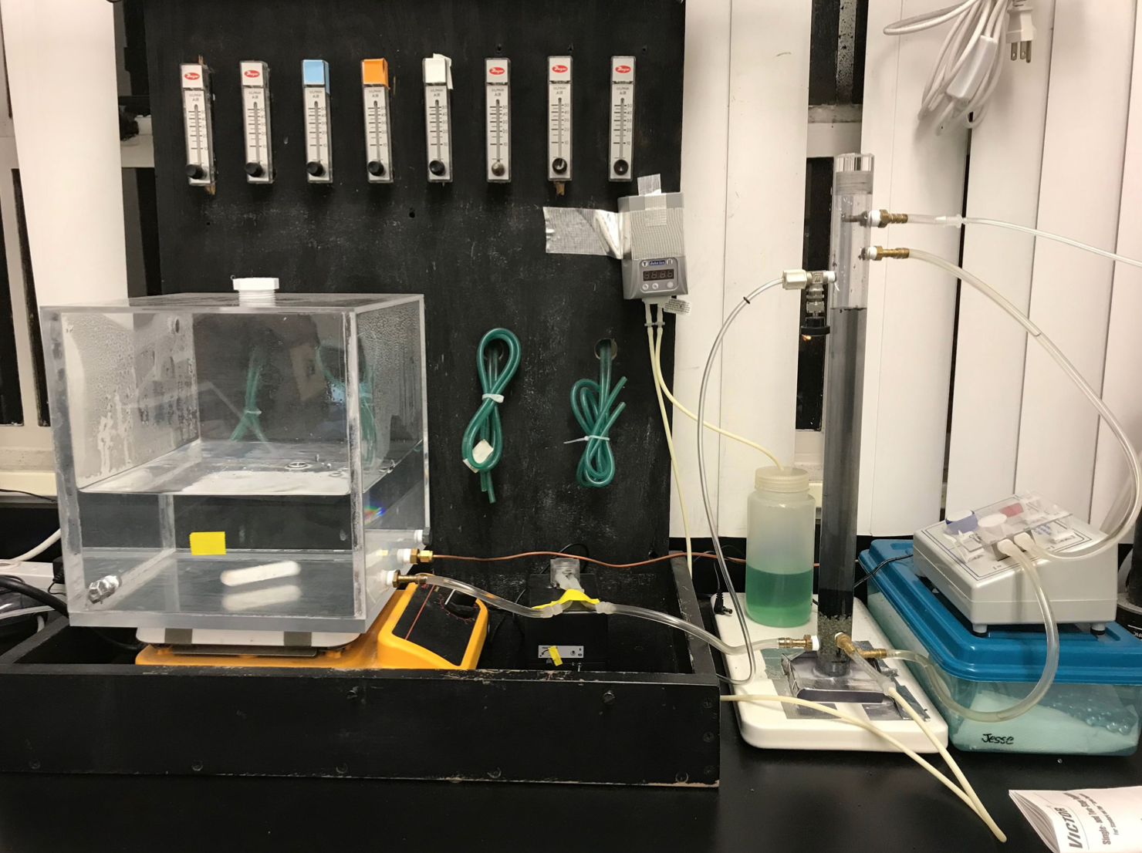
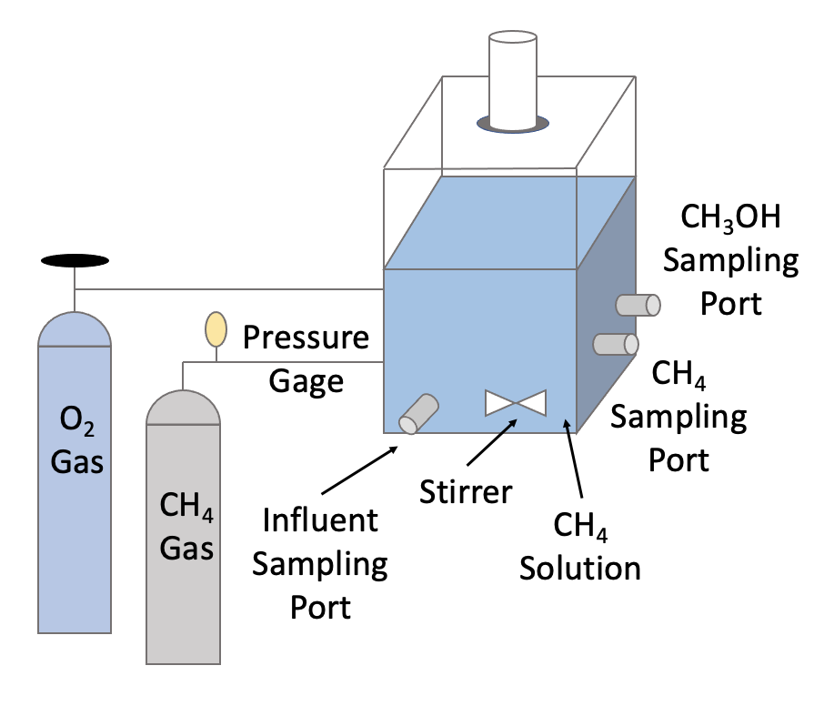
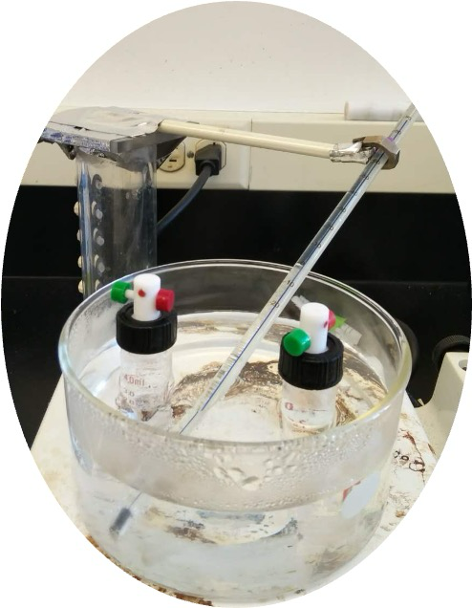
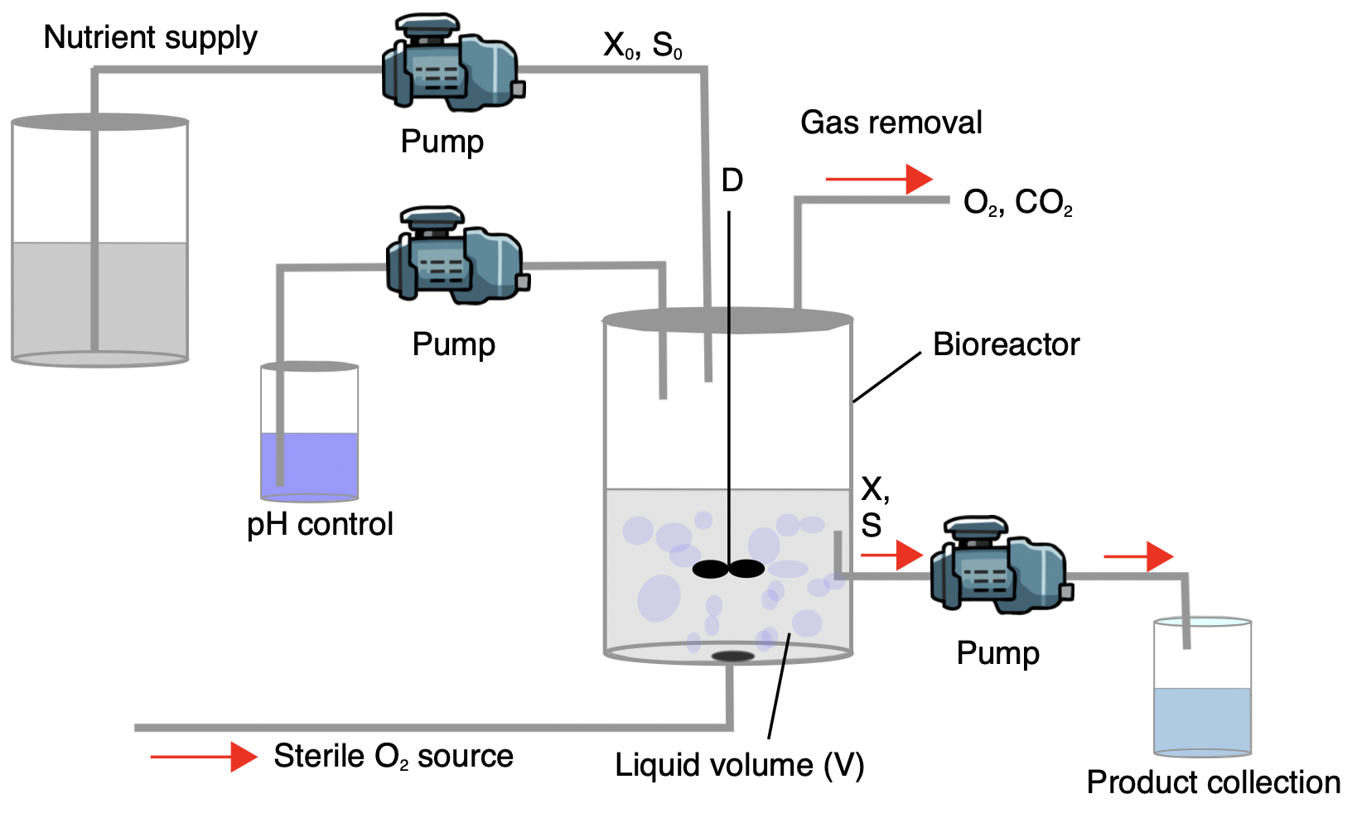
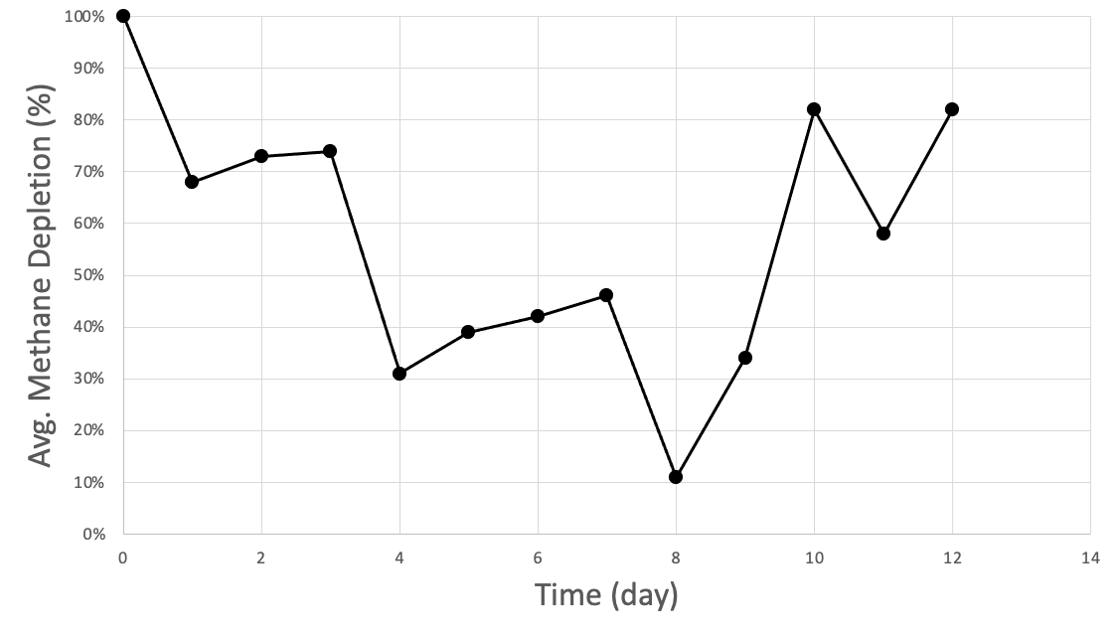
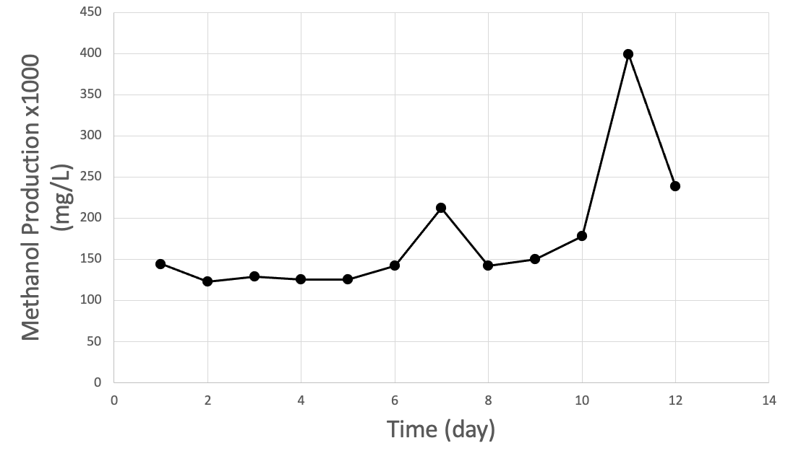
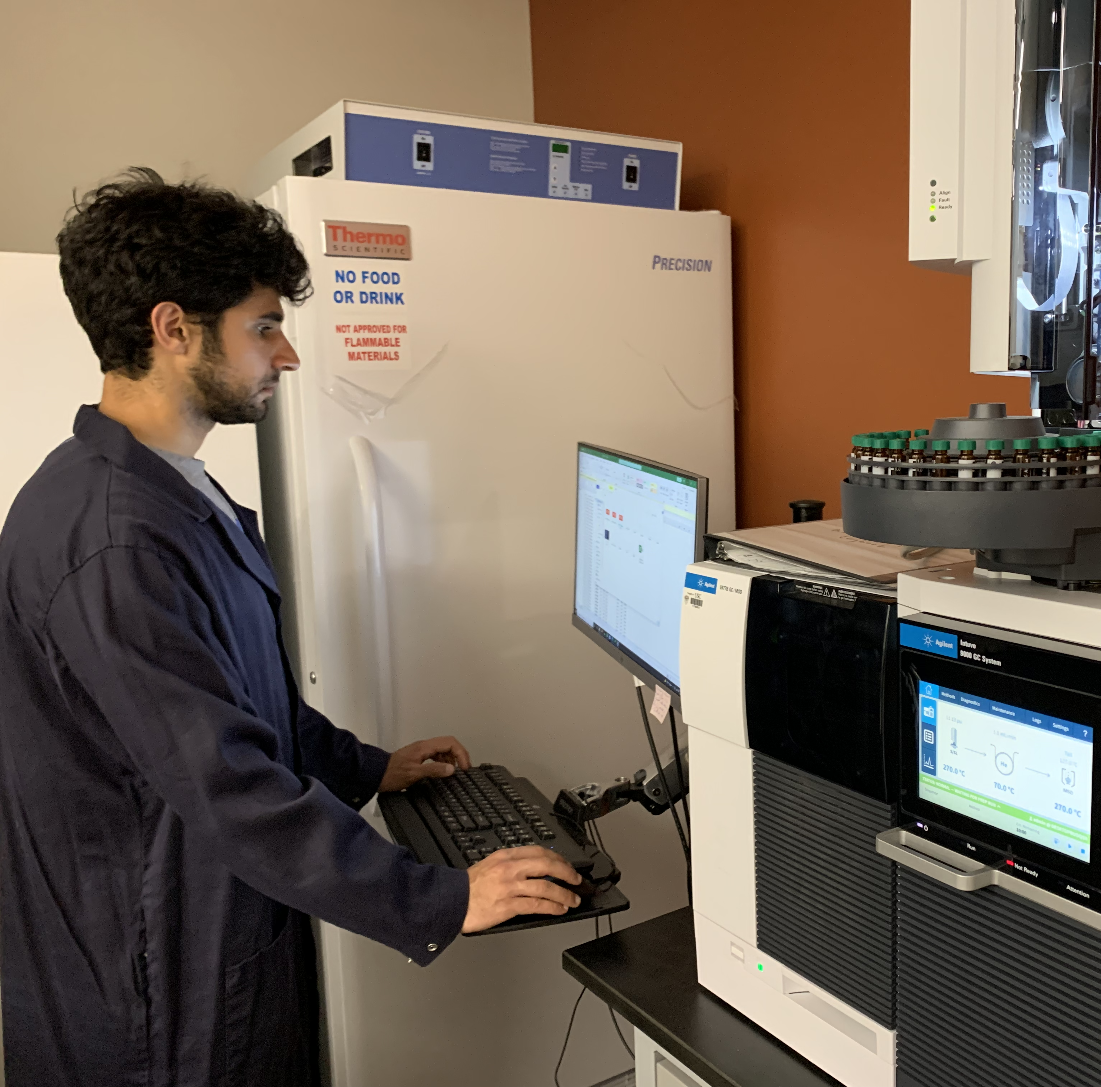
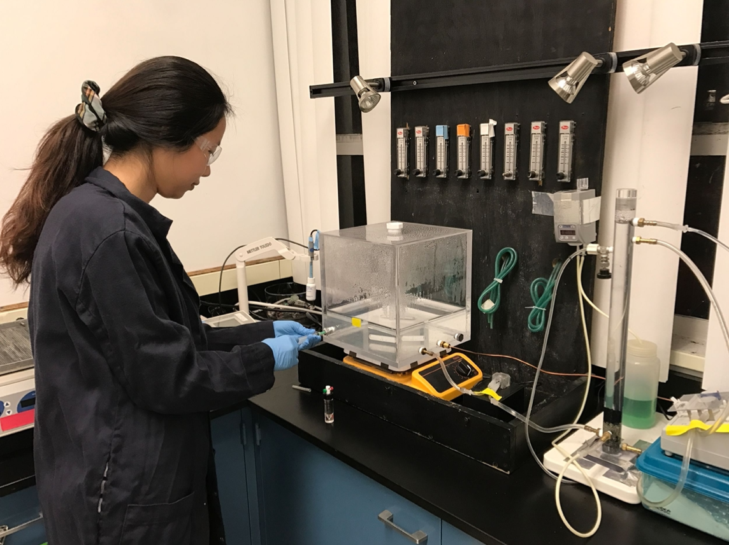
University of Southern California, Viterbi School of Engineering, Sonny Astani Department of Civil and Environmental Engineering
Bioconversion of Methane to Methanol by Methylomicrobium buryatense 5GB1 in Batch Bioreactor
(Part II)
Research Students: Michael Nazari, Keyuan Li, and Summer Siddiqui
Faculty Advisor: Professor Mike Pirbazari
Jan. 2024
Research Objectives
Future Work
This study will investigate:
  i) To test the ability of a promising strain of methanotrophic bacteria for bioconversion of methane to methanol in bioreactor/chemostat apparatus, ii) to develop a biokinetic model for designing the pilot-scale and full-scale systems, and iii) to forecast the bioreactor performance for long-term operation.
An important objective of future work is to employ a biokinetic model to describe the chemostat dynamics. The inherent advantages of chemostat are that they are well-mixed continuous systems for measuring biokinetic parameters under steady-state conditions.
In particular, chemostats provide better understanding of microbial cells cycles pertaining to design and optimization of continuous flow bioreactor systems.
In essence, phenomenological aspects of chemostat dynamics can facilitate the development of performance simulation/forecasting models towards efficient design and upscaling bioreactor systems.
In our future research, we will employ batch reactors to estimate various environmental parameters, followed by chemostat dynamic studies to find essential parameters that will aid in designing full-scale systems for long-term operations.
Experimental Methods
Major sequential steps:
Bacteria were incubated in a solution of nutrients and buffer for several days.
Bacteria were then transferred into the bath bioreactor, followed by introduction of methane and oxygen (Fig.2).
Samples of methane and methanol were withdrawn from the sampling ports and analyzed by gas chromatography.
Calibration curves were constructed for methane and methanol to determine the concentration of unknown samples.
Rationale
The rapid increase of greenhouse gases methane in the atmosphere creates great urgency to deploy technologies for methane mitigation. One approach to combat this problem is to use methanotrophic bacteria. Emission sites such as landfills, anaerobic digester, and gas wells contain elevated methane in the 500ppm range.
M. buryatense 5GB1 is an obligate type 1 methanotroph and is a candidate with promise to converting methane to valuable chemicals in industrial processes.
It is reported that M. buryatense 5GB1 strain exhibits greater methane consumption rate at both low and high methane concentration (from 200ppm to 1000ppm) compared to other methanotrophic strains.
These features make this strain a promising candidates for methane removal technology at emission sites with high concentration of methane in air.
Figure 1: Laboratory Experimental Setup
Figure 2: Schematic of Batch Bioreactor
Figure 3: Water Bath with Sample Vials for Headspace Analysis
Fundamentals
Methylomicrobium buryatense 5GB1 (M. buryatense 5GB1), has been identified as a candidate to be used in methane conversion processes.
In M. buryatense 5GB1, under specific growth conditions, methane is oxidized to methanol by a membrane-based enzyme called particulate methane monooxygenase (p-MMO).
M. buryatense 5GB1 is a fast-growing methanotroph. It grows optimally at 0.75% along with Sodium Chloride at pH 9.5.
M. buryatense 5GB1 is extremely robust and can withstand a wide range of growth conditions.
M. buryatense 5GB1 stands out as one of the most promising strains for industrialization. This is due to its short doubling time in comparison to most methanotroph and has remarkable resilience against contamination.
M. buryatense 5GB1 consumes methane at a low volume level, and also thrives to the extent of increasing its own numbers.
M. buryatense 5GB1 bacteria consumes methane faster than other types of bacteria.
Research is currently underway to genetically modify M. buryatense 5GB1 so that it can consume methane quickly at a lower concentration.
If the goal of widespread deployment were accomplished, these bacteria could be used to break down 300 million tons of methane in 20 years.
Results and Discussion
Fig.4 demonstrates variations in methanol. As can be observed, there are some variations in methane depletion during the first few days. This phenomenon may be due to:
    variations in nutrients concentration input
    variations in methane input.
Fig.5 shows satisfactory production of methanol in the bioreactor.
It was found that M. buryatense 5GB1can be acclimated significantly faster than M. trichosporium OB3b.
It is essential to optimize the methods of methanol extraction and analysis.
Figure 6: Schematic representation of a chemostat bioreactor. Indicated are some of the variables used in modeling bioreactors are: X₀: dry cell weight, S₀: substrate concentration,
D: flowrate of nutrient into the vessel, X: the cell mass(mass/volume), S=substrate concentration in chemostat(mass/volume).
Researchers in the Lab
References
Figure 4: Percentage Methane Depletion vs. Time in the Batch Bioreactor
Figure 5: Methanol Production vs. Time in the Batch Bioreactor
He, L, et. al. (2023) A methanotrophic bacterium to enable methane removal for climate mitigation. Proceedings of the National Academy of Sciences - PNAS, 120(35).
Hu, L., et al. (2020). Molecular Mechanism Associated With the Impact of Methane/Oxygen Gas Supply Ratios on Cell Growth of M. buryatense 5GB1 Through RNA-Seq. Frontiers in Bioengineering and Biotechnology, 8, 263–263.
Fu, Y., Li, Y., & Lidstrom, M. E (2017). The oxidative TCA cycle operates during methanotrophic growth of the Type I methanotroph M. buryatense 5GB1. Metabolic Engineering, 42(C), 43–51.
Kalyuzhnaya, M. G, et al (2017). Fatty Acid Biosynthesis Pathways in M. buryatense 5GB1. Frontiers in microbiology, 7, 2167.
Lidstrom, M. E, et al, (2015). Bioreactor performance parameters for an industrially-promising methanotroph M. buryatense 5GB1. Microbial Cell Factories, 14(1), 182–182.
Acknowledgements
We are deeply indebted to Professor Marina Kelyuzhnaya at San Diego State University who gracefully provided us with M. buryatense 5GB1 bacteria culture.
We would like to express our appreciation to Justine Lee, Cindy Q, Tengge Zhang, and Mila Catleman for their unparalleled assistance at different stages of this research.

